Slide 1
Functional interpretation of human DNA variants using existing knowledge and machine learning
Xiaoming Liu @ USF Genomics & College of Public Health
http://liulab.science
Interdisciplinary Data Sciences Consortium
02/07/2020

Slide 2
My research
Human Genome Sequence
Bioinformatics
Genetic Epidemiology
Population Genetics
Homepage: liulab.science

Slide 3
background

Slide 4
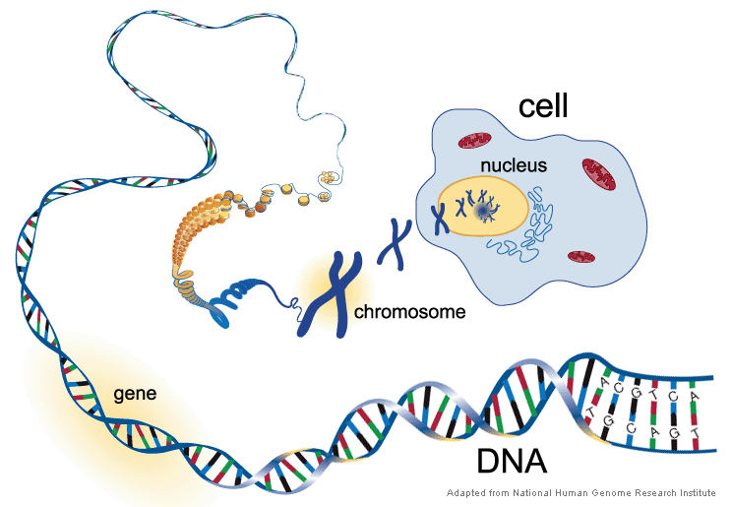
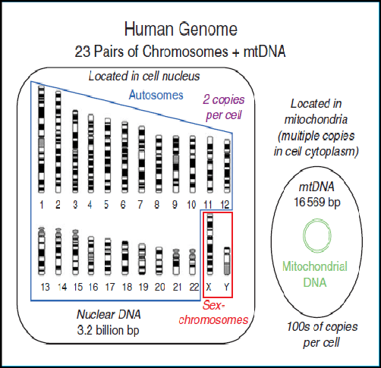
DNA, genome, and chromosomes
Zubi and Emsaed Journal of Sci and Eng 3:63

Slide 5
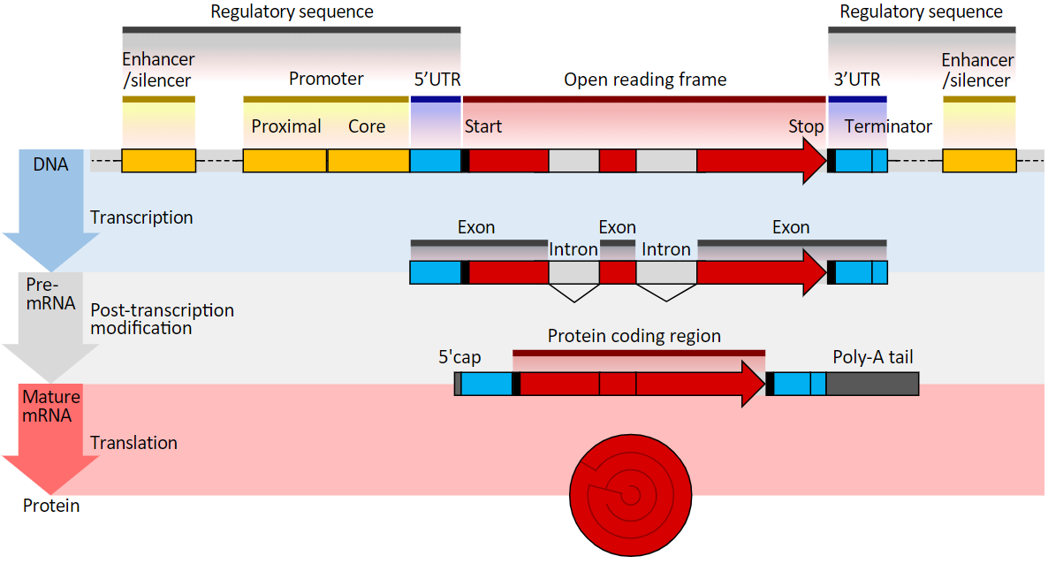
Eukaryote gene structure diagram
wikipedia

Slide 6
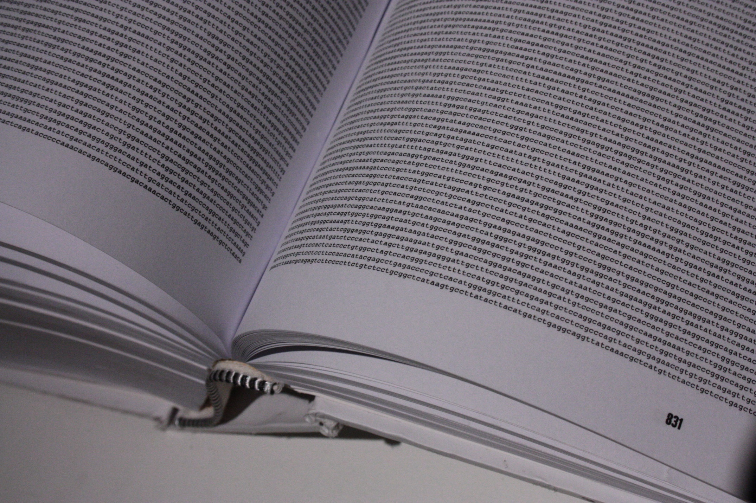

Slide 7
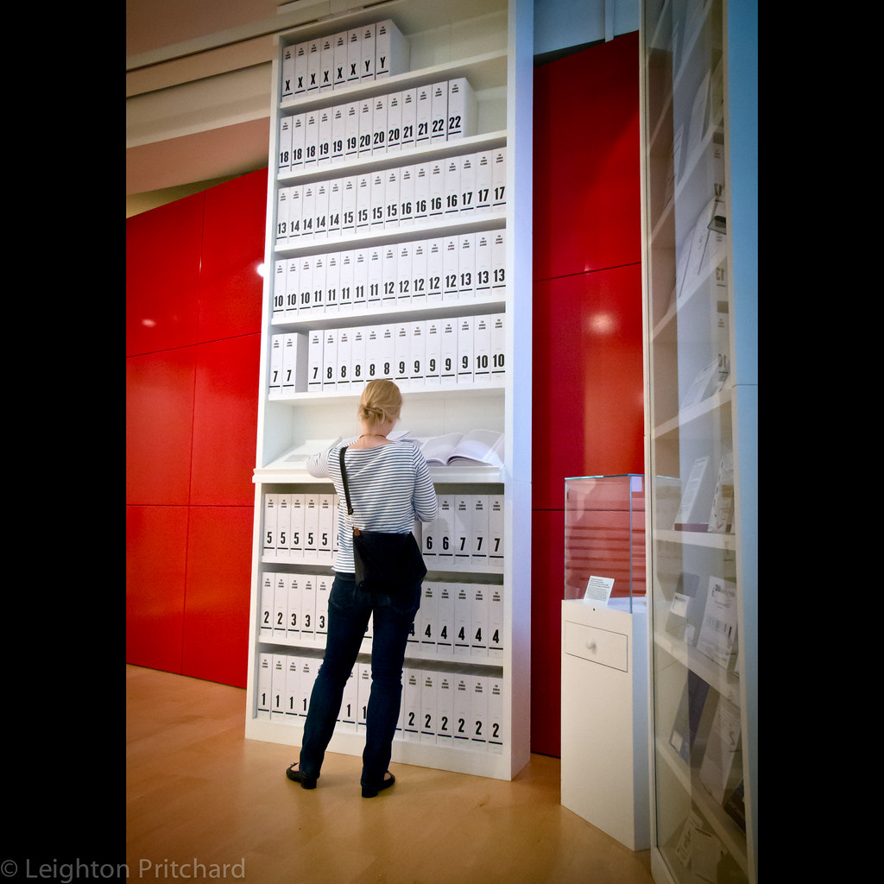

Slide 8
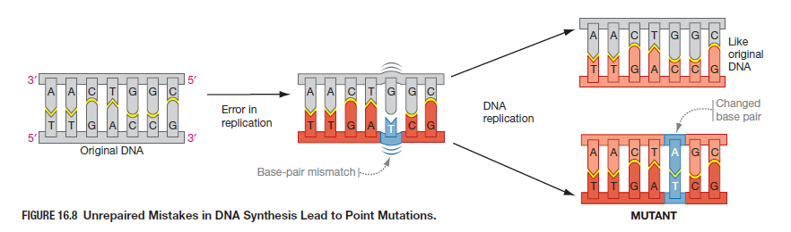
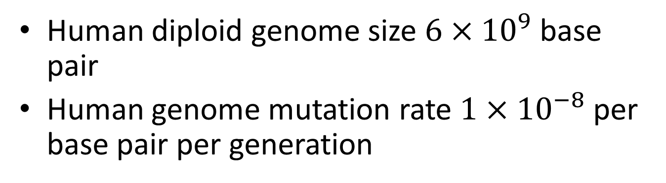
DNA mutation and polymorphism
Human diploid genome size $6×{10}^{9}$ base pair
Human genome mutation rate $1×{10}^{−8}$ per base pair per generation
Image from Biological Science by Scott Freeman

Slide 9
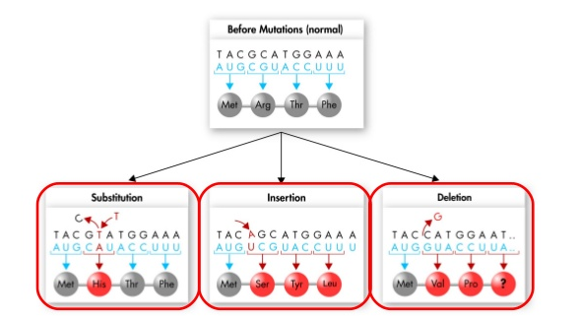

SNV and indel
Non-synonymous or missense
Frame-shift
Frame-shift

Slide 10
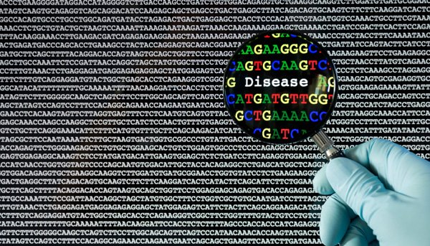
What is functional annotation?
https://www.linkedin.com/topic/genome-sequencing

Slide 11
Why we need them?
For Mendelian diseases: filter out or prioritize top candidate variants causing the disease
For common diseases: use as filters or weights in genotype-phenotype association analyses to increase detection power
For candidate variants: suggesting directions for further functional analyses or validation

Slide 12
knowledge integration
Database and annotation pipeline

Slide 13
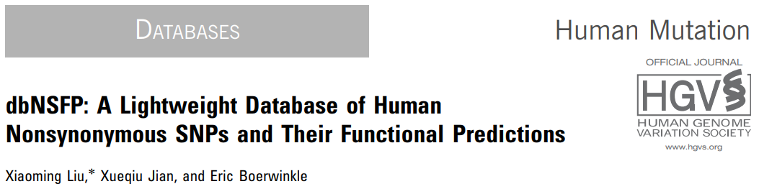
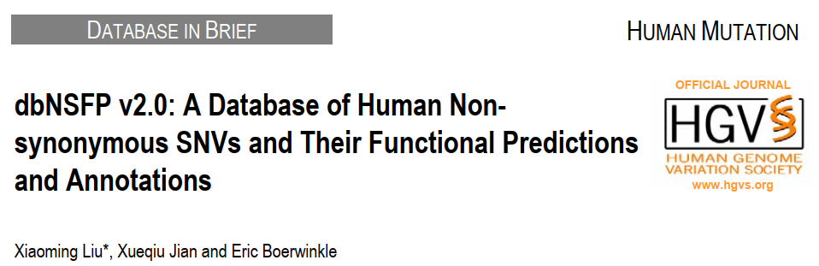
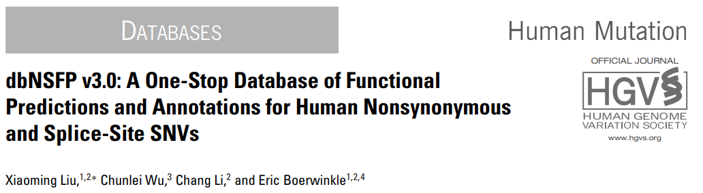
dbNSFP: a database for missense SNV

Slide 14
dbNSFP for whole exome sequence database for nonsynonymous SNPs’ functional predictions
A comprehensive collection of potential non-synonymous variants (nsSNV) and essential splicing (GT-AG) site variant (ssSNV) in the human genome based on GENCODE 22 (hg38 and liftover to hg19)
  A total of 83,422,341 nsSNVs and ssSNVs
  15,030,435 scSNVs (SNVs in splicing consensus regions) from dbscSNV (attached database)
20 prediction algorithms for nsSNVs (SIFT, Polyphen2-HDIV, Polyphen2-HVAR, LRT, MutationTaster2, MutationAssessor, FATHMM, MetaSVM, MetaLR, CADD, VEST3, PROVEAN, FATHMM-MKL coding, fitCons, DANN, GenoCanyon, Eigen coding, Eigen-PC, M-CAP, REVEL, MutPred)
2 deleteriousness predictions for SNVs in splicing consensus regions
6 conservation scores (PhyloP x 2, phastCons x 2, GERP++ and SiPhy)
Annotations for variants and genes

Slide 15
WGSA for whole genome sequence
Feature | Components
Functional prediction (missense and splicing SNVs) | dbscSNV, FATHMM, LRT, MetaLR, MetaSVM, MutationAssessor, MutationTaster, MutPred, M-CAP, Polyphen2, PROVEAN, REVEL, SIFT, SPIDEX, VEST3
Functional prediction (non-coding SNVs) | CADD, DANN, FATHMM-MKL, fitCons, Funseq/Funseq2, genoCanyon, GenoSkyline-Plus, Eigen/Eigen-PC RegulomeDB
Allele Frequency | 1000G, ESP6500, ExAC, gnomAD, UK10K
Disease-related Variants | ClinVar, COSMIC, GWAS catalog, GRASP
Conservation | GERP++, phastCons × 3, PhyloP × 3, SiPhy
Epigenomics | Encode, FANTOM5, Roadmap
Other | ancestral allele, dbSNP, GTEx, mappability scores, miRNA targets, snoRNA/miRNA, super enhancer, TADs
Input
Gene-model
Output
Pre-computed
SNV annotation
VCF
SNV
ANNOVAR SnpEff
VEP
×
Ensembl RefSeq
UCSC
“translate”
Local-run
INDEL annotation
Variant List
INDEL
ANNOVAR SnpEff
VEP
×
Ensembl RefSeq
UCSC
Functional prediction (non-coding indels) | CADD
Allele Frequency | 1000G, ESP6500, ExAC, gnomAD, UK10K
Disease-related Variants | ClinVar, GWAS catalog, GRASP

Slide 16
Deleteriousness prediction
Application of classifiers to tabular data

Slide 17
Variant classification with tabular data
Variant | Feature 1 | Feature 2 | Feature 3 | Feature 4 | … | Feature N | Class
Variant 1 |  |  |  |  |  |  | Deleterious
Variant 2 |  |  |  |  |  |  | Benign
Variant 3 |  |  |  |  |  |  | Deleterious
Variant 4 |  |  |  |  |  |  | Deleterious
… |  |  |  |  |  |  | …
Variant M |  |  |  |  |  |  | Benign

Slide 18
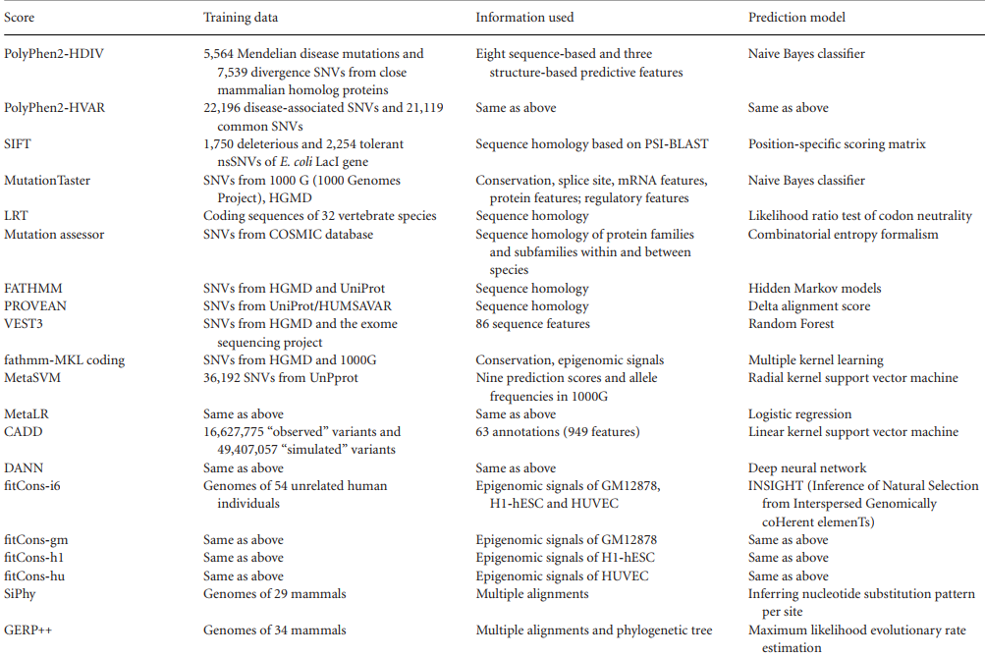

Slide 19
Missense mutations
- background
The most studied group of mutations – large amount of data for training and testing
There are many prediction models been developed
Different prediction models use different information and each has its own strength and weakness

Slide 20
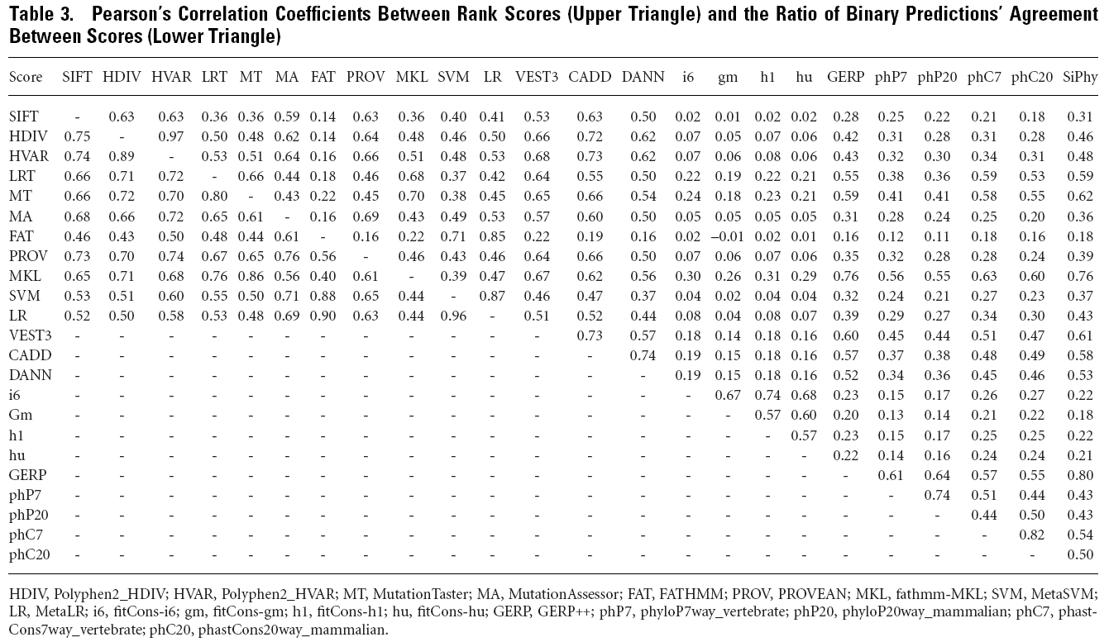
Scores are not highly correlated

Slide 21
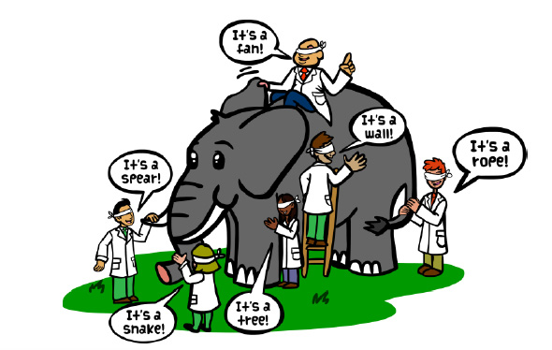
Let’s vote

Slide 22
Missense mutations
- our approach
Ensemble method: a type of machine learning method that makes prediction of new data points by taking a (weighted) vote of a set of predictions
Features used: 9 scores (SIFT, PolyPhen-2, GERP++, MutationTaster, Mutation Assessor, FATHMM, LRT, SiPhy, PhyloP) + max allele frequency of 1000 Genomes Project populations.
Prediction model: Linear Regression (LR) and Support Vector Machine (SVM)

Slide 23
Training/testing data
Dataset | Training dataset | Testing dataset I | Testing dataset II | Testing dataset III
True Positive | 14,191 | 120 | 6,279 | 0
True Negative | 22,001 | 124 | 13,240 | 10,164
Total | 36,192 | 244 | 19,519 | 10,164
Source | Uniprot database | Recent Nature Genetics publications for TP variants | VariBench dataset II without mutations in training dataset | CHARGE database
 |  | CHARGE database for TN variants
TP: True Positive, number of deleterious mutations that were treated as true positive observations in modeling. TN: True Negative, number of non-deleterious mutations that were treated as true negative observations in modeling. Total: Total number of mutations for each dataset. (Total = TP+TN)

Slide 24
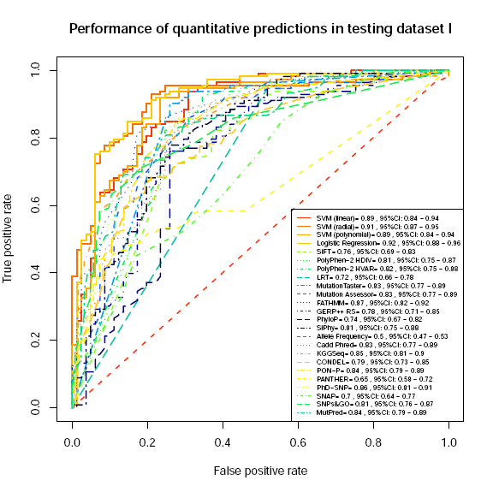
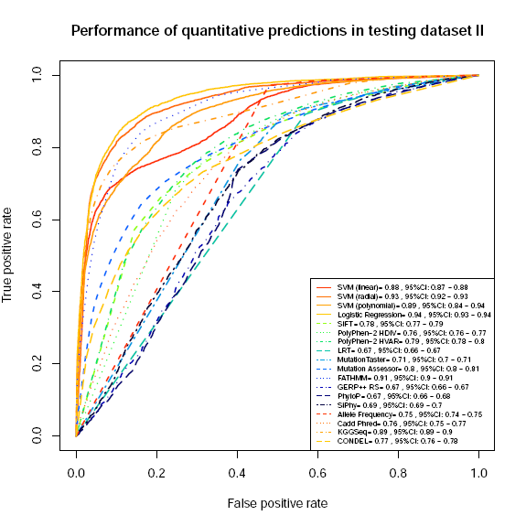
Performance
MetaLR 0.92
MetaSVM 0.91
MetaLR 0.94
MetaSVM 0.93

Slide 25
Mutations in splice region
- background
The second most reported disease-causing mutations – enough amount of data for training and testing
There is few method to measure how splicing signals change when one nucleotide is substituted by another
Most tools only output prediction scores for potential splice sites given an input DNA sequence
Most tools focus on splicing consensus regions (−3 to +8 at the 5 splice site and −12 to +2 at the 3 splice site)

Slide 26
Mutations in splice region
- our approach
Ensemble method
Features used: absolute and relative diff. of PWM, NNSplice, and HSF; relative diff. of MES; two conservation scores (phyloP46way_placental and phyloP46way_primate) and two whole-genome functional prediction scores (CADD_raw and CADD_phred)
Prediction model: AdaBoost and random forests

Slide 27
Training/testing data
Table 1. Summary of the dataset used in the present study.
Data source | 5’ | 3’ | Intronic | Exonic | Total
Positive
HGMD | 725 | 65 | 2 | 788 | 790
SpliceDisease | 182 | 84 | 235 | 31 | 266
DBASS | 63 | 45 | 96 | 12 | 108
Subtotal | 970 | 194 | 333 | 831 | 1,164
Negative
1000 Genomes | 712 | 1083 | 1,548 | 247 | 1,795
Total | 1,682 | 1,277 | 1,881 | 1,078 | 2,959

Slide 28
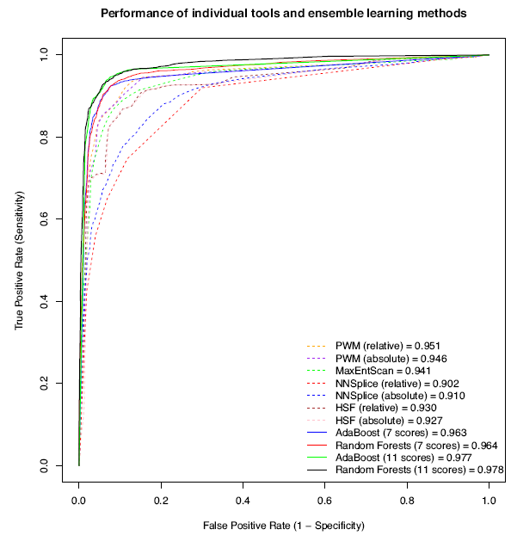
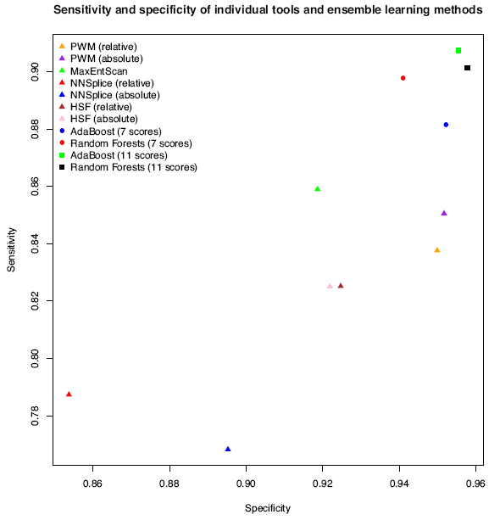
Performance
AdaBoost 0.977
Random forests 0.978

Slide 29
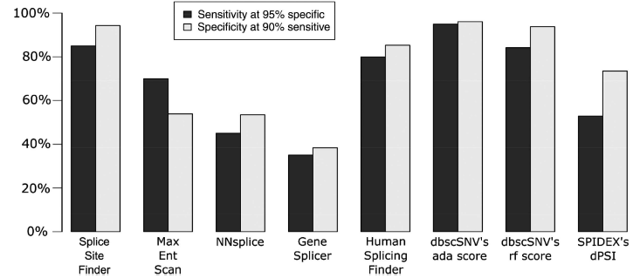

Independent evaluation
Positives: 20 validated variants causing inherited retinal disease (IRD) fell within a known consensus sequence and caused a disruption of that splice site
Negatives: 245 variants in one of the 281 IRD-causing genes and have an MAF > 5%

Slide 30
Challenges and open questions

Slide 31
Problem 1: no enough labeled data
It is quite often our knowledge is very limited
  Prediction score for mutations in miRNA target sites
  Gene-specific prediction score for missense mutation
Possible solutions
  Simulate unobserved variants (CADD, DANN)
  Unsupervised learning (Eigen)
Notes:
5; 252 negative examples and 3; 063 positive examples for training and testing

Slide 32
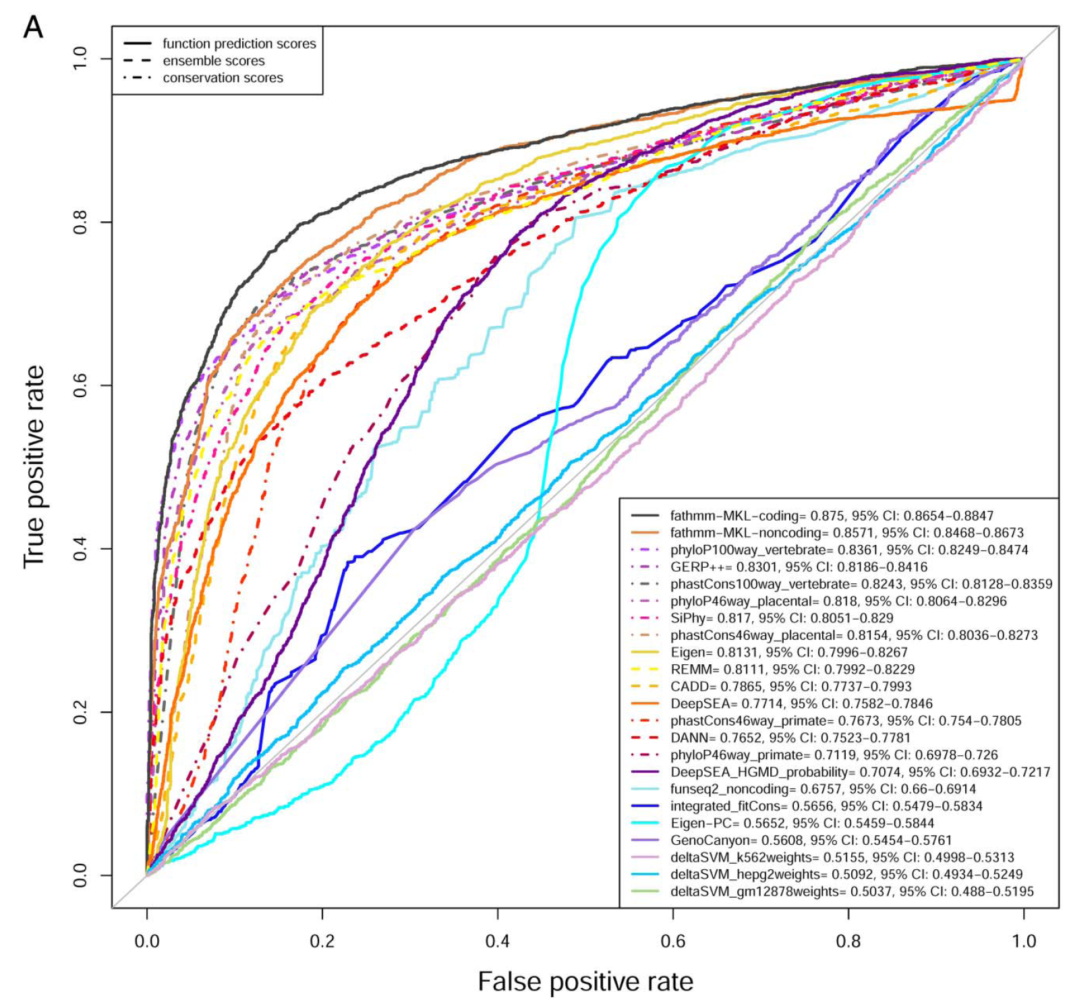
Prediction without labeled data?
Comparison of non-coding deleteriousness scores
2578 deleterious and 2578 benign non-protein-changing SNVs

Slide 33


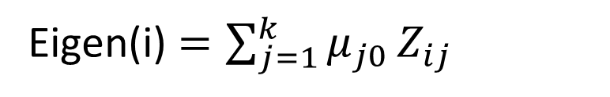


Eigen: background
Eigen score: a non-parametric, unsupervised classifier (Ionita-Laza et al. Nat Genet 2016 48: 214)
pathogenic variants
benign variants
$$μ_{j1}$$
$$μ_{j0}$$
$${F_{j}(Z}_{ij})=πF_{j1}(Z_{ij})+\left(1−π\right)F_{j0}{(Z}_{ij})$$
$$μ_{j}=πμ_{j1}+\left(1−π\right)μ_{j0}=0$$
Eigen(i) $=\sum_{j=1}^{k}{μ_{j0}}Z_{ij}$

Slide 34





Eigen: rationale
$μ_{j0}=π(μ_{j0}−μ_{j1})$
Annotation 1
$$μ_{j0}$$
$$μ_{j1}$$
Annotation 2
$$μ_{j0}$$
$$μ_{j1}$$

Slide 35
Problem 2: hidden features
It is quite often our knowledge is very limited (again!)
Flooding of genomics data means more noise
Possible solution
  Automatic feature extract with deep learning?

Slide 36
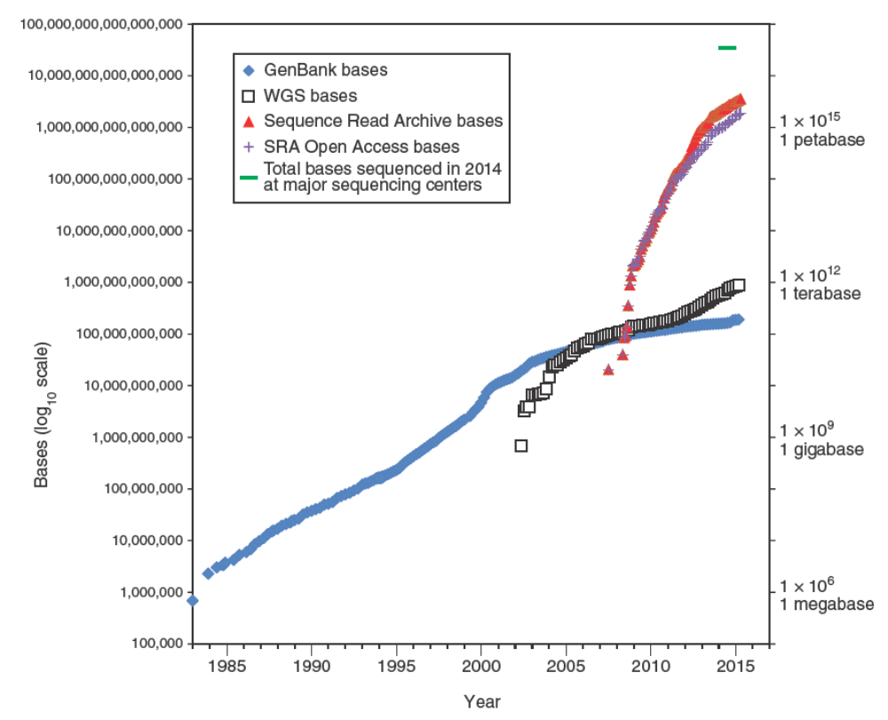

Slide 37
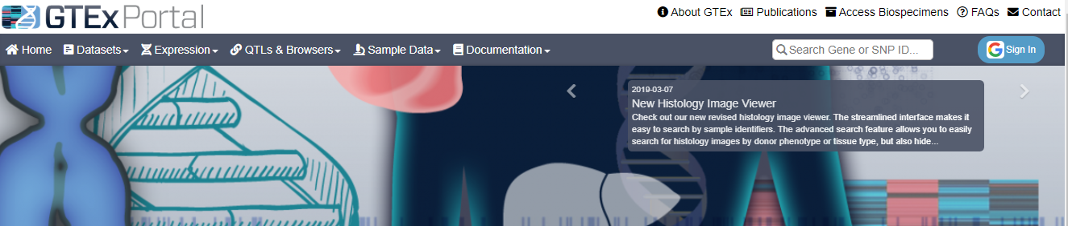
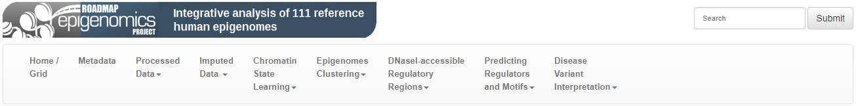
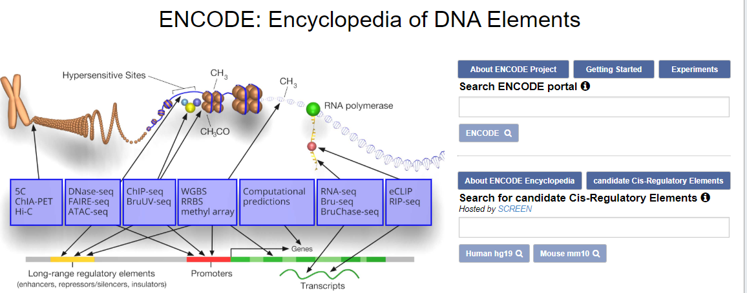

Slide 38
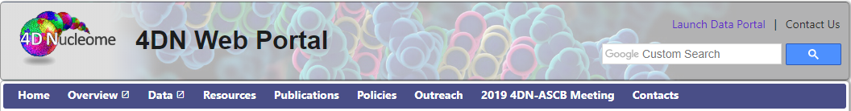

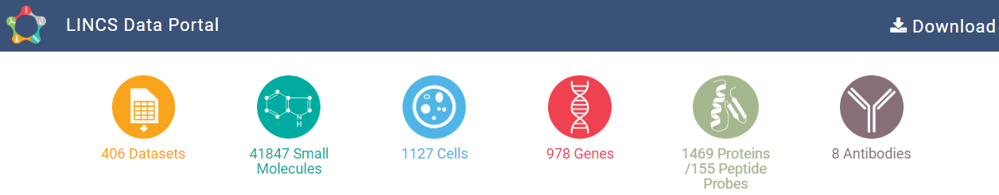


Slide 39
Training data/testing data
28 million SNVs used as CADD training data
  As true positives: 14 million simulated SNVs
  As true negatives: 14 million derived SNVs
Random split 28 million SNVs into training (70%), validation (15%) and testing data (15%)

Slide 40
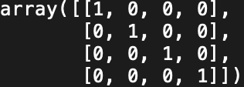
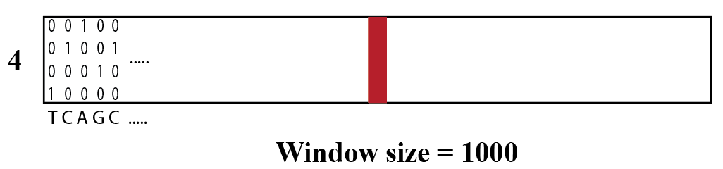
Model training
Convolutional neural network
One-hot encode A,C,G,T into vectors with length 4:
Input X: matrix with shape: 1000x4 centered around the labeled SNV
Input Y: 0 or 1; 0 for True negatives and 1 for True positives
A
C
G
T

Slide 41
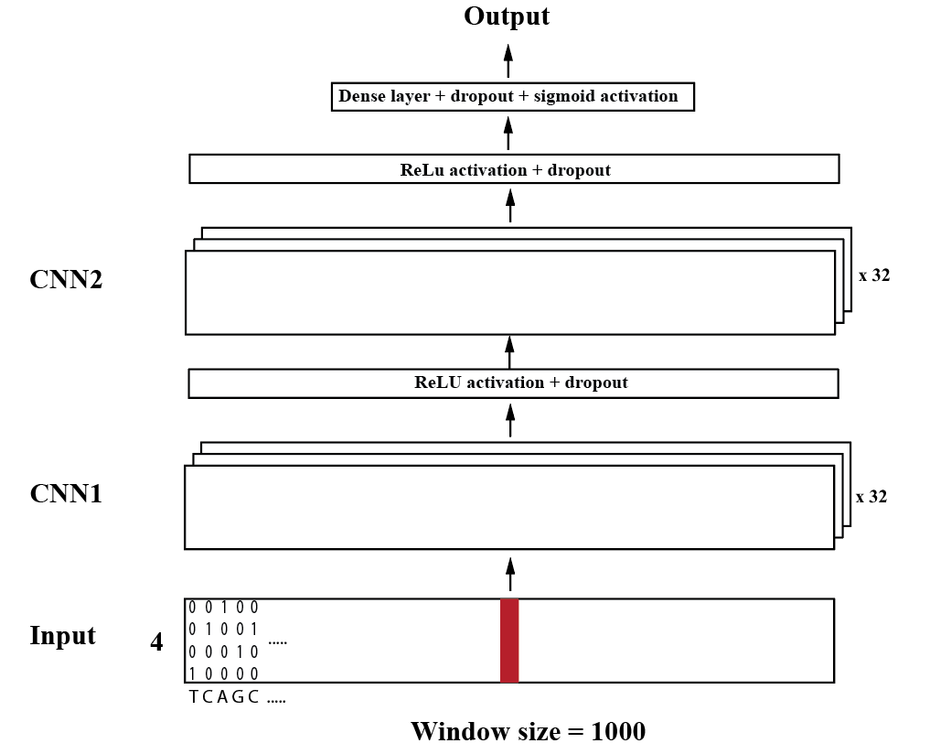
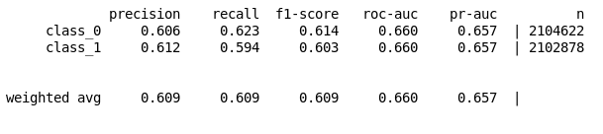
Structure and output
Parameters:
Adam optimizer
Number of kernels = 32
Kernel length = 5
Max norm weight constraint = 3
Dropout rate = 0.2
Notes:
Training stops after

Slide 42

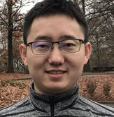
Acknowledge
UTHealth
  Yun-Xin Fu
  Eric Boerwinkle
  Alanna Morrison
  Zhongming Zhao
  Dianna M. Milewicz
  Dongchuan Guo
  Degui Zhi
  Bing Yu
Baylor College of Medicine
  Richard Gibbs
  Jeffery Rogers
  Rui Chen
  Fuli Yu
  Jinlan Zhang
UT MD Anderson Cancer Center
  Ken Chen
  Bo Peng
  Peng Wei
NHLBI Framingham Heart Study
  Andrew D Johnson
  L Adrienne Cupples
Icahn School of Medicine at Mount Sinai
  Robert J Klein
Children's Hospital of Philadelphia
  Kai Wang
Scripps Research Institute
  Chunlei Wu
Johns Hopkins University
  Shizhong Han
Xueqiu Jian, PhD
Chang Li, PhD

Slide 43
Thank you!

Slide 44
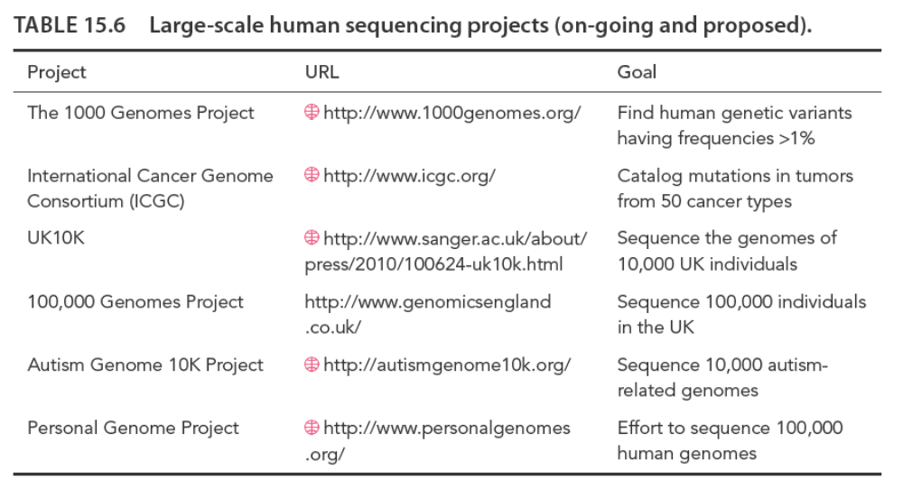

Slide 45
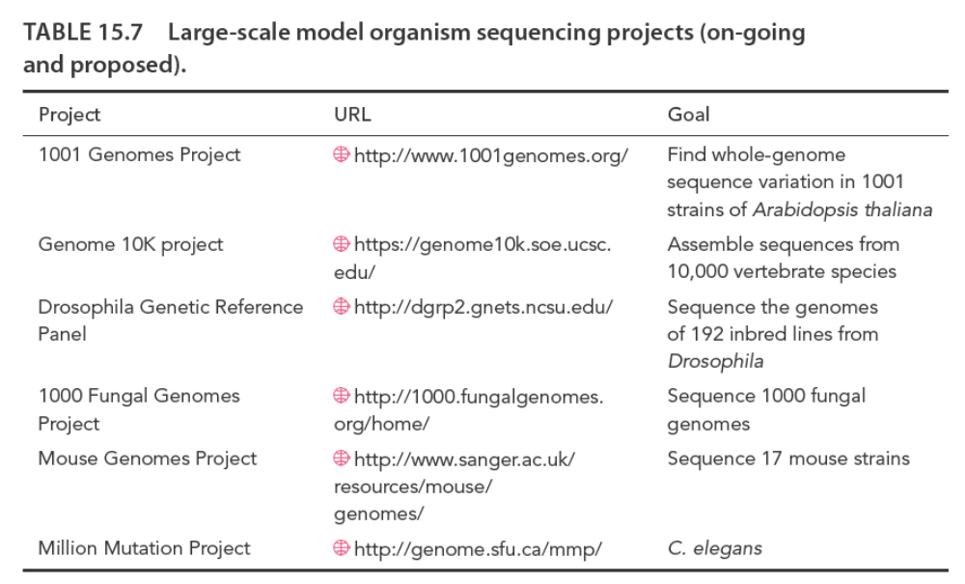

Slide 46
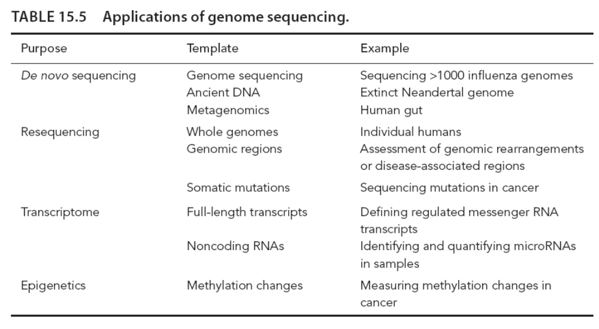

Slide 47
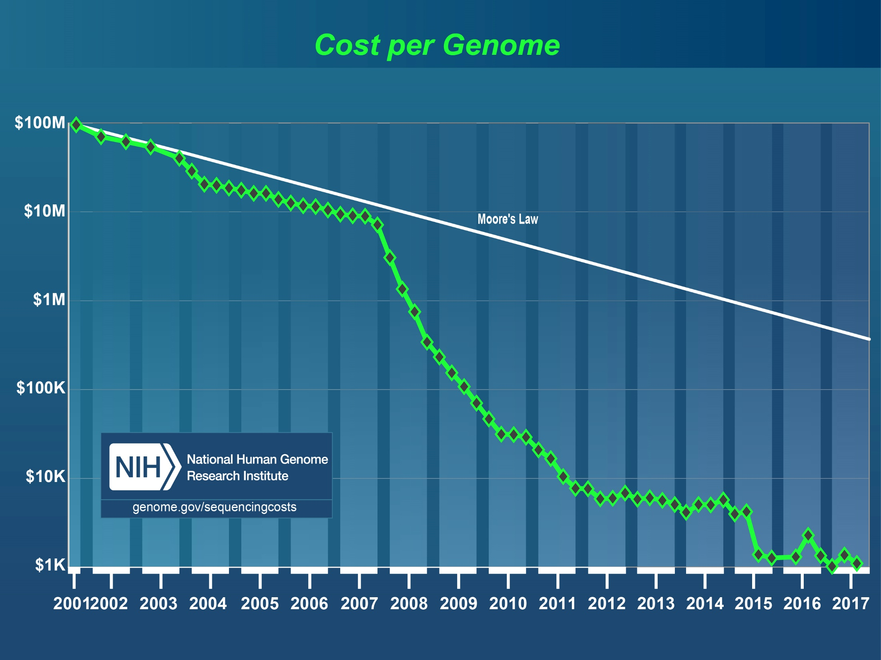

Slide 48
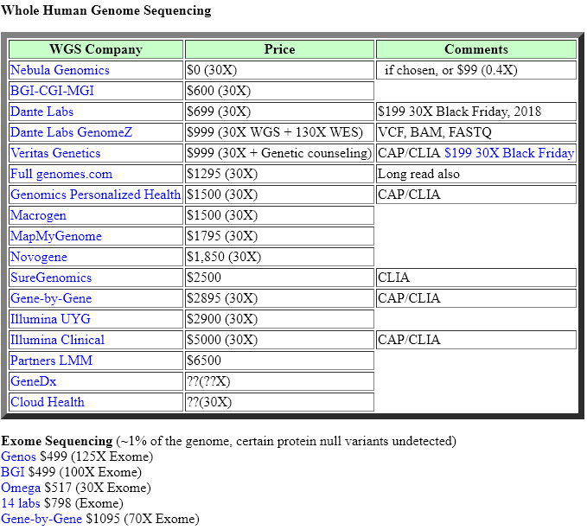
List of Personal Genome Sequencing Services
http://arep.med.harvard.edu/gmc/genome_services.html

Slide 49
