Slide 1

Utilization of Statistical Strategies in Team Science: An Outlier Approach in a Genomic Research and Data Visualization and Reduction in a Processed Image Data Analysis
USF Interdisciplinary Data Sciences Consortium (IDSC) Seminar Series
Dung-Tsa Chen, PhD
Biostatistics and Bioinformatics Department
Moffitt Cancer Center

Slide 2
Team Science Experiences

Slide 3
What Is Team Science?
A collaborative effort (Cross-disciplinary team science) to address a scientific challenge
  To leverage the strengths and expertise of professionals in every field.
  To accelerate innovation and the translation of scientific findings into effective practices.
Teamwork!!!
Source: NCI (http://www.teamsciencetoolkit.cancer.gov/)

Slide 4
Major Team Science Activities
Genomic signature development
  Malignancy-risk (MR) gene signature in breast and lung cancer, E2F and NF-KB signatures in lung cancer, BAD signature in ovarian cancer, a 15-gene signature in pancreatic cancer, a microRNA signature in predicting IPMN risk in pancreatic cancer, a senescence gene signature in brain cancer.
Clinical trial design
  Bayesian pick-the-winner design, Two-stage design for gene signature validation, Modified CRM, Design for comparison of two treatment assignment strategies.
Biostatistics Core for program project developments
  Lung, Multiple Myeloma, and GI.

Slide 5
One Example
Roadmap from Bench to Bedside:
MR/E2F Genomic Profiling in Breast and Lung Cancer

Slide 6
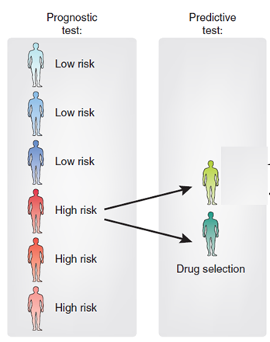
Applications in Precision Medicine
Roadmap from Bench to Bedside:
MR/E2F Genomic Profiling in Breast and Lung Cancer
Longer survival
Poor survival
Courtesy use of Majewski and Bernards

Slide 7
Roadmap from Bench to Bedside:
MR/E2F Genomic Profiling in Breast and Lung Cancer
Dynamic Team for Science Research
Quantitative Science*
Molecular Biology*
Clinical Science*
Dung-Tsa Chen, PhD
Lu Chen, PhD
William Fulp, MS
Matthew Schabath, PhD
Jamie Teer, PhD
Eric Welsh, PhD
Douglas Cress, PhD (E2F)
Brienne E. Engel, PhD
Mike Gruidl, PhD
Courtney A. Kurtyka, PhD
Sean Yoder, MS
Alberto Chiappori, MD
Jhanelle Gray, MD
Eric Haura, MD
Anthony Magliocco, MD
Timothy Yeatman, MD (MR)
*alphabetical order

Slide 8
Scope of Genomic Profiling Development
√
Almost √
Near future
Discovery Stage
Test Validation Stage
Clinical Utility Stage
Task:
Genomic profile development
Analytic validation
Prospective clinical trials
Evaluation in external cohorts
Clinical validation
Progress:
• Four unique validation cohorts
• Robustness in platforms and tissue types
• Prognostic and predictive
• CLIA-assay development
• Neo-adjuvant chemotherapy observation trial
• Prospective observation trial
Two gene signatures developed (MR and E2F)
Significance in numerous cohorts (n>10, including TCC)

Slide 9
Outline for Our Genomic Profiling Development
Malignancy-Risk (MR) Gene Signature in Breast and Lung Cancer
A Statistical Method to Identify Outlier Genes
A Sibling Gene Signature: E2F Signature Development
A Two-Stage Design for Gene Signature Validation

Slide 10
A Malignancy-Risk (MR) Gene Signature
Brief summary:
  117 genes (96 oncogenes and 21 tumor suppressed genes)
  Associated with many cell cycle related pathways (11 pathways)
References:
Proliferative genes dominate malignancy-risk gene signature in histologically-normal breast tissue. Chen et al., Breast Cancer Res Treat, 2010
Evaluation of malignancy-risk gene signature in breast cancer patients. Chen et al., Breast Cancer Res Treat, 2010
Distribution based p value for outlier sum in differential gene expression analysis. Chen et al., Biometrika, 2010
Novel molecular markers of malignancy in histologically normal and benign breast. Nasir et al. Patholog Res Int, 2011
Prognostic and Predictive Value of a Malignancy-Risk Gene Signature in Early-Stage Non-Small Cell Lung Cancer. Chen et al. JNCI, 2011 (Team Publication Award, 2011)

Slide 11
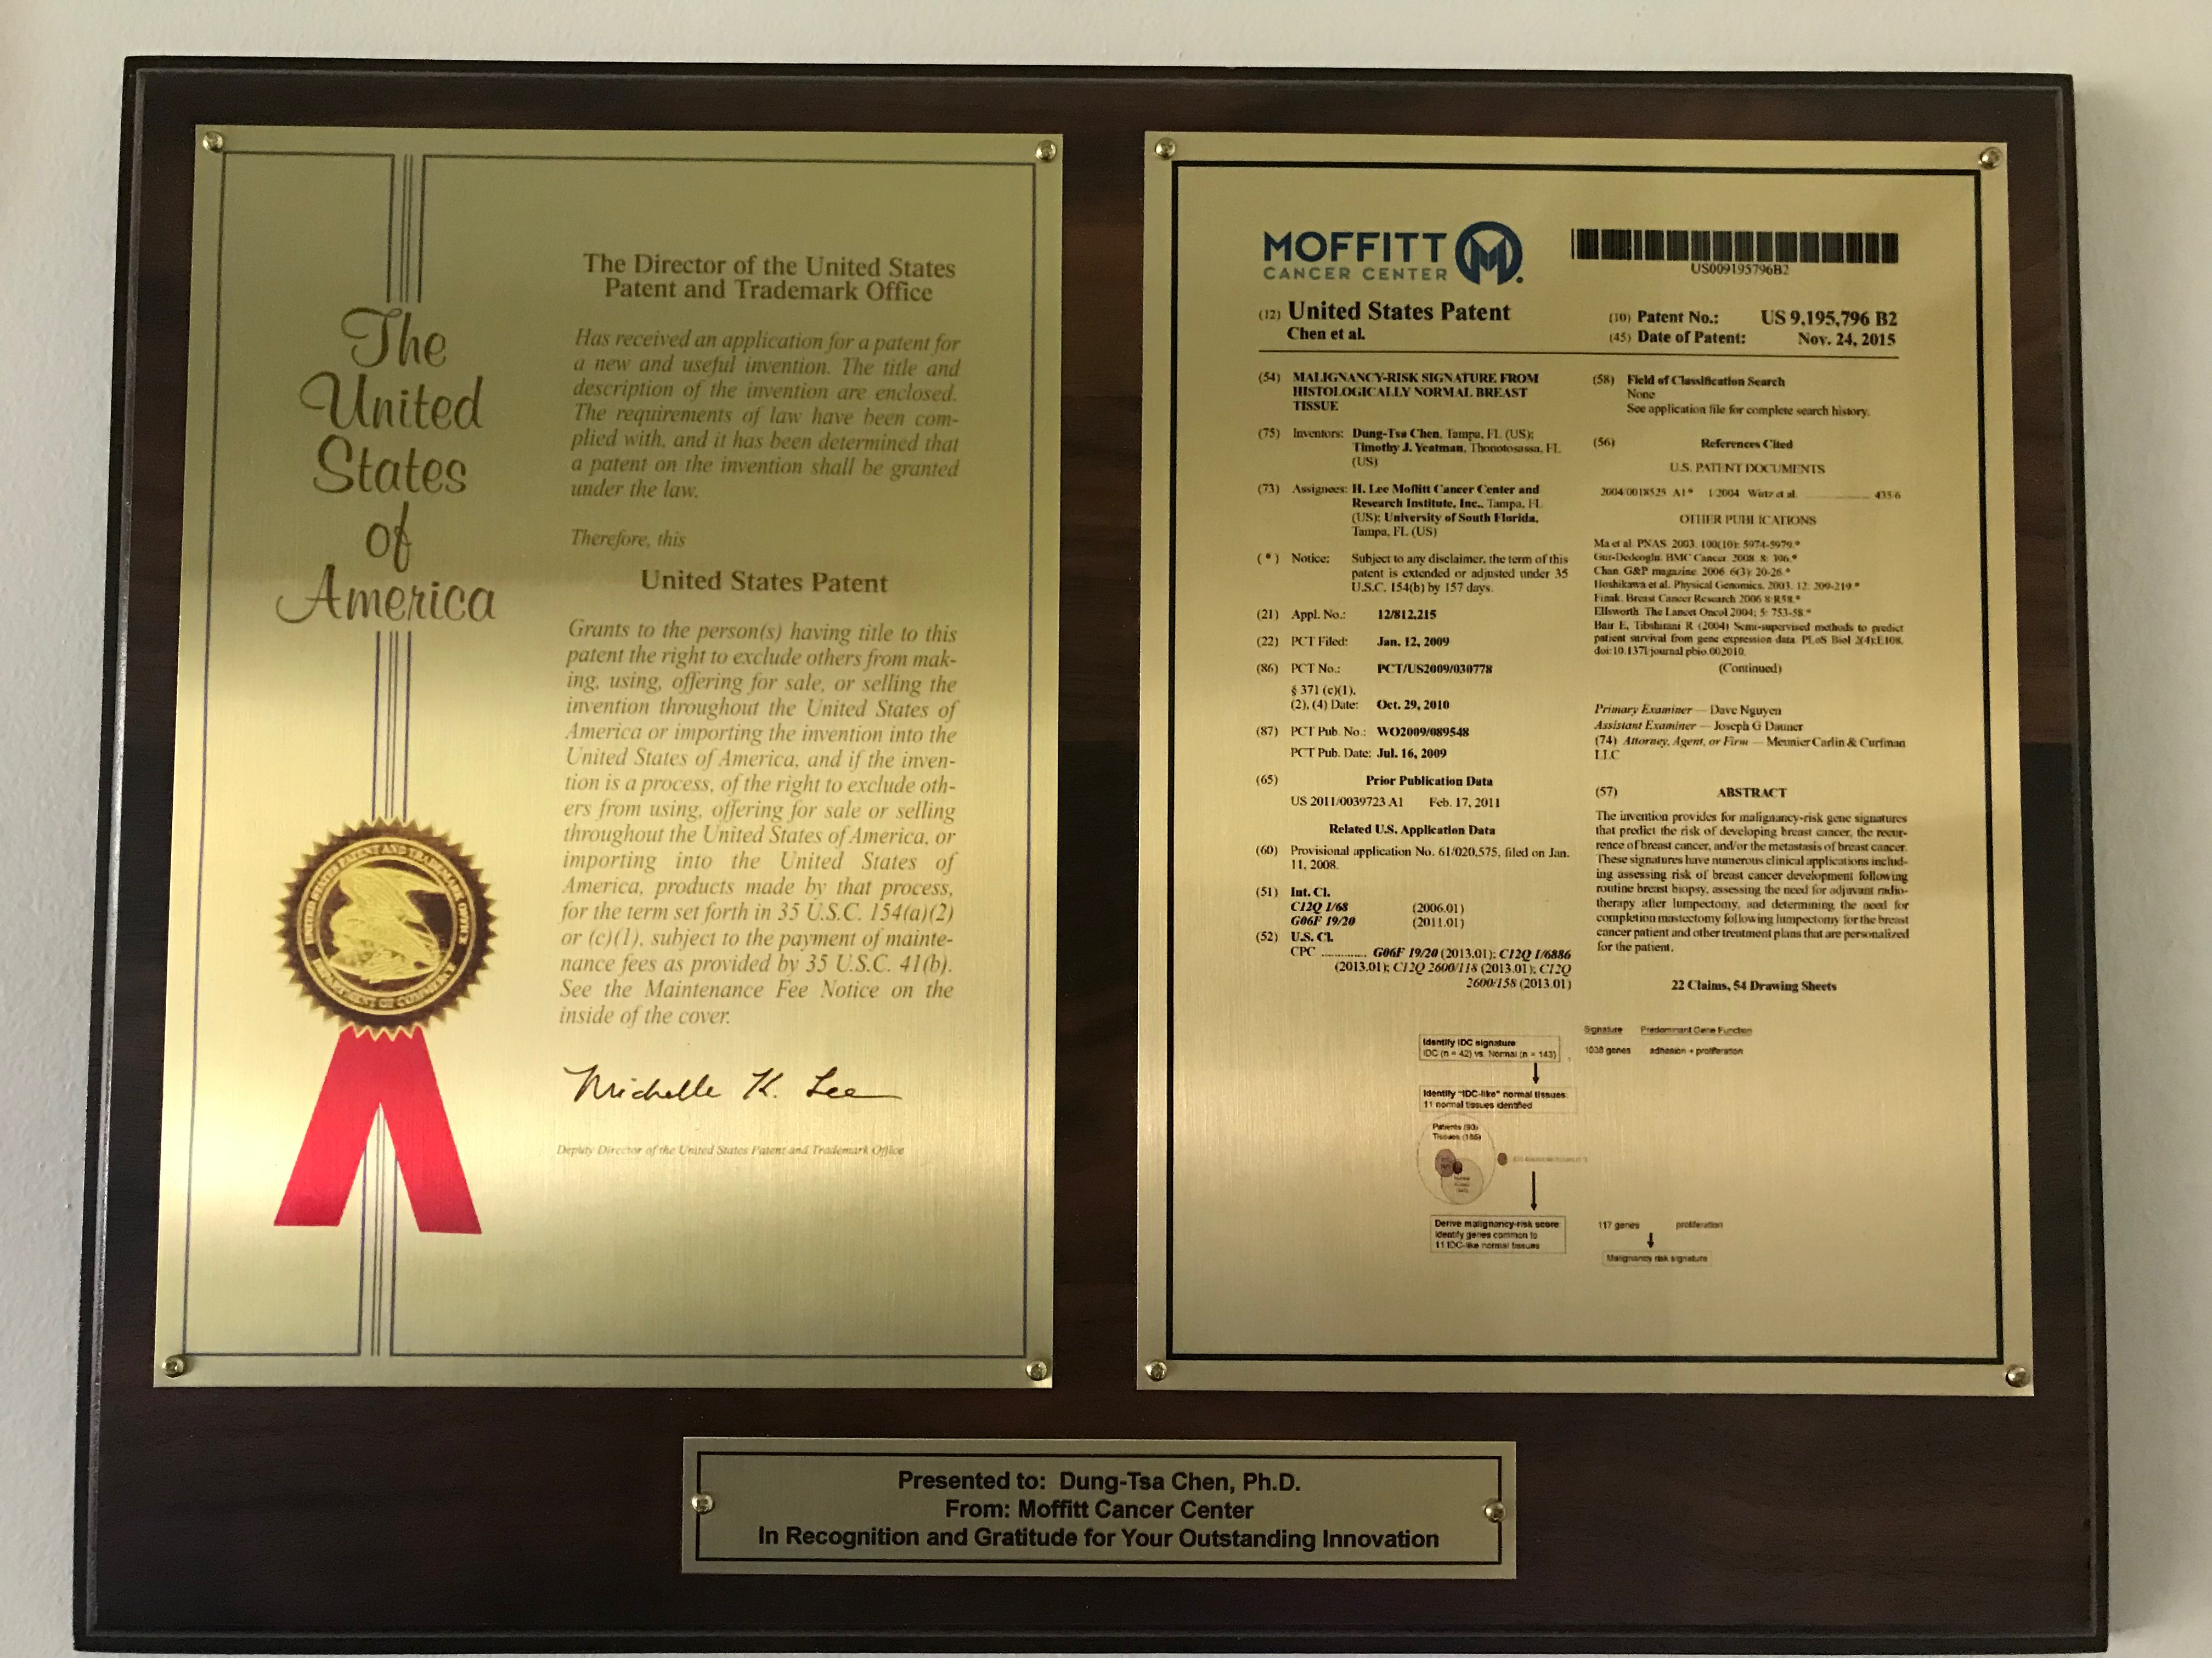
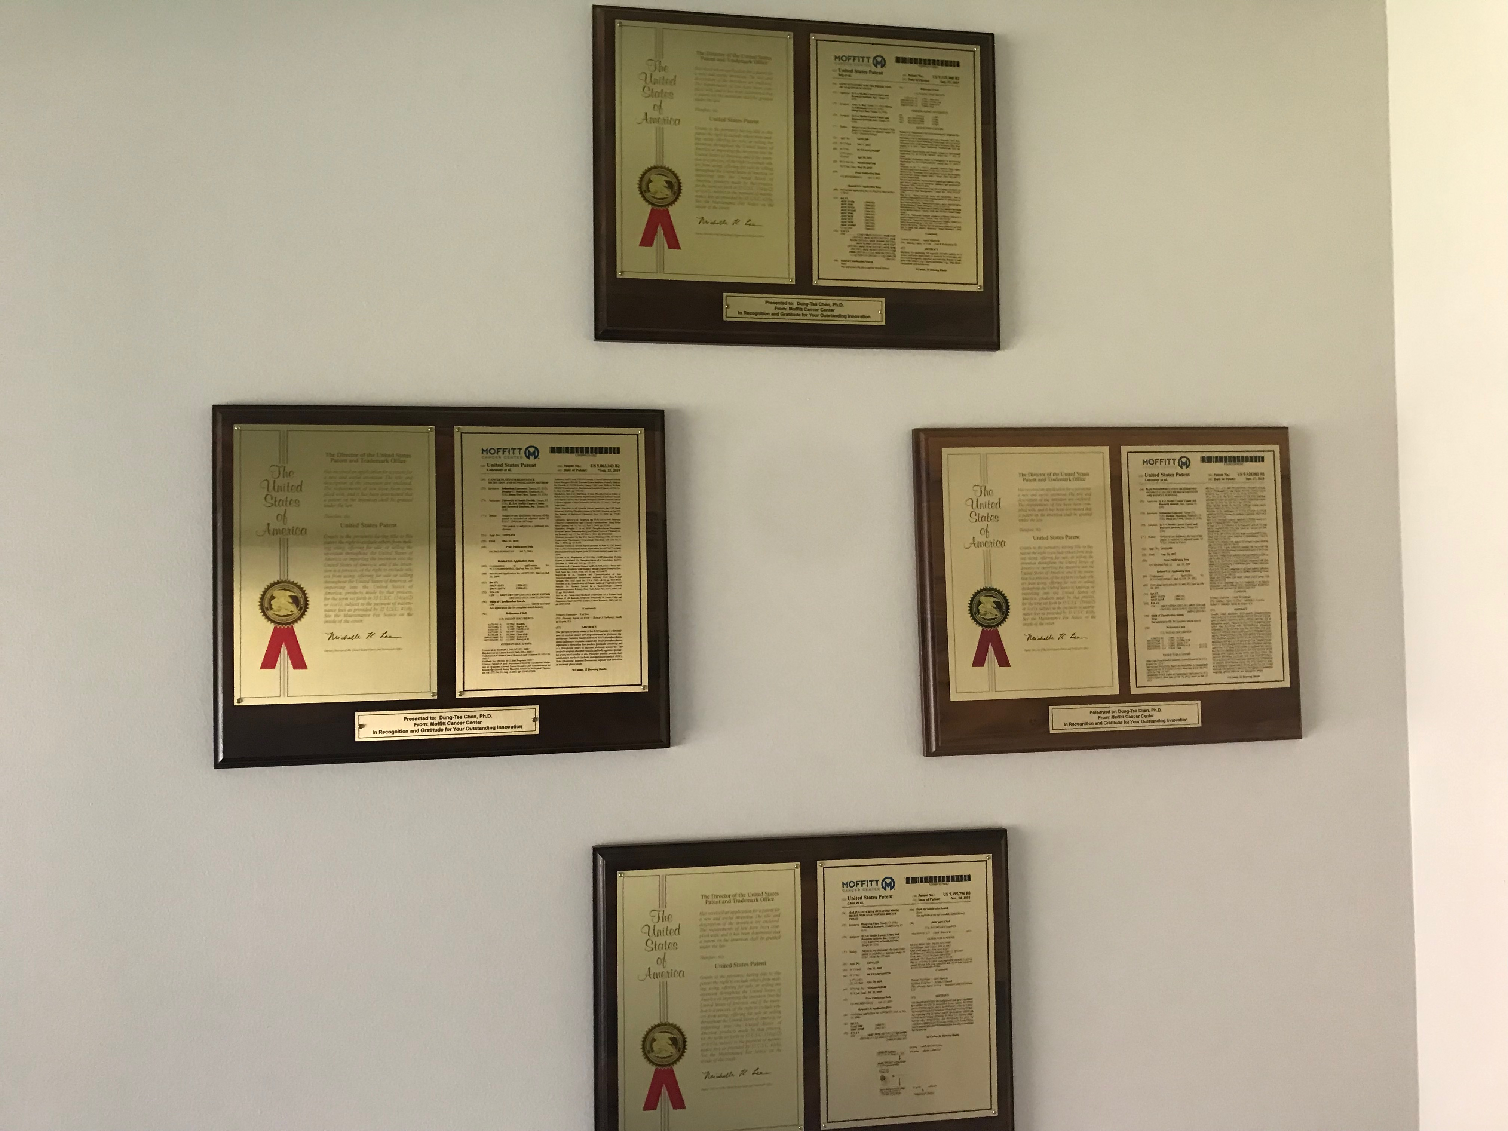
A Patent for Malignancy Risk Genomic Profiling
Many Patent Opportunities for Statistician in Golden Data Science Era

Slide 12
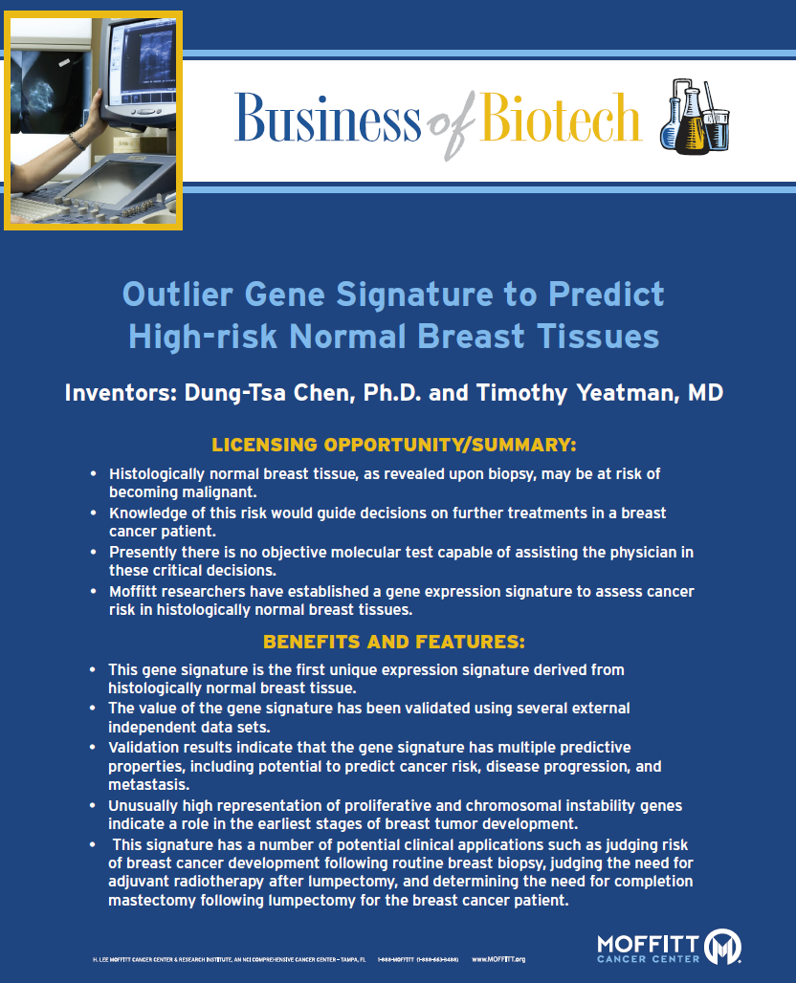

Slide 13

Breast Cancer Data (PI: Dr. Yeatman)
Objective: To identify high-risk genes for cancer development
Tumor (T)
Normal (N1)
Normal (N2)
...
…
Normal (N_{i})

Slide 14
Gene Profile for Tumor Development
Tumor
Develop a gene signature
Normal

Slide 15
Scope of Genomic Profiling Development
Discovery Stage
Test Validation Stage
Clinical Utility Stage
Genomic profiling development
Analytic validation
Prospective clinical trials
Clinical validation
Evaluation in external cohorts

Slide 16
Breast Cancer Data: Design
Tumor (T)
Normal (N1)
Normal (N2)
...
…
Normal (N_{i})

Slide 17
Collected Breast Cancer Data: Unbalanced
 | T₁ | N₁ | N₂ | … | N_{k}
S1 | x | x | x | x | x | (T,N)
S2 | x | x |  |  | x | (T,N)
S3 | x |  | x |  |  | (T,N)
S4 |  | x | x | x | x | (N)
S5 |  | x |  | x |  | (N)
S6 |  |  | x | x |  | (N)
S7 | x |  |  |  |  | (T)
S8 | x |  |  |  |  | (T)
… | …
11 cases (34 tissues)
60 cases (123 tissues)
19 cases (28 tissues)
A total of 90 cases: 143 normal breast tissues and 42 IDC tissues

Slide 18
Flowchart of MR Signature Development
Identify Invasive Ductal Carcinoma (IDC) signature (1038 genes)
IDC (n = 42) vs. Normal (n = 143)
SAM method
Develop an Outlier gene signature
(Malignancy-risk signature: 117 genes)
Outliers from Normal tissues (n = 143)
Statistical outlier
methods
Evaluate clinical associations in external cohorts

Slide 19
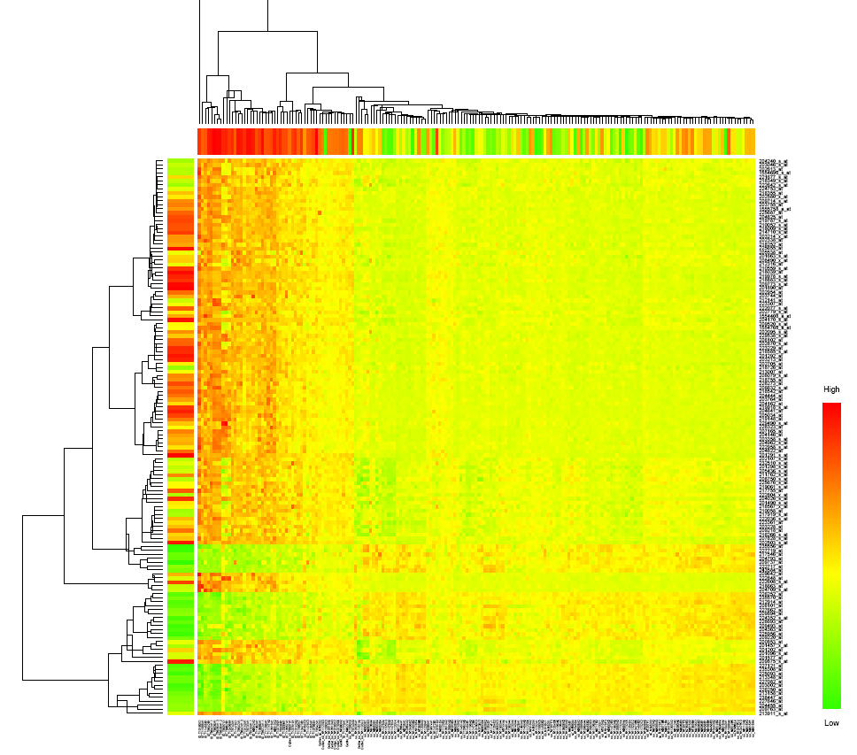
Heatmap of Malignancy Risk Genes
Tumor
Outlier
Normal

Slide 20
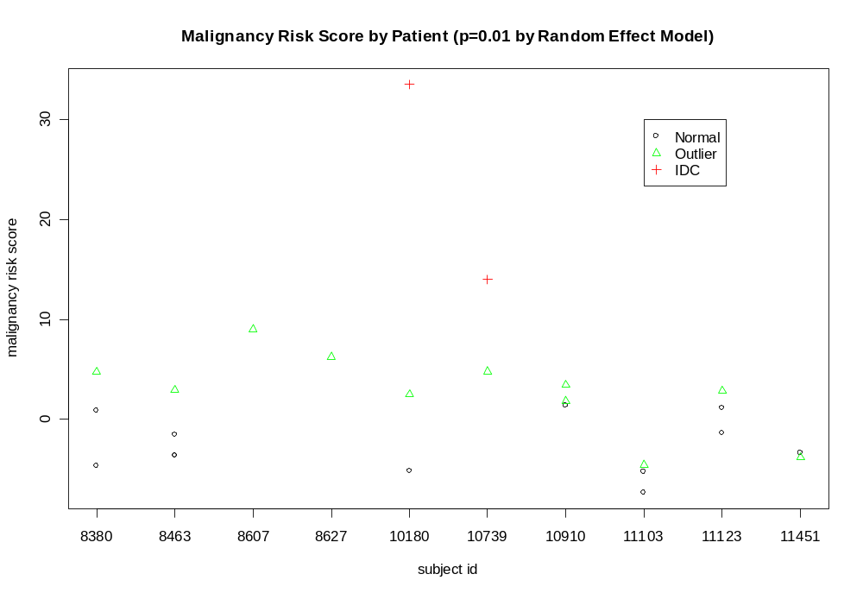
Outlier Versus Adjacent Normal Tissues

Slide 21
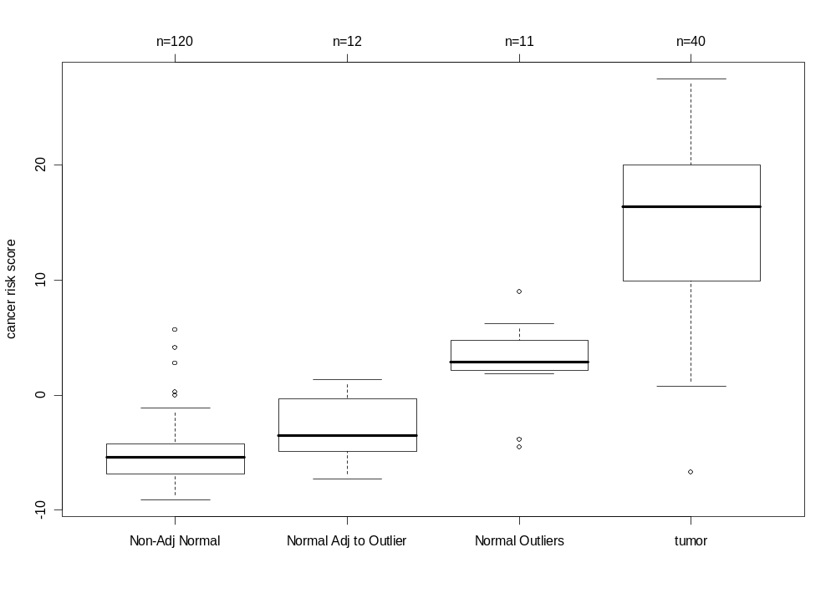
Cont.
Pearson correlation=0.63 with p<0.0001; (a) outlier tissues versus the adjacent normal tissues (p=0.0015) (b) adjacent versus non-adjacent normal tissues (p value=0.011).

Slide 22
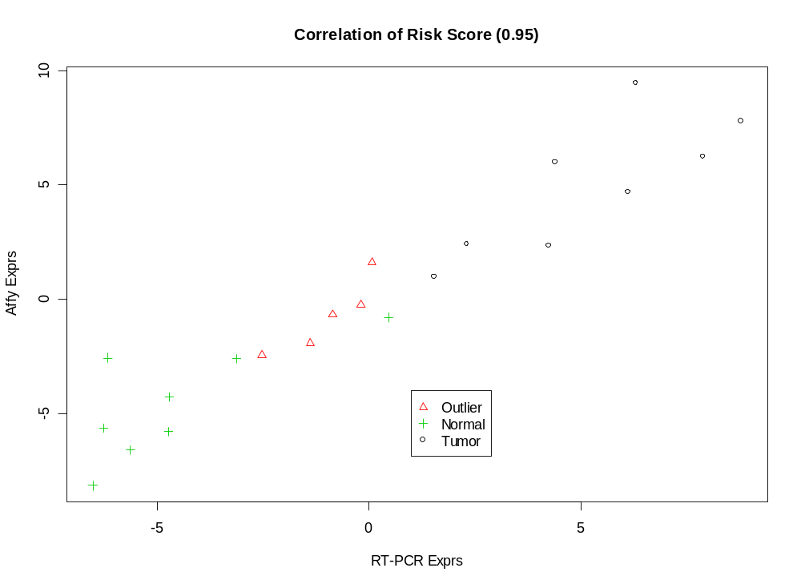
RT-PCR Validation

Slide 23
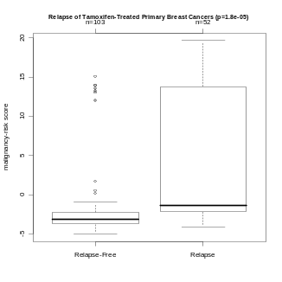
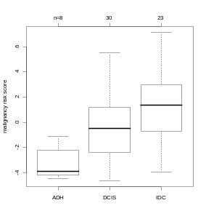
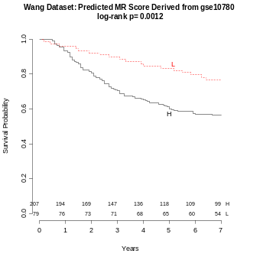
Clinical Association of MR Signature in Breast Cancer
Cancer Risk | • IDC vs. normal (p=0.03; Turashvili et al.)
 | • Relapse of primary cancer (p<0.0001; Chanrion et al.)
Disease Progression | • Normal, outlier normal, DCIS, IDC (r=0.87; p<0.0001; TCC)
 | • ADH, DCIS, IDC (r=0.50; p<0.0001; Ma et al.)
Prognosis | • Metastasis-free survival (p<0.0001; van’t Veer et al.)
 | • Metastasis-free survival (p=0.0004; Wang et al.)
 | • Lymph node positive (p=0.007; Hunag et al.)
L
H

Slide 24
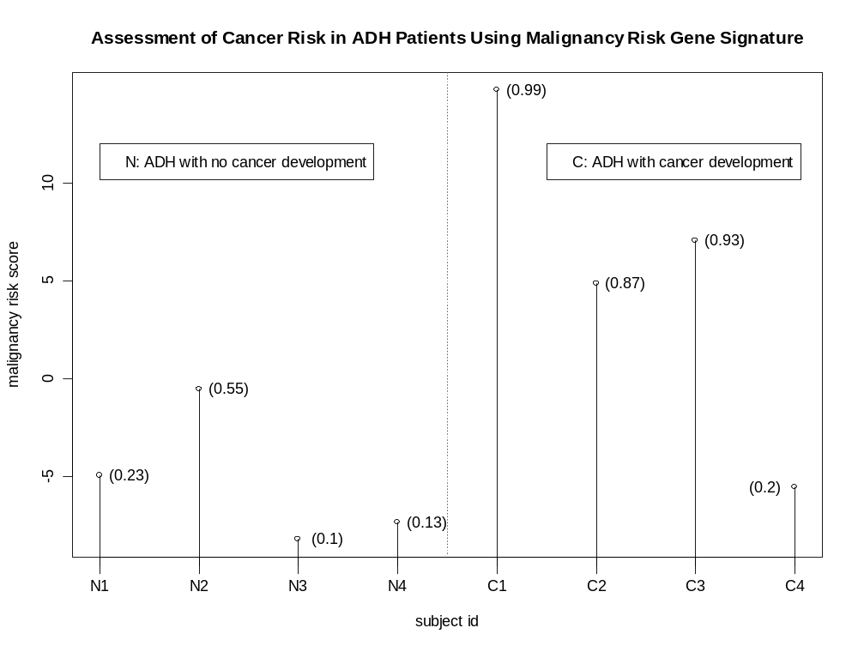
Cancer Development in ADH Study
Poola et al’s, 2005

Slide 25
Development of Outlier Statistics to Identify Outlier Genes
√
Biological outlier
QC outlier
Reference:
Distribution based p value for outlier sum in differential gene expression analysis. Chen et al., Biometrika, 2010

Slide 26

Cancer Outlier Profile Analysis (COPA)
Center at median.
Scale by the median absolute deviation (MAD).
COPA score: The k^{th} percentiles (e.g., 90%) of the transformed expression values
The COPA score is used as a criterion to select outlier genes.

Slide 27
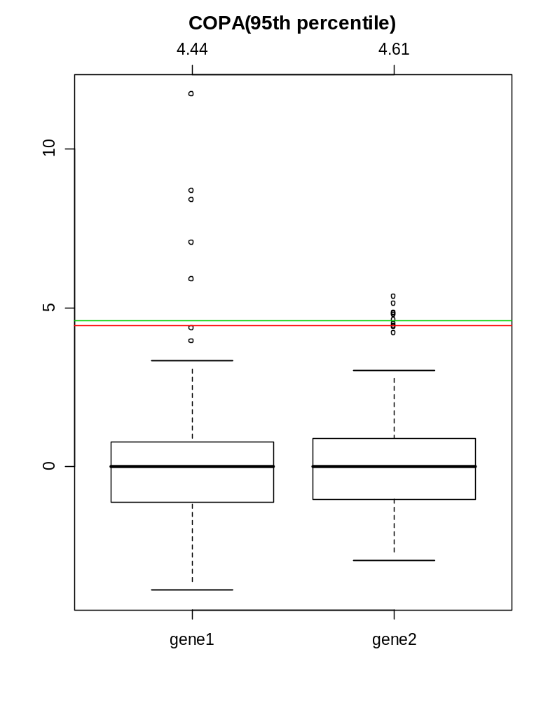
Limitation of COPA
(red)
(green)

Slide 28
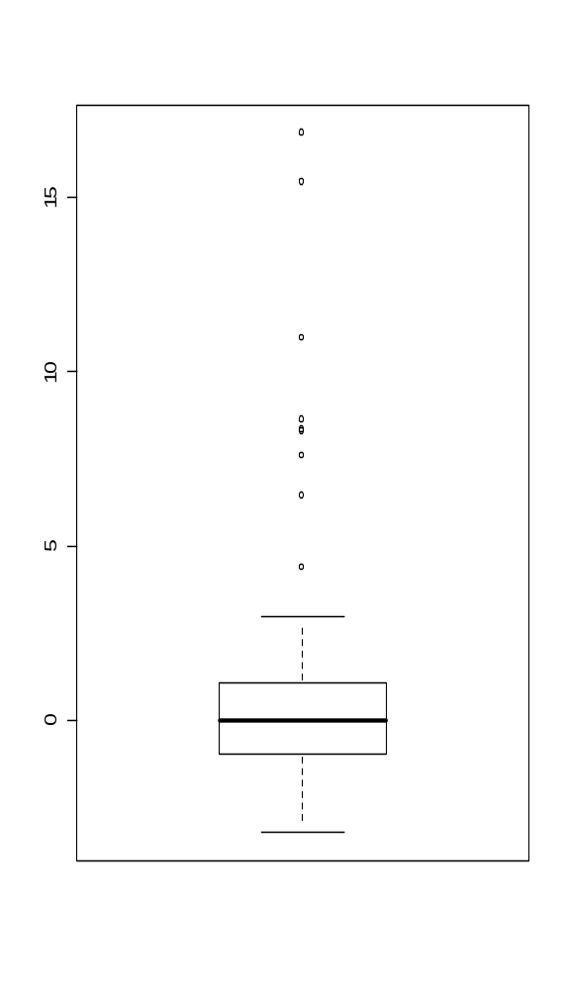
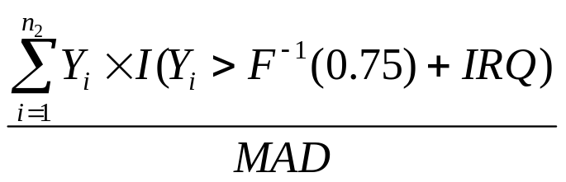
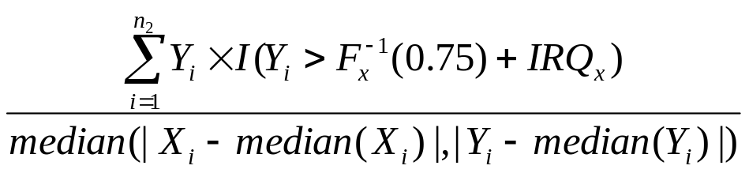
Other Outlier Statistics
Sum of Outliers
Outlier Sum (OS)
  by Tibshirani and Hastie (2007)
Outlier Robust t-statistic (ORT)
by Wu (2007):

Slide 29
Challenges for Existing Outlier Statistics
Sample size dependence
Difficult to determine a threshold for the test statistics to identify outlier genes.

Slide 30

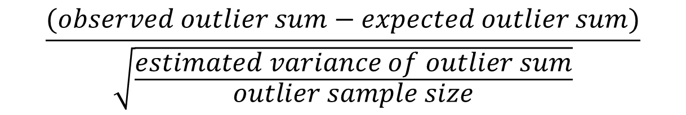
Distribution Based p Value for Outlier Sum (DPOS)
Outlier Statistics=
$$\frac{(observed outlier sum−expected outlier sum)}{\sqrt{\frac{estimated variance of outlier sum}{outlier sample size}}}$$
~ N(0,1)
Outlier statistics
Ref: Distribution based p value for outlier sum in differential gene expression analysis. Chen et al., Biometrika, 2010

Slide 31
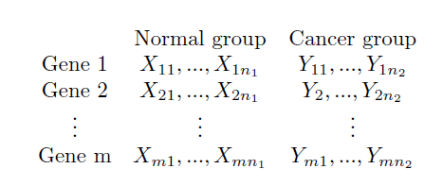
Simulation: Power Study
N(h,1)
N(0,1)
Simulation scheme (1,000 times)
Sample size: n1=20, n2=20
Gene size: m=1000 genes
X_{(i,j)} and Y_{(i,j)} ~N(0,1) except for the Gene 1

Slide 32
Simulation: Power Study (con’t)
Comparison of DPOS, t-test, COPA, OS, and ORT.
For DPOS and t-test:
  Collection of p value of the 1st gene at each simulation.
For COPA, OS, ORT,
  p value of the 1st gene:
  Proportion of the other (null) genes with the test statistics larger than the first gene.
Power is calculated at the corrected significance level of 0.05.

Slide 33
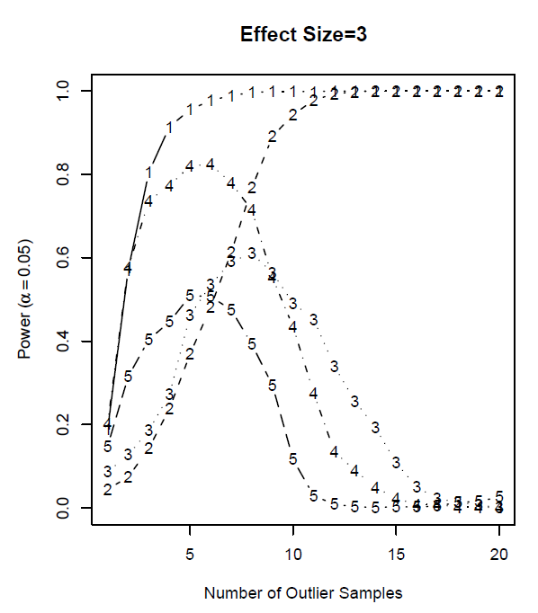
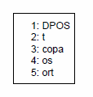
Result: Fixed Effect Size
Power

Slide 34
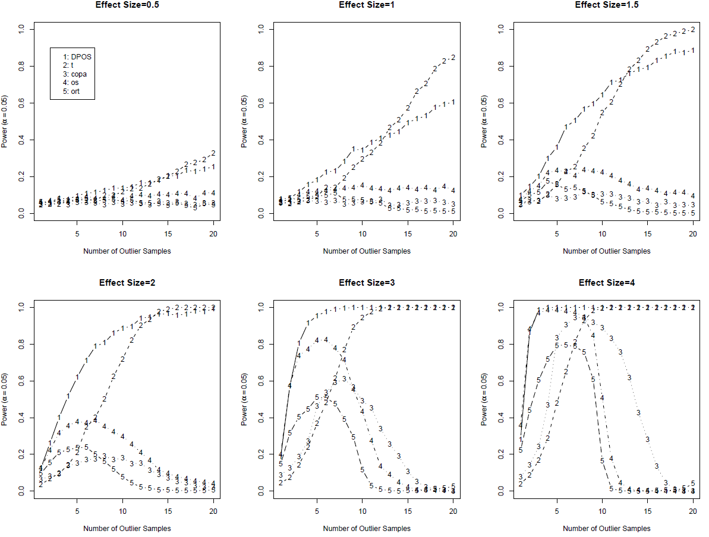
Cont

Slide 35
Clinical Association of MR Signature in Breast Cancer
Cancer Risk | • IDC vs. normal (p=0.03; Turashvili et al.)
 | • Relapse of primary cancer (p<0.0001; Chanrion et al.)
Disease Progression | • Normal, outlier normal, DCIS, IDC (r=0.87; p<0.0001; TCC)
 | • ADH, DCIS, IDC (r=0.50; p<0.0001; Ma et al.)
Prognosis | • Metastasis-free survival (p<0.0001; van’t Veer et al.)
 | • Metastasis-free survival (p=0.0004; Wang et al.)
 | • Lymph node positive (p=0.007; Hunag et al.)
How about other cancer types?

Slide 36
Clinical Association of MR Signature in Lung Cancer
References:
Chen et al. “Prognostic and Predictive Value of a Malignancy-Risk Gene Signature in Early-Stage Non-Small Cell Lung Cancer”. Journal of the National Cancer Institute. 2011 Dec 21;103(24):1859-70.

Slide 37
Applications in Precision Medicine
Longer survival
Poor survival
Courtesy use of Majewski and Bernards

Slide 38
External Dataset Validation:
Prognostic Signature
Molecular Classification of Lung Adenocarcinoma (MCLA) cohort from the Director Challenging Consortium study (N=442)

Slide 39
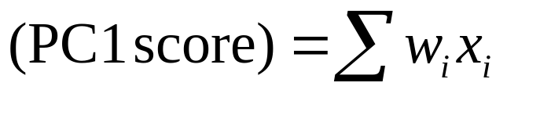
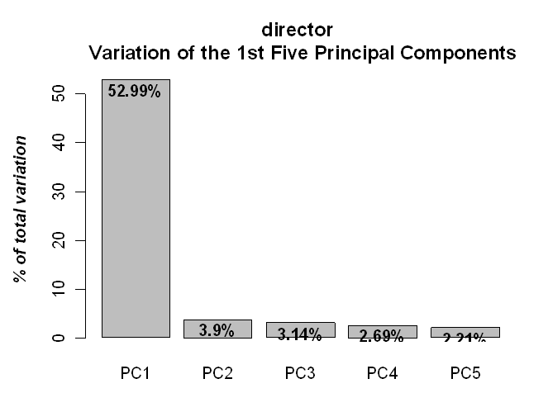
Calculation of Malignancy-Risk Score
Malignancy-risk (MR) score:
where x_{i}, a standardized MR gene expression and w_{i} as weight derived from 1st principal component’s (PC1) loading coefficient.
PC1 preserves most MR gene information
(effective data reduction)

Slide 40
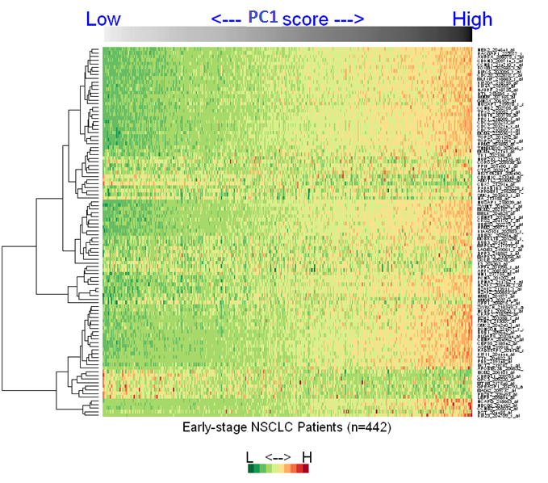
Molecular Classification of Lung Adenocarcinoma (MCLA) cohort from the Director Challenging Consortium study (n=442)
Median cutoff of PC1
MR genes
L-Risk
H-Risk
Patients

Slide 41
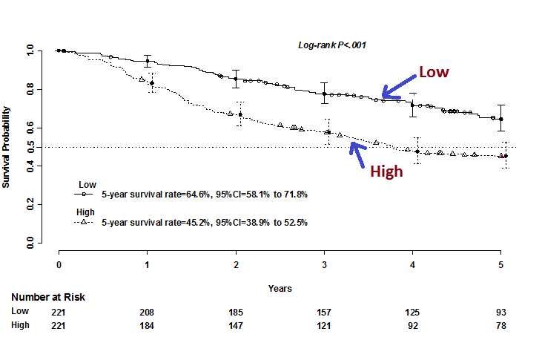
Prognostic Signature
Association of the malignancy-risk signature with overall survival (MCLA cohort: n=442)
MR Low
MR High

Slide 42
Applications in Precision Medicine
Longer survival
Poor survival
Courtesy use of Majewski and Bernards

Slide 43
External Dataset Validation:
Predictive Signature
JBR.10: A randomized phase III trial of adjuvant chemo therapy (ACT) versus observation (OBS) in completely resected stage IB and II non-small cell lung cancer
  ACT: n= 71
  OBS: n=62
Steps:
Calculate PC1 of the signature for each patient
Group patients based on low and high PC1 score
Compare ACT vs. OBS in high PC1 group
Compare ACT vs. OBS in low PC1 group
Evaluate interaction effect
Zhu et al, 2010

Slide 44
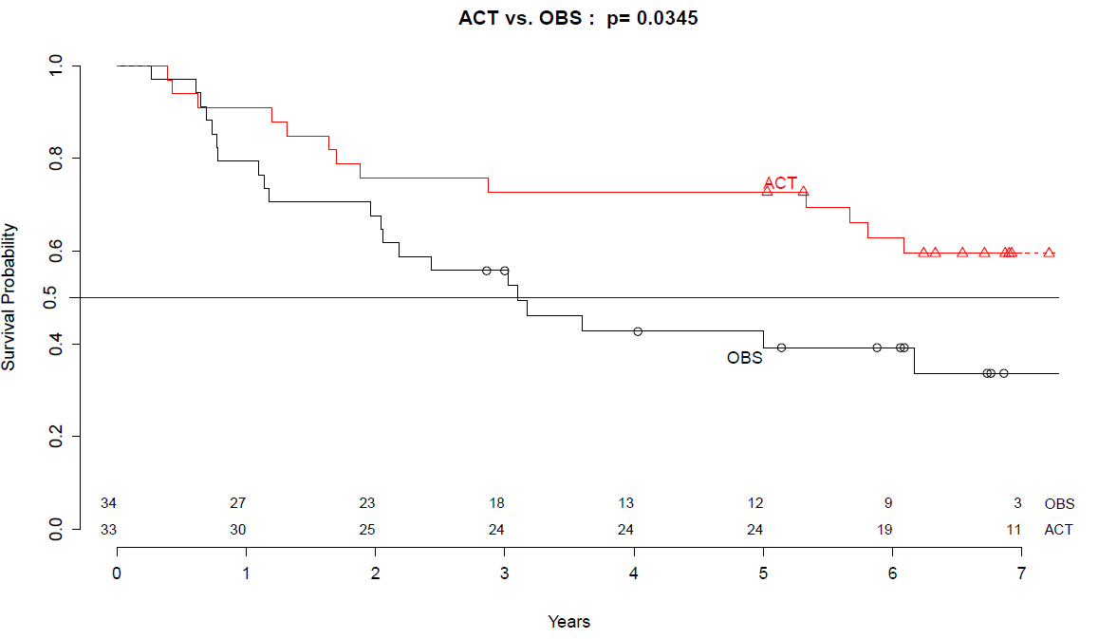
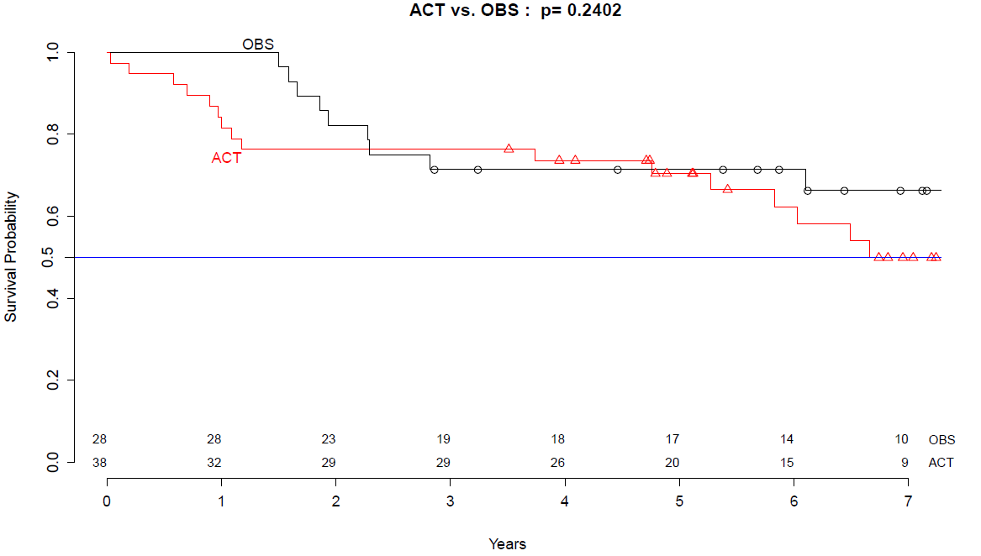
Predictive Signature (Cont)
High MR group:
Low MR group:
P=0.03
P=0.24
ACT
OBS
ACT
OBS

Slide 45
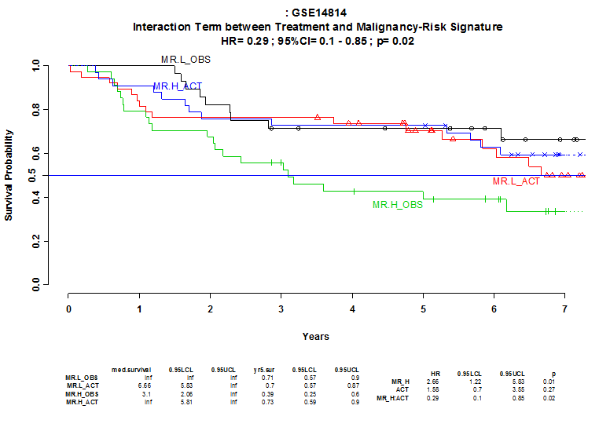
Predictive Signature (Cont.)
Combine both low and high PC1 groups:
Interaction Effect (HR=0.29; p=0.02).
MR.L: Low MR;
MR.H: High MR;
ACT: group with ACT
OBS: group without ACT.

Slide 46
A MR Sibling Gene Signature:
E2F Signature (PI: Dr. Cress)
Funded by the James and Esther King Biomedical Research Program Grant (5JK06)

Slide 47
From Bench to Bedside
Discovery Stage
Test Validation Stage
Clinical Utility Stage

Slide 48
Flow Chart of Development and Validation of E2F Signature
Discovery Stage:
E2F siRNA in Cell Lines Microarray
Tumor/Normal Comparison
Nanostring Optimization (E2F signature: 74 genes)
Validation Stage:
 | Microarray/RNA-seq (FF) | NanoString (FFPE/FF)
Prognostic effect (predict risk) | TCC, TCGA, MCLA, JBR10 | TCC, NATCH, DOD
Predictive effect (predict treatment) | JBR10* (Cisplatin/Vinorelbine) | NATCH* (Carboplatin/ Paclitaxel)
* JBR10 and NATCH both are two-arm randomized trial

Slide 49
A Prognostic E2F Signature (Microarray/RAN-Seq in FF Tissue)
Moffitt Cohort: p<0.001
TCGA Cohort: p=0.04
Low
Low*
High
High**
*Low E2F
**High E2F
Director Cohort: p<0.001
JBR10 Cohort: p=0.01
Low
Low
High
High
Notes:
All-stages, microarray/RNA seq, 74 genes
Slide 3

Slide 50
A Prognostic E2F Signature (NanoString in FF/FFPE Tissues)
Moffitt Cohort (FFPE): p=0.002
DOD Cohort (FF): p=0.02
Low*
Low
High**
High
*Low E2F
**High E2F
Low
NATCH Cohort (FFPE): p=0.03
High
Notes:
All-stages, microarray/RNA seq, 74 genes
Slide 3

Slide 51
A Predictive E2F Signature of Adjuvant Chemotherapy
JBR10: High E2F (p=0.03)
NTACH: High E2F (p=0.02)
Microarray (FF)
NanoString (FFPE)
ACT
ACT
Non-ACT
Non-ACT
JBR10: Low E2F (p=0.25)
NTACH: Low E2F (p=0.62)
ACT
Non-ACT
ACT
Non-ACT
Notes:
All-stages, microarray/RNA seq, 74 genes
Slide 3

Slide 52
Two-Stage Design for E2F Signature Validation in NSCLC Neo-Adjuvant Chemo Trial
Target Population: NSCLC
Treatment: Neoadjuvant Chemotherapy (single arm)
Primary endpoint: Pathological Response (PR)
Gene Signature: E2F signature

Slide 53
Challenges
The signature has not been tested in this population
  How to evaluate the association and validation for the signature in this observational trial design?
How to classify sensitive subgroup in this patient population:
  What is the right cutoff to determine if a patient could respond to the treatment?

Slide 54
Classic Design
Association Design:
  Test association of E2F and Pathological Response (PR)
  (Compare E2F score between responders and non-responders)
  Prior to treatment: measure E2F score for each patient
  Post to treatment: measure response for each patient
  Association evaluation:
  Logistic regression or two-sample t-test
  A passive approach
  Issues: (1) Association, not Validation
  (2) Unable to classify patient’s sensitivity to treatment

Slide 55
Our Innovative Design
Integration of ‘Association Design’ and ‘Validation Design’.
Split patients into two phases
  Phase I: Association Design
  Phase II: Validation Design

Slide 56
1st stage (training set: n=50)
  Test association of E2F and Pathological Response (PR)
  (Compare E2F score between responders and non-responders)
P<0.05: Validation phase
P>0.05: Exploration phase
  Determine the cutoff of E2F score
2nd stage (validation set: n=50: 25 sensitive and 25 non-sensitive)
  2nd stage (training set: n=50)
  Combine 1st and 2nd stages cohorts: Test association of E2F and PR
  (Compare E2F score between responders and non-responders)
  Test predictiveness of E2F in PR
  (Compare response rate
  between sensitive and non-sensitive groups)
P<0.05
P>0.05
P<0.05
P>0.05
Signature Validated
Signature Not Validated
More Exploration Needed

Slide 57
1st stage (training set: n=50)
  Test association of E2F and Pathological Response (PR)
  (Compare E2F score between responders and non-responders)
P<0.05: Validation phase
P>0.05: Exploration phase
  Determine the cutoff of E2F score
2nd stage (validation set: n=50: 25 sensitive and 25 non-sensitive)
  2nd stage (training set: n=50)
  Combine 1st and 2nd stages cohorts: Test association of E2F and PR
  (Compare E2F score between responders and non-responders)
  Test predictiveness of E2F in PR
  (Compare response rate
  between sensitive and non-sensitive groups)
P<0.05
P>0.05
P<0.05
P>0.05
Signature Validated
Signature Not Validated
More Exploration Needed

Slide 58
Statistical Simulation
Historical data: 20% response rate in NSCLC
Response data ~ Bernoulli distribution(p=20%)
Hypothesis for distribution of the signature score
  Non-responder: Norm(µ,1)
  Responder: Norm(µ+ d,1)
Evaluate how the mean difference, d, affects power and sample size

Slide 59
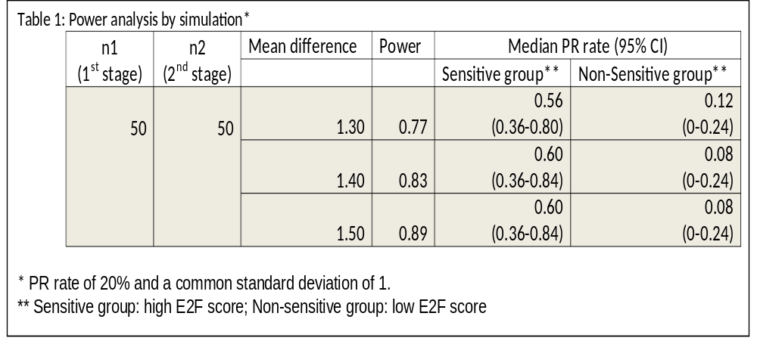
Power Analysis

Slide 60
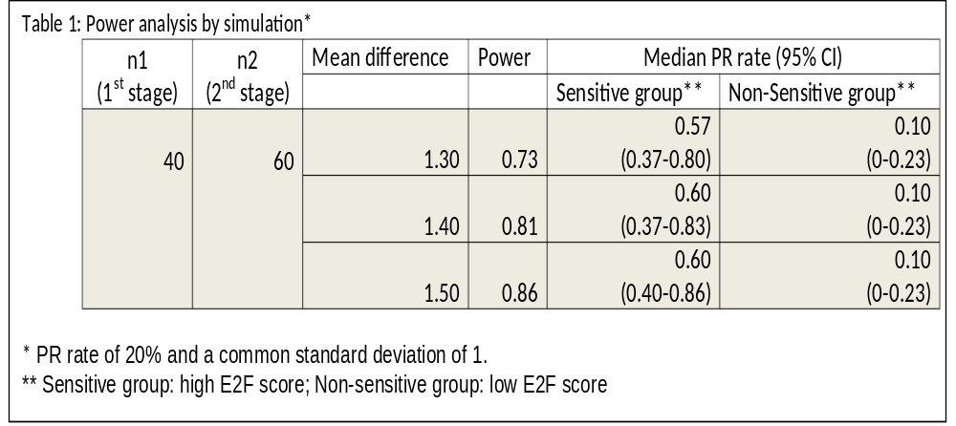
Power Analysis (Cont.)

Slide 61
Near Future Plan
Key Members | Task
Cress, Chiappori, Magliocco, DT Chen | CLIA Assay Development for Clinical Applications
Plan | NCI’s UH2-3
Cress, Chiappori, DT Chen | MR/E2F Signature Validation in Neo-Adjuvant Chemo Trial for Lung NSCLC
Plan | R01

Slide 62
Application to Other Team Science Projects in Gene Signature Development
PI | Other Team Science Projects
Dr. Malafa | A prognostic fifteen-gene signature in pancreatic cancer
Dr. Wey | A microRNA signature in pancreatic cancer
Dr. Catherine Lee | MR signature in predicting breast cancer risk
Dr. Beg | NF-KB signature in lung cancer*
Dr. Lancaster | BAD signature in ovarian cancer*
Dr. Coppola | Senescence gene signature in brain cancer*
Dr. Shain | Gene expression profiling of multiple myeloma
*: patent awarded

Slide 63
Summary
Involvement of translation team science from bench to bedside:
Genomic profile development
  Discovery phase: MR and E2F signatures
  Validation phase: Design of external cohorts and validation analysis.
  Clinical utility phase: Trial design for signature validation
Clinical trial design
  Innovative designs to advance clinical science

Slide 64
Analysis of Image Data
Large volume of correlated variables in processed data
Example: A brain tumor (GBM) study
Data:
  Outcome: recurrent free survival time
  Processed Image Data
    Many types of habitat features (e.g., voxel count, percentage, volume, habitat contrast)
    Each habitat feature containing multiple levels of variables (e.g., level 1-32).

Slide 65
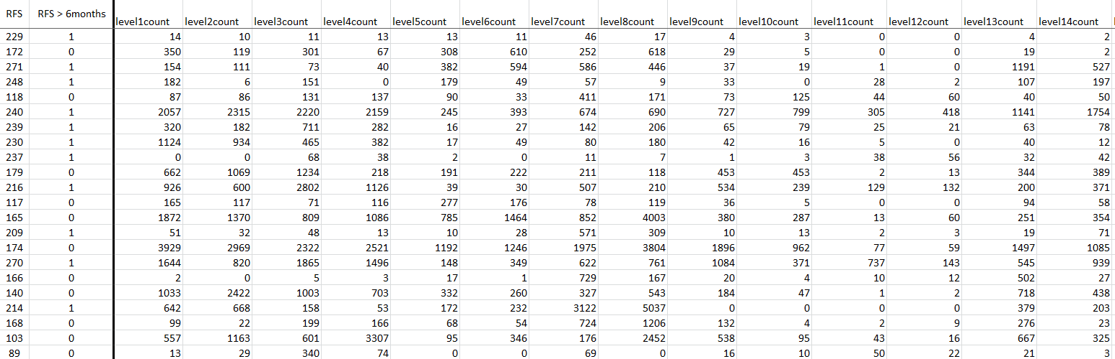
Snapshot of One Habitat Feature (Count)

Slide 66
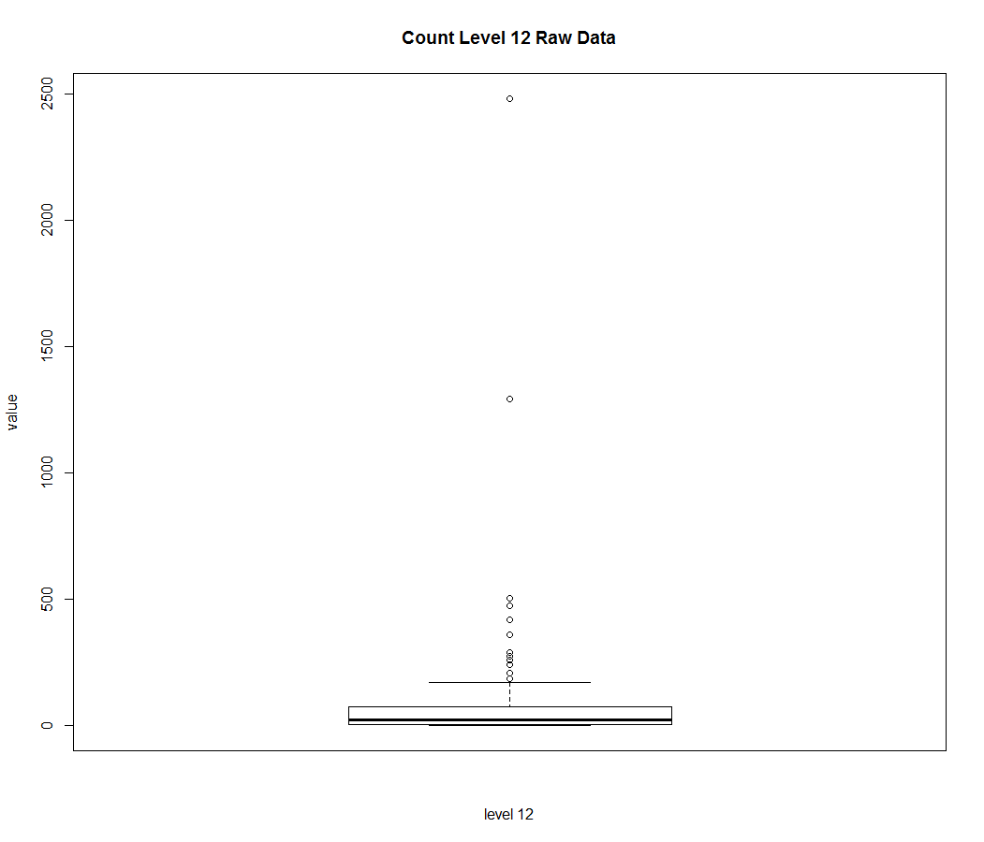
Distribution of Level 12 Data
High Skewness
Log or BoxCox Transformation?
But 14% Zero Value?

Slide 67
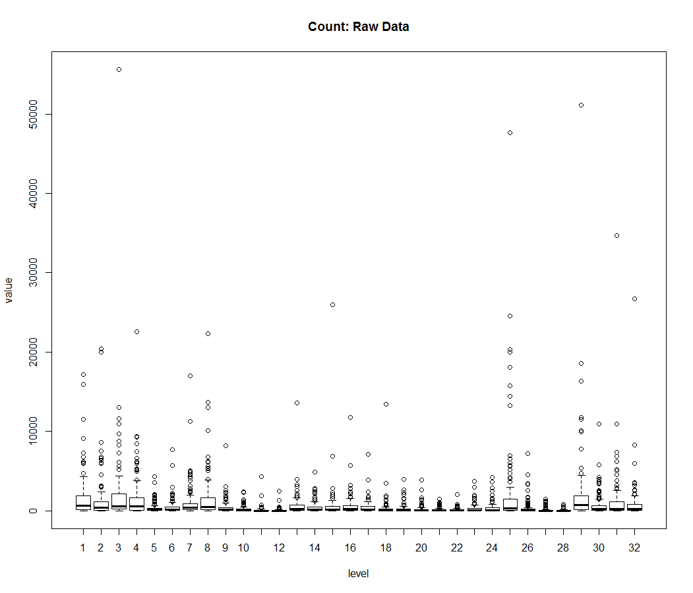
Distribution of All Level Data
How to Take Care of All Data?

Slide 68
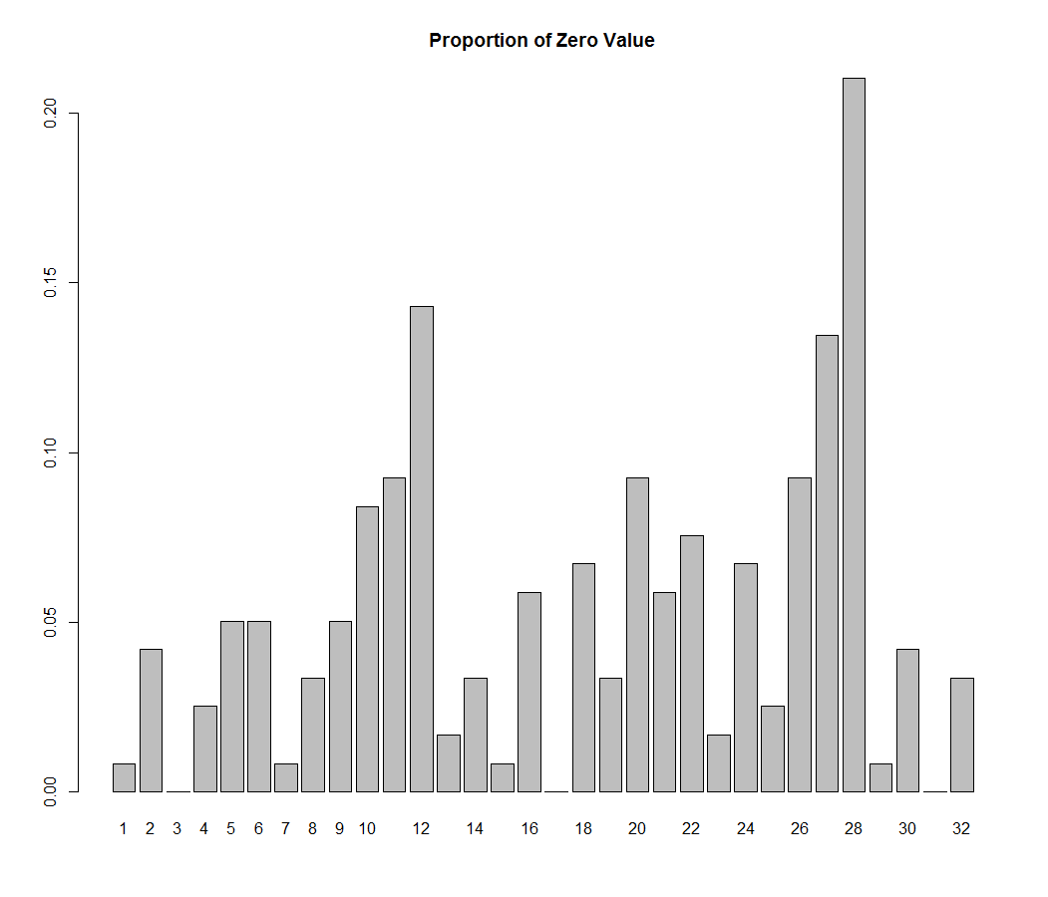
Distribution of Zero Value

Slide 69
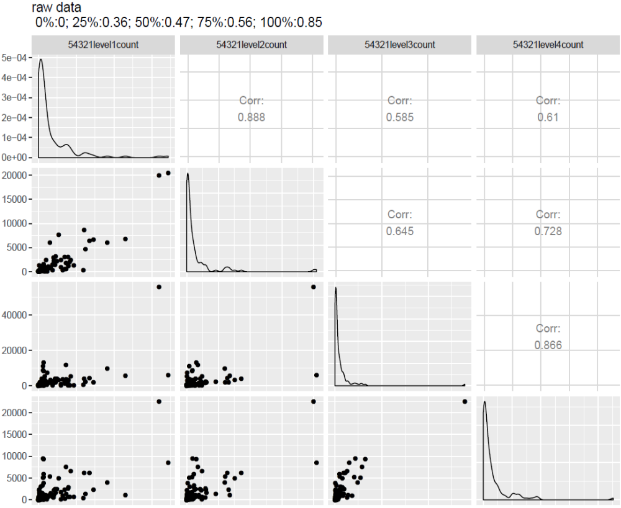
Another Issue: Correlated Image Data

Slide 70
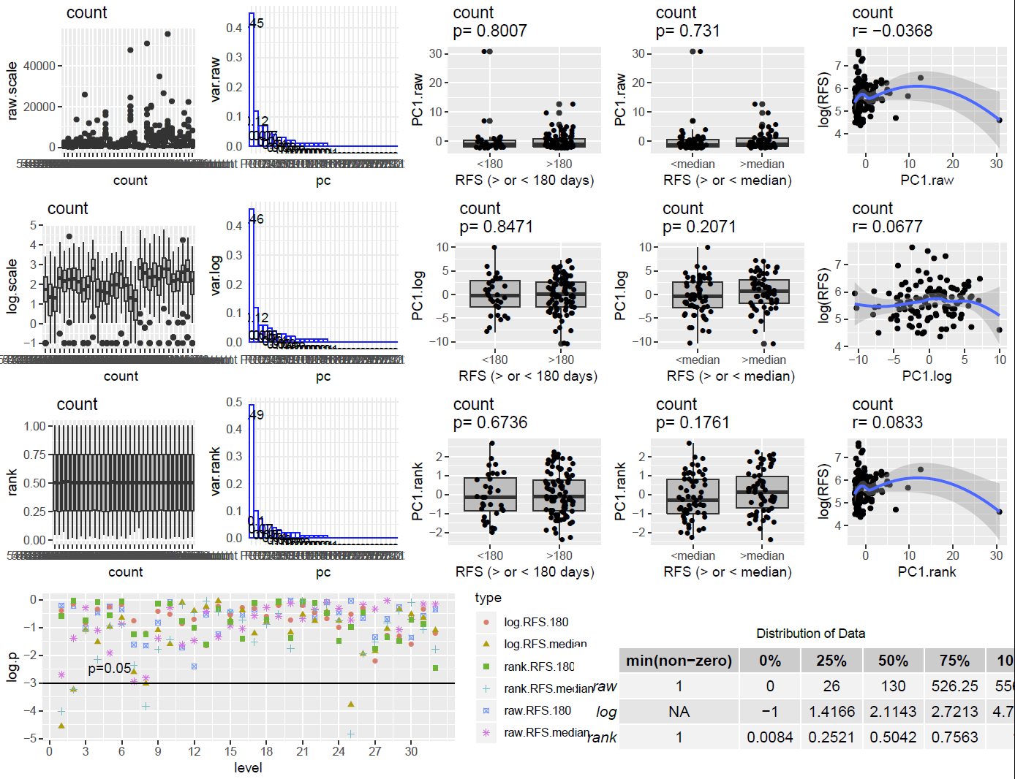
Analysis Strategy
Evaluation of Transformed Data
Data Reduction
Outcome Association
c
Analysis of Individual Level Data

Slide 71
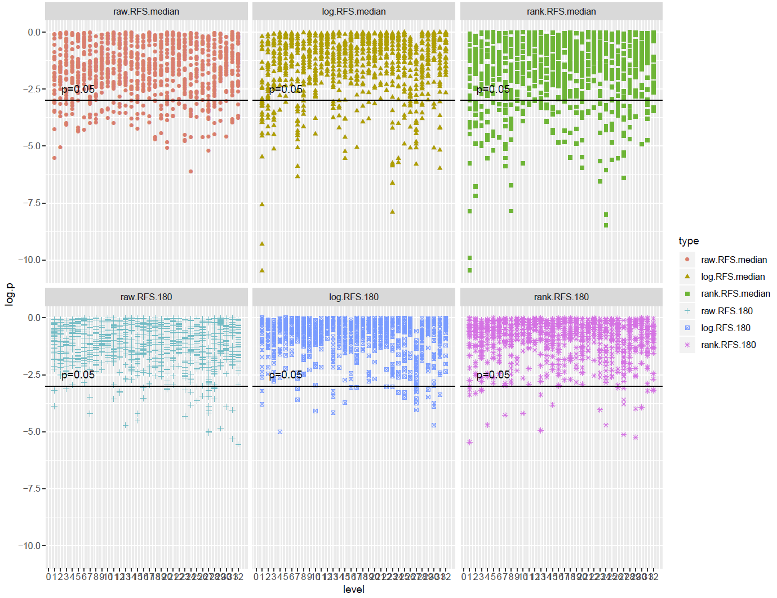
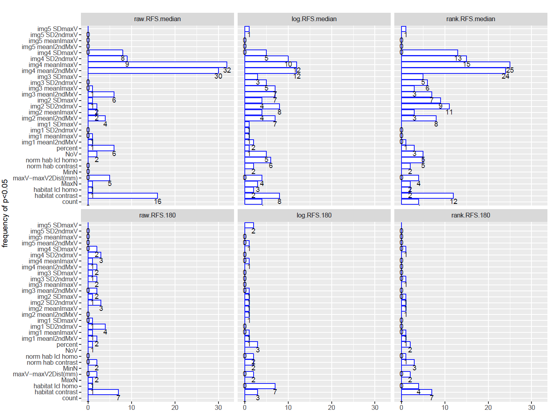
Analysis of P Value of All Habitat Features
Comparison of Transformation and Outcomes
Identification of Key Habitat Features
Many Level Data with P<0.05
Improved by Transformed Data

Slide 72
Near Future Work
Comparison to machine Learning methods
Integration with machine Learning methods

Slide 73
Questions/Comments

