Slide 1
Inference Integrity in Wireless Networks
Zhuo Lu,
Electrical Engineering / FC2
University of South Florida

Slide 2
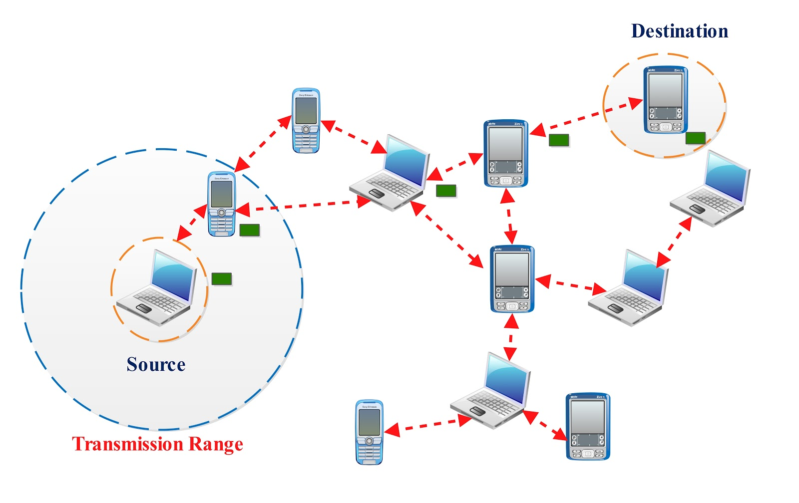

Proactive Network Security
feasibility
efficiency
security
Traditional security ➔ reactive/passive defense
Find the best application domains of being proactive in wireless network designs
We take a fundamental approach to quantitatively understand the benefits of being proactive in wireless networks

Slide 3
Case Studies
1. Protecting network flow information against inference attack (network anti-inference)
2. Scapegoating attacks in network tomography

Slide 4
Case I
Case I: Protecting network flow information against inference attack (anti-inference)

Slide 5
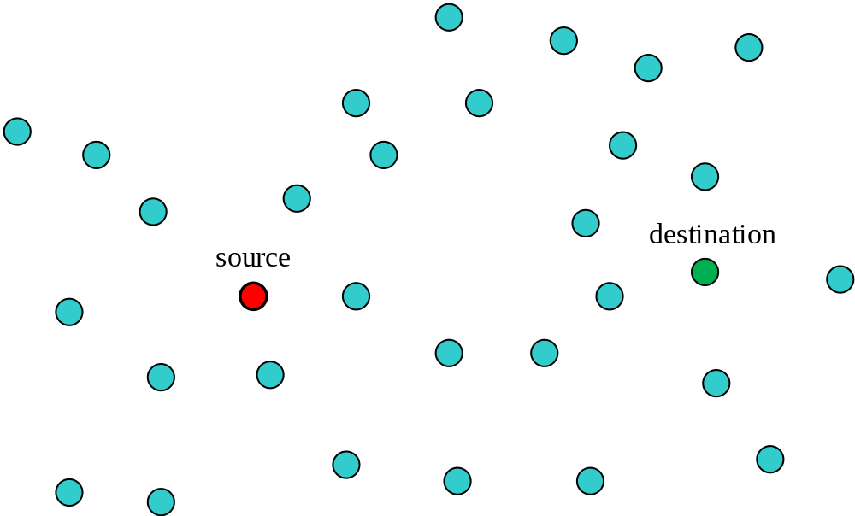
Multi-hop Wireless Network: Feasible Design
Example

Slide 6
Multi-hop Wireless Network: Optimized Design
Example

Slide 7
Multi-hop Wireless Network: Security Design
Prevent Eavesdropping
  Data content
  Connectivity/flow?

Slide 8
Strategy to Protect Connectivity Information
Understand attacks
  How malicious attacks can know the connectivity information, what is the worst-case attack?
Analyze potential strategies against attacks
  Limit the performance cost
  Measure the security impact

Slide 9
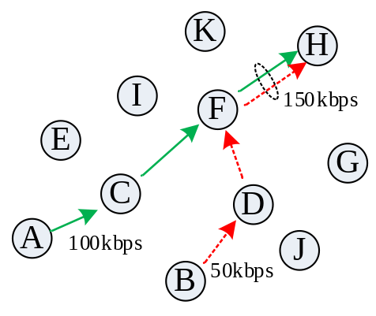
How to Know Connectivity Info
Network inference
  Sensing the wireless transmission
    Extracting who it transmitting to whom at low layers
  Building a relationship between link and flow information. Then, inferring flow info from link info.
Applications: fault diagnose, network monitoring, flow detection, …
  can also be used for malicious purpose.

Slide 10
Inference: Problem Formulation
Flow inference formulation: y = Ax
  y – link rate vector: observed by attackers
  x – flow rate vector: to be estimated
  A – routing matrix: known network info
Given A and y, estimate x
  Usually an under-determined system
  So no least squares solution!

Slide 11
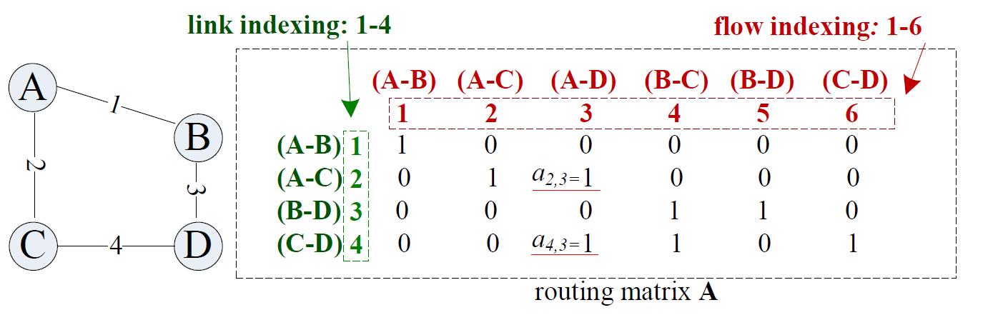
How to Get Routing Matrix A
Example:

Slide 12
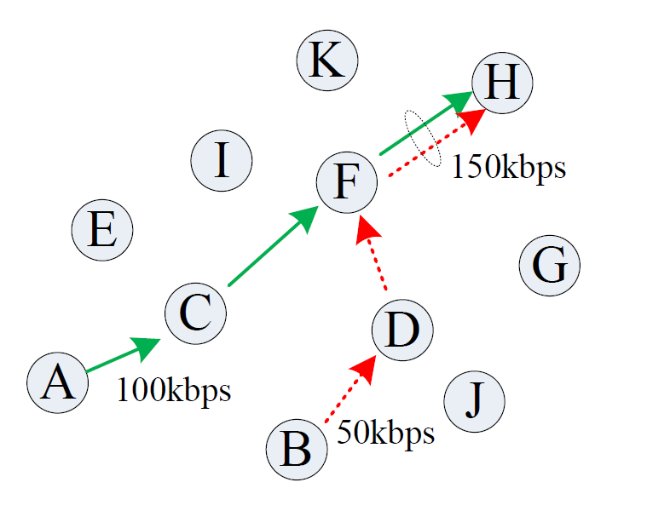
Example
Observing link transmissions (knowing y)
  11 nodes, 2 flows, y=Ax ➔ get x from y.
  Inference Result: A→H: 100kbps, B→H: 50kbps

Slide 13
How to Beat Inference Attack?
Two underlying assumptions for inference
Link traffic is only induced by network flows
  No flow → no link traffic
Routing is usually predictable
  E.g., shortest path routing.
To break at least one of these assumptions,
we have to be proactive!

Slide 14
Deception/Honey Traffic
Link traffic is only induced by network flows
  No flow → no link traffic
Every node randomly transmits some redundant traffic
All nodes transmit some redundant traffic in a coordinated way
Deception Traffic Strategy (Proactive)

Slide 15
Routing Changing
Routing is usually predictable
  E.g., shortest path routing.
Dynamically change routing paths to make sure the attacker has some information mismatch
Routing Changing Strategy (Proactive)

Slide 16
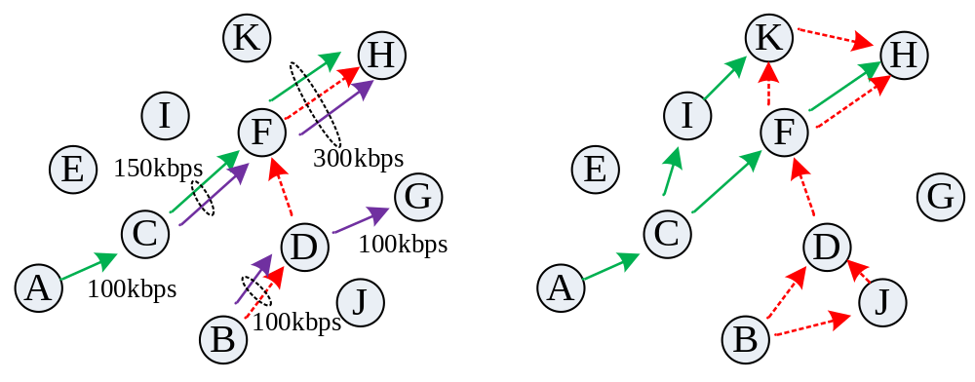
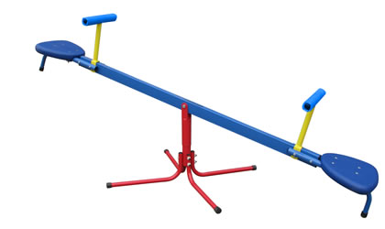
Fundamental Problem
Yes, we may confuse the attacks from properly inferring the connectivity information
  But ……
Deception traffic
Routing changing
security
efficiency

Slide 17
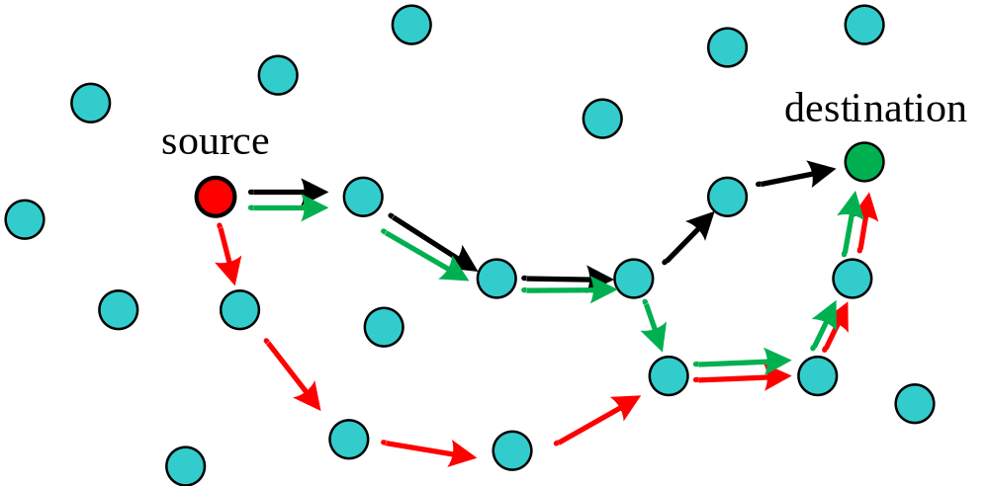
Research Goals
How proactive strategies improve security at a limited cost of efficiency?
  Improve security
  Limit the cost of efficiency

Slide 18
Formulation under Proactive Strategies
Original formulation:
  y = Ax
Deception Traffic:
  Add noise: y = Ax + J (← deception traffic vector)
Routing Changing:
  Information mismatch: changing routing means routing matrix A → B (← new routing matrix)

Slide 19
Metric to Measure Security Benefit
Metrics to measure the accuracy of network inference? Genie bound: lower bound of error in all possible methods.
    Assuming the attacker knows who is transmitting,
    Then using minimum mean squared error estimation to estimate all the flow rates.
Error of inference
… …
Method 1
Method 2
Genie bound

Slide 20
Genie Bound
We want to see how much the genie bound can be increased due to deception traffic and routing changing with limited costs.
Error of inference
Genie bound under proactive defense
Genie bound

Slide 21
Limit the Costs
  Deception Traffic: y = Ax + J
  |J|/n, or E|J|/n (average deception traffic per node) is smaller than a constant, where n is the number of nodes in the network.
Routing Changing: A → B
  We have a random geometric graph model, all nodes are randomly distributed.
  A and B are random matrices.
  How to model the routing changing ??

Slide 22
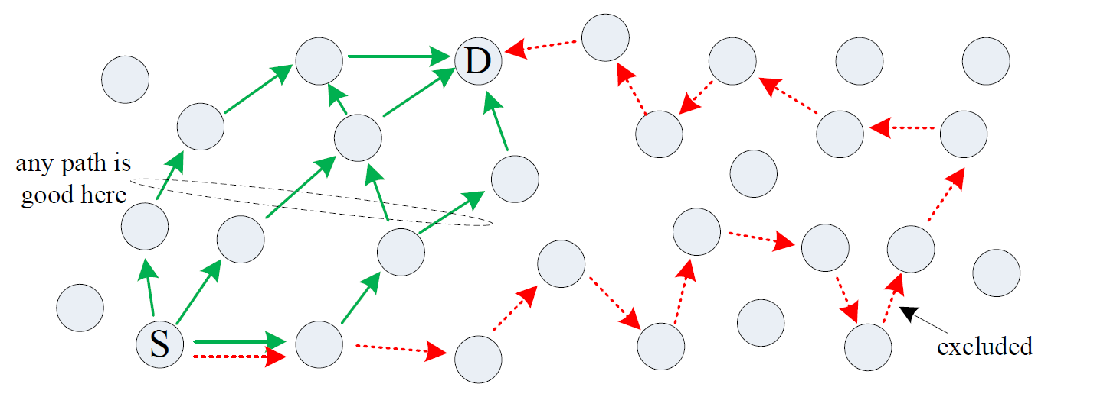
Routing Modeling
(from Scaling Law)
Model: Under any routing strategy, the average number of hops between any source-destination pair is denoted by a function g(n) satisfying g(n) = O(n), where n is the number of nodes in the network
  Existing K-shortest path routing satisfies this model.

Slide 23
Routing Modeling (cont’d)
Quantifying the cost of routing changing:
  The original routing changing: g(n)
  The new routing changing: h(n)
  The cost is h(n)/g(n),
  where n is the number of nodes in the network.
  Limit the cost: Θ(h(n)/g(n)) = Θ(1),

Slide 24
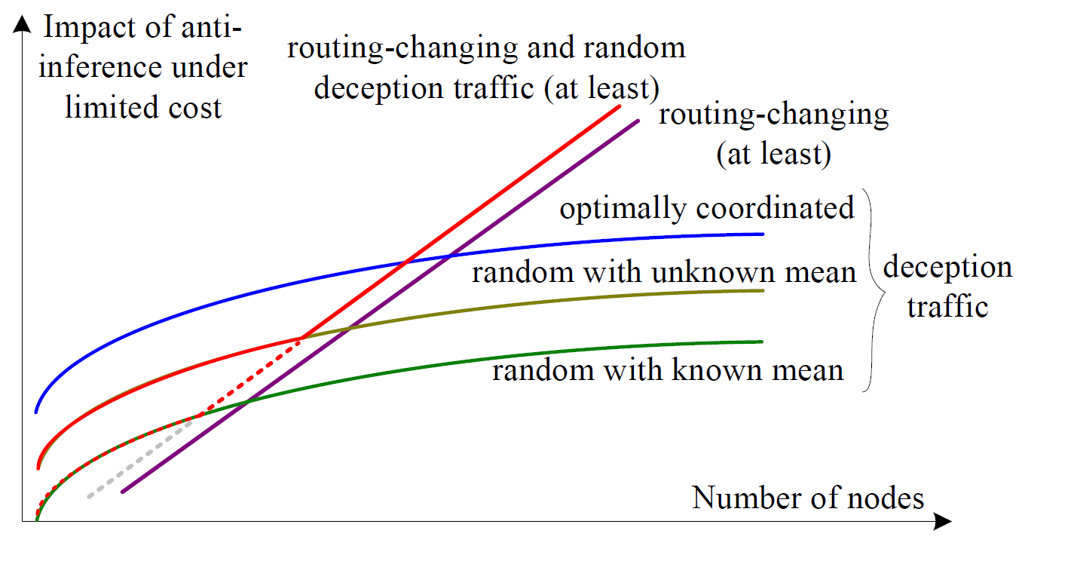
Theoretical Result: An Example
In a network with n nodes, Θ(n) random network flows/connectivities.

Slide 25
Case I
Case II: Scapegoating Attacks in Network Tomography
(in both wireline and wireless scenarios)

Slide 26

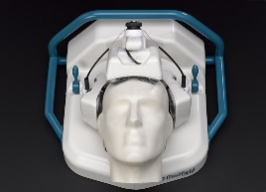
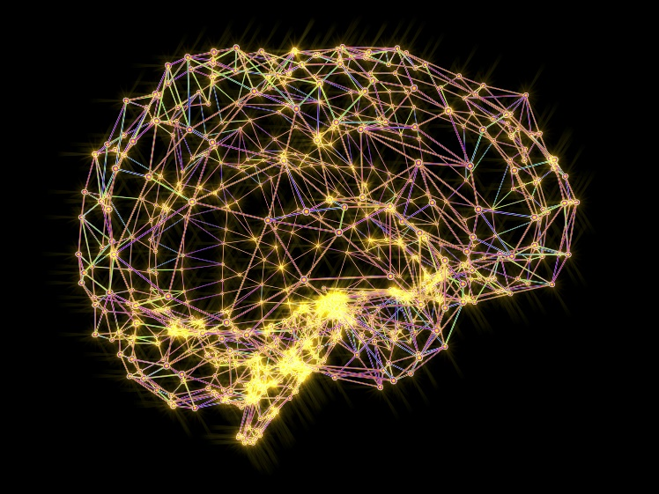
Move to Network Tomography
Motivation:
If we can’t see what’s going on in a network directly, how to measure the network performance?
Brain Tomography
Direct access is difficult

Slide 27
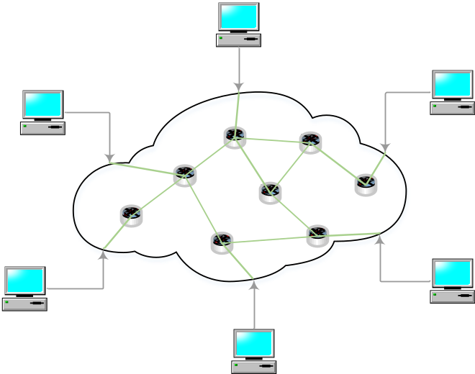
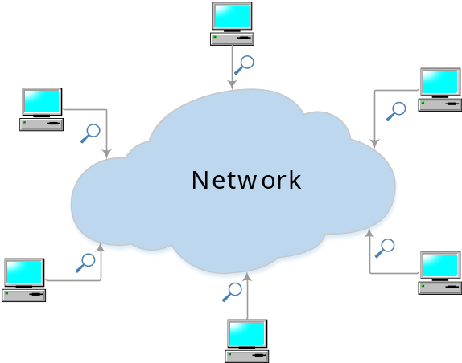
Move to Network Tomography
Motivation:
If we can’t see what’s going on in a network directly, how to measure the network performance?
Network Tomography
Direct access is difficult

Slide 28
Move to Network Tomography
Definition:
Study internal characteristics (e.g. link delay) of the network from external measurements (e.g. path delay).
  infer the link performance from end-to-end path measurements.
Applications: discovering in a network
  Link failures
  Node failures
  Performance bottleneck
  Potential security attacks

Slide 29
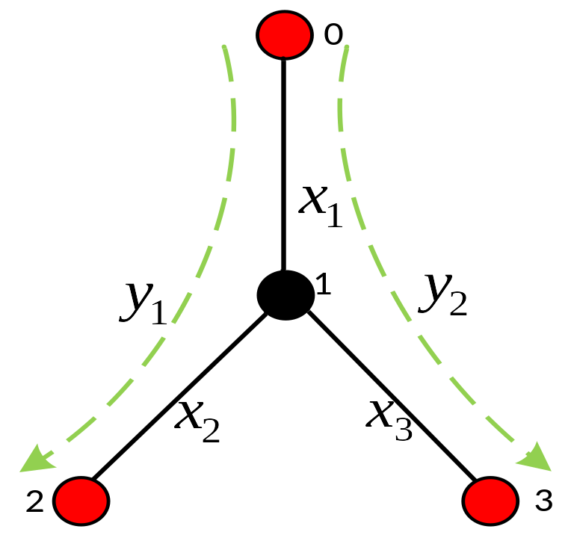
Basics in Network Tomography
Why we can infer internals via externals
Delay example:
  Nodes 0, 1, 2, 3
  End-nodes: 0, 2, 3
    We can only perform measurements
    between these end nodes.
    These nodes are called monitors
  Link delays:
    x1, x2, x3
  End-to-end path delays:
    y1, y2, y3
Key observation in network tomography
  There is a relationship between x and y.
  Objective: Given y, get x.
1ms
3ms
2ms
y3

Slide 30
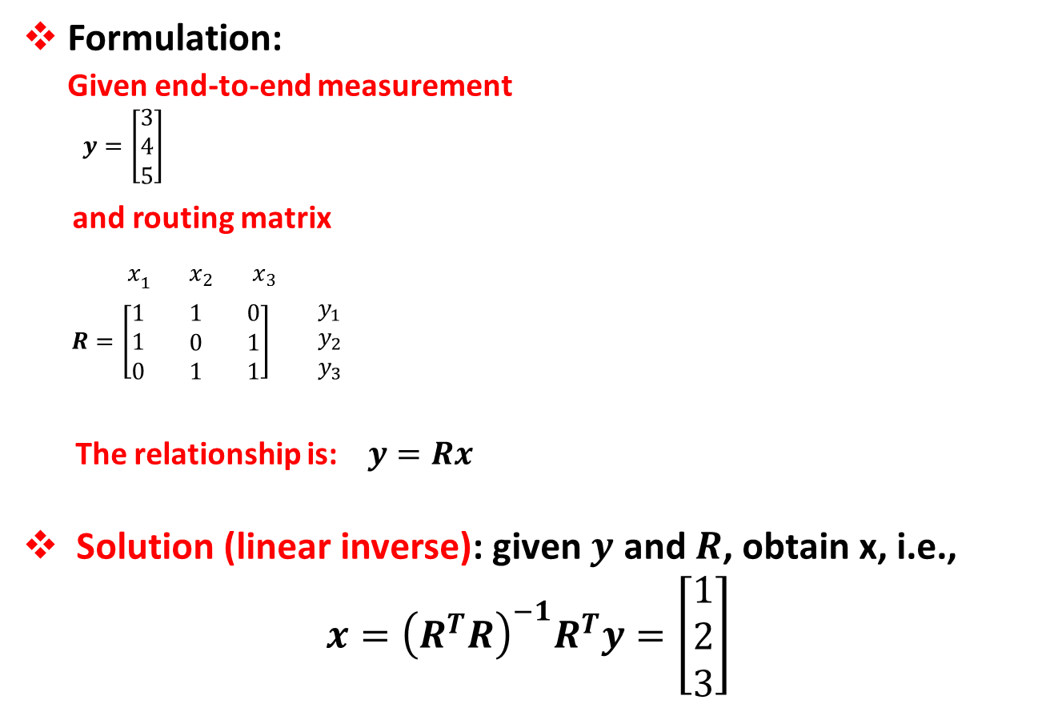
Formulation of Network Tomography (⬅➔ Network Inference)
Formulation:
Given end-to-end measurement
  $$y=\left[\begin{matrix}3 \\ 4 \\ 5\end{matrix}\right]$$
  and routing matrix
  $x_{1}$ $x_{2}$ $x_{3}$
  $R=\left[\begin{matrix}1 \\ 1 \\ 0\end{matrix}\begin{matrix} 1 \\ 0 \\ 1\end{matrix}\begin{matrix} 0 \\ 1 \\ 1\end{matrix}\right]\begin{matrix} y_{1} \\ { y}_{2} \\ y_{3}\end{matrix}$
  The relationship is: $y=Rx$
Solution (linear inverse): given $y$ and $R$, obtain x, i.e.,
$$x={\left(R^{T}R\right)}^{−1}R^{T}y=\left[\begin{matrix}1 \\ 2 \\ 3\end{matrix}\right]$$
1ms
3ms
2ms
y3

Slide 31
Traditional Attacks
Packet dropping attack:
Intentionally drop or delay packets routed to the malicious nodes.
  Black hole attack
  Grey hole attack
Weak Point
Very easy to be detected.
Find out the links which always suffer bad performance under network tomography.
delay all packets!
y3

Slide 32
Security Concerns
Current attack models are blind, brute-force
  Less sophisticated
Can an attacker do a better job?
Key Assumption in Network Tomography:
  Seeing is believing
Measurements indeed reflect the real performance aggregates over individual links.
does not always hold in the presence of a more sophisticated attack !!!

Slide 33
Scapegoating Attack
Key Idea:
Attackers cooperatively delay or drop packets to manipulate end-to-end measurements such that
  The network is damaged
  A legitimate node is incorrectly identified by network tomography as the root cause of the problem (thereby becoming a scapegoate).
The tomography can be deceived by attackers !

Slide 34

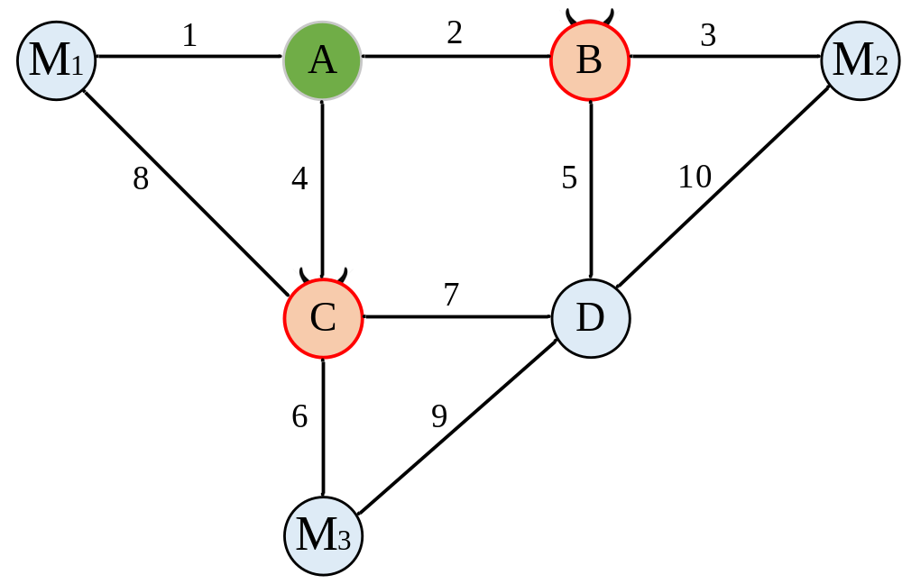
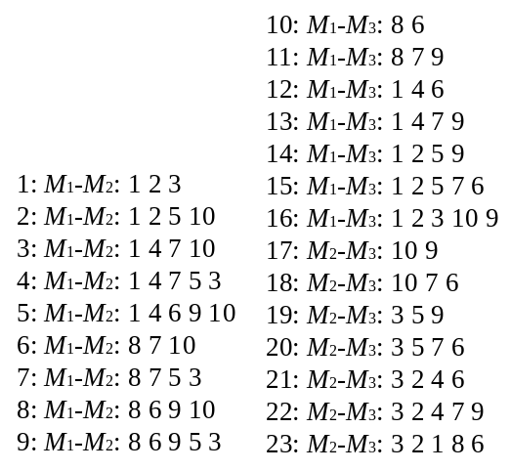

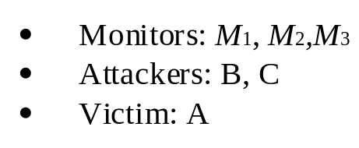
Intuition: Scapegoating Attack
M1: I can’t reach M2 through A!
B: Drop !!

Slide 35

Intuition: Scapegoating Attack
M1: I can’t reach M3 through A!
C: Drop !!

Slide 36
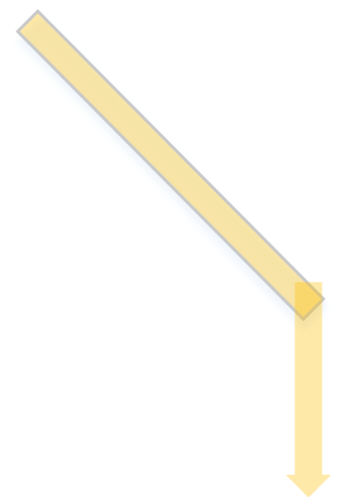
Intuition: Scapegoating Attack
M1: I can reach M3 through C!
Delivered

Slide 37

Intuition: Scapegoating Attack
All packets through A are blocked.
All packets do not pass A are delivered.
A must have some problems.

Slide 38
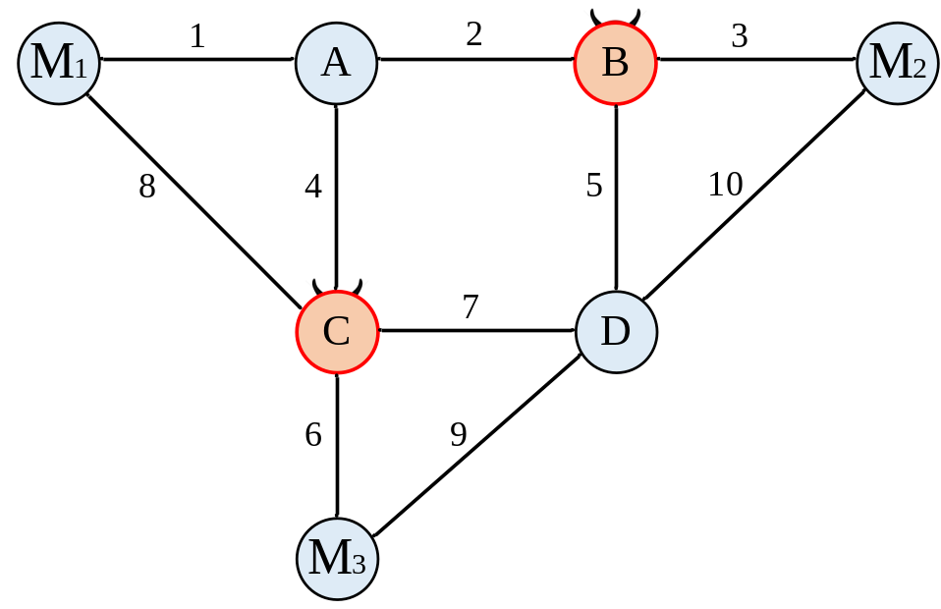

Possible Strategies
Strategies:
  Chosen-Victim Attack
    Victim set is already given.
  Maximum-Damage Attack
    Find best victim sets for the maximum damage in the network
  Obfuscation
    Make every link look mostly similar without evident outliers.

Slide 39
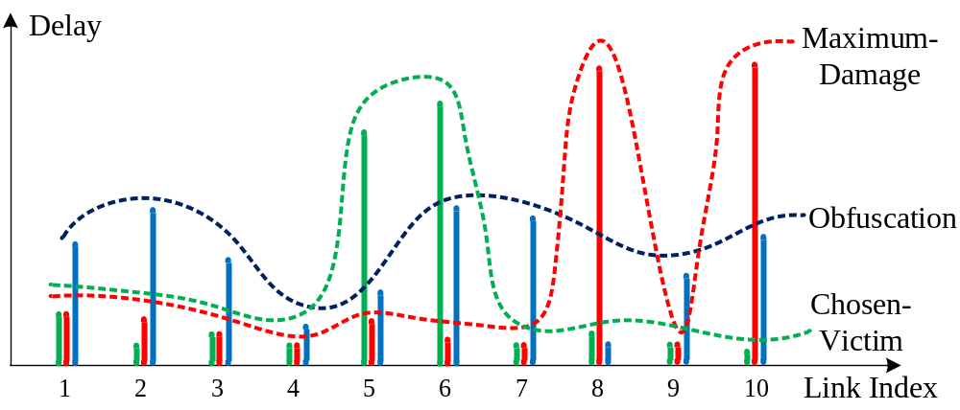
Possible Strategies: Examples
Strategies:
Example of three attacks

Slide 40
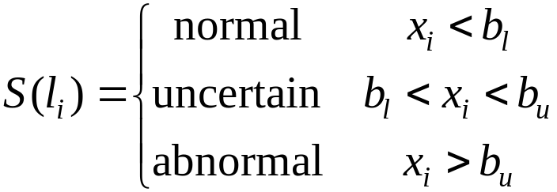



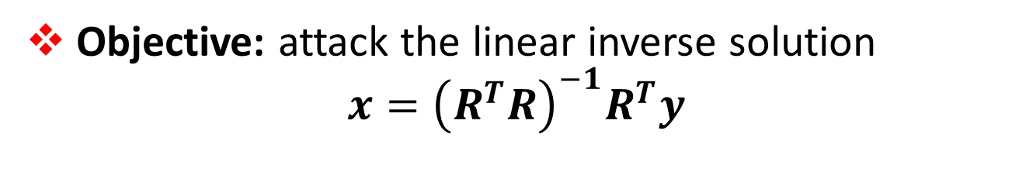
Convert Intuition into Formulation
Objective: attack the linear inverse solution
$$x={\left(R^{T}R\right)}^{−1}R^{T}y$$
Things significantly go wrong after inverse!
manipulated measurement
Formulation:
  Definition: wrong or right link state
    is the performance of link .
    and are the lower and upper bound.
  Definition: link set
    is the victim link set.
y3

Slide 41
Measuring the Attack Damage
Formulation:
  Definition of the damage vector: m = y’ - y
    y’ is the measurements with attack.
    y is the measurements without attack.
      If an attacker cannot manipulate a particular path, the entry at m is 0.
Attack- manipulatable
Attacker cannot manipulate this path!

Slide 42
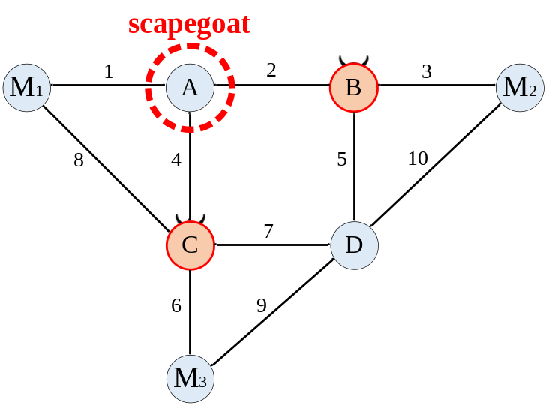

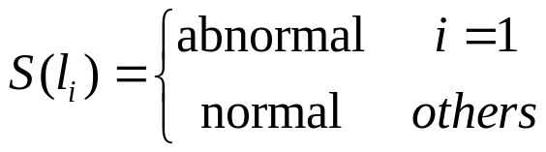
Example: Formulating Chosen-Victim
Chosen-Victim Attack:
  Damage objective: find a damage vector m with
  Deceiving objective (added as constraint to the max):
  link 1 should be the one detected abnormal via the inverse

Slide 43
Example: Formulating Max-Damage
Max-Damage Attack:
  Objective: find a damage vector m with
  Subject to:
    The victim(s) look abnormal
    The attack nodes/links look normal

Slide 44
Example: Formulating Obfuscation
Obfuscation
  Objective: maximize the number of uncertain links

Slide 45
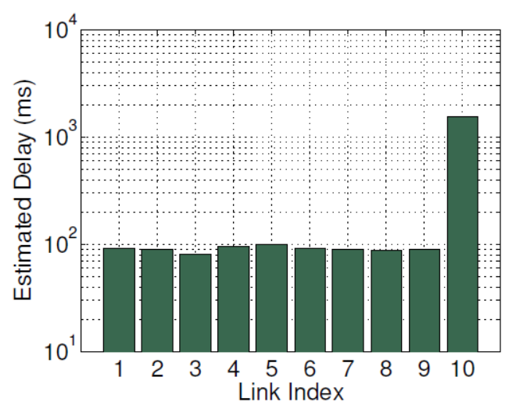
Experimental Evaluation
Attack Example
Chosen-Victim Attack
  Link 10 has a very high delay.
make it a scapegoat!

Slide 46
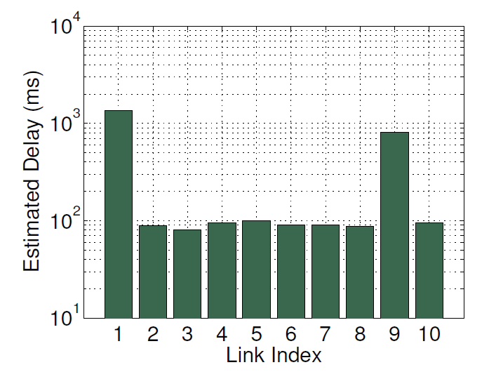
Experimental Evaluation
Attack Example
Maximum-Damage Attack
  Delay of both link 1 and 9 are high.
make it a scapegoat!
make it a scapegoat!

Slide 47
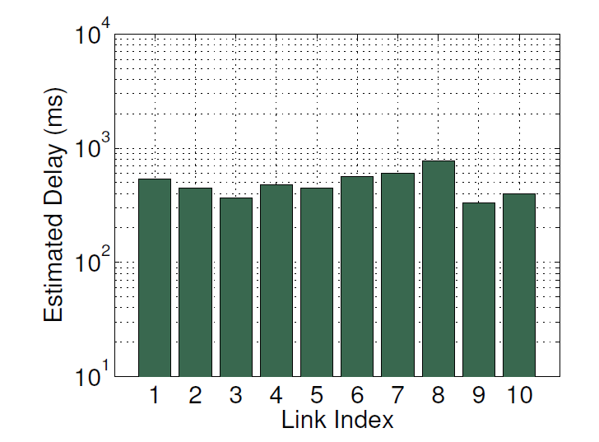
Experimental Evaluation
Attack Example
Obfuscation
  Delay of all links are similar, making the measurement of the network look very confusing!

Slide 48
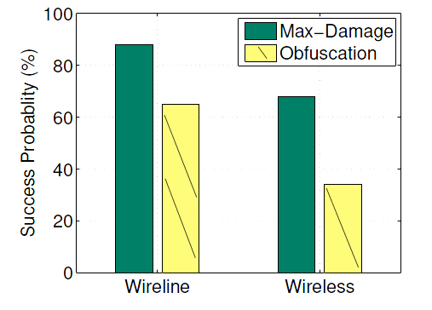
Imperfect Cut: Max-Damage and Obfuscation
Max-Damage and Obfuscation
  Use the Rocketfuel datasets as topologies for wireline networks.
  Use random geometric graph to generate wireless network topologies.
Even one single attacker is likely to succeed, and maximum-damage attacks are always more likely than chosen-victim attacks.

Slide 49
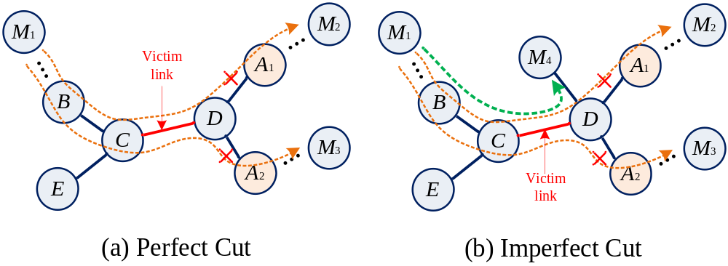
How to Detect Such Attacks
Can we really detect perfect cut?
  The attackers completely block our view of the victim link!!

Slide 50
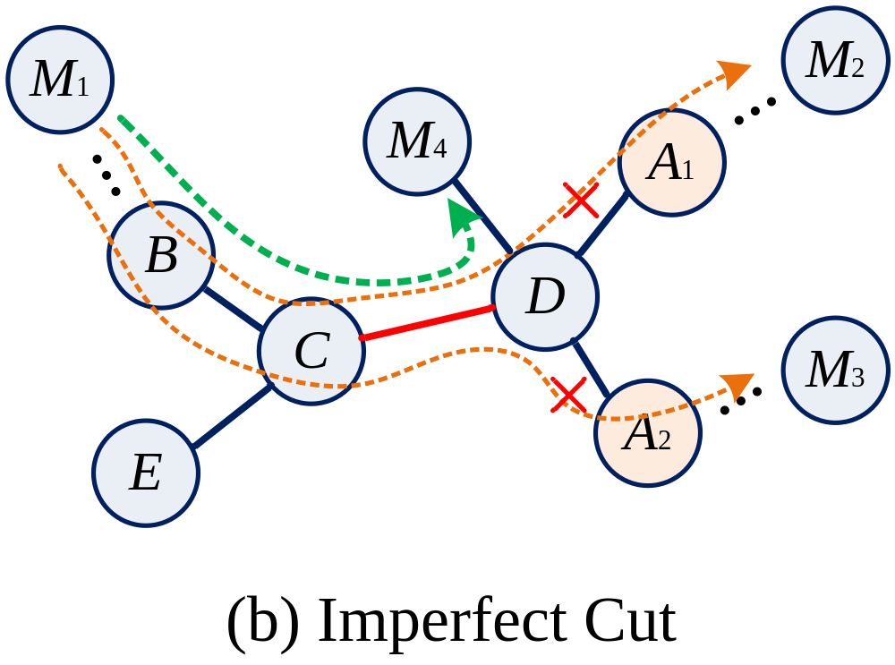
How about imperfect cut?
We should find inconsistency between attack paths (M1-M2 and M1-M3) and non-attack paths (M1-M4)

Slide 51
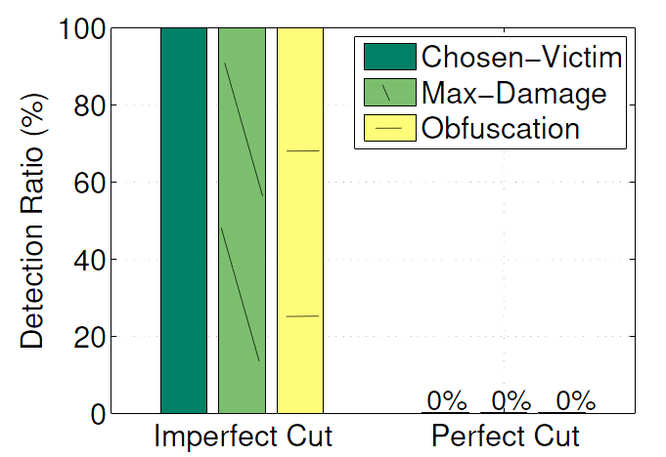
Experimental Evaluation
Detection evaluation
  Perfect-cut attack is undetectable. Imperfect one is always detectable

Slide 52
Summary
Network inference and tomography were not designed with a security purpose.
Inference integrity issues:
Methods to disrupt the inference integrity
  Can be used as a defense against malicious inference
  Can be used as an attack against legitimate monitoring

Slide 53
Q&A
Thank you!

