Slide 1
Hosting a Data Competition: Strategic Design and Analysis to Get More than Just a Winner
Christine Anderson-Cook, Los Alamos National Laboratory
Lu Lu, University of South Florida
https://sites.google.com/site/andersoncookluftctalk/
September 2018
LAUR-128887

Slide 2
Why Host a Data Competition?
Crowdsourcing
  New participants from other areas of expertise providing innovative solutions
  Cheap labor (fixed prize money for winners, but can get many diverse solutions)
Competition spurs results
  Drive to improve solutions and win leads to accelerated improvements
  Close to deadline for competition closing often sees frenzied activity
Enables objective comparisons of solutions
  Often many algorithms claim to have the best solution, but assumptions for the scenario where it is best not clearly specified
  Competition allows host to intentionally specify the problem space for which solution is sought

Slide 3
Outline
Description of Data Competition Recently Hosted by LANL
  Urban Radiation Search
  Basic Structure of Data
Opportunities in Design of Data
  Where can we be strategic?
Opportunities in Analysis of Data
  Limitations of the Leaderboard Scoring
  Post-Competition Analysis
Conclusions: Design and Analysis combined

Slide 4
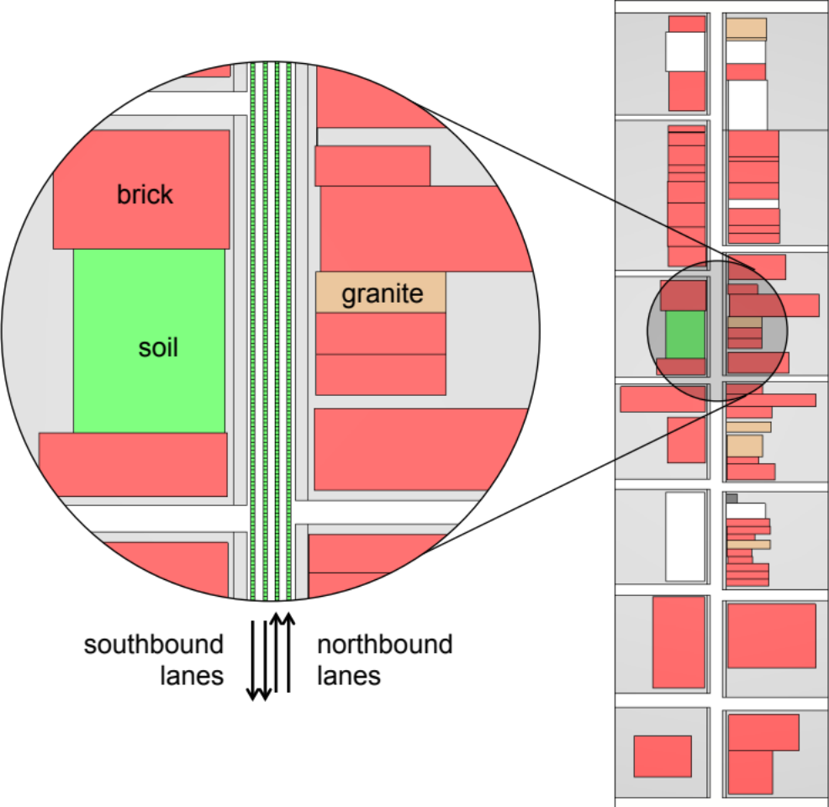
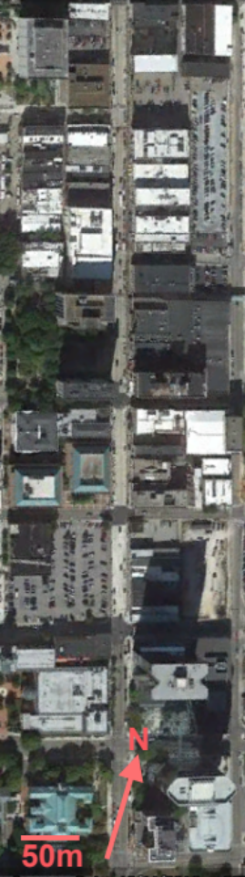
The Urban Radiological Search Competition
ORNL initially designed a 0.5 mile street model with characteristics similar to those of Knoxville’s Gay Street.
56 buildings
  48 brick, 7 granite, 1 concrete
  Hollow shells
Side streets, sidewalks,
6 parking areas.
Ability to vary levels of K, U, Th.
In response to LANL’s explorations, ORNL later developed multiple street layouts.

Slide 5
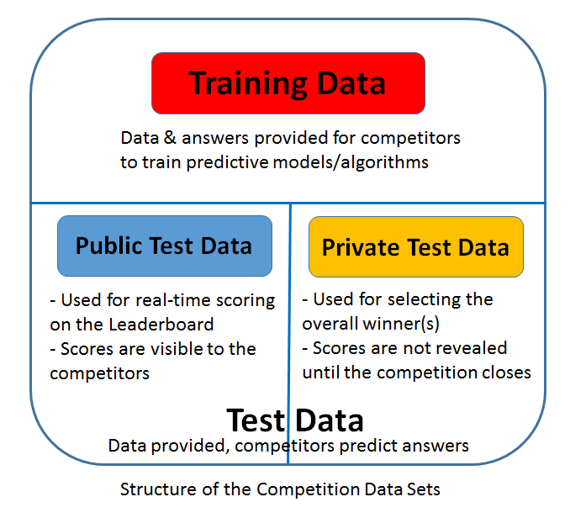
Basics of Data Competitions
Training data: <list mode data,
source type and location>
Test data: <list mode data>
Public and Private data combined – competitors don’t know which runs will be used for each leaderboard
Leaderboards rank teams/competitors based on a score to assess how well they answered the problem of interest
Same scoring function for public and private
Multiple aspects of solution must be combined

Slide 6
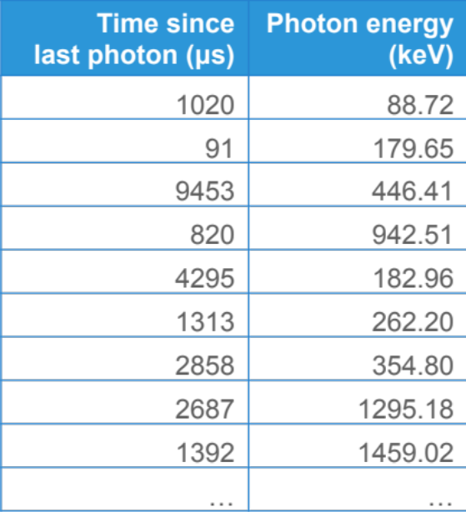
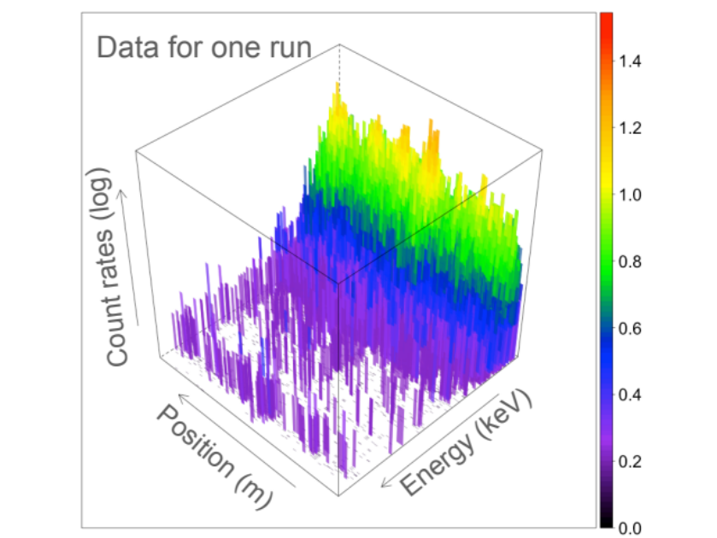
Competition format: datacompetitions.lbl.gov
Competitors are provided with
A training set of list mode data for ~10k runs.
A test set of ~16k runs: 43% public, 57% private.
Energy spectra for each source type.
For each run in the test set, competitors must
Detect whether there is an extraneous source.
Identify the type of source.
Locate when the detector is closest to it.
Competitors can submit up to 1000 entries for scoring. Final rankings are based on the best performance of all submissions on the private test set.

Slide 7
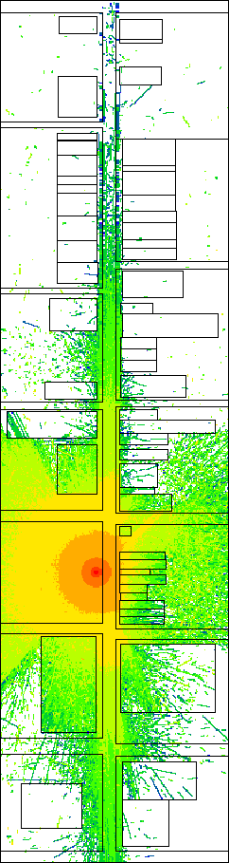
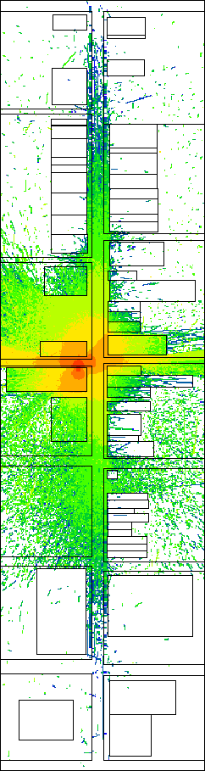
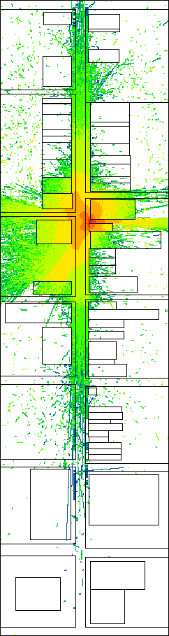
Factors considered for generating the competition data
A. Background: 8 background models,
each with 82 parameters
B. Source
  6 types
  2 shielding settings (On/Off)
  14 source locations
C. Other
  speed
  source strength (individually tailored to source type and location)
  proximity to source
  length of path, starting location

Slide 8
Outline
Description of Data Competition Recently Hosted by LANL
  Urban Radiation Search
  Basic Structure of Data
Opportunities in Design of Data
  Where can we be strategic?
Opportunities in Analysis of Data
  Limitations of the Leaderboard Scoring
  Post-Competition Analysis
Conclusions: Design and Analysis combined

Slide 9
Strategies for Improved Design for Data Competitions
Select data that adequately cover the region of interest
    Match region explored to target study goals
Encourage competitors from diverse technical backgrounds
    Provide sufficient background for those new to problem
    Match current practices for established disciplines
Emphasize data of maximum interest
    Avoid “too easy” and “too hard” regions to enhance ability to distinguish between competitor solutions
Discourage overfitting by competitor algorithms
    Include regions of interpolation and extrapolation in test sets
Balance standard design of experiment principles while avoiding unintentional clues for competitors
    Adapt replication, balance and randomization for competition data
Create leaderboard scoring that ranks performance to match competition goals
    Find suitable balance between multiple criteria
Intentional choices in the design stage enable better analysis later

Slide 10
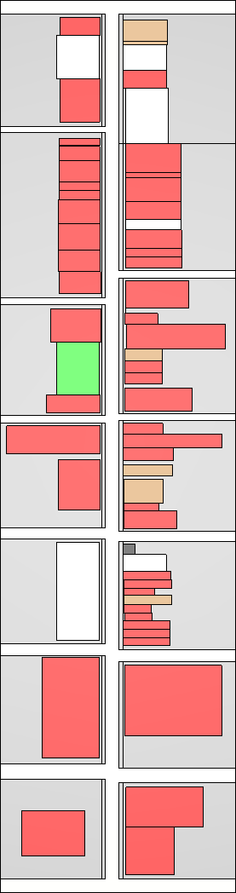
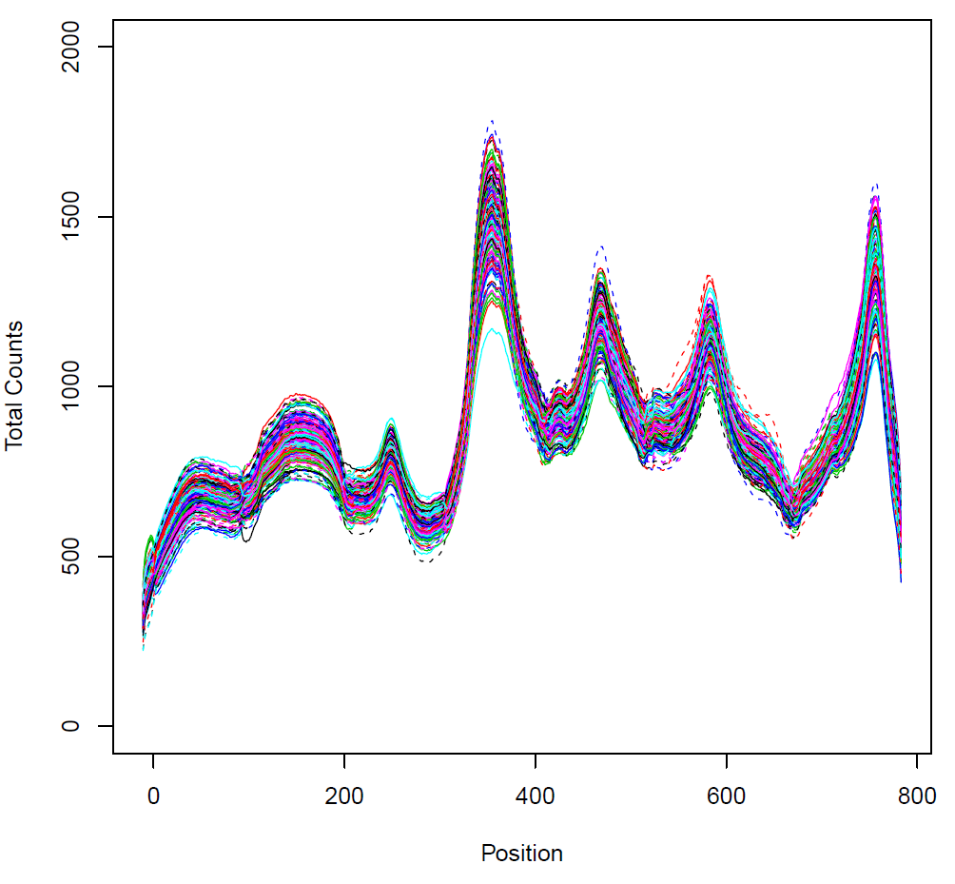
Select data that adequately cover the region of interest
Precisely define the goals of the competition
  What do we want to assess? Criteria for success?
  Over what set of conditions do we need the solution?
Assess the capability of data to match competition goals
  Constraints of data generator?
  Sufficient heterogeneity possible?
  What simplifying assumptions are made? Do they compromise the ability to address the goals?
Goal for Urban search competition:
  Detect, identify and locate multiple radioactive sources on a typical US street.
Capability of simulator for background
  Initially, not very heterogeneous:
  Solution:
    Multiple street layouts
    Circular street that allowed flexible start and finish
    Adapted K, U, Th contributions to match regional differences
Will we be able to adequately estimate within data size constraints?
  Does complexity of input space match the total data sets?
Details of the inputs and their ranges?
  What is of interest? Will the problem be solvable here?

Slide 11
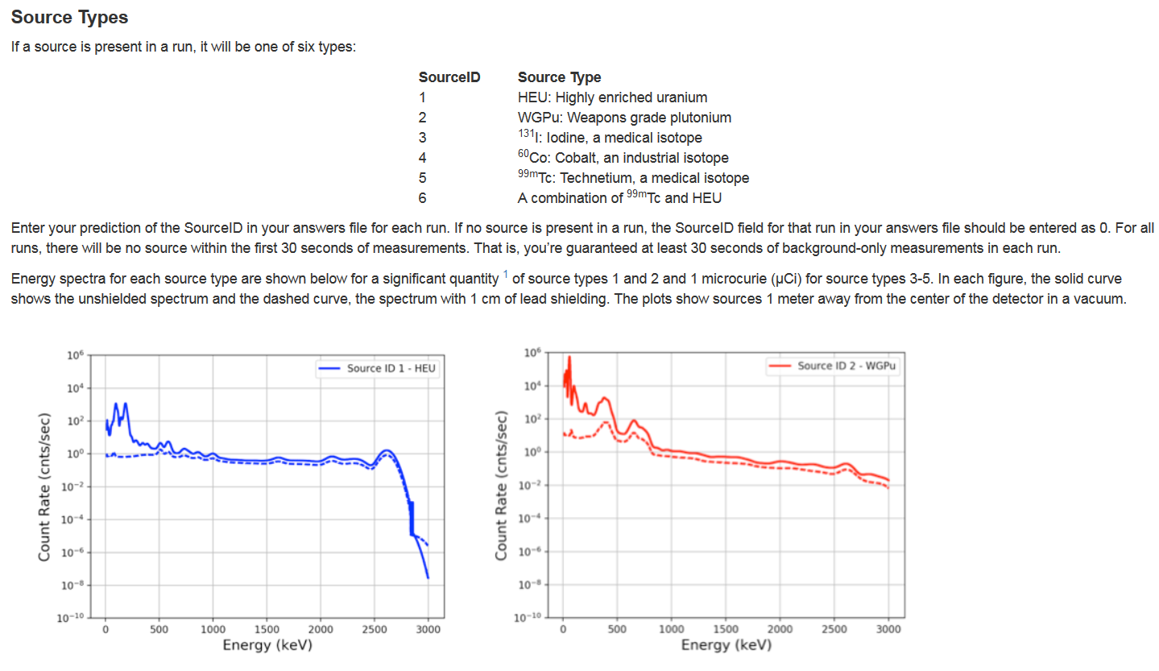
Encourage competitors from diverse technical backgrounds
Remove obstacles to join for non subject matter experts.
  If something is a one-time discovery to help with solving the problem, provide it.
Include some of fundamental assumptions currently used by subject matter experts (or think hard about why to not include them)
  Allow current best algorithm to provide a starting point for those in area
For non-SMEs:
  Provided details about the source spectra.
For current radiation detection experts:
  Generally, start with a period of calibration for algorithm
  We announced that “no source would be located within the first 30 seconds of any run”

Slide 12
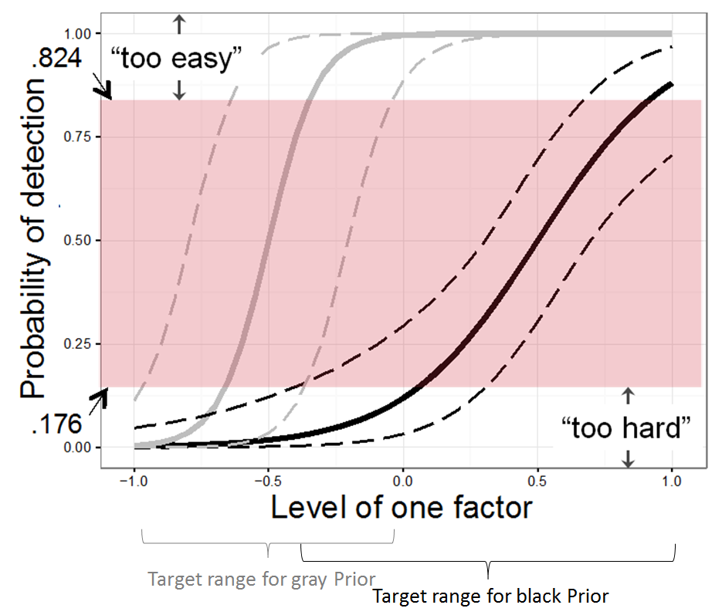
Emphasize data of maximum interest
For univariate case with known relationship:
  Best solution: ½ points each at P(success) = 0.176 & 0.824
  What is different for our scenario:
    Multiple inputs
    Multiple objectives – detect & identify (using logistic model)
    Unknown a priori relationship between inputs and responses
    Multiple competitors (with different performance anticipated)
Our solution:
  Bound our region with “current best algorithm” and “dream capability”
  Want robust estimation throughout span
  Generate a “superset” with 10x runs to select from
  Eliminate regions that are
    “too easy” – all the good algorithms will get them right
    “too hard” – no one will be able to get them right
  Emphasize region with good potential to distinguish between algorithms
Used best algorithm available to predict answers for entire superset
Consult radiation detection experts for upper bound
Downweighted regions where current algorithm has P(detect) > 0.5
Formal methodology: Quinlan et al (2017), Quinlan & Anderson-Cook (2018)

Slide 13
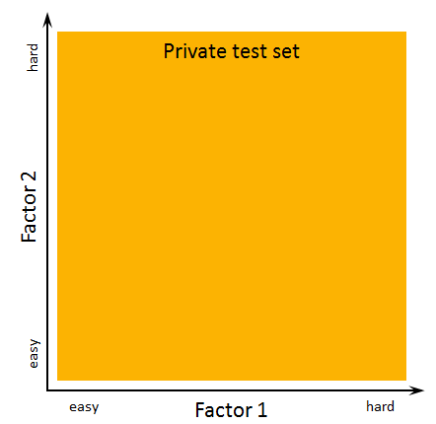
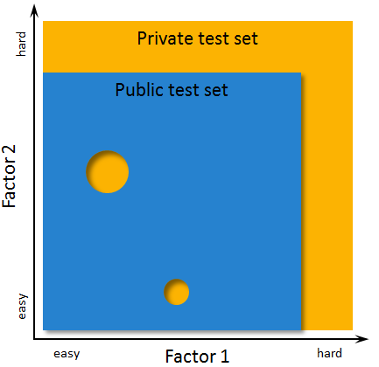
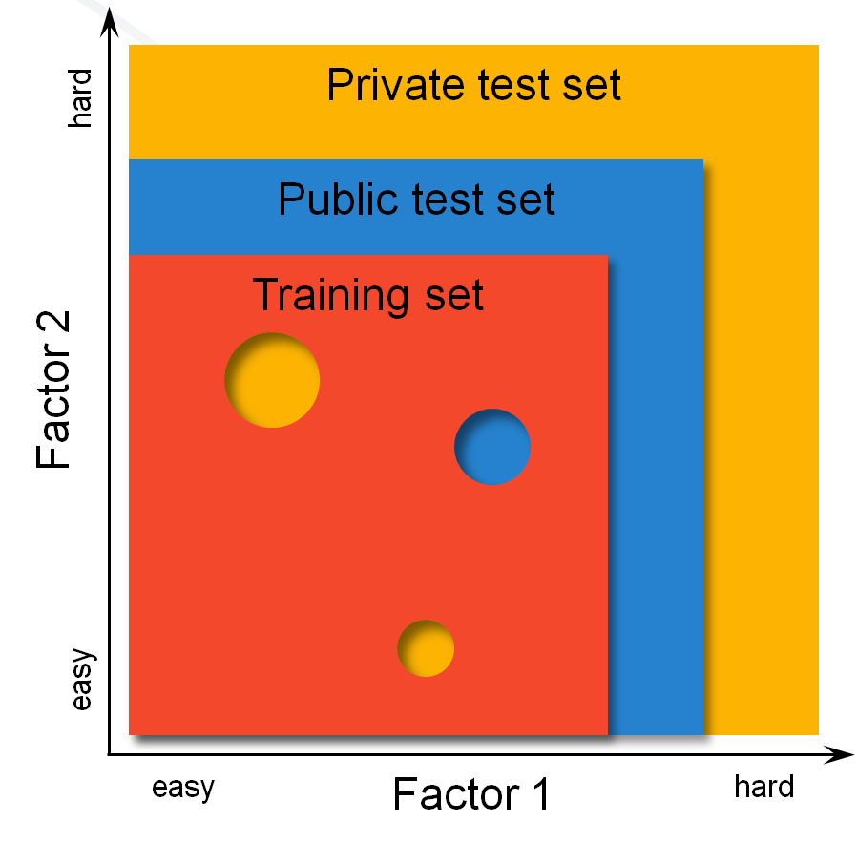
Discourage overfitting by competitor algorithms
Multiple entries on a single test set tempt competitors to tune to the idiosyncrasies of the data.
Overfitted solutions are unlikely to predict well for new scenarios
Private test set:
Final choice of best algorithm based on this
Set should span the entire space of interest
Public test set:
Strategically exclude some difficult and internal regions
Allows assessment on new situations
Training set:
Labels provided to competitors
Strategically further shrink region

Slide 14
Balance Design of Experiment principles & avoid unintentional clues
Traditional design of experiments does not have an adversary to consider.
Seasoned data competition participants often gain advantage by exploiting unintended artifacts in the data
Our goal: force competitors to solve the intended problem, while still collecting ideal data
Design of Experiment concepts to leverage:
Replication –luxury of a large data set, better information for binary response
Balance – improved estimation of model parameter estimates and prediction throughout space
Randomization – avoids systematic patterns
Replication
  Generated 3 replicates of each scenario in superset
  Use starting location and length of detector path to make runs look different from each other
  Vary number of replicates included in final data (1, 2 or 3)
Balance
  For the number of run for different sources:
    Decided separately on fraction of “no source” needed estimate false positive rate throughout region
    Varied number of runs for each of 6 sources in [MinSize, 1.2*MinSize]
Randomization
  Sorted training data
  Randomized order of public and private runs in overall test set
  Randomized source / no source in test set

Slide 15
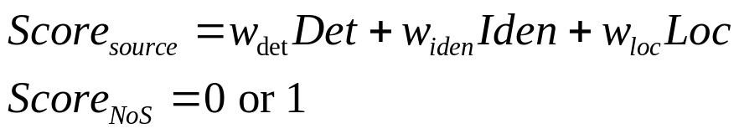




Create leaderboard scoring to match competition goals
Recall goals of competition are to detect, identify and locate multiple sources
Leaderboard scoring requires a single static formula to evaluate and compare algorithm performance – need to get this right for declaring the right winner!
Our strategies:
  Not all runs contribute equally to the total
  Use a weighted average of different contributions for different goals
  Constructing different types of algorithm mistakes, experiment with different weights to get a desirable final ranking that matches subject matters priorities
  Check, check, check for correct implementation! There are no second chances without embarrassment!
“no source” runs contributed ½ as much as “with source” runs
True source

Slide 16
Outline
Description of Data Competition Recently Hosted by LANL
  Urban Radiation Search
Opportunities in Design of Data
  Basic Structure of Data
  Where can we be strategic?
Opportunities in Analysis of Data
  Limitations of the Leaderboard Scoring
  Post-Competition Analysis
Conclusions: Design and Analysis combined

Slide 17
Why Post-Competition Analysis
We have three separate objectives for the competition: detect, identify and locate
  We are interested in the performance of each of these aspects separately – the best algorithms for each individually might be different
  We were forced to pick a fixed weight for the leaderboard scoring – what if we got it wrong? Or we consider a different scenario
The goals of the competition include:
  Ranking the competitors’ algorithms (hopefully, primarily handled by leaderboard)
  Understanding the strengths and weaknesses of each algorithm
  Understanding the relative impacts of the inputs on the difficulty of the problem
  Understanding the regions of the input space where
    All top algorithms can get the right answer
    All do poorly
    Different algorithms perform differently
True source

Slide 18
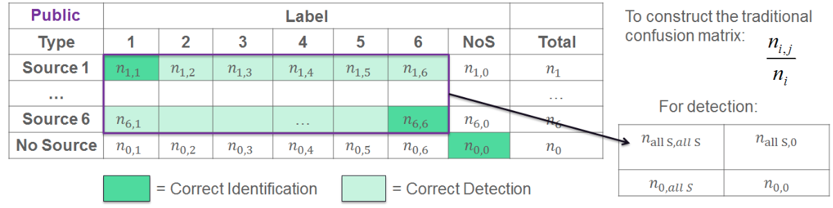
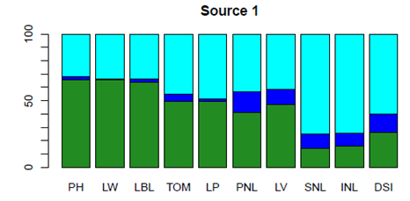
Elements for More Detailed Study
Sorted based on current
best leaderboard score

Slide 19
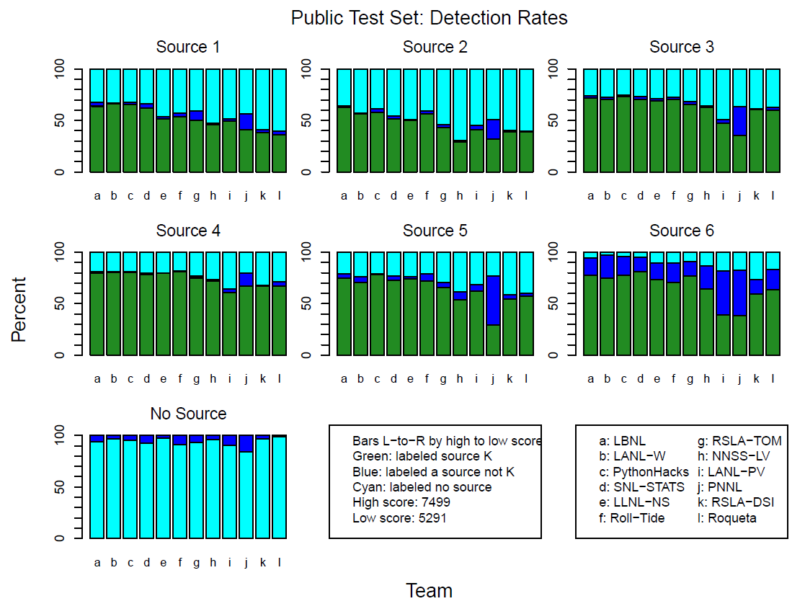
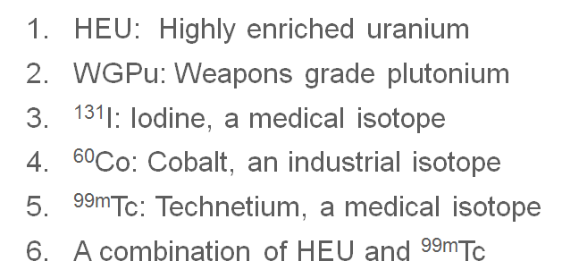
Comparison of Performance for Each Source By Team
Patterns:
Non-monotonic performance
Harder/easier sources
False positive rates

Slide 20
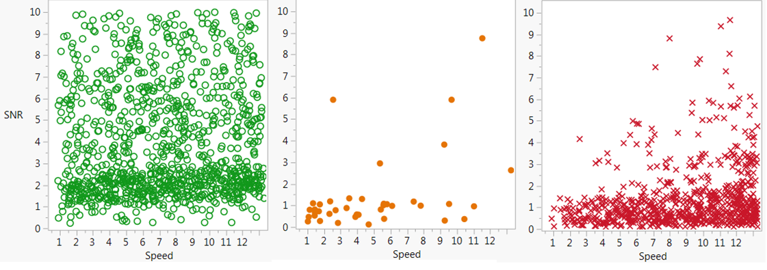
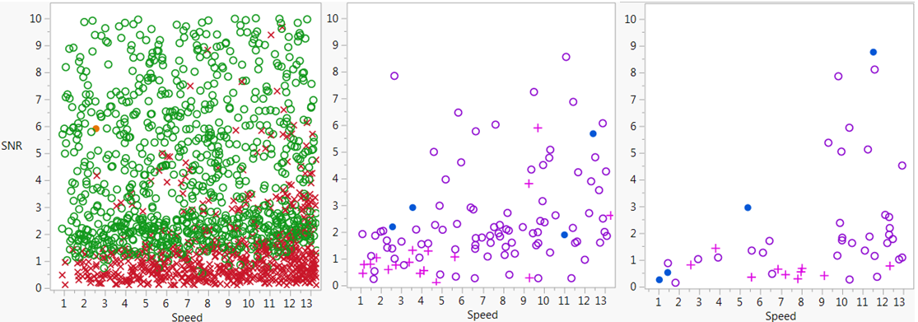
Comparison of Team Performance Run-by-Run
Source 2
For each team, we can see where they
Correctly identified (and detected)
Correctly detected (incorrect identify)
Missed source
1 identify, 2 detect
1 identify, 2 missed
1 detect, 2 missed
Team 1 > Team 2
Team 2 > Team 1
To compare teams:
Look where results are the same and different
Team 1 beating Team 2 on leaderboard, does not mean Team 2 might not be superior in some places.

Slide 21
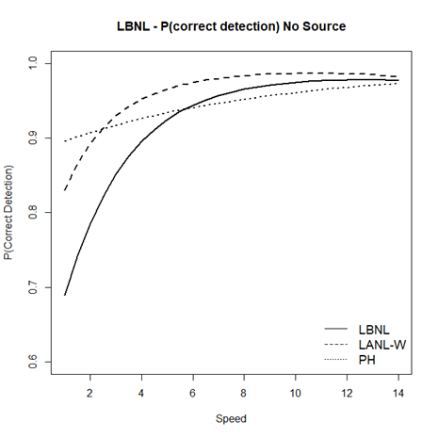

Model-based Analysis
To understand the impact of different inputs on algorithm performance as well as prediction throughout the region, we model each of detect, identify and locate separately
Logistic regression model for correctly identifying no source
No Source
Significant
Not significant

Slide 22

Understanding Contributions From Different Input Factors
GLM for detection or identification:
Linear regression model for location:

Slide 23
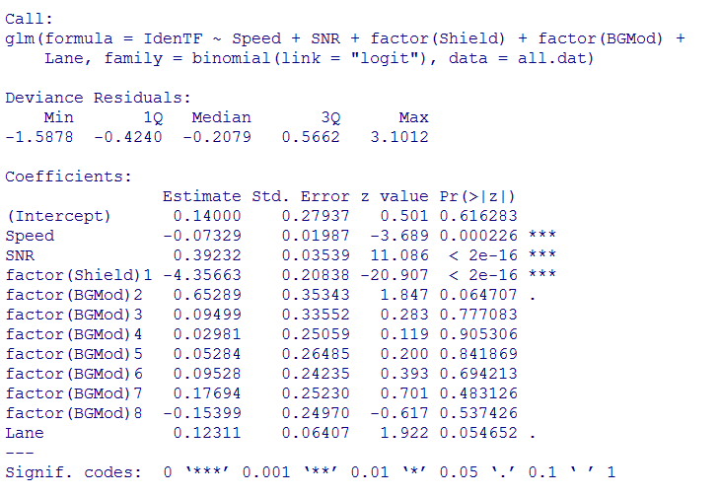
Understanding Contributions From Different Input Factors
This analysis will be performed for the best submission(s) from each team
Significant
Not significant
Generally not significant for detect, identify,
but significant for locate

Slide 24
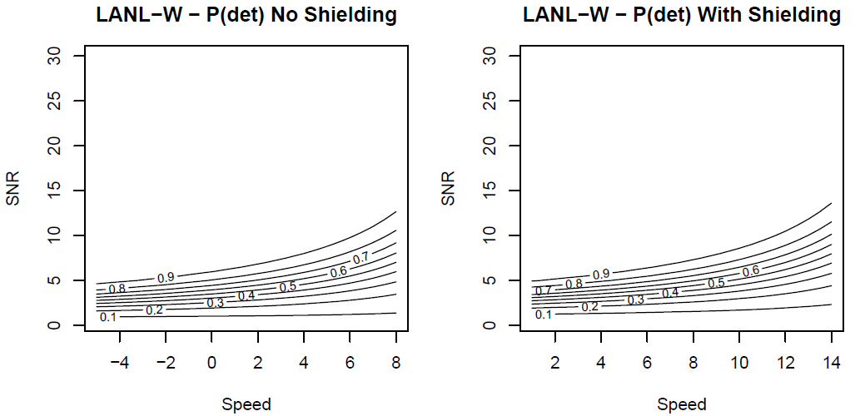
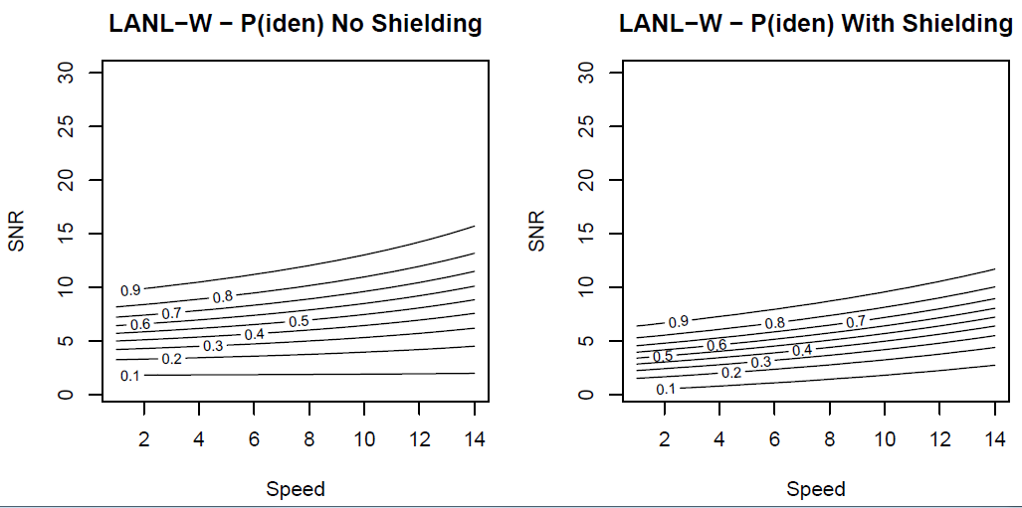

Performance Throughout the Input Region
Stronger signal dramatically improves performance
For this source, with shielding is a bit easier
Increasing speed is somewhat harder

Slide 25
Comparison of Performance Between Teams
  Do submissions from different teams have different performance?
  Are the difference similar across the input space?
Definitely same

Slide 26

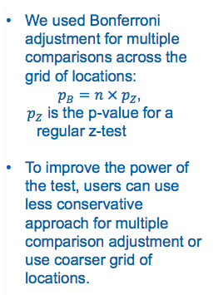
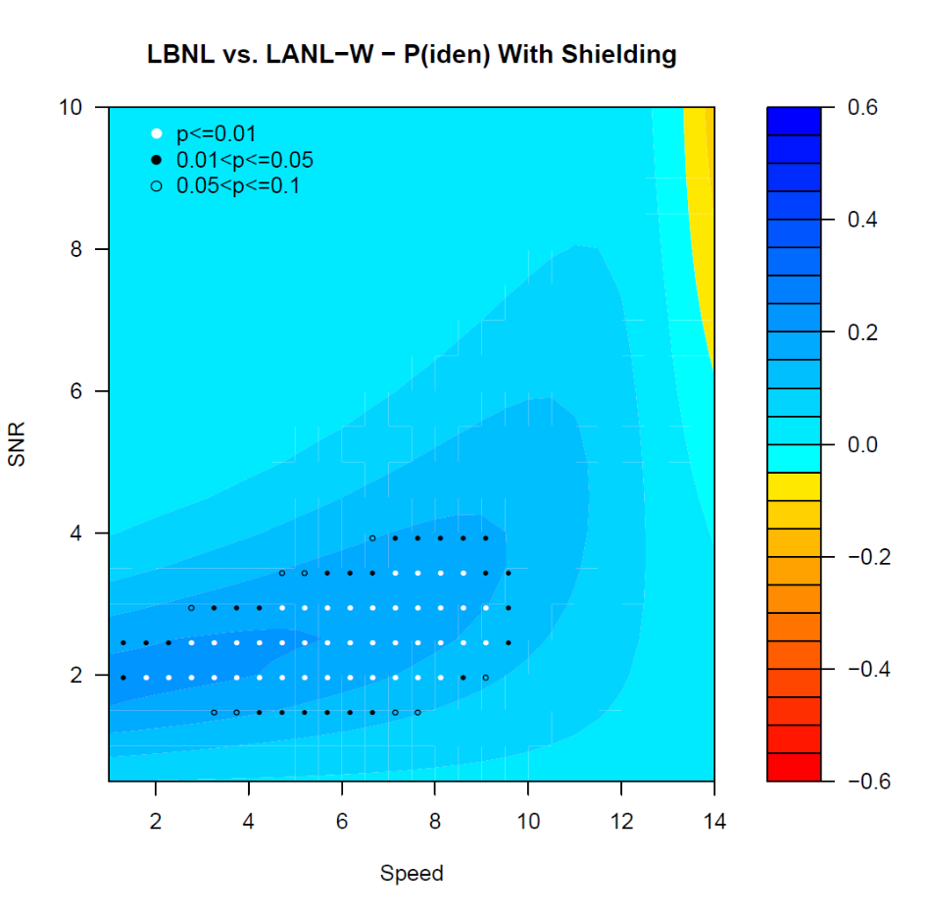
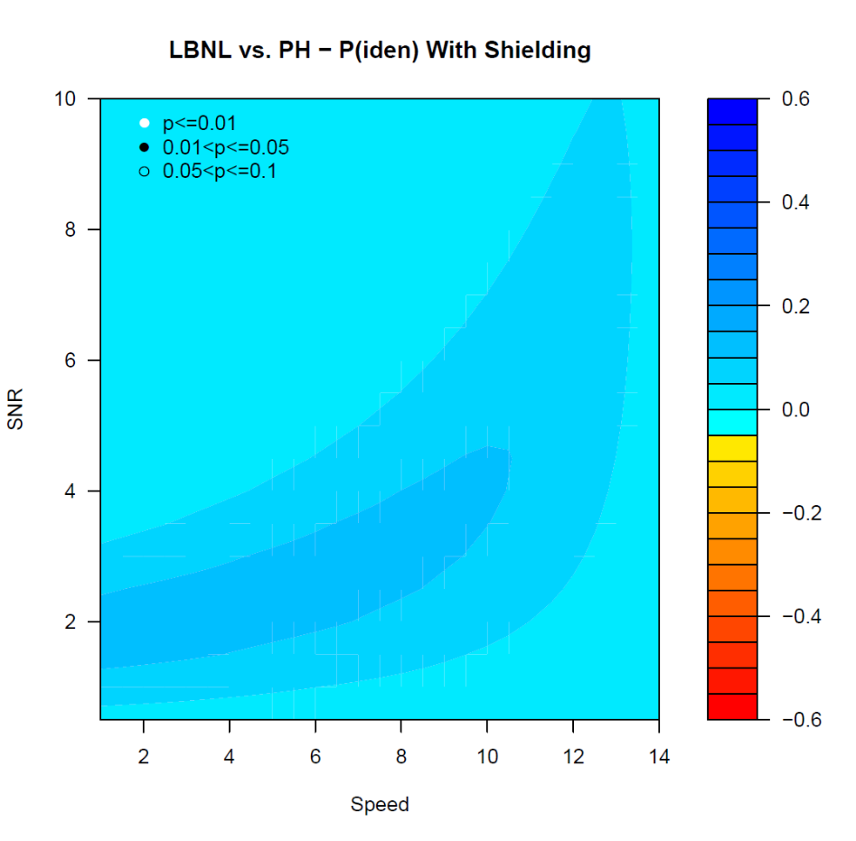
Comparison of Performance Between Teams

Slide 27
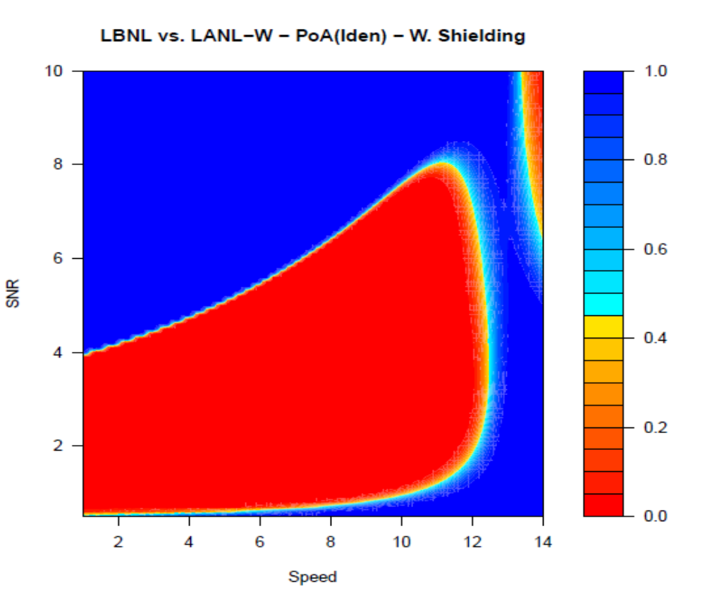
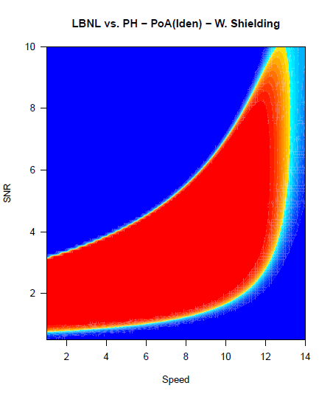
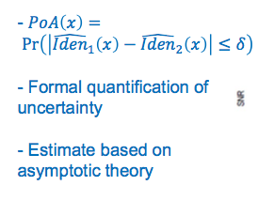

Probability of Agreement (PoA) for Comparing Teams
Similar to equivalence testing with user specified threshold, $δ$
Difference $>δ$ is considered of practical importance
Definitely same
Definitely same
Definitely different
Definitely different
$$δ=0.05$$
Formal methodology: Stevens & Anderson-Cook (2017a & b)

Slide 28
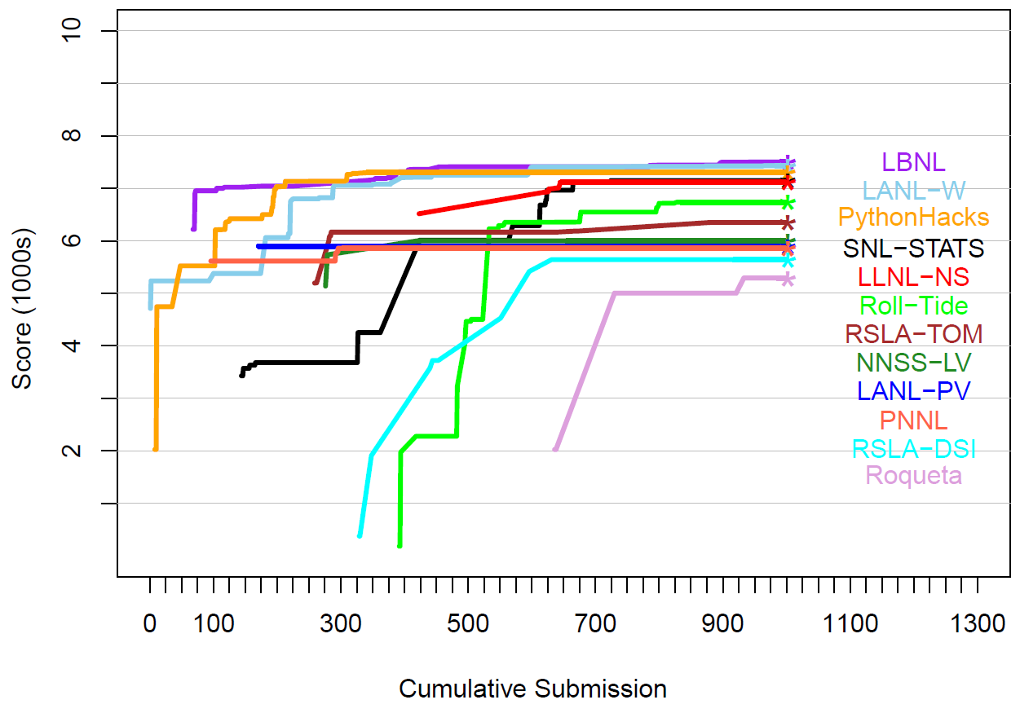
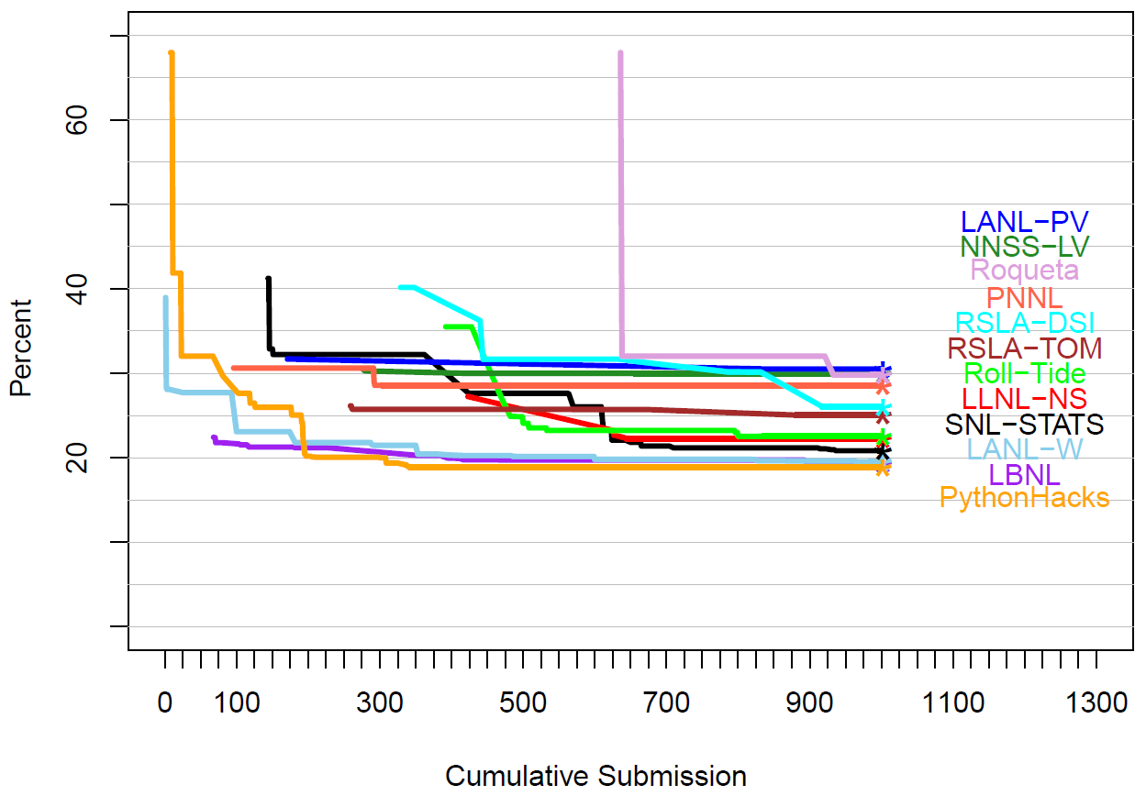
Evolution of Competitor Scores During Competition
Best Score
Lowest Error Rate

Slide 29
Conclusions: Design and Analysis – working in harmony
By intentionally designing the data to train and test the competitors, we
  Gain confidence in our ability to address competition goals
  Maximize the amount of usable information obtained
  Hopefully, avoid artifacts that allow the competitors to solve a different problem
  Set up the desired analysis to match the design for maximum learning outcome
By carefully constructing the leaderboard scoring, we
  Rank the teams to match our competition objectives
By using EDA and model-based post-competition analyses, we
  Gain additional insights about performance for individual components of competition (detect, identify, locate)
  Take pressure off the assigned weighting of components on the leaderboard
  Can understand and compare algorithm strengths and weaknesses
  Can understand patterns in performance throughout the inputs space
  Can calibrate the scoring system for future competitions
https://sites.google.com/site/andersoncookluftctalk/

