Slide 1

Cyber-Security: A Stochastic Modeling Approach for Security Quantification
K. Ruwani M. Fernando & Prof. Chris P. Tsokos

Slide 2

Presentation overview
Introduction
Cyber-Security Analytical Framework
    Stochastic Modeling: Discrete-Time & Continuous-Time Markov Chains
Quantitative Security Assessment
Illustration
Conclusions

Slide 3

Introduction
Cyber Attacks becomes more and more sophisticated & complex.
Losses due to such attacks are immense varying from loss of money and confidential information to the spoilage of reputation.
Therefore, it is extremely important for corporations to have security metrics in order to mitigate the security risks.
During the operational lifetime of a system, it can alternate between different security states, mainly due to intrusion attempts of attackers.
The behavior of an attacker can be described by the transitions between states of the system where each transition is caused by attacker’s event.
Since both the event and the time it will occur is random, the states of a network system and the attacker behavior can be modeled as a stochastic process, which can capture its dynamical behavior.

Slide 4
Introduction: Quantitative security models
How? | Quantitative Analysis is performed by the use of analytical approach relying on Stochastic Modeling.
By? | Computing Security Metrics such as: Identification of most critical stack state The most probable goal among many goal states The number of steps the attacker is expected to take to compromise the security of the system Mean Time To Security Failure(MTTSF)
Why? | Quantitative Analysis will help to mitigate risk and the impact of Cyber-Attacks

Slide 5

CYBER Security ANLYTICAL FRAMEWORK
Stochastic modeling
Model Representation

Slide 6
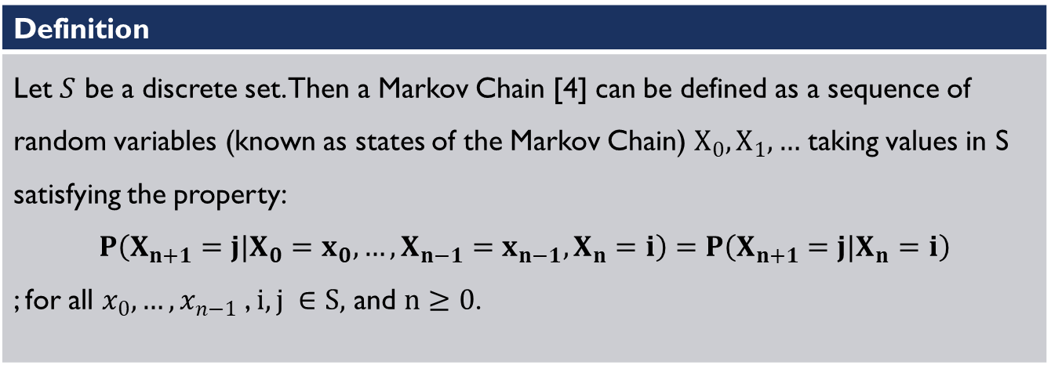
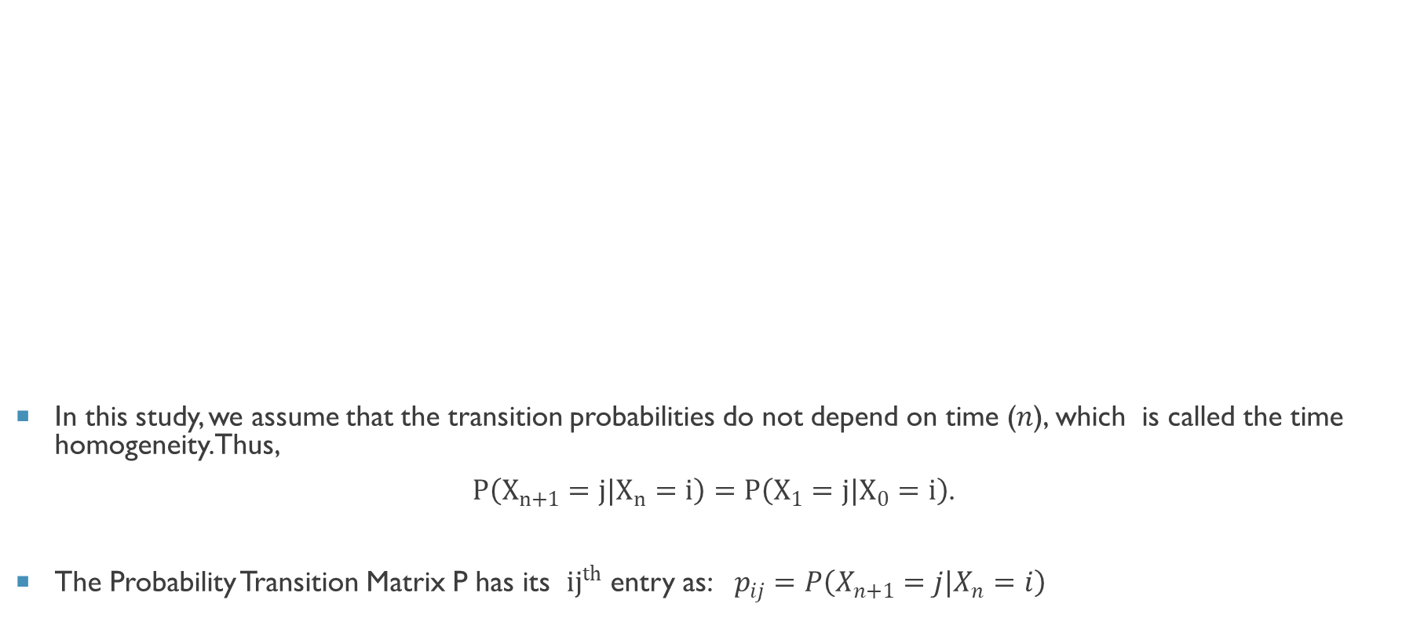
Discrete-Time Markov Chain
In this study, we assume that the transition probabilities do not depend on time ($n$), which is called the time homogeneity. Thus,
$P\left(X_{n+1}=j|X_{n}=i\right)=P\left(X_{1}=j|X_{0}=i\right)$.
The Probability Transition Matrix P has its ${ij}^{th}$ entry as: $p_{ij}=P\left(X_{n+1}=j|X_{n}=i\right)$
Definition
Let $S$ be a discrete set. Then a Markov Chain [4] can be defined as a sequence of random variables (known as states of the Markov Chain) $X_{0},X_{1},…$ taking values in S satisfying the property: $P\left(X_{n+1}=j|X_{0}=x_{0},…,X_{n−1}=x_{n−1},X_{n}=i\right)=P\left(X_{n+1}=j|X_{n}=i\right)$ ; for all $x_{0},…, x_{n−1}$ , $i,j ∈S,$ and $n≥0$.

Slide 7
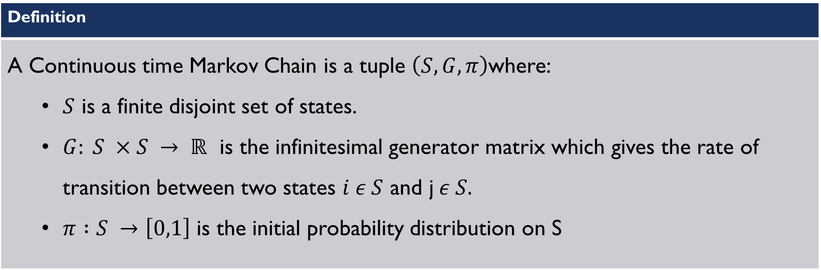
Continuous-Time markov chain
Definition
A Continuous time Markov Chain is a tuple $\left(S, G, π\right)$where: $S$ is a finite disjoint set of states. $G: S ×S → ℝ$ is the infinitesimal generator matrix which gives the rate of transition between two states $i ε S$ and j$ε S.$ $π :S →\left[0,1\right]$ is the initial probability distribution on S

Slide 8
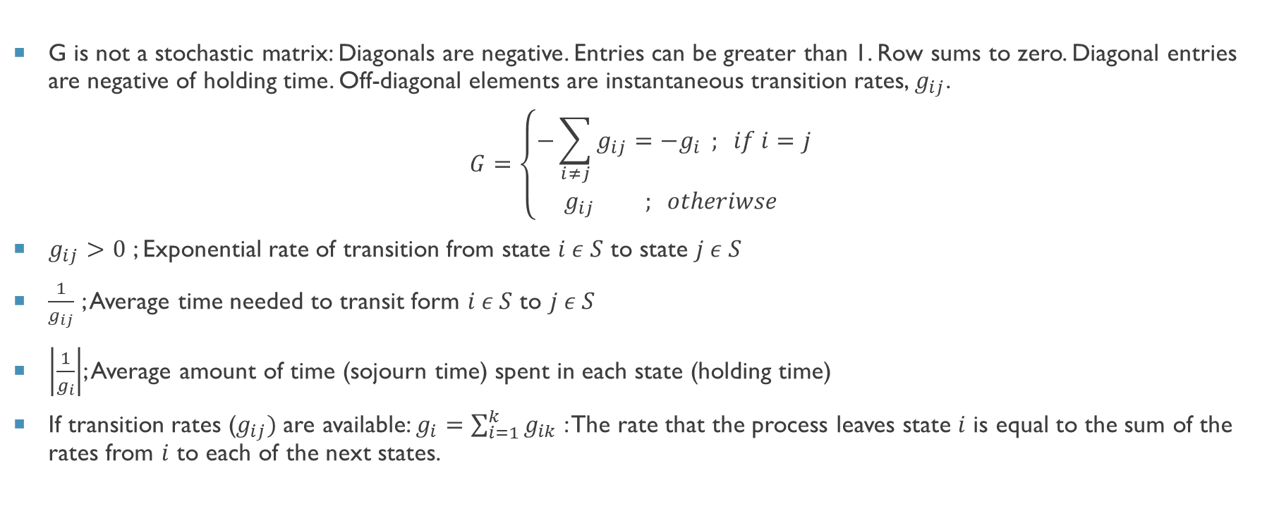
Continuous-Time markov chain: Infinitesimal Generator
G is not a stochastic matrix: Diagonals are negative. Entries can be greater than 1. Row sums to zero. Diagonal entries are negative of holding time. Off-diagonal elements are instantaneous transition rates, $g_{ij}$.
$$G=\left\{\begin{aligned}−\sum_{i≠j}{g_{ij}=−g_{i}} ; if i=j \\ g_{ij} ; otheriwse \end{aligned}\right.$$
$g_{ij}>0$ ; Exponential rate of transition from state $i ε S$ to state $j ε S$
$\frac{1}{g_{ij}}$ ; Average time needed to transit form $i ε S$ to $j ε S$
$\left|\frac{1}{g_{i}}\right|$; Average amount of time (sojourn time) spent in each state (holding time)
If transition rates ($g_{ij})$are available: $g_{i}=\sum_{i=1}^{k}{g_{ik}}$ : The rate that the process leaves state $i$ is equal to the sum of the rates from $i$ to each of the next states.

Slide 9
Quantitative Security Assessment

Slide 10
Quantitative security Assessment
Markov Chain
Discrete-Time(DTMC)
P = $\left[\begin{matrix}Q & R \\ 0 & I\end{matrix}\right]$ ; where $p_{ij}= \frac{v_{j}}{\sum_{k=1}^{n}{v_{k}}}$
Probability Transition matrix
P = [■8(𝑄&𝑅@0&𝐼)] ; where 𝑝_𝑖𝑗= 𝑣_𝑗/(∑_(𝑘=1)^𝑛▒𝑣_𝑘 )
Probability Transition matrix
Continuous-Time(CTMC)
$P\left(t\right)= e^{Gt}$
Probability Transition Function
𝑃(𝑡)= 𝑒^𝐺𝑡
Probability Transition Function
$$G= \left[\begin{matrix}a & 0 \\ ∗ & V\end{matrix}\right]$$
Infinitesimal Generator
𝐺= [■8(𝑎&0@∗&𝑉)]
Infinitesimal Generator
$$F=− V^{−1}$$
Fundamental Matrix
𝐹=− 𝑉^(−1)
Fundamental Matrix
$$N= {\left(I −Q\right)}^{−1}$$
Fundamental Matrix
𝑁= (𝐼 −𝑄)^(−1)
Fundamental Matrix
$$B= {\left(I −Q\right)}^{−1}R$$
Absorbency Matrix
𝐵= (𝐼 −𝑄)^(−1) 𝑅
Absorbency Matrix
$$T=Nc$$
𝑇=𝑁𝑐

Slide 11
ILLUSTRATIONS

Slide 12
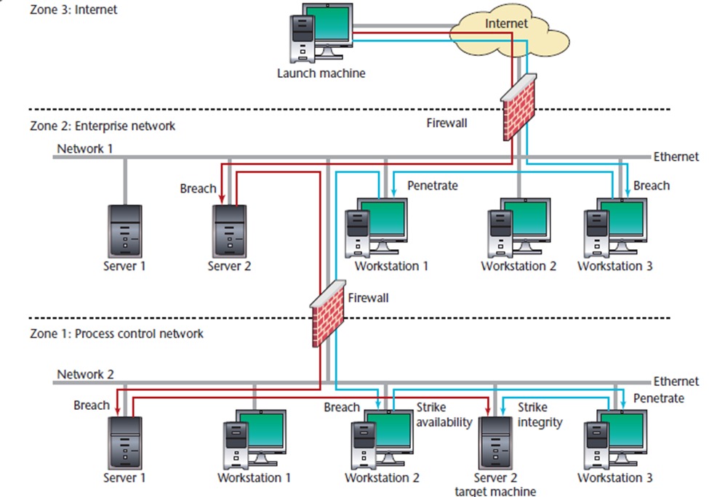
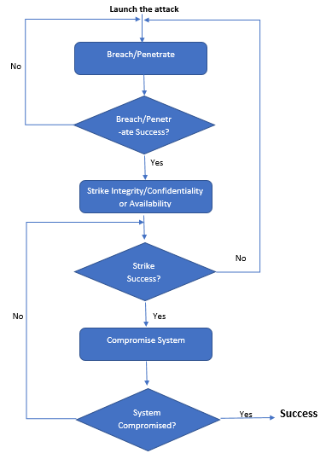
Attacker path attack algorithm

Slide 13
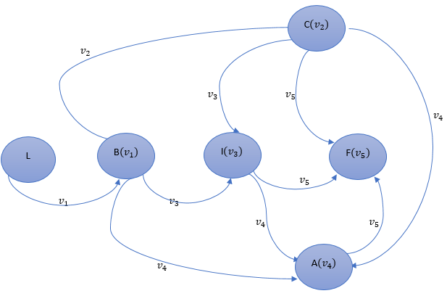
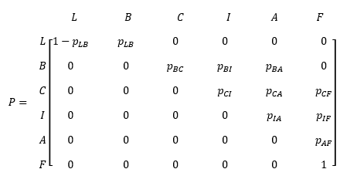
ILLUSTRATION 1 (dtmc) : SPECIFYING THE MODEL
State Space Model
Transition Probability Matrix

Slide 14
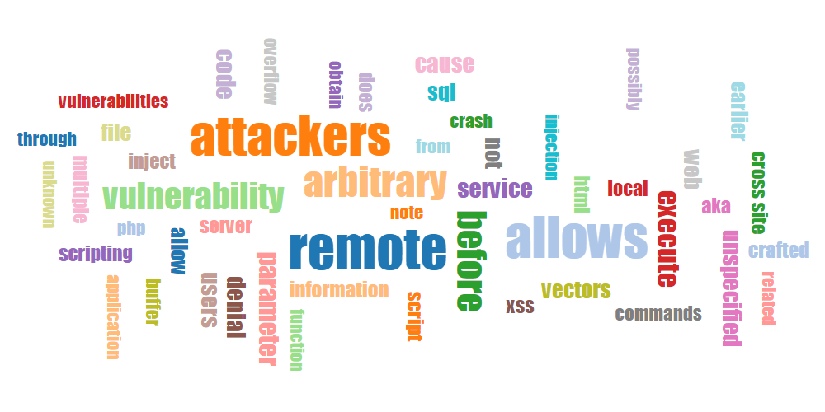

ILLUSTRATION 1…..
CVE ID | Description | Impact | Score
CVE-2016-3245 | Internet Explorer Security Feature Bypass Vulnerability | Breach System | 4.3
CVE-2017-0191 | Windows Denial of Service Vulnerability | Availability | 3.5
CVE-2017-0192 | Information Disclosure Vulnerability | Confidentiality | 4.3
CVE-2017-0211 | Fails an integrity-level check | Integrity | 4.3
CVE-2017-0166 | Elevation of Privilege Vulnerability | System can be Compromised | 9.3

Slide 15
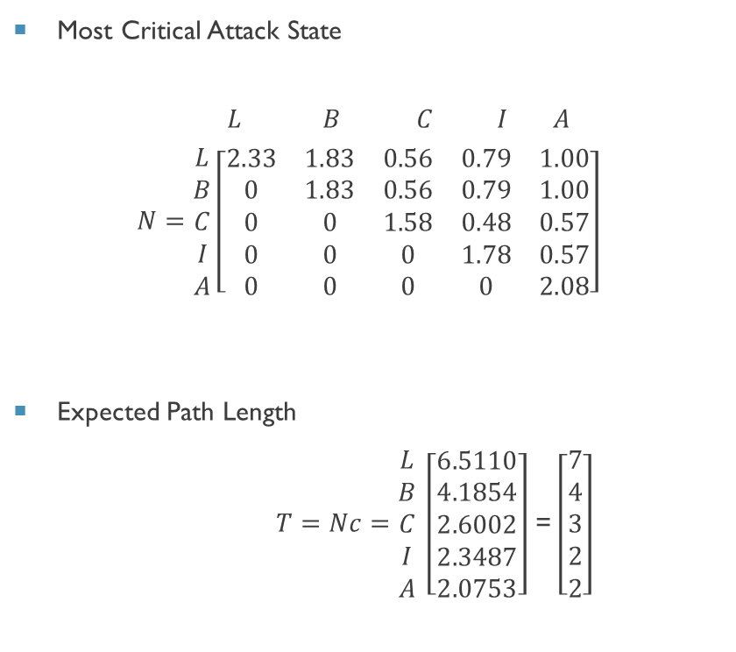
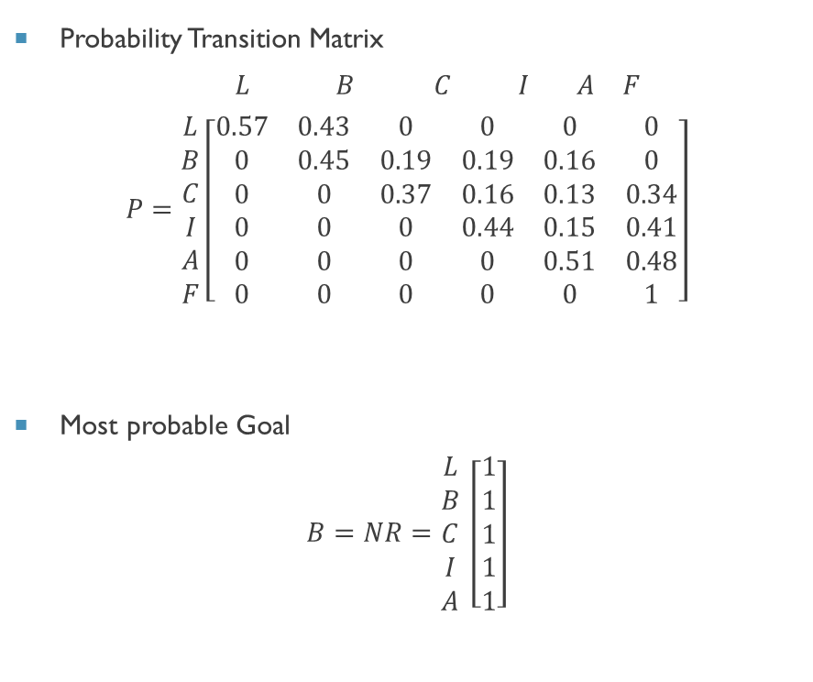
ILLUSTRATION 1……
Probability Transition Matrix
$$\begin{matrix} L & B & C & I & A & F\end{matrix}$$
$$P=\begin{matrix}L \\ B \\ C \\ I \\ A \\ F\end{matrix}\left[\begin{matrix}0.57 & 0.43 & 0 & 0 & 0 & 0 \\ 0 & 0.45 & 0.19 & 0.19 & 0.16 & 0 \\ 0 & 0 & 0.37 & 0.16 & 0.13 & 0.34 \\ 0 & 0 & 0 & 0.44 & 0.15 & 0.41 \\ 0 & 0 & 0 & 0 & 0.51 & 0.48 \\ 0 & 0 & 0 & 0 & 0 & 1\end{matrix}\right]$$
Most probable Goal
$$B=NR=\begin{matrix}L \\ B \\ C \\ I \\ A\end{matrix} \left[\begin{matrix}1 \\ 1 \\ 1 \\ 1 \\ 1\end{matrix}\right]$$
Most Critical Attack State
$$\begin{matrix} L & B & C & I & A\end{matrix}$$
$$N=\begin{matrix}L \\ B \\ C \\ I \\ A\end{matrix}\left[\begin{matrix}2.33 & 1.83 & 0.56 & 0.79 & 1.00 \\ 0 & 1.83 & 0.56 & 0.79 & 1.00 \\ 0 & 0 & 1.58 & 0.48 & 0.57 \\ 0 & 0 & 0 & 1.78 & 0.57 \\ 0 & 0 & 0 & 0 & 2.08\end{matrix}\right]$$
Expected Path Length
$T=Nc=\begin{matrix}L \\ B \\ C \\ I \\ A\end{matrix} \left[\begin{matrix}6.5110 \\ 4.1854 \\ 2.6002 \\ 2.3487 \\ 2.0753\end{matrix}\right]$ = $\left[\begin{matrix}7 \\ 4 \\ 3 \\ 2 \\ 2\end{matrix}\right]$

Slide 16
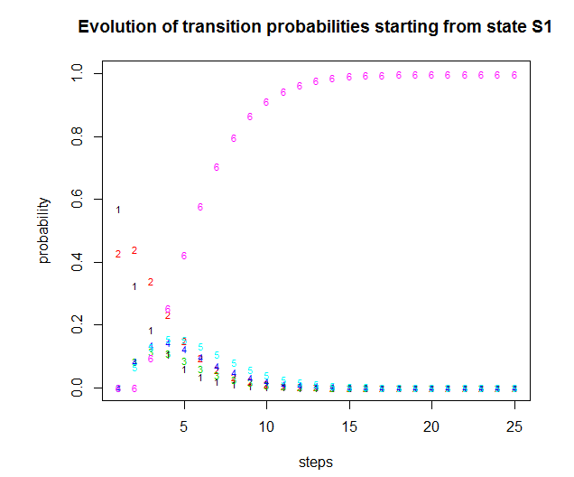
Illustration……
Transition probabilities

Slide 17
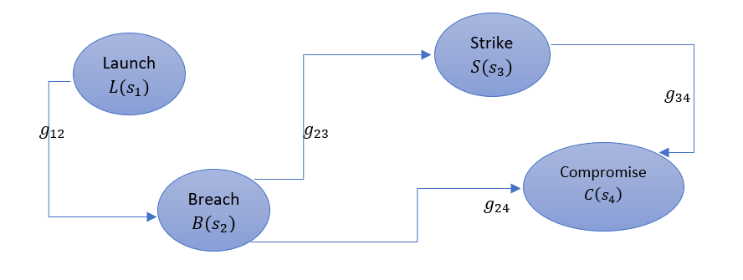
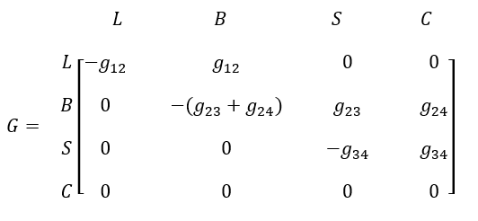
ILLUSTATION 11 (ctmc) : SPECIFYING THE MODEL
Attack Progression Model
Infinitesimal Generator

Slide 18
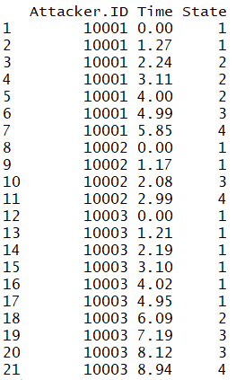

ILLUSTRATION II

Slide 19
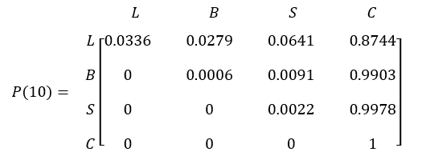
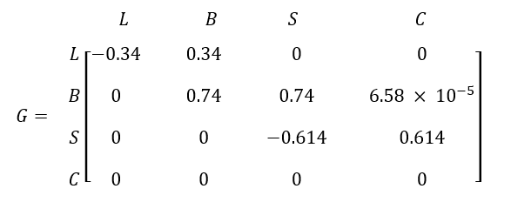
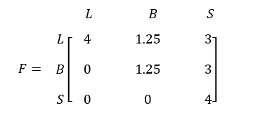
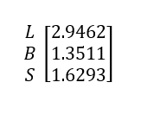

ILLUSTRATION II
Transition Intensities estimated from data (G
Mean sojourn times
Transition Probability Function: P(10)
Fundamental Matrix
MTSSF

Slide 20
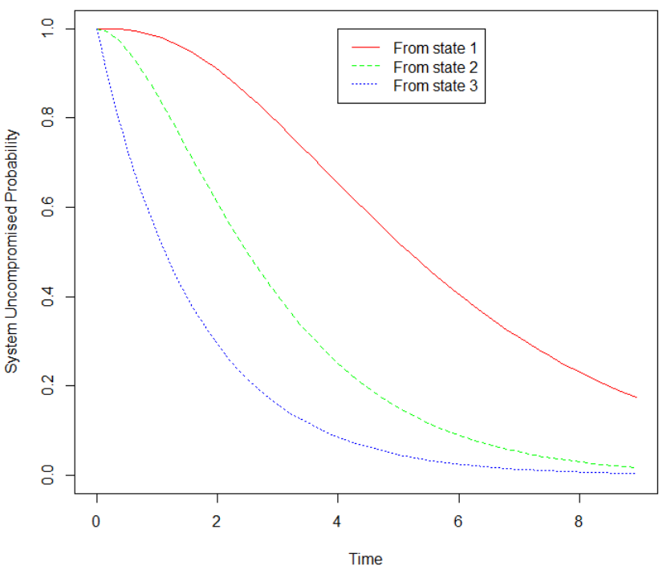
ILLUSTRATION II ….

Slide 21
conclusion
Model presented is concentrated on attacks launched remotely through internet.
Current Model focuses primarily on software vulnerabilities.
Any attack scenarios involve four states: breach, strike confidentiality, strike integrity, and strike availability—remarkably similar to the states we present here.
The obtained security measures: The amount of steps performed in each attack scenario, the most probable goal, Expected path length, Mean Time to Security Failure(MTTSF)
Estimating the transition probabilities, transition rates and holding times have always been the biggest challenges for security assessment.

Slide 22
REFERNCES
Madan, Bharat B., et al. "A method for modeling and quantifying the security attributes of intrusion tolerant systems." Performance Evaluation 56.1 (2004): 167-186.
Abraham, Subil, and Suku Nair. "Exploitability analysis using predictive cybersecurity framework." Cybernetics (CYBCONF), 2015 IEEE 2nd International Conference on. IEEE, 2015.
Leversage, David John, and Eric James Byres. "Estimating a system's mean time-to-compromise." IEEE Security & Privacy 6.1 (2008).
Trivedi, K. S. (2016). Probability and statistics with reliability, queuing, and computer science applications.

Slide 23
THANK YOU

