Slide 1
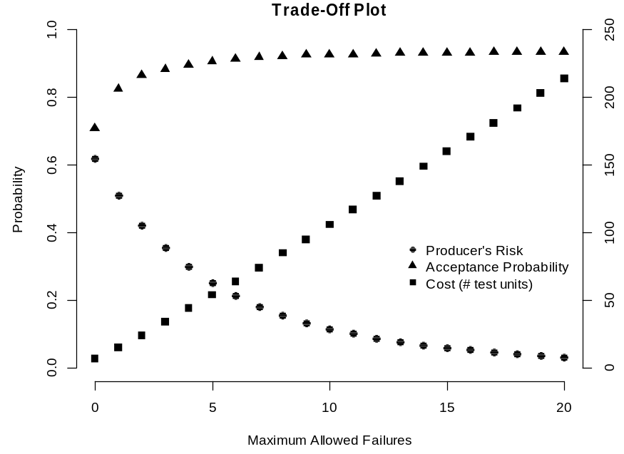
Optimal Reliability Demonstration Test Plan with Multiple Objectives
Lu Lu, University of South Florida
Christine M. Anderson-Cook, Los Alamos National Laboratory
Mingyang Li, University of South Florida

Slide 2
Outline
Binomial Demonstration Test Plan
Risk Criteria: consumer risk and producer risk
Pareto front multiple objective optimization
Three strategies based on different user priorities
Conclusions

Slide 3

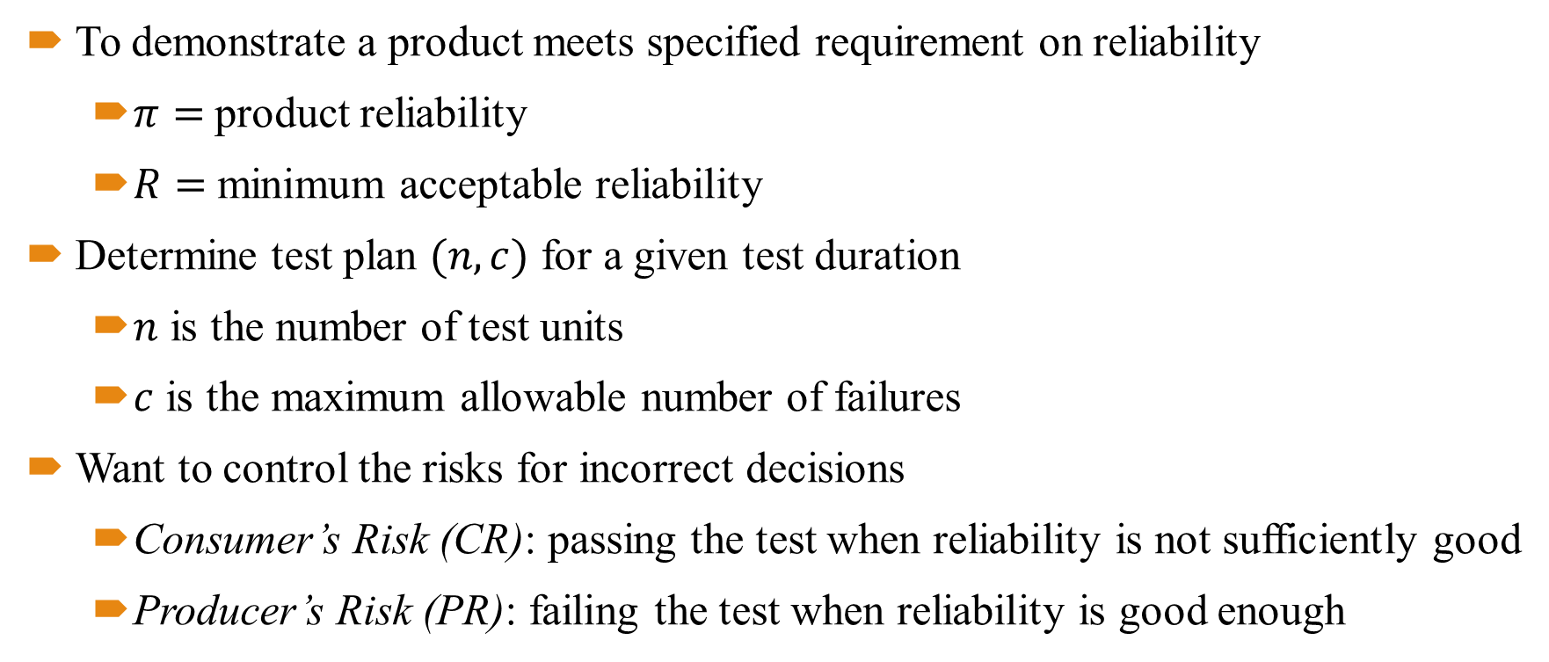

Binomial Demonstration Test Plan
To demonstrate a product meets specified requirement on reliability
  $π=$ product reliability
  $R=$ minimum acceptable reliability
Determine test plan $(n,c)$ for a given test duration
  $n$ is the number of test units
  $c$ is the maximum allowable number of failures
Want to control the risks for incorrect decisions
  Consumer’s Risk (CR): passing the test when reliability is not sufficiently good
  Producer’s Risk (PR): failing the test when reliability is good enough
0
$$R$$
1
$$π$$
Rejection Region
Acceptance Region

Slide 4
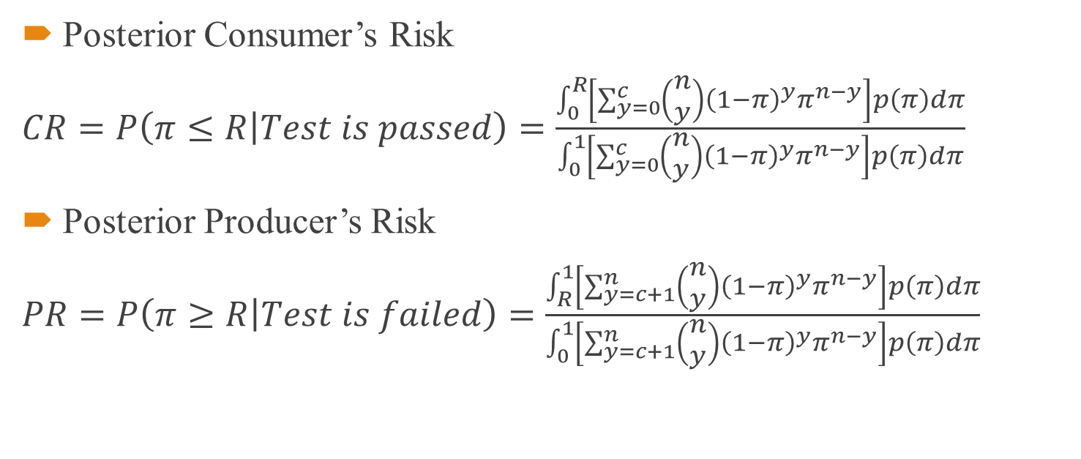
Bayesian Risk Criteria
Posterior Consumer’s Risk
$CR=P\left(π≤R | Test is passed\right)=\frac{\int_{0}^{R}{\left[\sum_{y=0}^{c}{\left(\begin{matrix}n \\ y\end{matrix}\right){\left(1−π\right)}^{y}π^{n−y}}\right]p\left(π\right)dπ}}{\int_{0}^{1}{\left[\sum_{y=0}^{c}{\left(\begin{matrix}n \\ y\end{matrix}\right){\left(1−π\right)}^{y}π^{n−y}}\right]p\left(π\right)dπ}}$
Posterior Producer’s Risk
$PR=P\left(π≥R | Test is failed\right)=\frac{\int_{R}^{1}{\left[\sum_{y=c+1}^{n}{\left(\begin{matrix}n \\ y\end{matrix}\right){\left(1−π\right)}^{y}π^{n−y}}\right]p\left(π\right)dπ}}{\int_{0}^{1}{\left[\sum_{y=c+1}^{n}{\left(\begin{matrix}n \\ y\end{matrix}\right){\left(1−π\right)}^{y}π^{n−y}}\right]p\left(π\right)dπ}}$

Slide 5
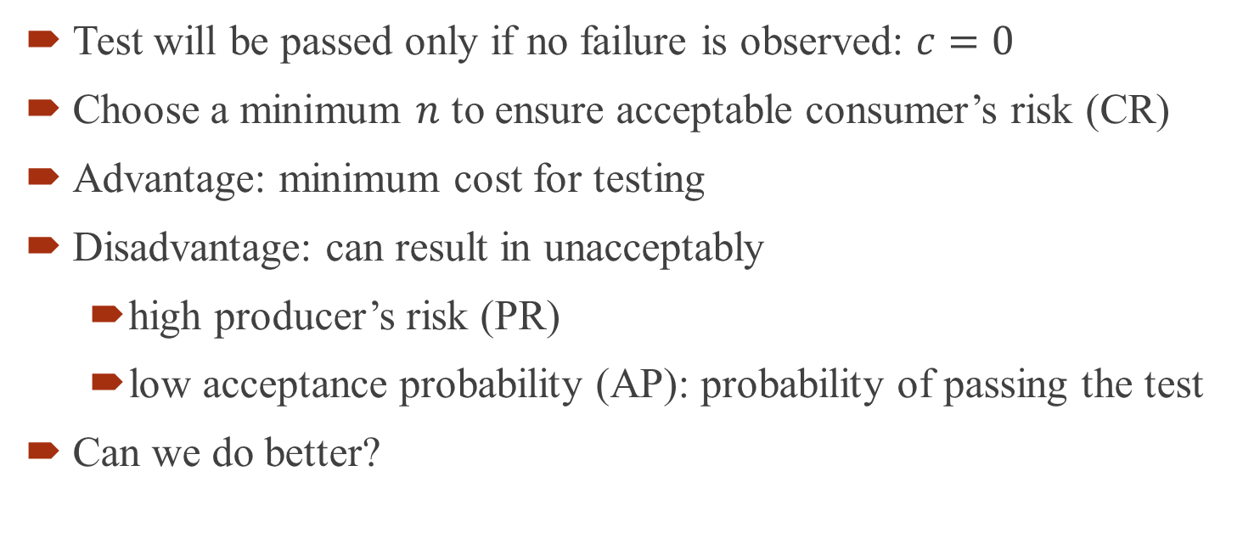
Zero-Failure Test
Test will be passed only if no failure is observed: $c=0$
Choose a minimum $n$ to ensure acceptable consumer’s risk (CR)
Advantage: minimum cost for testing
Disadvantage: can result in unacceptably
  high producer’s risk (PR)
  low acceptance probability (AP): probability of passing the test
Can we do better?

Slide 6
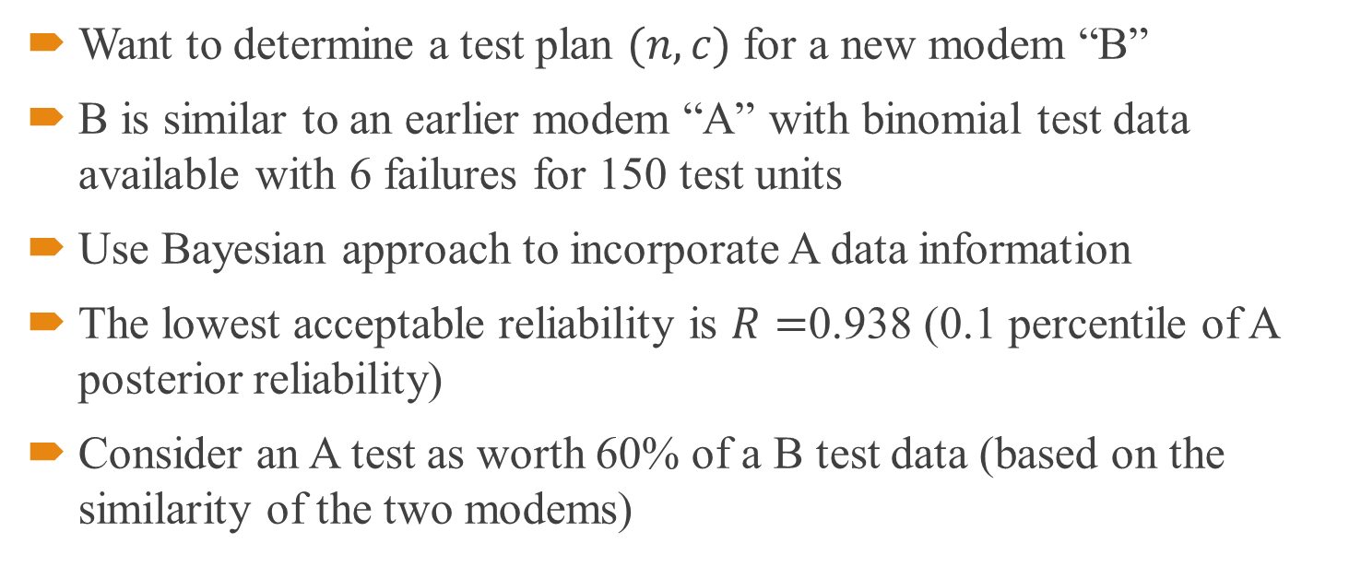
Binomial Test Plan Example
Want to determine a test plan $(n,c)$ for a new modem “B”
B is similar to an earlier modem “A” with binomial test data available with 6 failures for 150 test units
Use Bayesian approach to incorporate A data information
The lowest acceptable reliability is $R=$0.938 (0.1 percentile of A posterior reliability)
Consider an A test as worth 60% of a B test data (based on the similarity of the two modems)
Hart (1990) and Hamada et al. (2008)

Slide 7
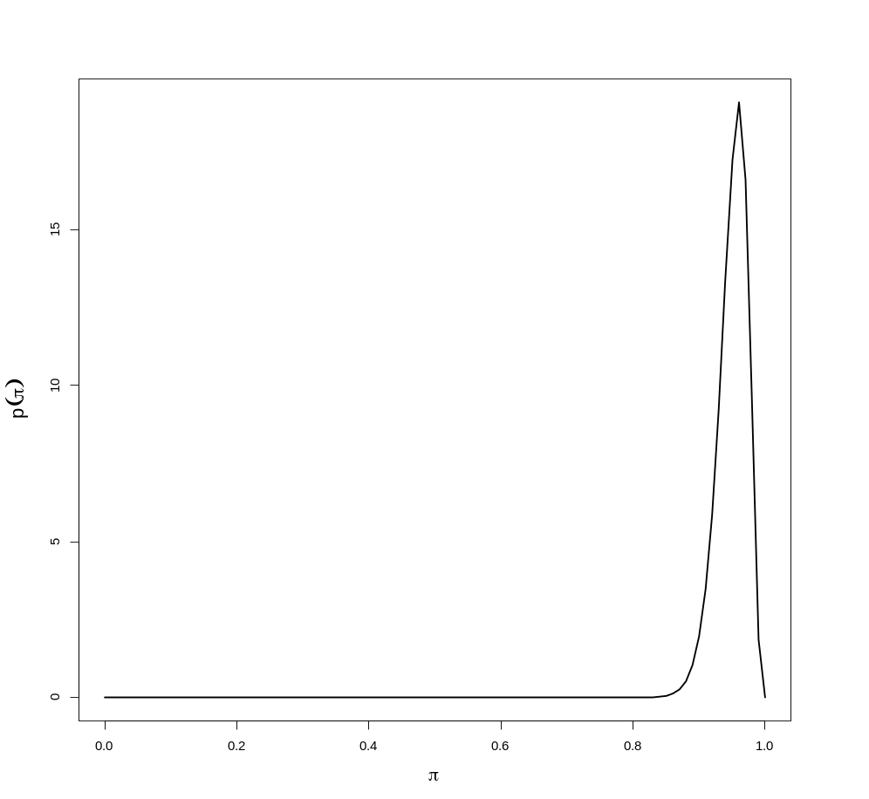
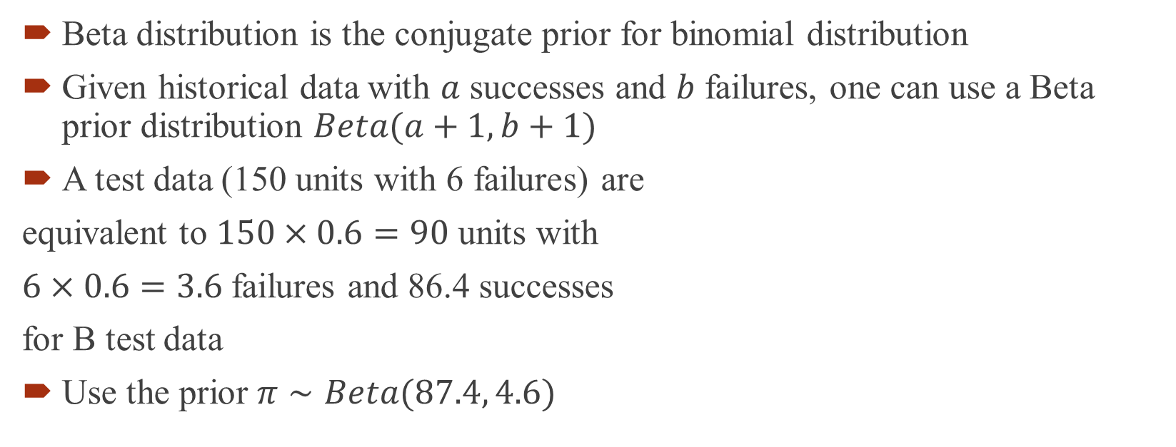
Prior Distribution Specification
Beta distribution is the conjugate prior for binomial distribution
Given historical data with $a$ successes and $b$ failures, one can use a Beta prior distribution $Beta(a+1,b+1)$
A test data (150 units with 6 failures) are
equivalent to $150×0.6=90$ units with
$6×0.6=3.6$ failures and 86.4 successes
for B test data
Use the prior $π∼Beta(87.4, 4.6)$

Slide 8
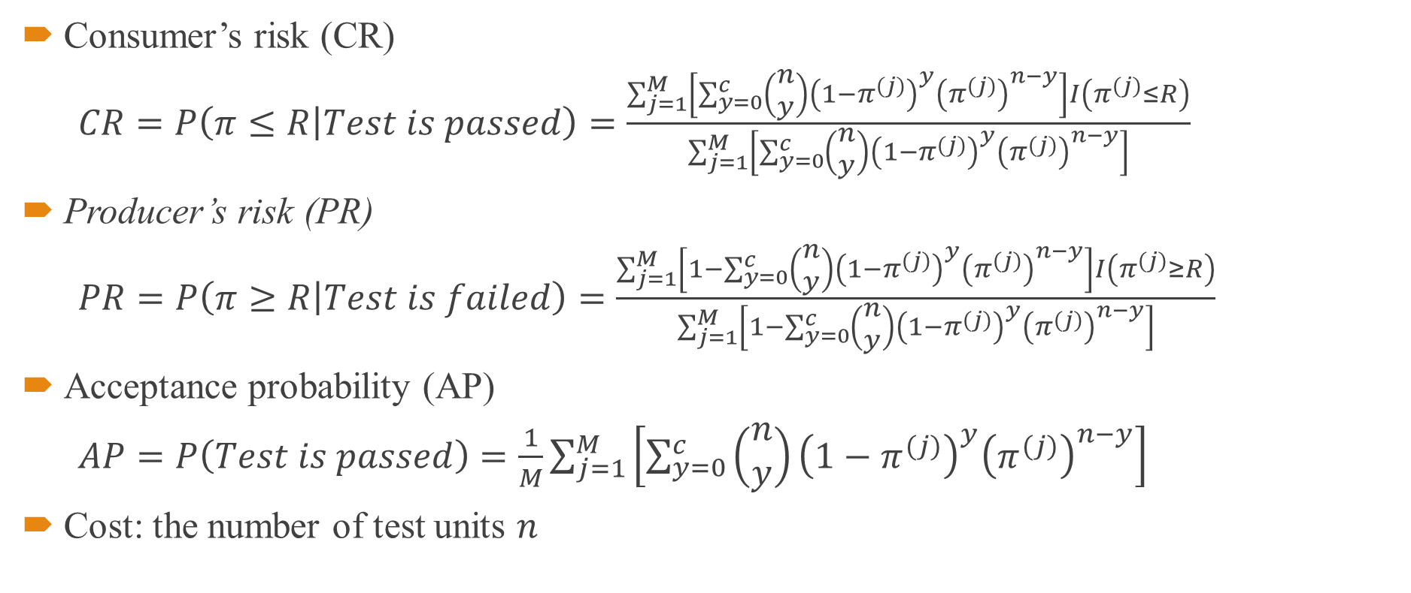
Test Criteria
Consumer’s risk (CR)
$CR=P\left(π≤R | Test is passed\right)=\frac{\sum_{j=1}^{M}{\left[\sum_{y=0}^{c}{\left(\begin{matrix}n \\ y\end{matrix}\right){\left(1−π^{(j)}\right)}^{y}{\left(π^{(j)}\right)}^{n−y}}\right]I\left(π^{(j)}≤R\right)}}{\sum_{j=1}^{M}{\left[\sum_{y=0}^{c}{\left(\begin{matrix}n \\ y\end{matrix}\right){\left(1−π^{(j)}\right)}^{y}{\left(π^{(j)}\right)}^{n−y}}\right]}}$
Producer’s risk (PR)
$PR=P\left(π≥R | Test is failed\right)=\frac{\sum_{j=1}^{M}{\left[1−\sum_{y=0}^{c}{\left(\begin{matrix}n \\ y\end{matrix}\right){\left(1−π^{(j)}\right)}^{y}{\left(π^{(j)}\right)}^{n−y}}\right]I\left(π^{(j)}≥R\right)}}{\sum_{j=1}^{M}{\left[1−\sum_{y=0}^{c}{\left(\begin{matrix}n \\ y\end{matrix}\right){\left(1−π^{(j)}\right)}^{y}{\left(π^{(j)}\right)}^{n−y}}\right]}}$
Acceptance probability (AP)
$AP=P\left(Test is passed\right)=\frac{1}{M}\sum_{j=1}^{M}{\left[\sum_{y=0}^{c}{\left(\begin{matrix}n \\ y\end{matrix}\right){\left(1−π^{(j)}\right)}^{y}{\left(π^{(j)}\right)}^{n−y}}\right]}$
Cost: the number of test units $n$
Notes:
Add 4-tuple plot for the four criteria on slide 9 or 10?

Slide 9
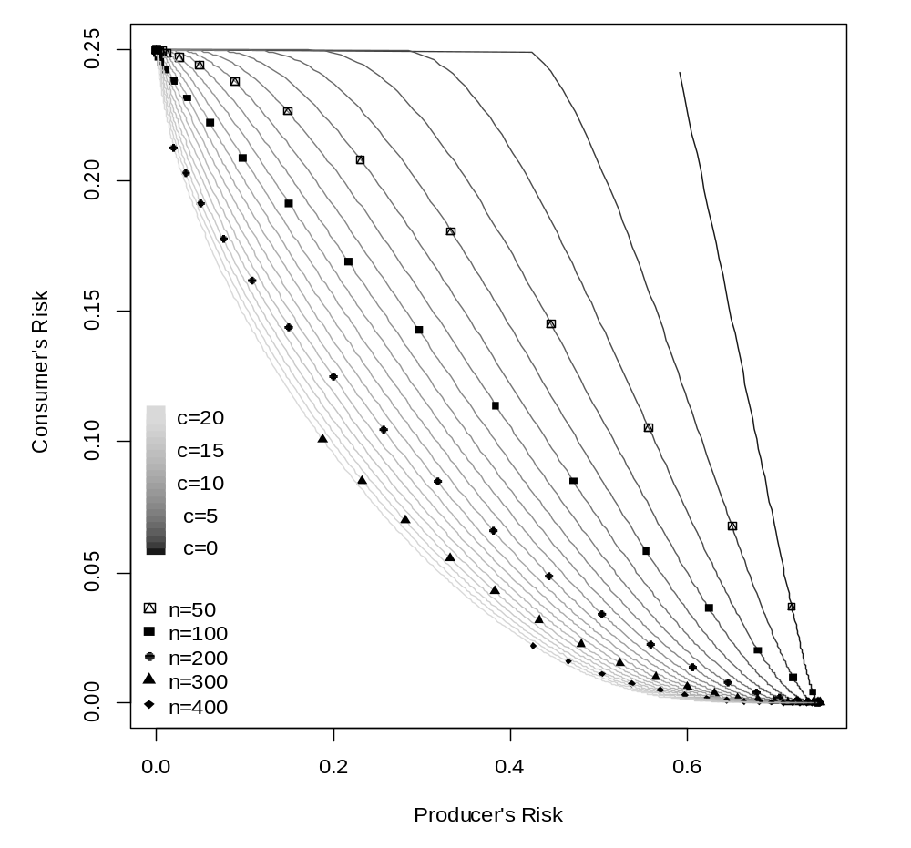
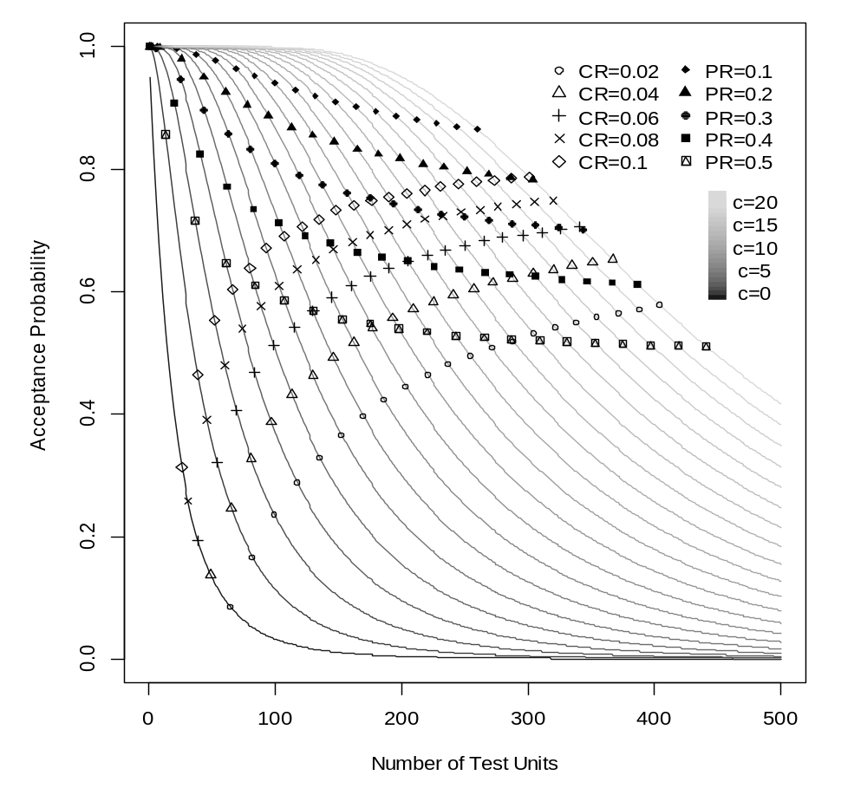
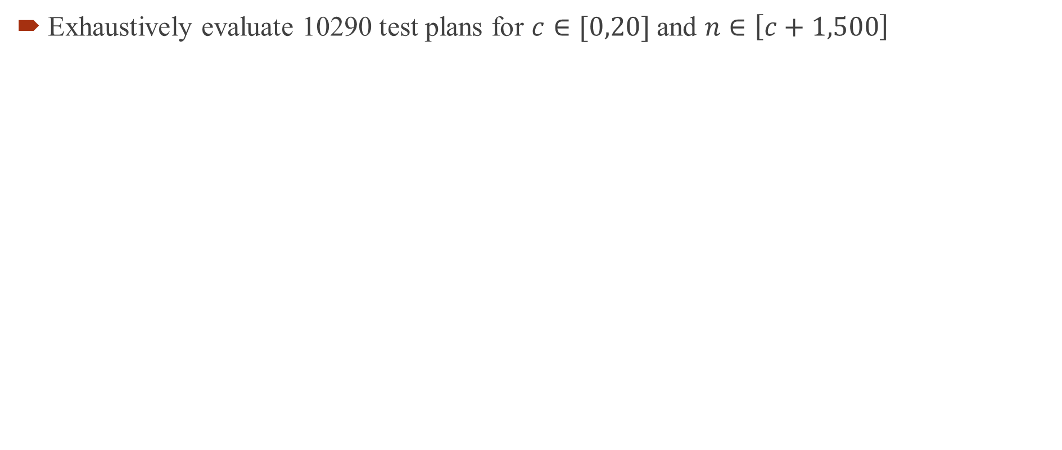
Trade-offs between Criteria
Exhaustively evaluate 10290 test plans for $c∈[0,20]$ and $n∈\left[c+1,500\right]$

Slide 10
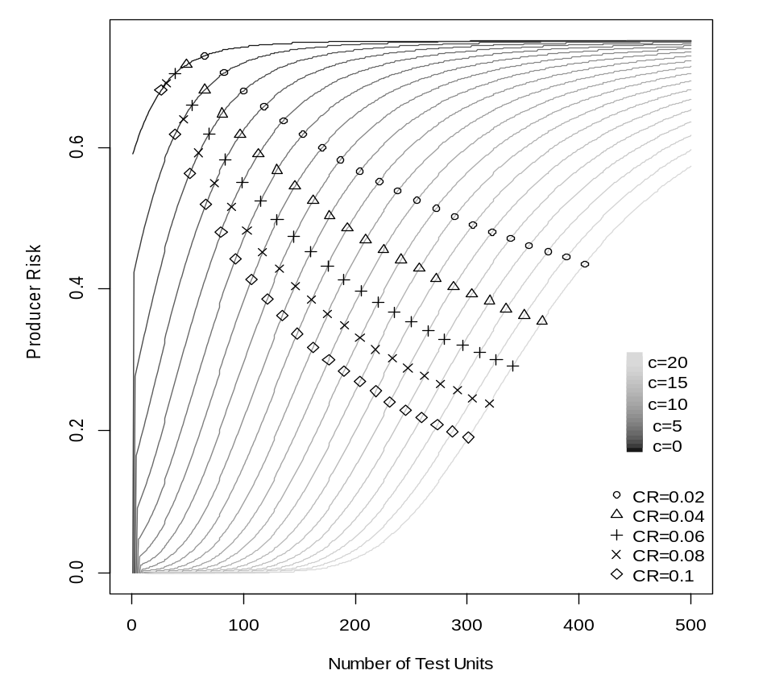
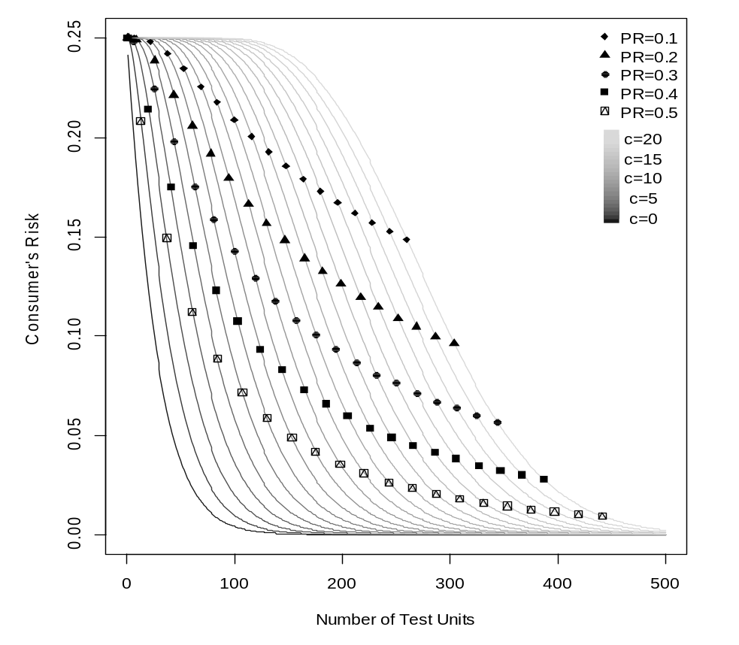
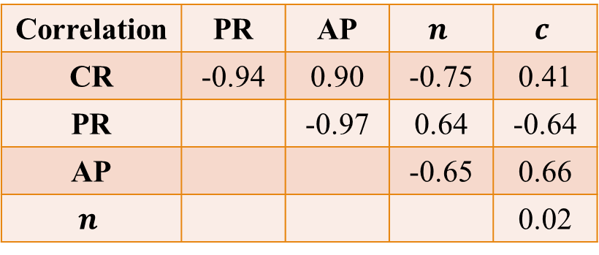
Trade-offs between
Criteria (Cont’d)
Correlation | PR | AP | $$n$$ | $$c$$
CR | -0.94 | 0.90 | -0.75 | 0.41
PR |  | -0.97 | 0.64 | -0.64
AP |  |  | -0.65 | 0.66
$$n$$ |  |  |  | 0.02
Another view of the interrelationship

Slide 11
Pareto Front Multiple Criteria Optimization
Find the Pareto set which is the collection of solutions that cannot be outperformed by any other solution based on all criteria under consideration
The set of criteria values for all solutions in the Pareto set forms the Pareto front in the criterion space
The Pareto set is the objective set of superior
solutions to consider for further decision-making
This can help reduce from 10290 choices to
a much smaller set
better
better
Criterion 2
Dominated point
Obtainable Criterion Region
Pareto optimal point
Lu, Anderson-Cook, and Robinson(2011) and
Anderson-Cook & Lu (2015) offer structured process with a rich set of graphical tools to facilitate informed and data-driven decisions
better
Utopia point
Criterion 1

Slide 12
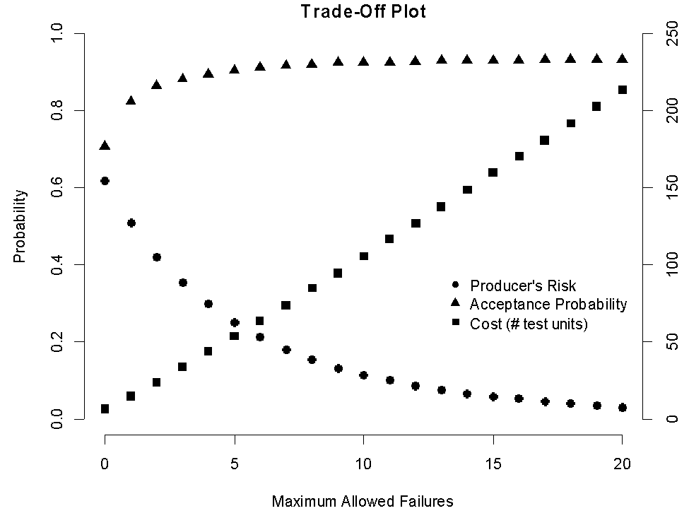
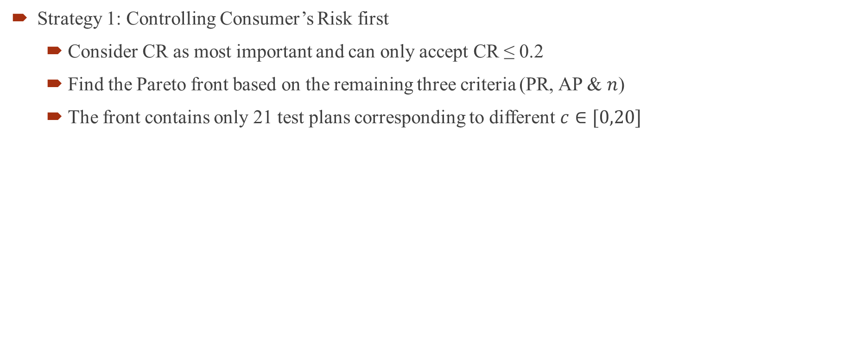
Three Strategies for Different Priorities
Strategy 1: Controlling Consumer’s Risk first
  Consider CR as most important and can only accept CR ≤ 0.2
  Find the Pareto front based on the remaining three criteria (PR, AP & $n$)
  The front contains only 21 test plans corresponding to different $c∈[0,20]$

Slide 13
Strategy 1 Examples – Fixed CR ≤ 0.2
1. Fix n ≤ 150
Test selected gives:
c = 14
PR ≈ 0.07
AP ≈ 0.93
3. Fix PR ≤ 0.1
Test selected gives:
n = 117
c = 11
AP ≈ 0.93
2. Fix c ≤ 4
Test selected gives:
n = 44
PR ≈ 0.30
AP ≈ 0.90

Slide 14
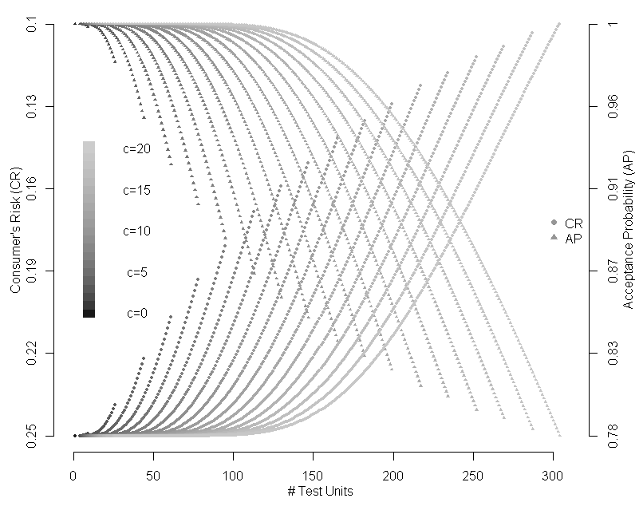
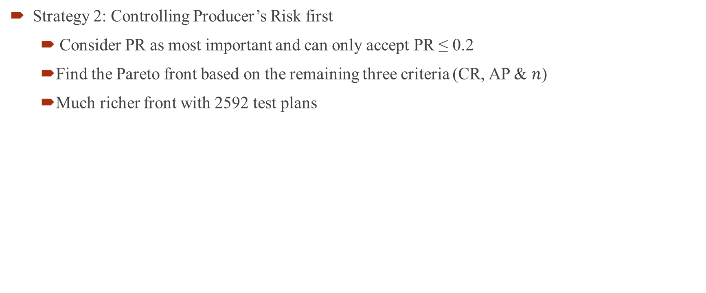
Strategy 2: Controlling Producer’s Risk first
  Consider PR as most important and can only accept PR ≤ 0.2
    Find the Pareto front based on the remaining three criteria (CR, AP & $n$)
    Much richer front with 2592 test plans
Notes:
Need a bit more discussion about how to drill down to different possible soltuions:
Eg. Next focus on max c, then look at options
Or focus on AP, then look at choices?

Slide 15
Strategy 2 Examples – Fixed PR ≤ 0.2
2. Fix n ≤ 100
1. Fix CR ≤ 0.15
Still multiple choices
Fix CR ≤ .2
Still multiple choices
Fix c ≤ 5
Not Possible
Test selected gives:
n = 100
c = 9
CR ≈ 0.19
AP ≈ 0.87
or
n = 95
c = 9
CR ≈ 0.2
AP ≈ 0.85
b. Fix c ≤ 15
Test selected gives:
n = 193
AP ≈ 0.92

Slide 16
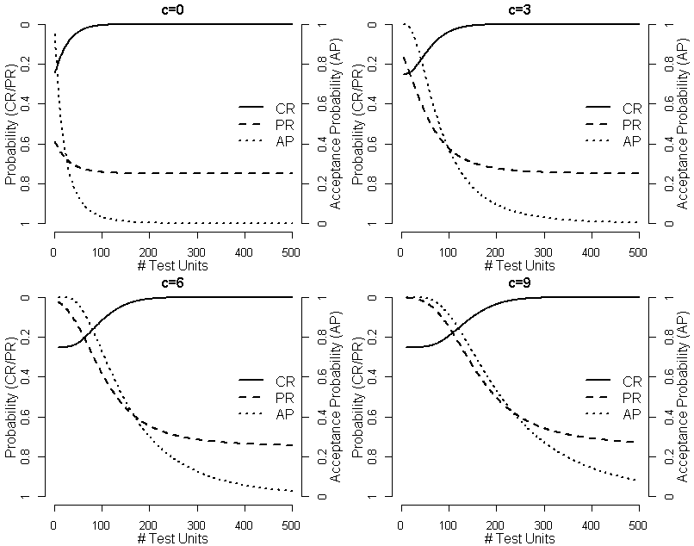
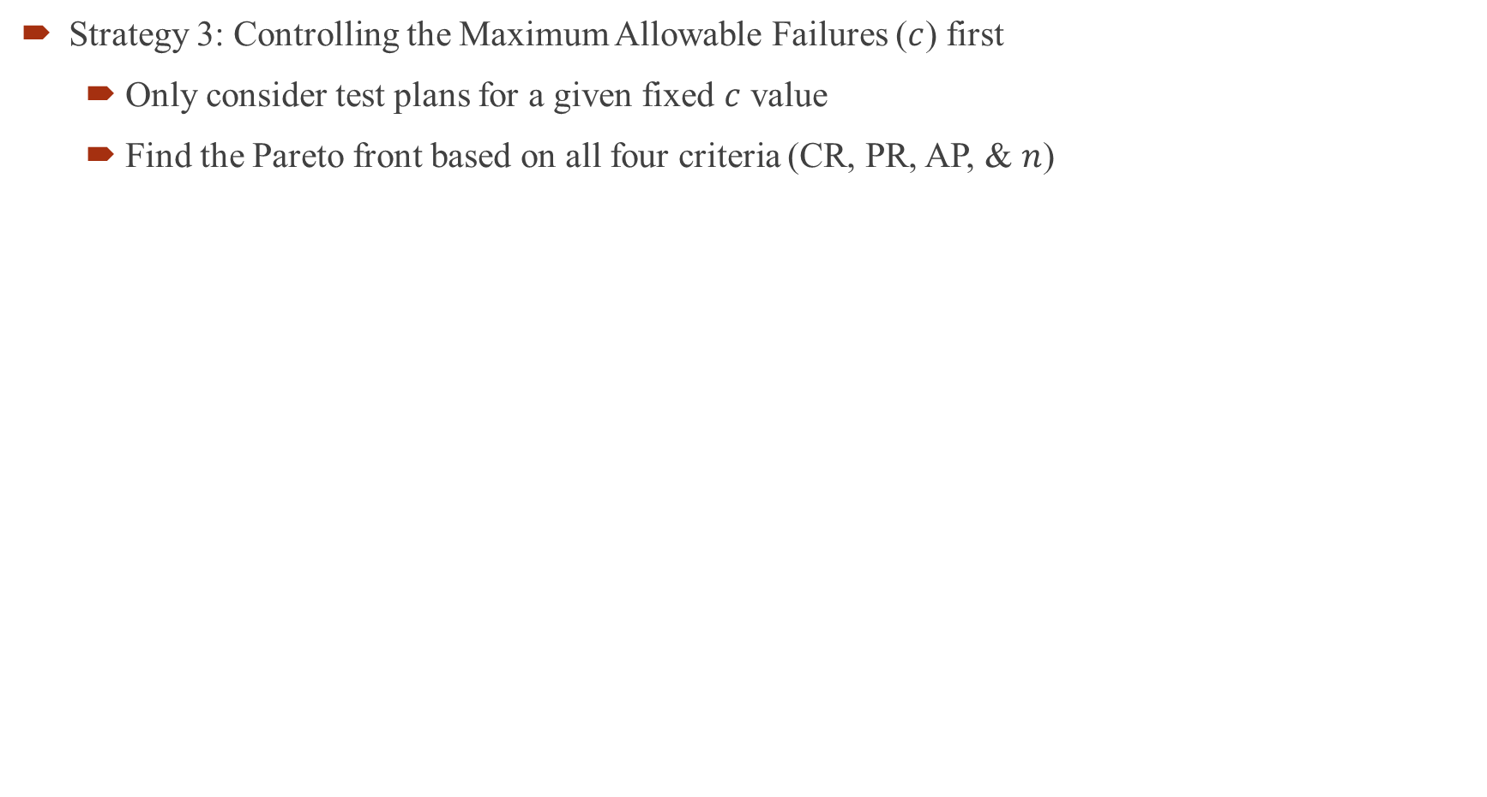
Strategy 3: Controlling the Maximum Allowable Failures ($c$) first
  Only consider test plans for a given fixed $c$ value
  Find the Pareto front based on all four criteria (CR, PR, AP, & $n$)
Notes:
Also need to talk through some different scenarios and identify a best test

Slide 17
Strategy 3 Examples – Fixed c first
1. Fix c = 3
Fix n ≈ 200
Test selected gives:
CR ≈ 0
PR ≈ 0.7 (!!!)
AP ≈ 0.1 (!!!)
For c = 3
Likely sensible ranges
for n are < 80

Slide 18
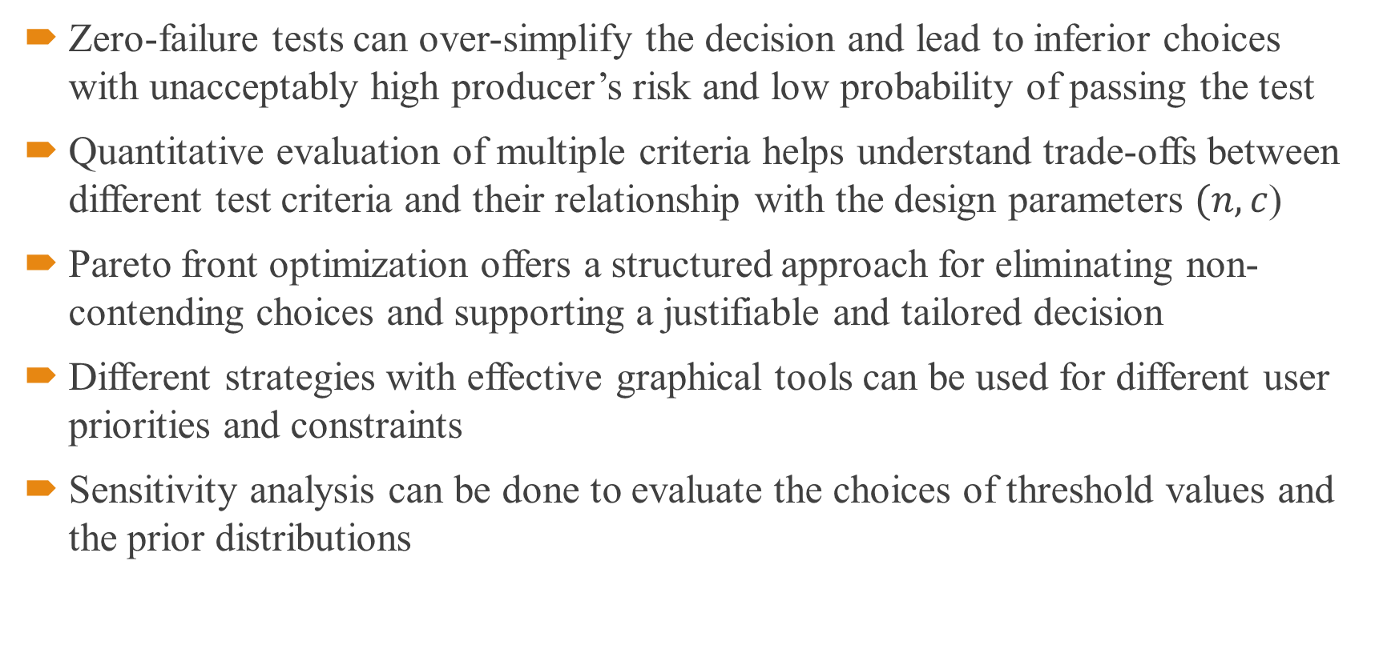
Conclusions
Zero-failure tests can over-simplify the decision and lead to inferior choices with unacceptably high producer’s risk and low probability of passing the test
Quantitative evaluation of multiple criteria helps understand trade-offs between different test criteria and their relationship with the design parameters $(n,c$)
Pareto front optimization offers a structured approach for eliminating non-contending choices and supporting a justifiable and tailored decision
Different strategies with effective graphical tools can be used for different user priorities and constraints
Sensitivity analysis can be done to evaluate the choices of threshold values and the prior distributions

Slide 19
Reference
Lu, L., Li, M., Anderson-Cook, C.M. (2016) “Multiple Objective Optimization in Reliability Demonstration Testing” Journal of Quality Technology 48 (4) 326-342.
Anderson-Cook, C.M., Lu, L. (2015) “Much-needed structure: a new 5-step decision-making process helps you evaluate, balance competing objectives”, Quality Progress, 48(10) 42-50.
Hamada, M. S., Wilson, A.G., Reese, C.S., and Martz, H.F. (2008). Bayesian Reliability, Springer.
Hart, L. (1990) “Reliability of modified designs: a Bayes’ analysis of an accelerated test of electronic assemblies”, IEEE Transactions on Reliability, 39, pp. 140-144.
Lu, L, Anderson-Cook, CM, and Robinson, TJ. (2011) “Optimization of designed experiments based on multiple criteria utilizing a Pareto frontier”, Technometrics, 53, pp. 353 – 365.

Slide 20
Thank you!

