Slide 1
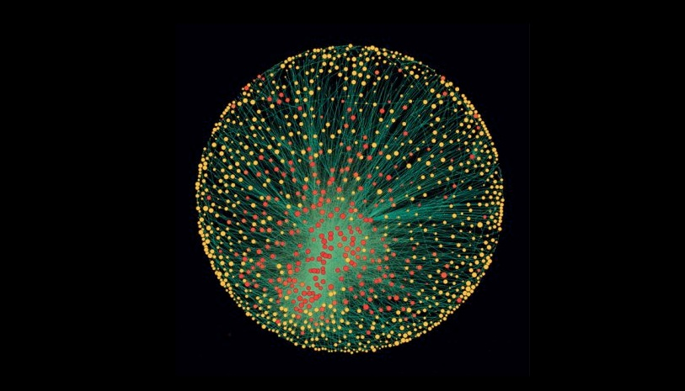
Cyber futures surviving and thriving in the brave new world
Dr. Ronald Sanders
Director and Clinical Professor
School of Public Affairs
University of South Florida

Slide 2
Cyber Futures
Augmented Humanity
Cyber Crimes, Cyber Wars
The Future of Cyber
The War for Cyber Talent
Cyber Ninjas

Slide 3
Cyber futures:
Augmented society, augmented Humanity
Today…
Tomorrow…
Internet of Things
Conscious Connectivity
Tech-Assisted
Wearable Devices
Alexus and Roomba
Vulnerable…
Prevention and Detection
Internet of Everything
Ubiquitous Connectivity
Autonomous/AI
Implanted Devices
Robots and AIs
Brittle…
Insurance and Inoculation
What does this mean for…
Cities and Communities, Friends and Family, Malls and Schools?

Slide 4
Cyber futures:
Cyber crimes, cyber wars
Today…
Tomorrow…
Cyber Terror
Cyber Felonies, Cyber Gangs
Social Media: Troll Farms and Influence OPS
Hard Targets: Nations, Organizations
Free Lance, Allied Threat Actors
Black Hats vs. White Hats
Compartmented, Proprietary Responses
Cyber Wars
Cyber Muggings, Cyber Crime Families
Social Media: I/O and Active Measures
Soft Targets: Individuals, Communities
Vertically Integrated Threat Networks
Ninjas, Heuristic Machines, Killer Robots
Integrated, WOG Responses
What does this mean for the economy, national security, culture and society…
Nations and Militaries, Cops and Robbers, Security and Privacy?

Slide 5
Cyber futures: the war for talent
Today…
Tomorrow…
Adam Smith vs. Lenin
Supply Gaps
Traditional Pipelines
Decentralized Chaos
Hard Technical Skills
Clearances and Background Checks
Citizenship Barriers
Militias vs. Minutemen
Capacity Gaps
Non-Traditional Talent Development
Centralized ‘Planning’
Softer Cognitive/CT Skills
Real-Time, Continuous Monitoring
MAVNI-like Models
What does this mean for…
Labor Markets, Universities and Community Colleges, Schools?

Slide 6
Cyber Futures: the cyber Career…broadly defined
Today…
Tomorrow…
Gangs and Guards
Recruiters
SIGINT and Cryptoanalysis
Interviews and Internships
Bureaucracies and Desk Jobs
Pay Checks
Samurai
Guilds and Networks
Targeters
All-Source and ‘Big Data’
Cyber ROTC and Commission
Flying Squads, Sentient Organizations
Bounties
Ronin
What does this mean for…
Organizations and Professionals, Careers and Jobs, Learning?

Slide 7
Cyber futures
So What Does All This Mean?

