Slide 1


Stochastic Game Models in Cyber Security
Kandethody Ramachandran & Zheni Stefenova
Department of Mathematics and Statistics
University of South Florida

Slide 2







Who attacks our network?
A cyber attack is an attack initiated from a computer against a website, computer system or individual computer (collectively, a computer) that compromises the confidentiality, integrity or availability of the computer or information stored on it.
Hacktivists
Hackers
Terrorists,
Criminal Groups
Foreign
Governments
Disgruntled
Insiders

Slide 3





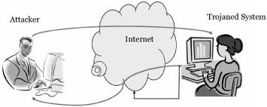
Cyber Security and Game theory
Dynamic of the new attacking strategies and vulnerability of the protection mechanisms;
Not efficient enough quantitative decision framework to defend against highly organized attacks;
Game theory provides a set of quantitative and analytical tools for describing and analyzing interactive decision situations in computer security.
model the interactions between an omnipresent attacker and system administrators as the defender.
Security
DoS/DDoS, Brut force,
SQL injection etc
Example: Remote Attack
“Vampires are fond of their games. But the games that They play are different than the variants that I'm familiar with. The rules were made to be bent, broken, shattered—and somebody always gets hurt. Always.”

Slide 4
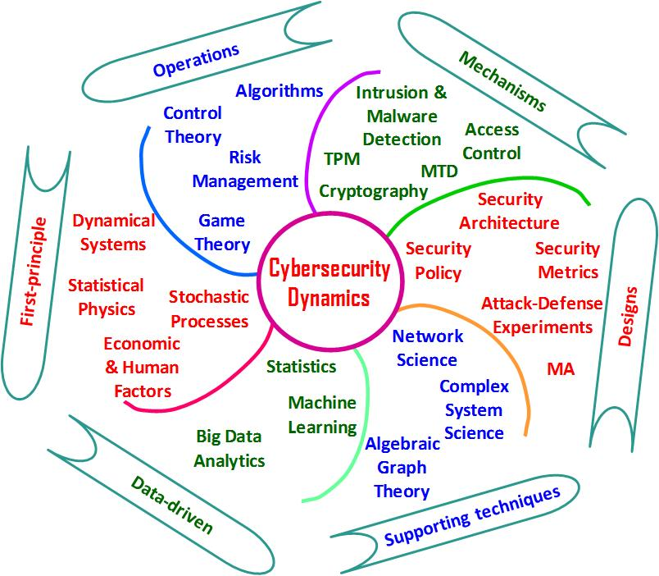
Some practical solutions?
Cyberspace’s dynamic nature must be acknowledged and addressed by policies that are equally dynamic.
Game theory can provide the needed decision and control framework for intrusion detection systems (IDS) to address issues like attack modeling, analysis of possible threats, and decision on response actions

Slide 5
Current research classification
Game Theory
Cooperative Game
Non-Cooperative game
Static Game
Dynamic game
Complete and Imperfect information
Incomplete and Imperfect information
Bayesian approach
Non Bayesian approach

Slide 6
Static games
Static games: all players make decisions simultaneously, without having an information of the decisions that are being made by other players (imperfect information);
According to the completeness of information, static games can be divided into two classes:
Complete and Imperfect information: Jormokka and Carin
Incomplete and Imperfect information: Liu
Static Games
Complete and Imperfect information
Incomplete and Imperfect information
Bayesian approach
Non Bayesian approach

Slide 7

Dynamic Games
Dynamic or stochastic games: presented by Lloyd Shapley in early 1950s: a collection of normal-form games that the agents play repetitively, played by one or more players.
Complete perfect information: Lye, Xiaolin, Nguyen.
Complete imperfect information: Alpcan, Nguyen, Chen
Incomplete perfect information: Chen, Patcha, Alpcan, Bloem, Basar
Incomplete imperfect information: Alpcan, You, Basar
Lloyd Shapley
2012 Nobel Memorial Prize in Economic Sciences
"for the theory of stable allocations and the practice of market design
Dynamic Games
Complete and perfect information
Complete and Imperfect information
Incomplete and perfect information
Incomplete and imperfect information

Slide 8





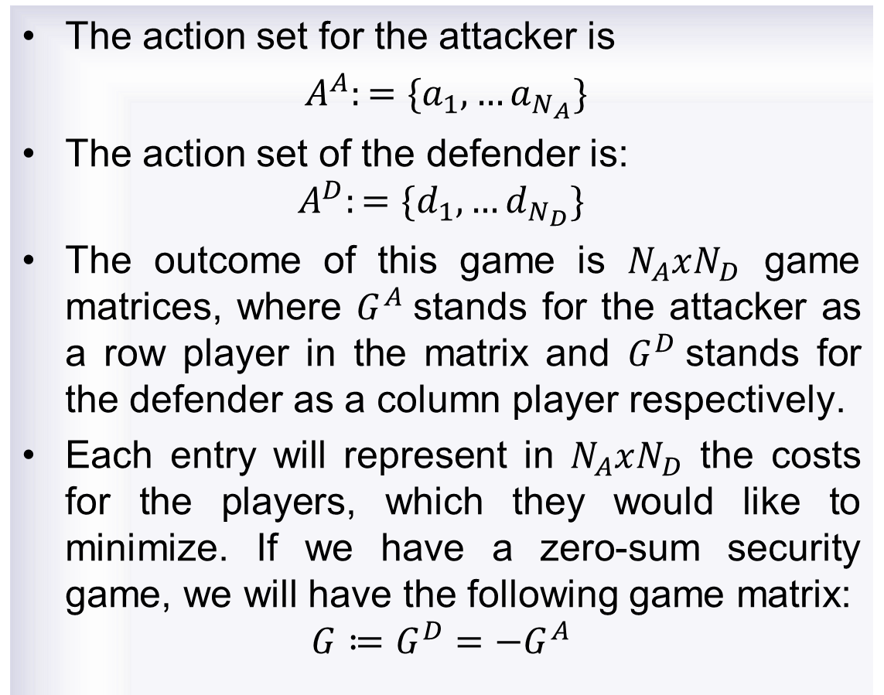
Game Theory 2 players
The action set for the attacker is
$A^{A}:=\{a_{1},…a_{N_{A}}\}$
The action set of the defender is:
$$A^{D}:=\{d_{1},…d_{N_{D}}\}$$
The outcome of this game is $N_{A}xN_{D}$ game matrices, where $G^{A}$stands for the attacker as a row player in the matrix and $G^{D}$stands for the defender as a column player respectively.
Each entry will represent in $N_{A}xN_{D}$ the costs for the players, which they would like to minimize. If we have a zero-sum security game, we will have the following game matrix:
$$G≔G^{D}=−G^{A}$$
Internet
Server 1
Server 2
Server 3

Slide 9
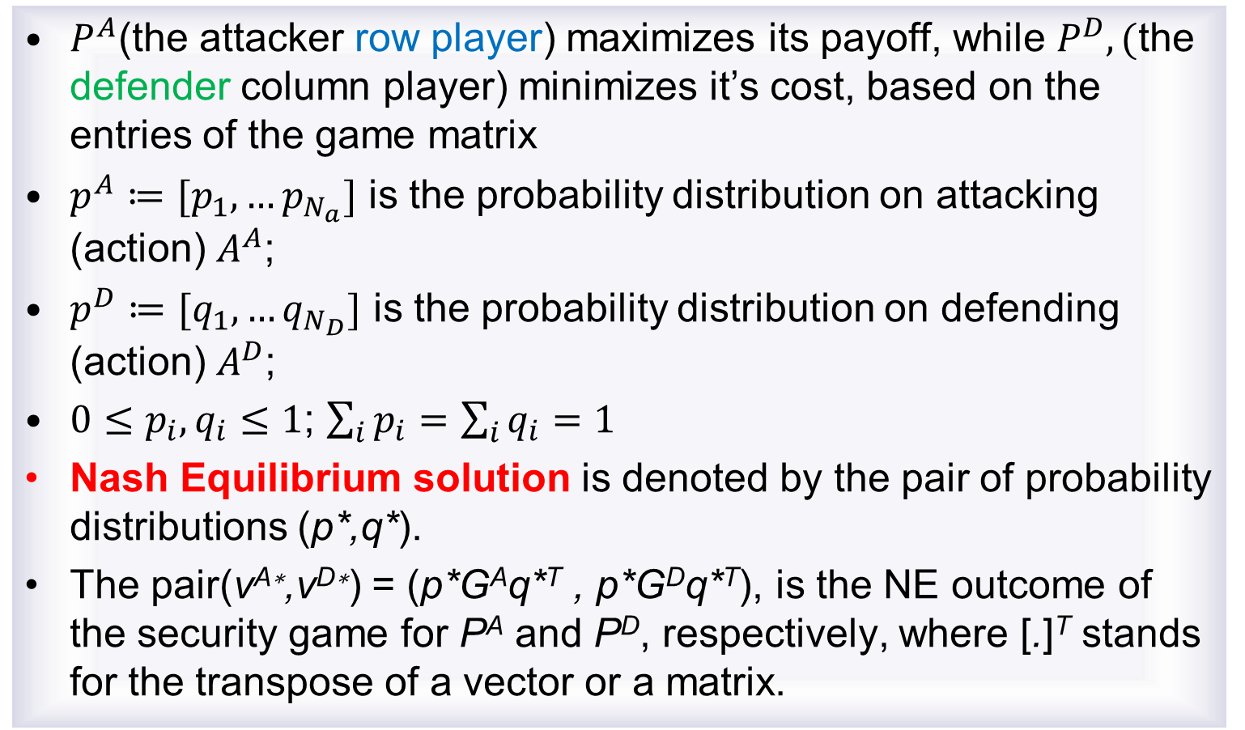
Game Theory 2 players
$P^{A}$(the attacker row player) maximizes its payoff, while $P^{D},($the defender column player) minimizes it’s cost, based on the entries of the game matrix
$p^{A}≔[p_{1},…p_{N_{a}}]$ is the probability distribution on attacking (action) $A^{A}$;
$p^{D}≔[q_{1},…q_{N_{D}}]$ is the probability distribution on defending (action) $A^{D}$;
$0≤p_{i},q_{i}≤1$; $\sum_{i}{p_{i}}=\sum_{i}{q_{i}=1}$
Nash Equilibrium solution is denoted by the pair of probability distributions (p*,q*).
The pair(v^{A∗},v^{D∗}) = (p*G^{A}q*^{T} , p*G^{D}q*^{T}), is the NE outcome of the security game for P^{A} and P^{D}, respectively, where [.]^{T} stands for the transpose of a vector or a matrix.

Slide 10





Stochastic Games
Stochastic Games
A 2-person stochastic game with finite state action spaces is given by
Where S-finite state space, A(s) & B(s) are finite set of admissible actions in state s for player 1 & player 2, respectively,
p=p(s,a,b,z) is the transition probability from state s to z with actions a & b.
is the reward function. is the discount factor.
If
The game is called zero-sum, otherwise general sum.

Slide 11







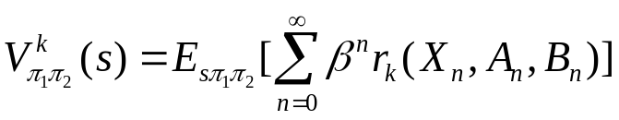
Stochastic Game
A strategy for a player is a rule for any given history
Such strategies are represented by
For initial state s and any strategy pair
In zero-sum game, player 1 tries to maximize his profit while player 2 tries to minimize the same.
upto stage n, helps to choose a randomized action to use in state
at stage n.
discounted reward to player
with
(state, action pair) is

Slide 12
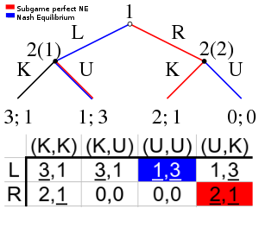

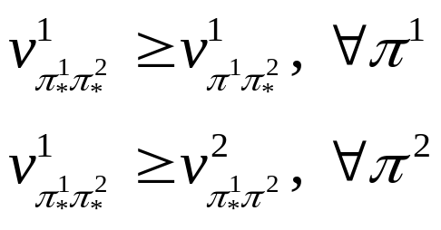

Stochastic Games
The Nash equilibrium of this game is defined to be a pair of strategies which simultaneously satisfy the following equations component-wise:
The value of the game is considered as where 𝑠₁ is the start state;
Let 𝑉 denote the value of the game;
$$v_{π_{∗}^{1}π_{∗}^{2}}^{1}(s1)$$
Under appropriate conditions it can be shown that a value (equilibrium) exists.

Slide 13
Intrusion Detection: Definition
Definition. Intrusion Detection (ID) is the process of monitoring the events occurring in a computer system or network and analyzing them for signs of intrusions, defined as attempts to compromise the confidentiality, integrity, availability, or to bypass the security mechanisms of a computer or network.
Attack Types
Confidentiality: Unauthorized access to company secrets, resources.
• Integrity: Altering system state or data (e.g. in databases)
Scanning Attacks: Attacker gains more information on target system. e.g. probing ports.
Denial of Service: Attacker renders the service unavailable. e.g. flooding
Penetration: Attacker gains unauthorized privileges in the system.
Input Validation Error: Attacker causes system to execute a malicious program by sending a specific input. e.g. Buffer overflow

Slide 14
Intrusion Detection Systems
Information Sources
⇒
Analysis
⇒
Response
• Information Sources:
– Network Based (Distributed) IDSs: monitor packets
– Host Based IDSs: Analyze system logs, messages on the host
– Application Based: Analyze application behavior, logs
• Analysis: Misuse/signature detection (e.g. specific event patterns); Anomaly (e.g. CPU utilization of a process, login count of users, data integrity).
• Response: Active (change environment, e.g. password change) ; Passive (alert through alarms)

Slide 15
Application of Game Theory to Intrusion Detection
Reconfiguration of security policies given the severity of attacks and making decisions on tradeoffs like increasing security versus increasing system overhead or decreasing efficiency.
• Decisions on where to allocate or reallocate limited resources in real time for detecting significant threats to vital subsystems in a large networked system.
• Modeling, development, and analysis of distributed decision and control schemes (possibly using autonomous software agents).

Slide 16
Intrusion Detection System
SENSORS
For Intrusion/Anomaly Detection
Other Methods
Patttern Recognition
Signature Matching
Neural Networks

Slide 17


Intrusion Detection Games
[Alpcan and Basar]
Afrand Agah, Sajal K. Das, Kalyan Basu, Mehran Asadi
Consider a zero-sum finite Markov game model with 2 players (attacker & IDS (Intrusion detection system))
Action space of the attacker is defined as (represents various attack types)
IDS’s action space is
(passive actions (such as setting an alert) and active actions (like gathering further information)
In this stochastic system, players are assumed to interact.

Slide 18



Intrusion Detection Games
The output of the sensor network is captured by a finite number of environment states
Each state may represent detection of a specific type of attack or correspond to “no detection”
The sensor network is modeled as a finite state Markov chain.
Probability of the sensor network’s output being in a specific state is given by the vector
where

Slide 19

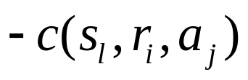
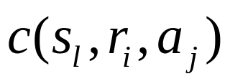
Intrusion Detection Games
The transition probabilities between environment states are described by the transition matrix
The IDS’s and attacker’s cost are (respectively)
Attacker
NA
D
ND
A
D
NR
c(D,NA,NR)
R
c(D,NA,R)
NR
c(ND,NA,R)
R
c(ND,NA,R)
ND
NR
c(D,A,NR)
R
c(D,A,R)
NR
c(ND,A,NR)
R
c(ND,A,R)
and
Simple game
Sensor
Sensor
IDS
IDS

Slide 20
Intrusion Detection Games
Assume that each player knows its own cost at each stage of the game.
3 different information structures are considered:
full information;
no information about sensor network characteristics (transition probabilities, M), and
only information about own costs, past actions, and past states

Slide 21
Intrusion Detection Games
(i) In the full information case each player knows everything about the sensor network as well as the preferences and past actions of its opponent.
Players may utilize well-known MDP(Markov decision process) methods such as value iteration to calculate their own optimal mixed strategy solutions to the zero-sum game.
(ii) In this case, the attacker can calculate its optimal strategy online (i.e. while playing the game) using a technique called minimax-Q learning.
(iii) In this situation where a player only observes the sensor network’s output and keeps track of its own actions and costs. In this third case, we study single agent “naive” Q-learning (ignoring the other player’s actions) as a possible approach.
Note: Calculating an optimal strategy for this zero-sum Markov game under extremely limited information continues to be an interesting research question.

Slide 22
Some Other Forms of Games
Flipit game (ALAN NOCHENSON and JENS GROSSKLAGS, Ari Juels,… )
Data fusion approach (Dan Shen, Genshe Chen, Jose B Cruz, Jr., Leonard Haynes, Martin Kruger, and Erik Blasch)
Game theoretic decision support (Yoav Freund, Robert E Schapire)
Simulation Game for Computer Security (Michael L. Valenzuela, and Jerzy W. Rozenblit)
Cooperative game theory for security warning schemes

Slide 23
Key References
A. Agah, S. Das, K. Basu, and M. Asadi, “Intrusion detection in sensor networks: A non-cooperative game approach,” in 3rd IEEE International Symposium on Network Computing and Applications, (NCA 2004), Boston, MA, August 2004, pp. 343–346.
Tansu Alpcan, and Tamer Basar, An Intrusion Detection Game with Limited Observations, http://alpcan.org/tansu/papers/isdg06.pdf
Tansu Alpcan, and Tamer Basar, Network Security A decision and game-theoretic Approach, Cambridge University press, 2011.
Ibidunmoye EO, Alese BK, and Ogundele OS, A Game-theoretic Scenario for Modelling the Attacker- Defender Interaction, J Comput Eng Inf Technol 2013
D. McMorrow, Science of Cyber-Security, MITRE Corporation report, 2010, http://fas.org/irp/agency/dod/jason/cyber.pdf
Quanyan Zhu, Hamidou Tembine, and Tamer Basar, HYBRID LEARNING IN STOCHASTIC GAMES AND ITS APPLICATION IN NETWORK SECURITY, http://publish.illinois.edu/quanyanzhu/files/2012/10/LearningChapter.pdf

Slide 24

You have to learn the rules of the game and then you have to play better than anyone else – “Albert Einstein”
Computers More Difficult to Secure than a Car, or a House!

