Slide 1

Avlino Inc.
Presentation to: University of south florida

Slide 2

Prophecies often fail…..
“I think there is a world market for maybe five computers.”
Thomas Watson, chairman of IBM, 1943 
“There is no reason anyone would want a computer in their home.”
Ken Olson, President, Chairman of Digital Equipment Corp., 1977 
“640K ought to be enough for anybody.”
Bill Gates, chairman of Microsoft, 1981
Share Point of View:
To highlight the changing paradigms; &
Provoke new thinking

Slide 3
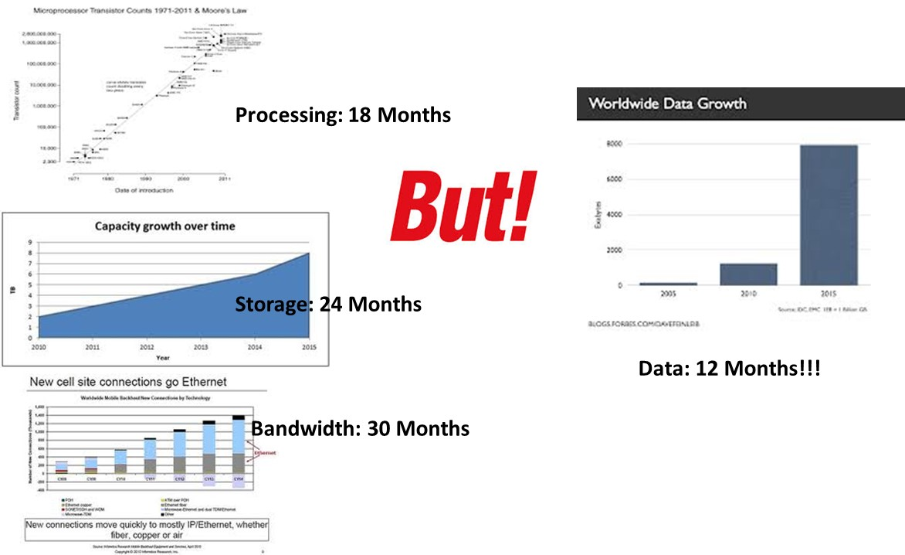
Exponential Data Growth
Processing, Storage, and N/W BW Doubling 18-30 months, Data Doubling every 12 Months!!!

Slide 4
Paradigm Shifts in the Enterprise Computing
Virtualization versus Distributed Computing
Data to CPU versus CPU to Data
Open Source versus Proprietary SW
Structured versus Unstructured Data
Noise in Data versus Data in Noise
Appliances versus Platforms

Slide 5
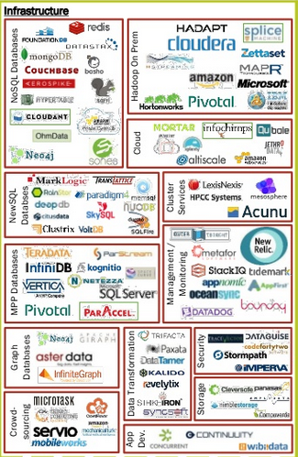
Landscape Analysis – Change of Guard

Slide 6
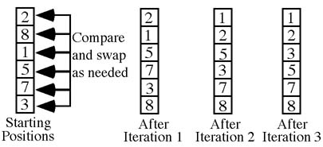
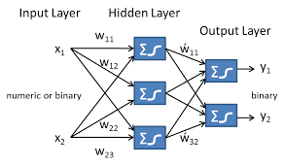
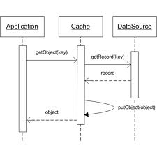
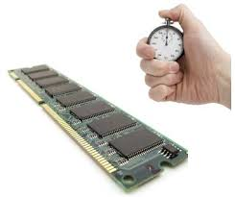

What did Avlino do to address the challenge?
Acelero has a patent-pending approach to Data Engineering with M-R framework
Enhanced Sorting Technique
Predictive Learning Capability
Adaptive Caching Mechanism
In-Memory
Shuffling

Slide 7


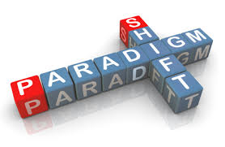




Avlino Software Value Proposition
Avlino’s Acelero Software propels 1 Analytics Server to do the Task of 2-3 Servers
Faster Analytics
Quicker Results
Fewer Servers
Lower Power & Cooling
Improved Utilization
Lower TCO

Slide 8


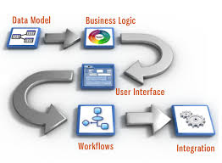
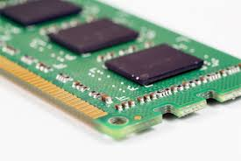
How easy is to implement Avlino SW?
Avlino’s Acelero Software Solution is a true Plug N Play Solution
Code Change??
Data Flow Change??
Added System Requirement??

Slide 9
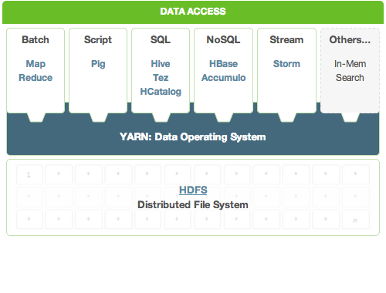






What components does Avlino Accelerate?
Avlino’s accelerates all major Map-Reduce distributions and the supporting ecosystem
Spark
Apache, Cloudera, MapR, and Hortonworks have 80-90% of Map-Reduce distribution Market Share
  Avlino’s Acelero Software accelerates all of the above four vendors, i.e. Acelero Software can accelerate the solutions by 3 vendors on a plug N play basis
  Avlino is certified by leading M-R vendors including Cloudera and MapR. Hortonworks Certification is in progress
PIG and Hive are the most popular Scripting languages in Data Analytics
  Acelero supports both PIG and Hive, and hence seamlessly integrates with Analytics ecosystem

Slide 10
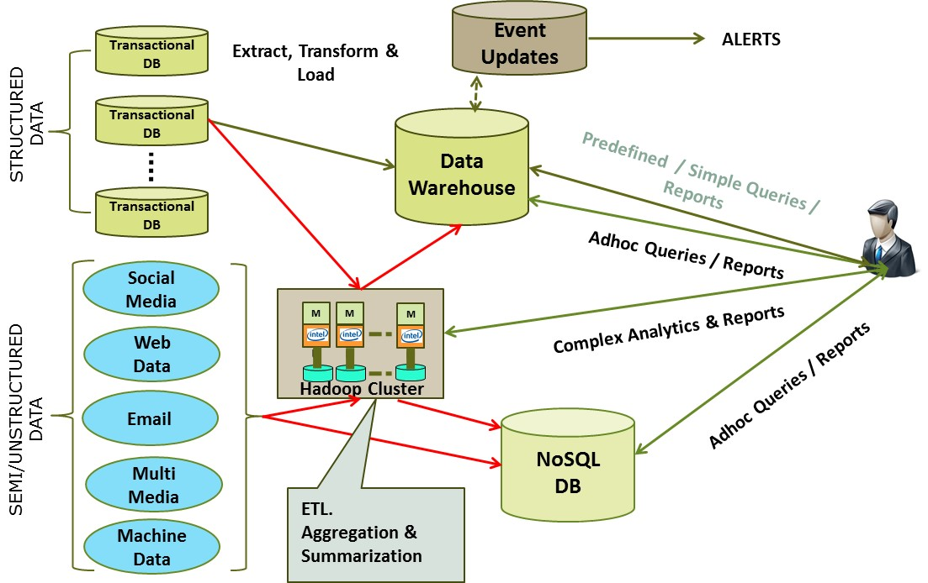
Analytics Paradigm Shift
Organizations are Inundated with New Sources of Data, which can Offer Profound & Actionable Insight
10

Slide 11
Data Dimensions
Data Value and Dimensional Dependence:
Temporal Validity
  Time Value
  Transactional Value
Contextual Relevance
3) Data Localization
4) Correlation

Slide 12
Changing Computing Models
Data Engineering: Data value chain - Data Aggregation, Preparation, and Modeling, Analytics and Visualization.
Continuous Analytics: Pre-defined and structured Queries versus real-time, adhoc Queries
Convergence: Big Data (Hadoop) based Data Lakes are replacing the traditional Enterprise Data Warehouse concepts
Edge Computing: Boundary-less computing, data and analytics is distributed and often pushed to edge

Slide 13
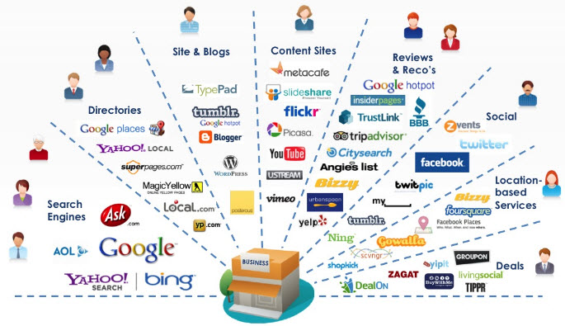
Distributed
Landscape
Online Landscape has significantly number of influencers, who can significantly impact Enterprises, both online and offline.
How could Enterprises Manage the exponentially growing content and customer feedback?

Slide 14


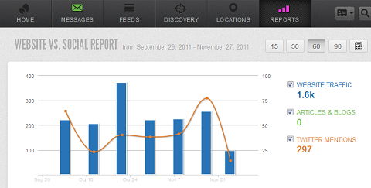
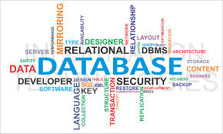
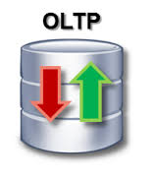
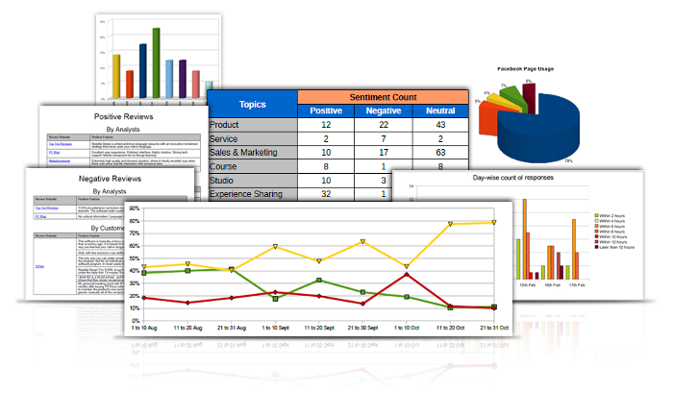


What is the Alenza Platform?
Integrates Technology, Process, and People – Total Solution as Service
ALENZA PLATFORM
R
E
P
O
R
T
D
A
T
A
Business Analysts
Data Scientists
Software Developers
Visualization & Reporting
Analytics & Data Sciences
Pre-Processing & ETL

Slide 15
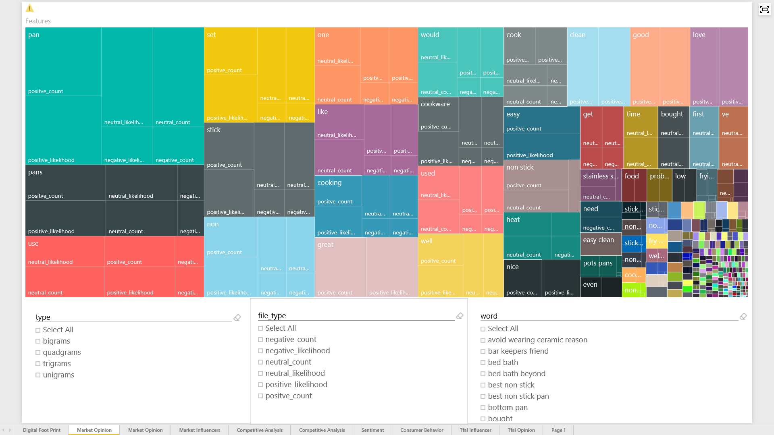
Brand Perception & Word Cloud
Companies endeavor to proliferate their brands with certain attributes…
However, what do consumers really hear and how do they perceive a brand, as opposed to what companies are trying to project?
Imagine having a real-time tool to validate the consistency between projection versus perception of the brand attributes

Slide 16

Sentiment Analysis
Imagine having the ability to know what your customers think about your organization or product real-time. How would this knowledge influence your marketing strategy?
Gaining insight into customer perception is a powerful tool the Alenza Platform offers. It mines the chatter from various Social Media sources pertaining to your product as well as the competition.
Using complex programming concepts like NLP (Natural Language Processing), Alenza will assign a positive, negative, or neutral connotation to the word patterns extracted from Social Media sites. In addition, the top mentioned sentiments are counted, isolated, and presented to you so that you can take actionable measures.

Slide 17
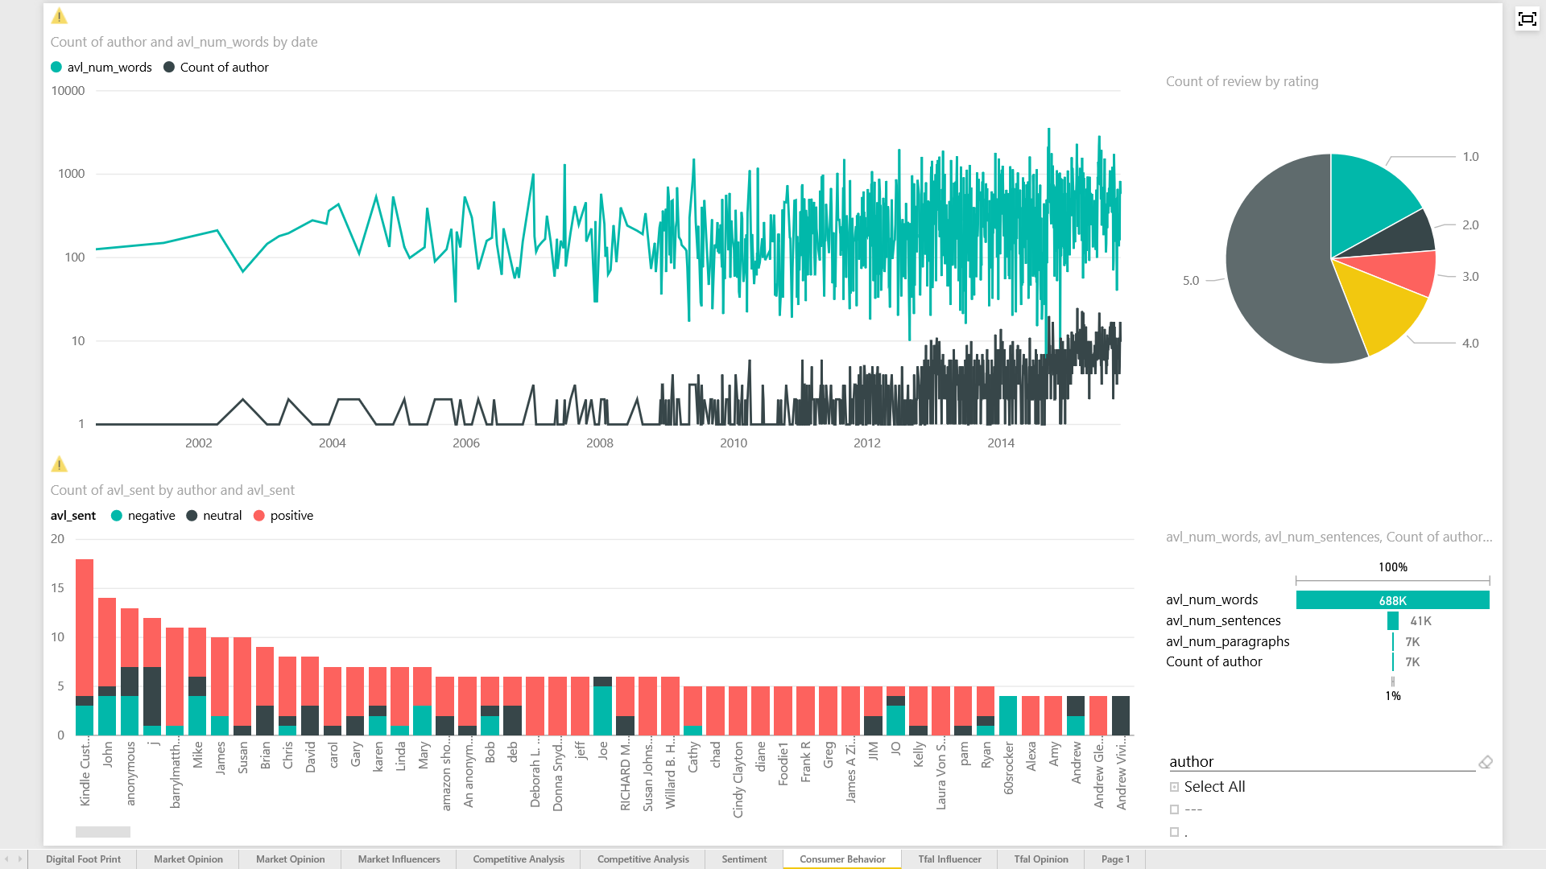
Key Insights from Sentiment Analysis:
Brand Specific Sentiments
The Alenza platform is able to pull insight from each individual conversation or opinion for a particular product. The chart highlights the top authors that have commented on Wearever and further

Slide 18
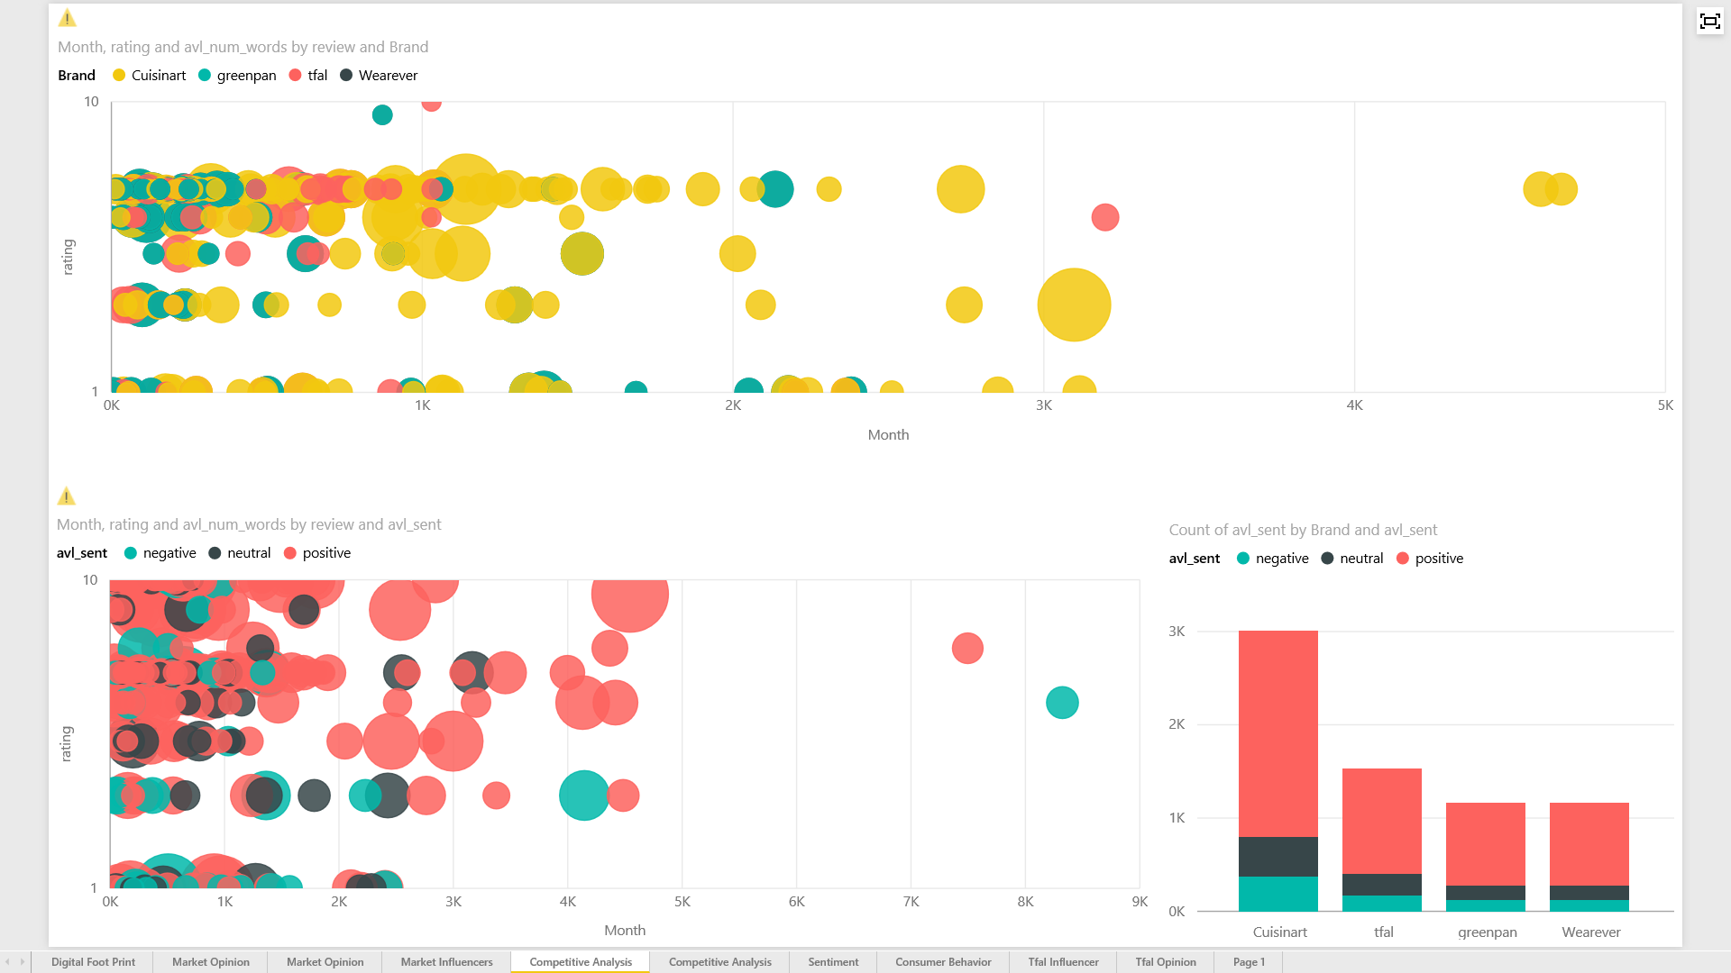
Key Insights from Sentiments:
Brand Specific Insights
In addition to Cuisinart had the most positive reviews.
Reviews and Comments mirrored the Digital Presence and online activity – proving the efficacy of customer engagement.
Cuisinart surpasses the competition in on line conversations.

Slide 19
Associative
Attributes
Top words or products that occur with Wearever
GV – to Update the chart and then analyze the Text

Slide 20
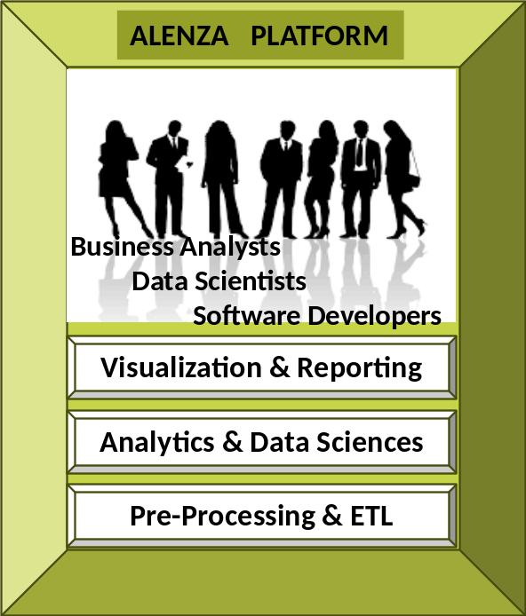
Wireless Carrier Solution
Alenza platform based Predictive Analytics for Call Coverage Issues
Aggregated 3 Years of Data
Define Key Performance Indicators (KPIs):
  Signal Strength
  Lost Call/Short Call Log
  Device and Device Configuration
  Network Parameters (for LTE & EVDO)
  Geo-Coordinates
  Median Call Duration
  Variable Coverage Areas
Prepared and Modeled the KPI Data for Statistical Analysis
Additionally, leveraged data from technician’s notes and 611 Calls that were converted to text
Used Machine Learning to find key Correlations
Used the correlated data & predictive modeling, Alenza generated
an algorithm that gained 85% Prediction Accuracy

Slide 21

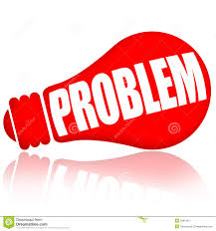


Wireless Carrier Solution
Alenza platform based Predictive Analytics for Call Coverage Issues
End-User: One of the largest telecom service provider
Customer: Solutions platform provider to the end-user
611 Calls: Customers call Tech Support for call issues, and a trouble-ticket is issued
Call Center Action: The end-user dispatches a technician, and it takes ~ 2 hours to determine if there was a call coverage issue, or any other non-network issue
Technician Time: Reduce or eliminate the need for a Technician for the diagnostics
Reduced 611 Calls: Use predictive analytics to resolve the problem before they occur, which would reduce or minimize the Tech Support Calls
Alenza Platform: Avlino aggregated the required data, and conducted statistical analysis to determine patterns in the data
Predictive Analytics: Determine which predictive models fits the data to get the predetermined accuracy, so that the call diagnosis can be automated

Slide 22
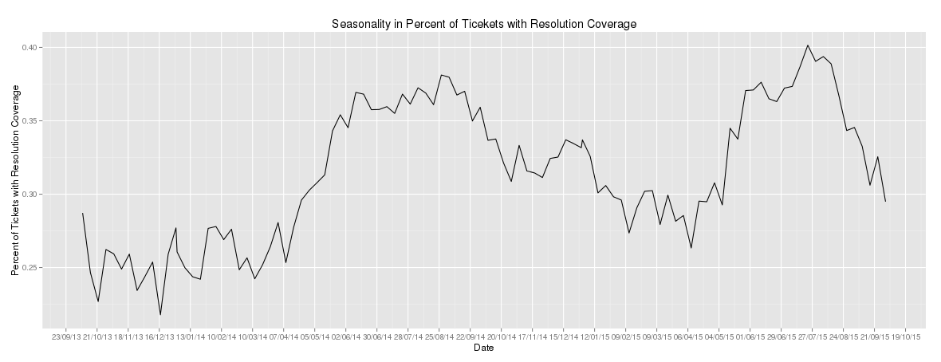
Wireless Carrier Solution
Alenza platform found a KPI that was not taken into account – Seasonality caused coverage Issues

Slide 23
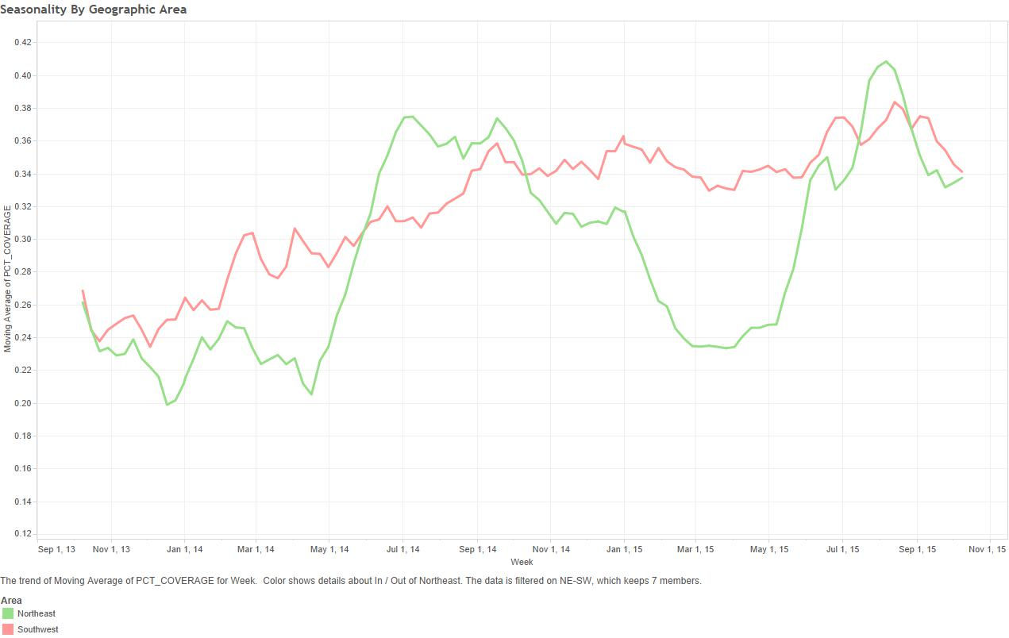
Wireless Carrier Solution
Alenza platform further analyzed a correlated KPI that was not taken into account – Seasonality caused differing results on different geographies

Slide 24
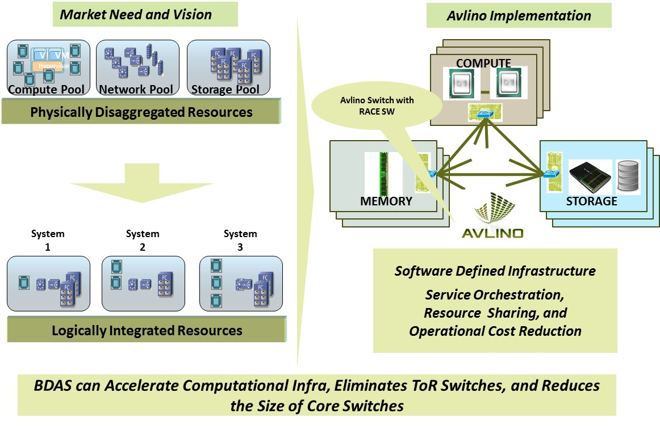
Hardware Paradigm Shift – Intelligent & Distributed Switching
Notes:
Uses the network to ensure applications are dynamically supported throughout the infrastructure.

Slide 25
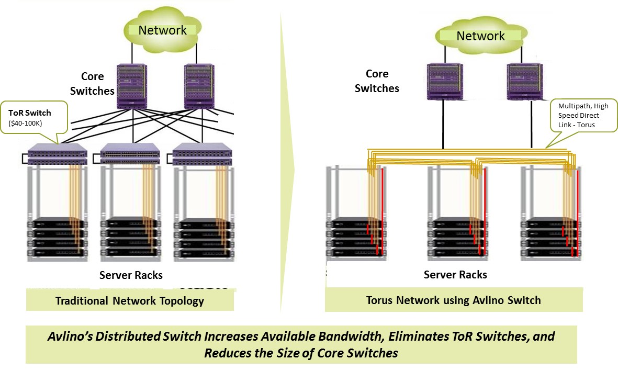
Hardware Paradigm Shift – Intelligent & Distributed Switching

Slide 26
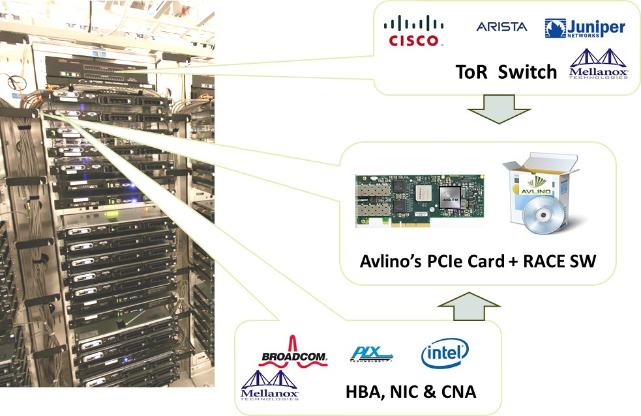
Who could be displaced by Avlino’s BDAS?
Avlino’s Switch Integrates the Functionality and Replaces ToR Switches & HBA/NIC/CNAs

Slide 27
What are some of the skill sets industry is looking for?
Data Sciences (Algorithms and Modeling)
Machine Learning Concepts
Languages and Packages (Scala, R etc)
New Frameworks (Map-Reduce, Spark etc)
Business Analysts
Software Defined Networking and Storage

Slide 28


Thank You
Contact:
email: sales@avlino.com
Phone: (732) 946 0472
Fax: (732) 946 5876
Q2 2014

