Slide 1

Interdisciplinary Data Sciences
Mathematics and Statistics Colloquium
March 23, 2017
Jennifer Lewis Priestley, Ph.D.
Professor of Statistics and Data Science

Slide 2
No matter how its measured…
A really big number
A really small number
Kennesaw State University
Department of Statistics and Analytical Sciences

Slide 3
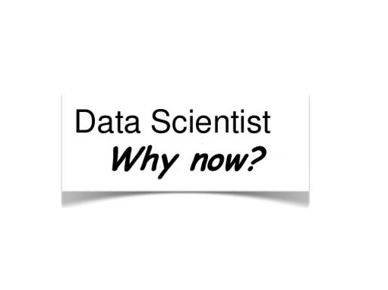
Kennesaw State University
Department of Statistics and Analytical Sciences

Slide 4
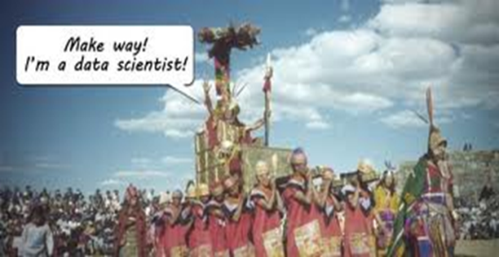
Everyone is chasing the same talent…
Finance
Retail
Political Science
Consulting
Healthcare
Economics
Manufacturing
Kennesaw State University
Department of Statistics and Analytical Sciences

Slide 5
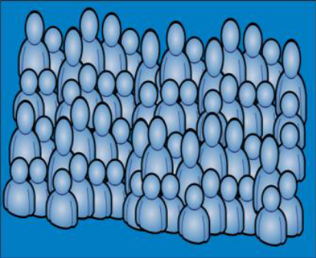
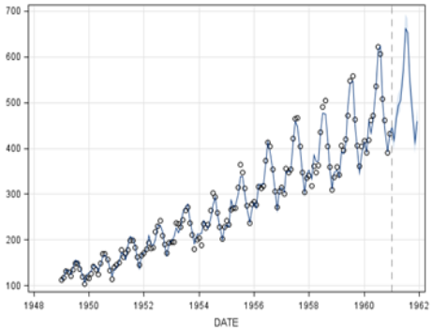
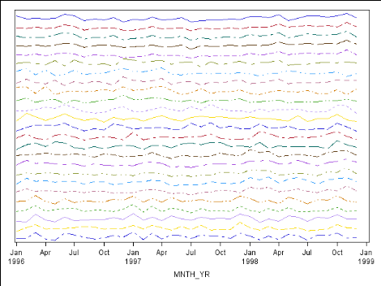

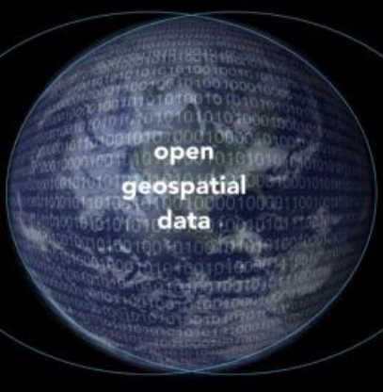
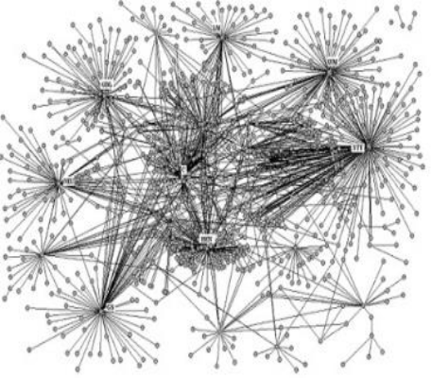
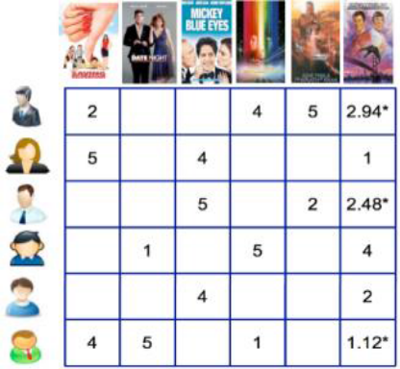
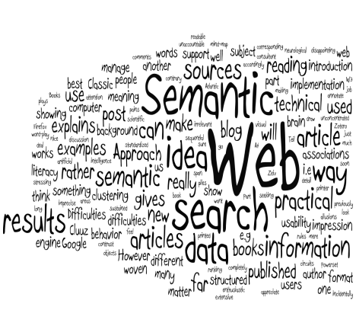
…and the data is different
Cross Sectional
Time Series
Streaming
Image/Video
Geo Spatial
Networks
Link
Text
Kennesaw State University
Department of Statistics and Analytical Sciences

Slide 6
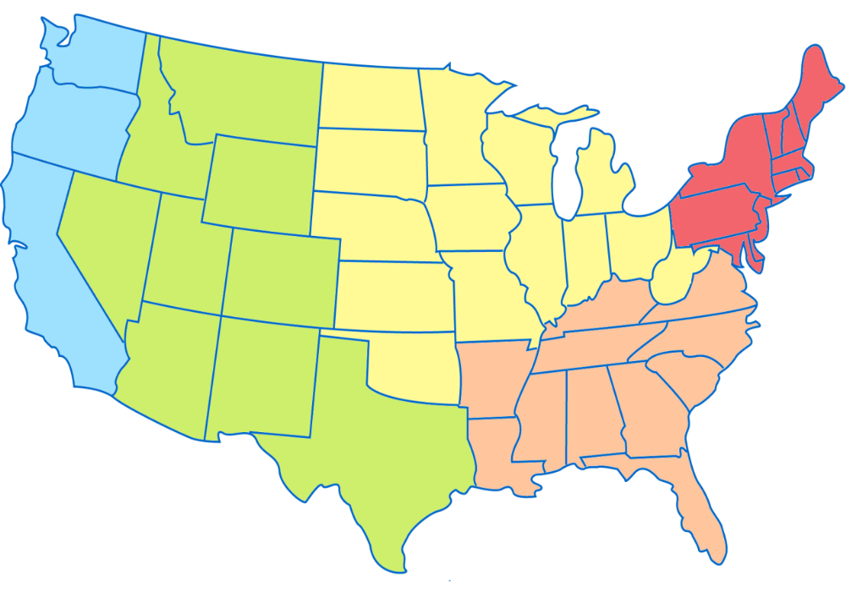
WEST COAST
23% of POPULATION
43% of Data Scientists
NORTHEAST
17.5% of POPULATION
25% of Data Scientists
MIDWEST
21% of POPULATION
14% of Data Scientists
MOUNTAIN
12% of POPULATION
10% of Data Scientists
SOUTH
27% of POPULATION
8% of Data Scientists
Kennesaw State University
Department of Statistics and Analytical Sciences

Slide 7





Native and Non Natives…
Kennesaw State University
Department of Statistics and Analytical Sciences

Slide 8






Non-Natives are a big part of the talent gap…
Kennesaw State University
Department of Statistics and Analytical Sciences

Slide 9
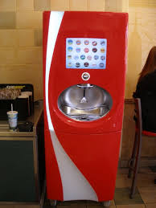

Big Data Company : Coca Cola
~ 50,000 machines around the world
Can dispense about 95 drinks an hour
Can dispense about 125 different drinks
Submits real time data on:
Syrup consumed/drink configuration
Outlet
Time
Kennesaw State University
Department of Statistics and Analytical Sciences

Slide 10
What do these companies have in common?
They are all non-native to Big Data.
They have all invested heavily in new hardware and software to capture and store their new data.
They have new talent needs: Computer Scientists, Statisticians, Mathematicians.
Kennesaw State University
Department of Statistics and Analytical Sciences

Slide 11
…which brings us back…
A really big number
A really small number
Kennesaw State University
Department of Statistics and Analytical Sciences

Slide 12

This shift has huge implications for developing, recruiting and retaining analytical talent…
Kennesaw State University
Department of Statistics and Analytical Sciences

Slide 13
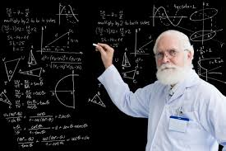
We can’t teach the way we have always taught
The 1950s called …they want their curriculum back…
Kennesaw State University
Department of Statistics and Analytical Sciences

Slide 14


Who ARE these People?
“Person who is better at statistics than any software engineer and better at software engineering than any statistician” – Josh Wills, Director of Data Engineering at Slack
“Person who is better at explaining the business implications of the results than any scientist and better at science than any business school graduate”
Jennifer Priestley, Ph.D. Data Nerd
Kennesaw State University
Department of Statistics and Analytical Sciences

Slide 15
What Did They Study?

Slide 16
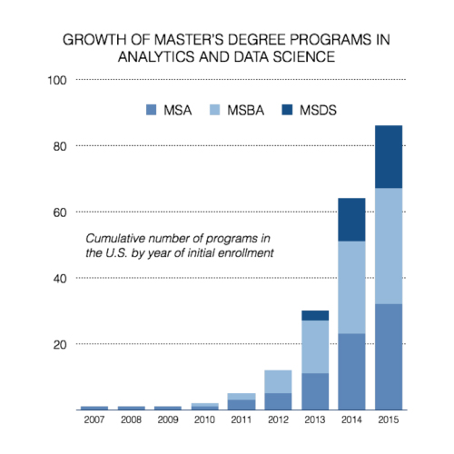
Growth of Analytics Programs…
But this does not tell the whole story…
Kennesaw State University
Department of Statistics and Analytical Sciences

Slide 17
Landscape…
Programs Across The Country
Programming Languages Used
Kennesaw State University
Department of Statistics and Analytical Sciences

Slide 18
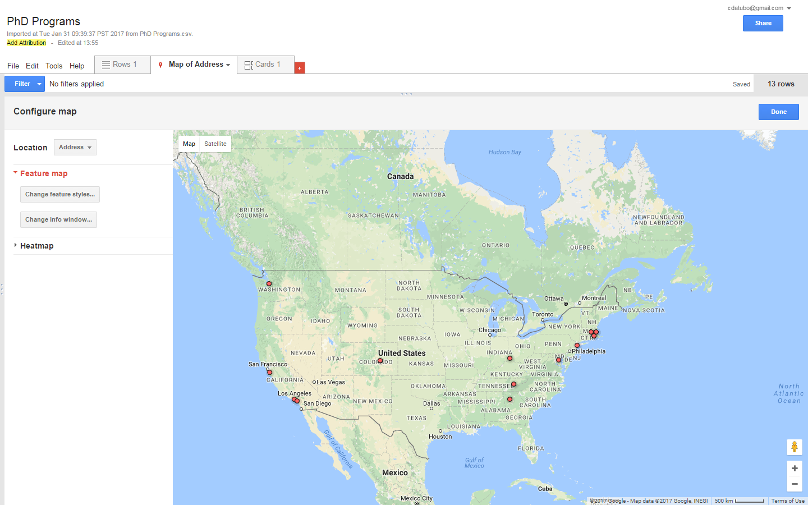
UNIV. OF WASHINGTON – SEATTLE
PH.D. IN BIG DATA AND DATA SCIENCE
INTERDISCIPLINARY
UMASS – BOSTON
PH.D. IN BUSINESS ADMINISTRATION - INFO SYSTEMS FOR DATA SCIENCE TRACK
MANAGEMENT
WORCESTER POLYTECHNIC
PH.D. IN DATA SCIENCE
ARTS & SCIENCES
UNIV. OF CINCINNATI
DOCTOR OF PHILOSOPY IN BIOSTATISTICS - BIG DATA TRACK
MEDICINE
BROWN UNIV.
PH.D. IN COMPUTER SCIENCE –
DATA SCIENCE
COMPUTER SCIENCE
STANFORD UNIV.
PH.D. IN STATISTICS
DEPARTMENT OF STATISTICS
UT KNOXVILLE
PHD IN ANALYTICS
BUSINESS
NYU
PH.D. IN COMPUTER SCIENCE WITH SPECIALIZATION IN BIG DATA
ENGINEERING
COLORADO TECH
DOCTOR OF COMPUTER SCIENCE - BIG DATA ANALYTICS
COMPUTER SCIENCE
USC
PH.D. IN DATA SCIENCE & MANAGEMENT
BUSINESS
UNIV. OF MARLYAND – COLLEGE PARK
PH.D. IN INFORMATION STUDIES - CONCENTRATION IN BIG DATA/DATA SCIENCE
INFORMATION STUDIES
CHAPMAN UNIV.
DOCTORATE IN COMPUTATIONAL AND DATA SCIENCES
SCIENCE & TECHNOLOGY
KENNESAW STATE UNIV.
PH.D. IN ANALYTICS AND DATA SCIENCE
SCIENCE & MATHEMATICS

Slide 19
The Ph.D. Curriculum…
MATH CORE:
THEORY OF LINEAR MODELS
DISCRETE MATHEMATICS
GRAPH THEORY
MATHEMATICS FOR BIG DATA
CS CORE:
ADVANCED DATABASE SYSTEMS
ALGORITHM DESIGN
WEB AND TEXT MINING
MACHINE LEARNING
ONE CS ELECTIVE
STAT CORE:
DATA MINING I
DATA MINING II
ADV PROGRAMMING IN SAS
BINARY CLASSIFICATION
ADV REGRESSION
3 STAT ELECTIVES
OTHER:
APPLICATION ELECTIVE
CONSULTING CENTER
ETHICS
DISSERTATION
PROJECT/PRACTICUM (Tell the story!)
Kennesaw State University
Department of Statistics and Analytical Sciences

Slide 20
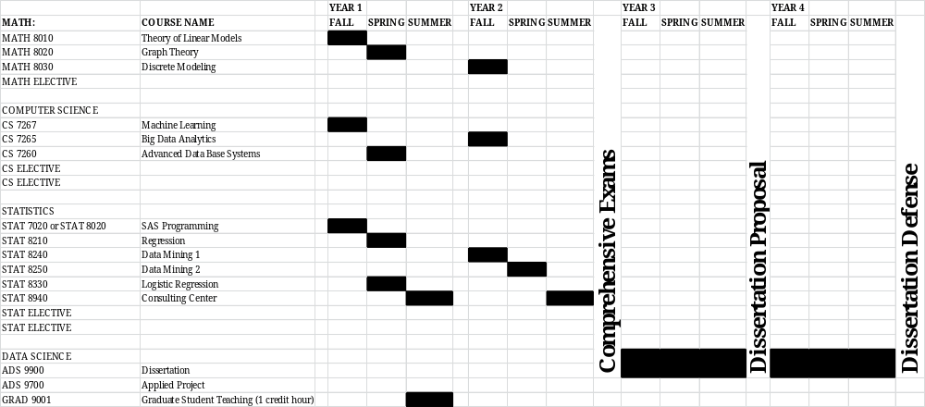
The Curriculum…
Kennesaw State University
Department of Statistics and Analytical Sciences

Slide 21
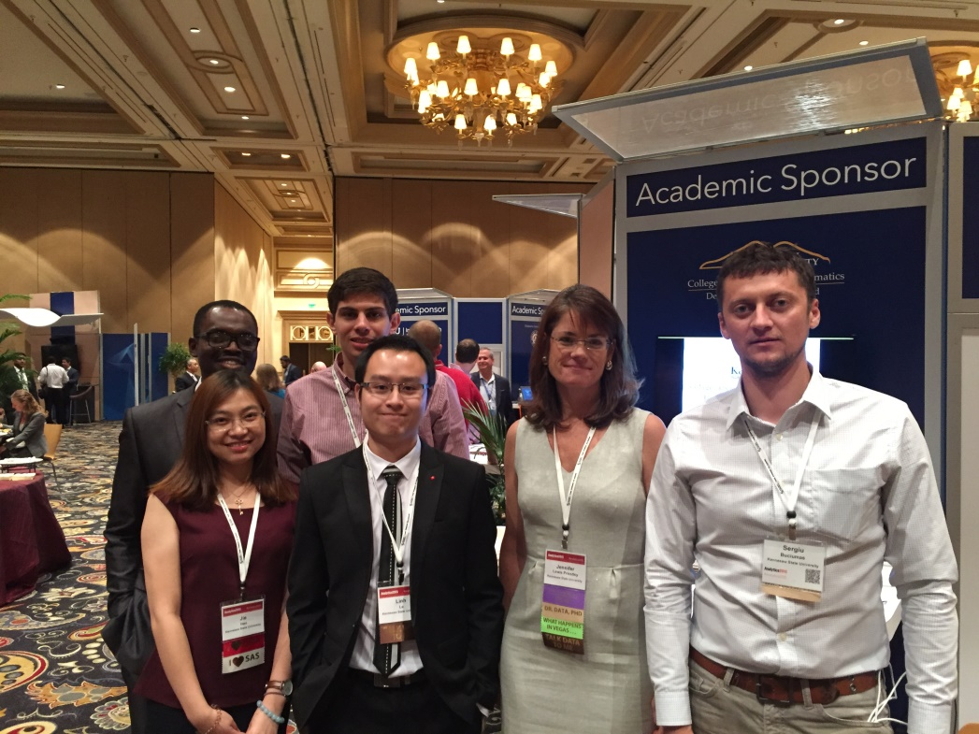
The Ph.D. Students…Cohort 1
Edwin Baidoo – MS Computational Finance
Sergiu Busciumas – MS Computer Science
Bogdan Gadidov – MS Industrial Engineering
Linh Le – MS Information Technology
Jie Hao – MS Applied Mathematics
Bob Vanderheyden – MS Mechanical Engineering (not pictured)
Kennesaw State University
Department of Statistics and Analytical Sciences

Slide 22
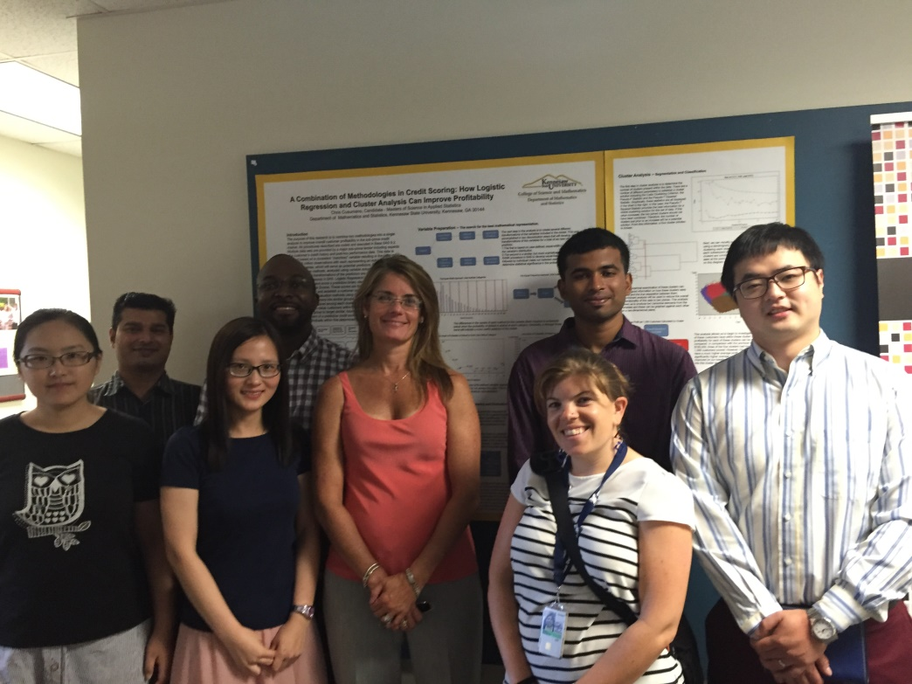
The Ph.D. Students…Cohort 2
Lili Zhou– MS industrial Engineering
Dhiraj Gharana – MS Computer Science
Yan Wang – MS Statistics
Michael Onwi– MS Aeronautical Engineering
Jessica Rudd – MS Epidemiology
Shashank Hebbar – MS Industrial Engineering
Yiyun Zhou – MBA
Kennesaw State University
Department of Statistics and Analytical Sciences

Slide 23
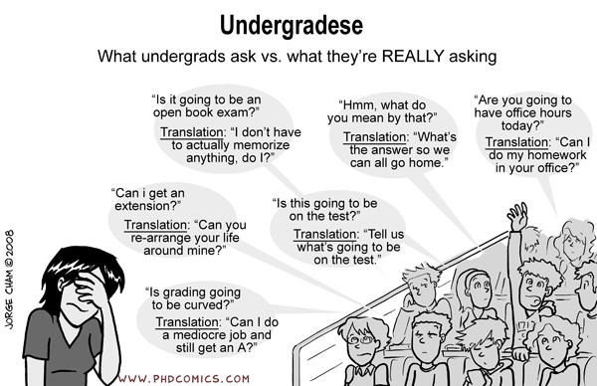
Kennesaw State University
Department of Statistics and Analytical Sciences
23

Slide 24
Analytics Programs at KSU
Ph.D.
(n=13)
Masters (n=60)
Undergraduates (n=150)
Kennesaw State University
Department of Statistics and Analytical Sciences

Slide 25
Analytics Programs at KSU - Undergraduate
Minor field of study – Interdisciplinary
Top Majors: Psychology, Math, Biology
Programming Emphasis - R, SAS, SQL
5 Courses – Programming, Methods, Applications
Applied Project Work
Undergraduates (n=150)

Slide 26
Analytics Programs at KSU - MSAS
Largest producer of applied statisticians
20 Month Program – pm courses
Emphasis on programming/application
Most students work in the Consulting Center and/or have an internship
Effective 100% Placement Rate
Masters (n=60)

Slide 27
Analytics Programs at KSU – Ph.D.
Only Ph.D. in Data Science in GA
Four year program – Full Time
MS and Ph.D. level courses in Math, Statistics, Computer Science
Application areas include Healthcare, Finance, Engineering, Retail
Both research and application
Required Applied Practicum
Ph.D.
(n=13)

Slide 28
Center for Statistics and Analytical Services
Internal Charter
  Grant Support
  Publication/Research Support
  Ad hoc training
  “Low Risk” Consulting for Students
External Charter
  Private Sector Sponsored Research
  Fee-for-Service Consulting
  Online Certificate Programs
Kennesaw State University
Department of Statistics and Analytical Sciences

