Slide 1
Recent Developments in Big-data Enabled Personalized HeathCare
Sriram Chellappan
Dept. of Computer Science and Engineering
University of South Florida
sriramc@usf.edu
http://www.cse.usf.edu/~shri/

Slide 2
Statistics on Mental Health
USA
  1 in 4 adults experience mental health problems in a given year (75 million people)
  1 in 17 adults live with a serious condition like schizophrenia, major depressive disorders, bi-polar disorders and more
  Upto 30% of college students experience mood problems at some point
Asia
  Statistics are much higher for adults for Stress and Anxiety
  Upto 11% of South Korean youth are reported to be addicted to the Internet
Consequences
  Suicidal Tendencies, Poor productivity, Economic losses, High medical costs, Unhappy families and more

Slide 3
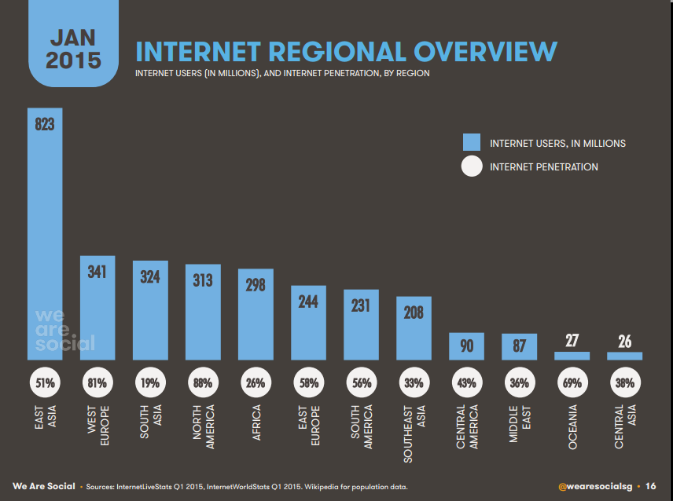
Statistics on Internet Usage

Slide 4
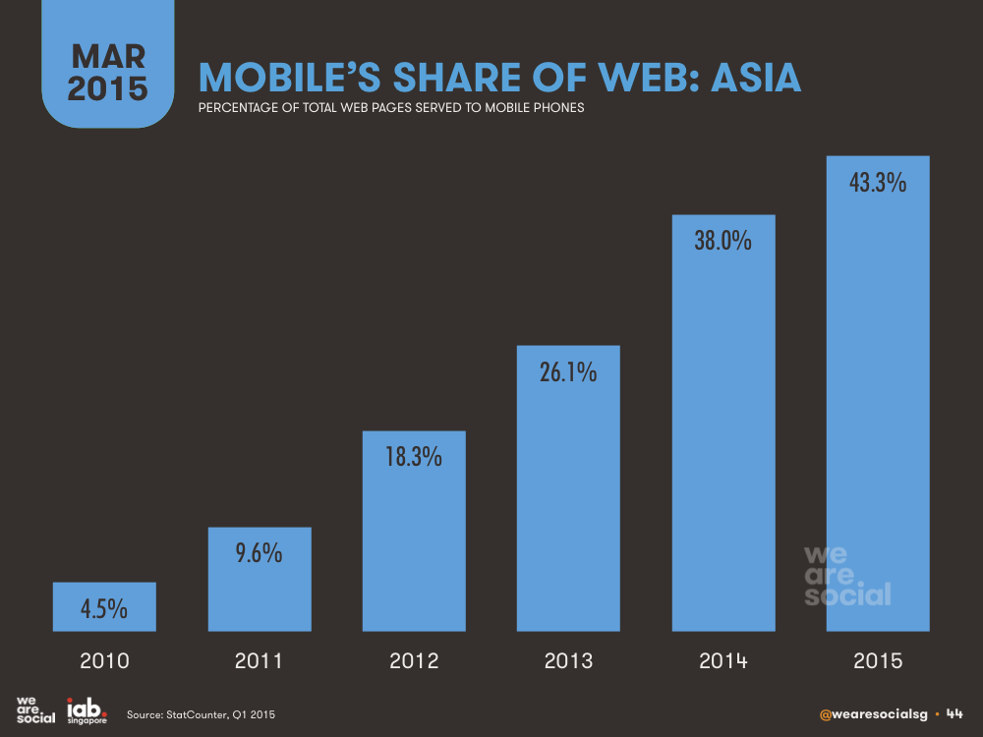
Statistics on Mobile Web

Slide 5
Presentation Overview
Big-data clues on Mental Health and Algorithms
  Methodology for extracting real and big-Internet data
  Continuous, Unobtrusive and Privacy Preserving
  Novel features to study mood disorders
  Learning algorithms to predict mood disorders from passive Internet usage monitoring
App development and Commercialization
    Real challenges faced by the mental health community
    Overview of app
    Future work
  Wearables and HealthCare

Slide 6
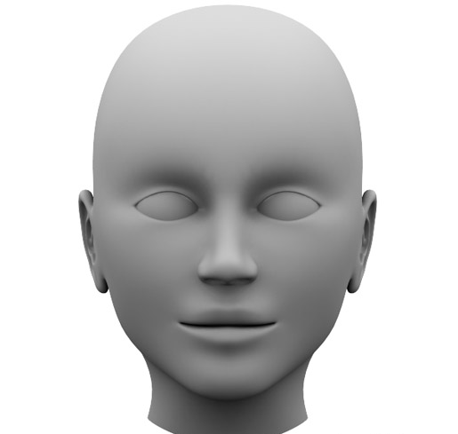


Part 1 – Big-data Clues and Algorithms
Notes:
www.secondpicture.com

Slide 7

State of the Art
Internet data collected via surveys – self reported usage
  How many time did you check email last week
  How many times did you chat last week
  How many hours did you use facebook last month
  …
But as we know
  Internet data is high dimensional, large volume and multi modal
  Hence quantity, dimensionality and granularity of data collected via surveys is very limited
  Conclusions are naturally generalized and may have limited practical applicability

Slide 8

Advancing State of the Art ???
Continuous, Unobtrusive and Privacy Preserving Collection
Notes:
www.secondpicture.com

Slide 9
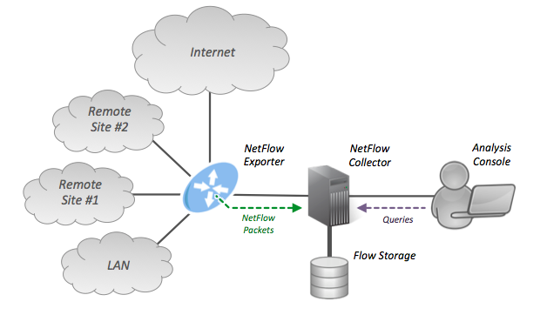
NetFlow – Developed by Cisco

Slide 10
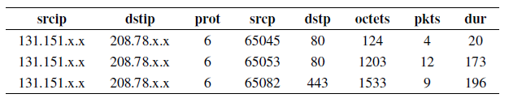
NetFlow…
Detect network anomalies
Scanning for suspicious port activity
Efficient troubleshooting
Resources deployment
…

Slide 11
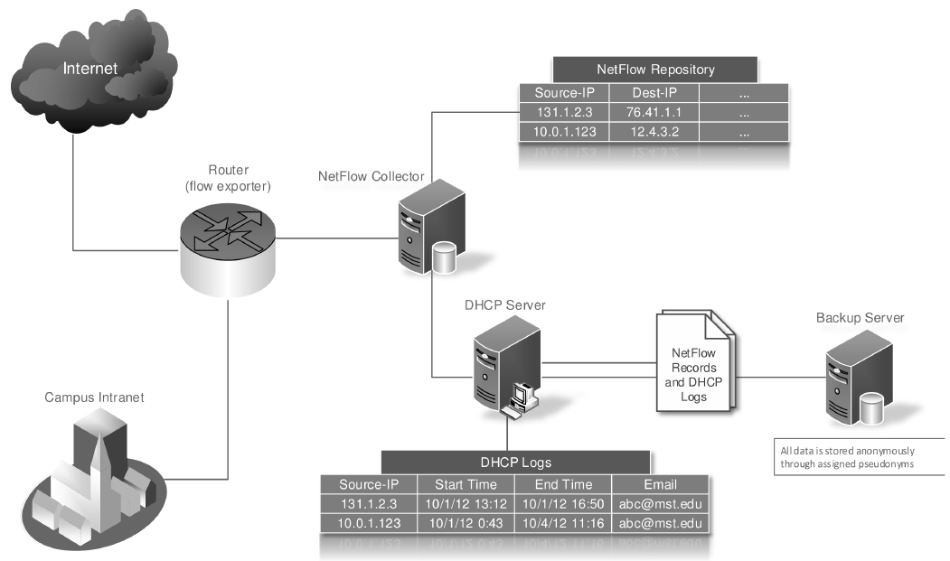
First of All - Internet Data Collection

Slide 12
Our Internet data
For each subject, we now have
But, Internet usage of a student over weeks runs into millions of records – GB size
Start Time | End Time | Dest-ip | Protocol | Src Port | Dest Port | Octets | Packets | Duration
10/1/12 13:12 | 10/1/12 15:12 | 164.33.22.3 | 6 | 65045 | 80 | 200 | 15 | 50
10/2/12 1:12 | 10/1/12 1:44 | 87.34.33.2 | 6 | 65053 | 80 | 323 | 23 | 98
10/2/12 16:12 | 10/2/12 17:11 | 123.44.3.22 | 17 | 65082 | 443 | 1234 | 45 | 129
… | … | … | … | … | … | … | … | …

Slide 13
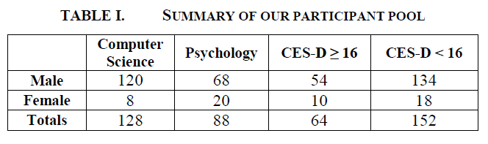
Experiment 1 – Depressive Symptoms
We recruited 216 UG students to participate in our study in Feb 2011
Students completed the Center for Epidemiologic Studies Depression (CES-D) scale
30% met the minimum criteria for depressive symptoms

Slide 14
Experiment 2 – Internet Addiction
It is a relatively new phenomenon and characterized as behavioral
Recent studies indicate that
  Upto 3.5% of German teens are reported to be addictive Internet users
  Upto 8.5% of teens in Greece report addiction to Internet with males and gaming dominating the study
  Upto 11% of South Korean youth are reported to be addicted to the Internet
Unfortunately, we don’t have clear norms yet
Many clinics are now operating to treat Internet Addiction across the world
Our survey with 69 students in Fall 2012
  Problematic Internet Usage Questionnaire (Monash U.)
  Introversion, Craving, Tolerance, Reduced Activities

Slide 15
Experiment 3 – Stress and Anxiety
70 students across departments participated in the study in Fall 2012
Students were given Depression, Anxiety and Stress (DASS) Questionnaire questionnaire to assess Stress and Anxiety
14 students met the criteria for Stress and 7 students met the criteria for Anxiety

Slide 16
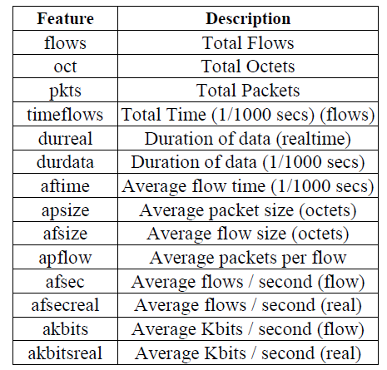
Features Extraction
We processed NetFlow records to derive three broad categories
  Aggregate Features – Summarize raw aggregates of Internet usage

Slide 17
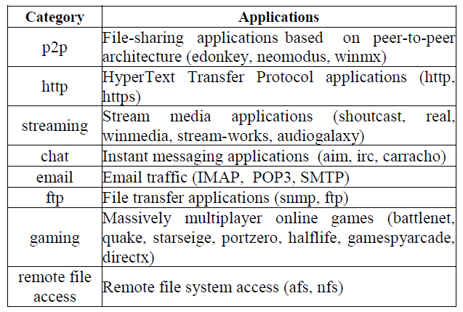
Features Extraction – Cont’d
Application Features – Summarize aggregates of Internet usage categorized by application type

Slide 18

Features Extraction – Cont’d
Entropy Features
  Difficulty concentrating or making clear decisions is a symptom of mood disorders, especially depression
  We wanted to capture this behavior from Internet usage
  Shannon Entropy of 1) Source IP address, 2) Destination IP address, 3) Source port, 4) Destination port, 5) Protocol, 6) Octets, 7) Packets and 8) Duration

Slide 19
Summary of Critical Statistical Results
Packets per Flow
Chat Octets
Peer to Peer Packets
Peer to Peer Octets
Mail Duration
FTP duration
Flow Duration Entropy
Chat Duration Chat Octets
Streaming Duration
Total Duration Mail Duration
Total Duration
Total Number of Flows
Gaming, Chatting, Email Octets
Packets per Flow
Flow Duration Entropy
Depressive Symptoms
Stress and Anxiety
Tolerance, Craving, Withdrawal, Reduced Activities

Slide 20
Algorithms for Classification of Mood Disorders
We are currently implementing machine learning algorithms to classify mood disorders from run time Internet usage monitoring
Results with Support Vector Machines are pioneering and highly encouraging
Applications are enormous
 | Precision | Recall | Accuracy
Depressive Symptoms | 88% | 86% | 87%
Stress | 91% | 87% | 89%
Anxiety | 87% | 87% | 87%

Slide 21
Wrapping up Part 1
Internet usage can reveal significant information about a person’s behavior
Being ‘big’ and ‘high-dimensional’, challenges are there in collecting and processing data sets
One can extend our study to identify more general and more fine-grained features as well – there is still a high degree of privacy
Potential Utility – Orange Societies from Internet Usage
  Proactive and Personalized Mental Health care
  Care for young and elderly whose problems are not diagnosed
  Care in rural areas where services are sparse
  Even Cyber Security…

Slide 22










Media Coverage

Slide 23
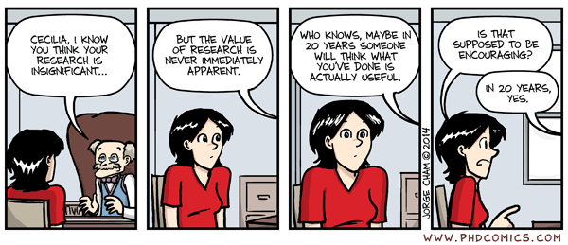

Slide 24
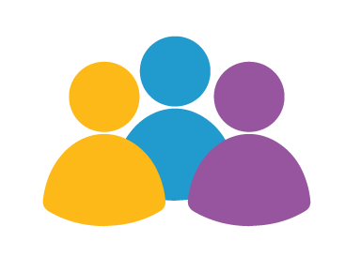
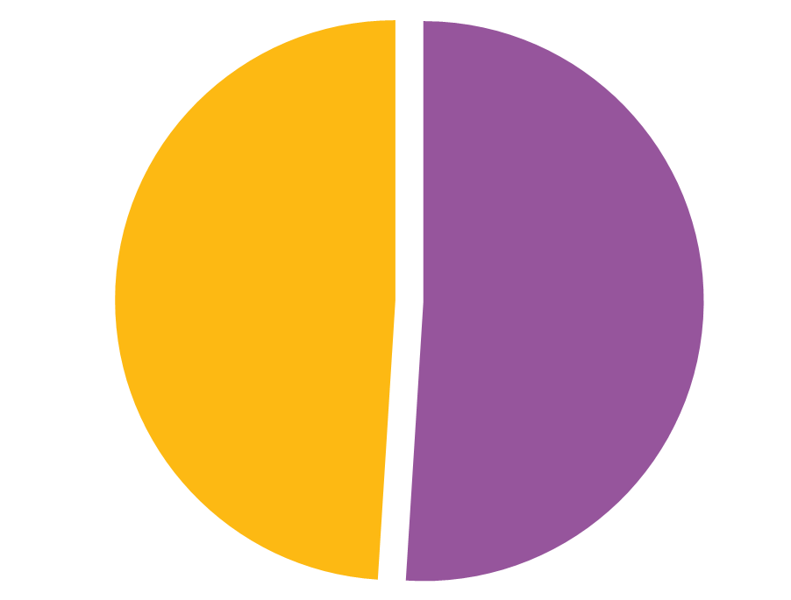
Part 2 – App Development for Orange Societies
91 million in US
Adults live in areas affected by shortages of mental health workers
No Access
51 percent
Of all US counties have no psychiatrists, psychologists, or social workers
Some Access

Slide 25





State of the Art
Mood
+
Notes:
Most cases – no information between visits, Some cases - unreliable information between visits, Multiple sources of information, Consequences are very worrying

Slide 26
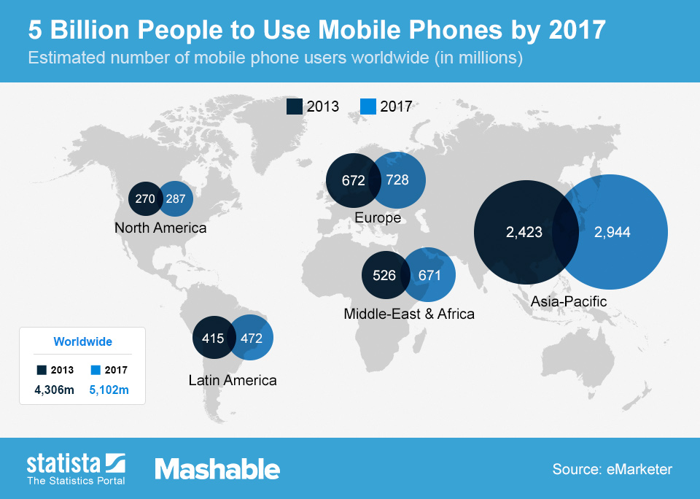
Opportunities

Slide 27
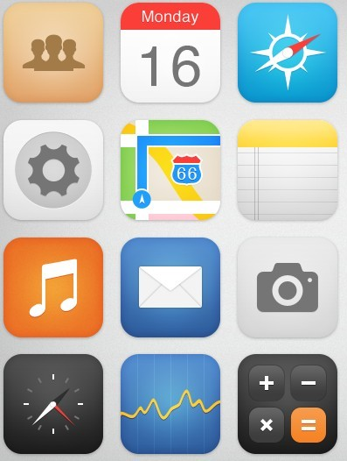
Mental Health App Categories
Screening
Reference
Therapy Delivery
Drug Reminders
…
Notes:
Use Cases
Self assessments
Therapy: recorded messages or live support
Tracking appointments and reminders for treatments
Tele consultations among providers
Reference guides
Psycho-education through text messages
Connecting with peers: Facebook to app for veterans(Operation Reach Out)

Slide 28
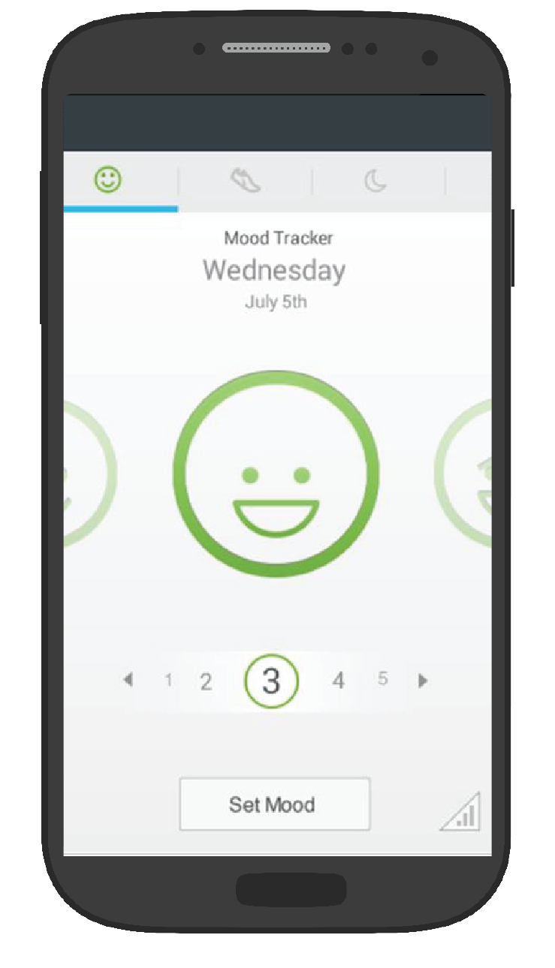
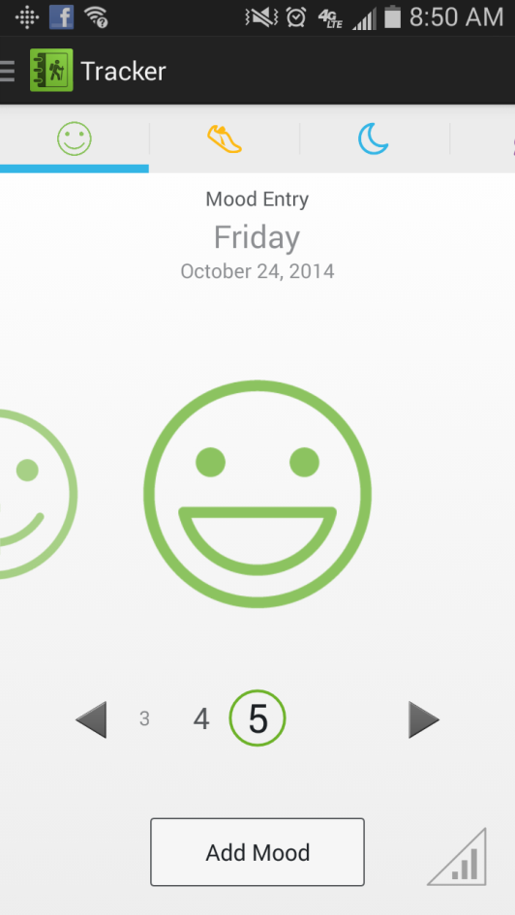
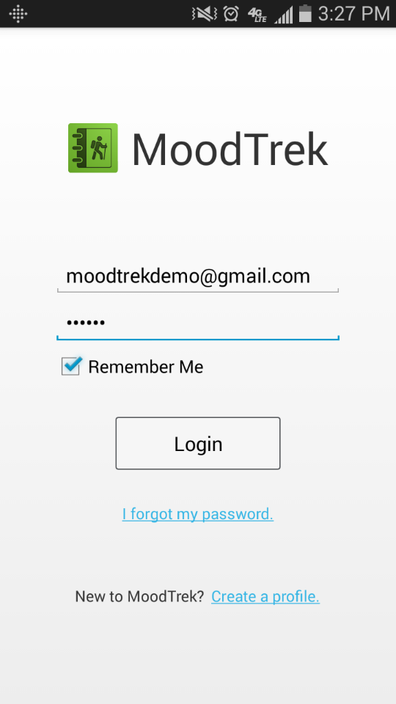
Fully encrypted and meeting all HIPAA Standards

Slide 29
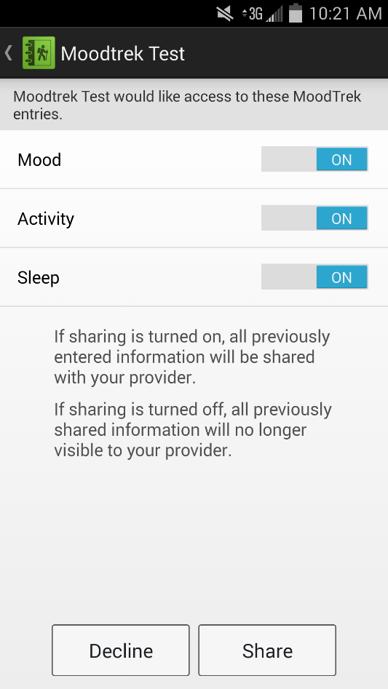
Our App – Mood-Trek on Android

Slide 30
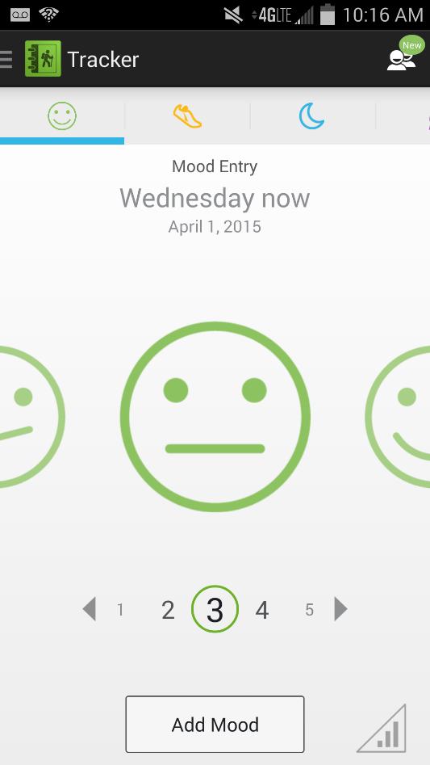
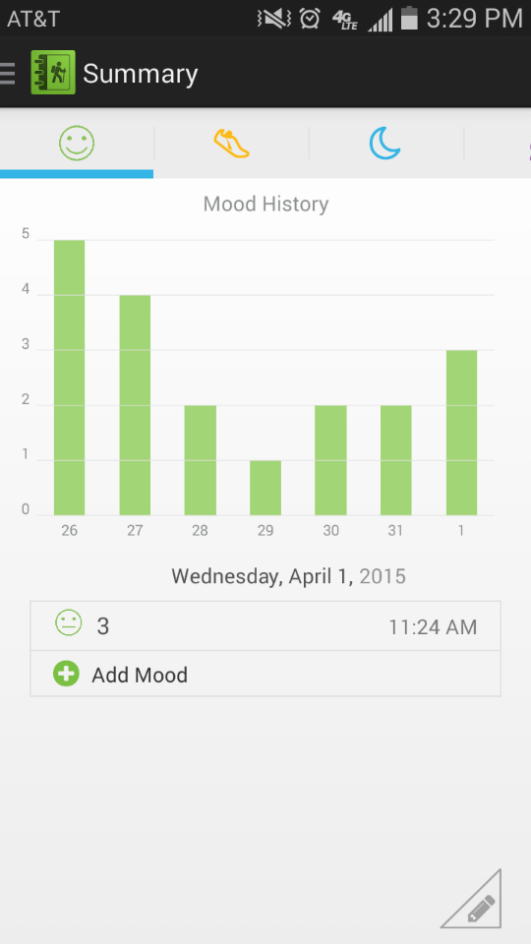
Mood-Trek…

Slide 31
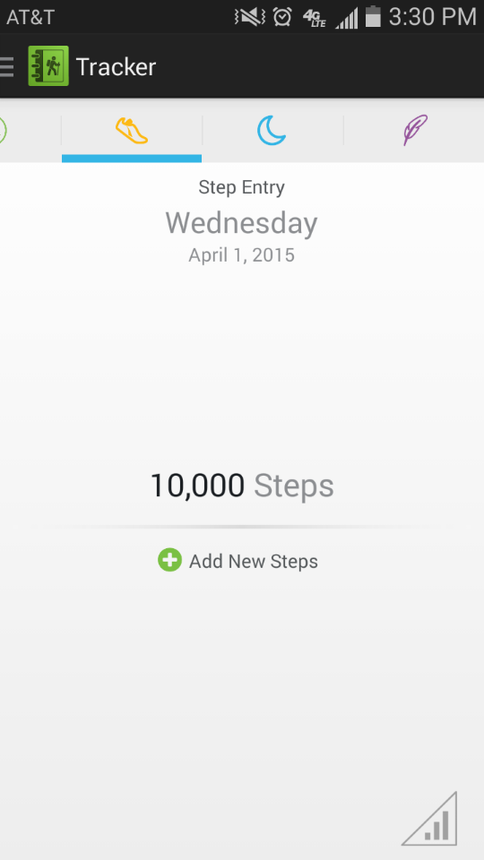
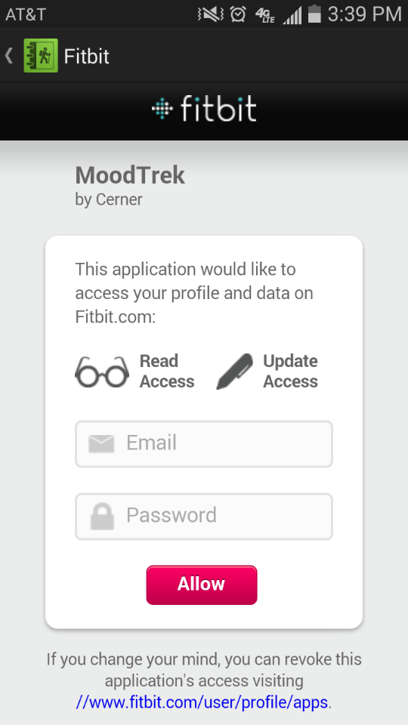
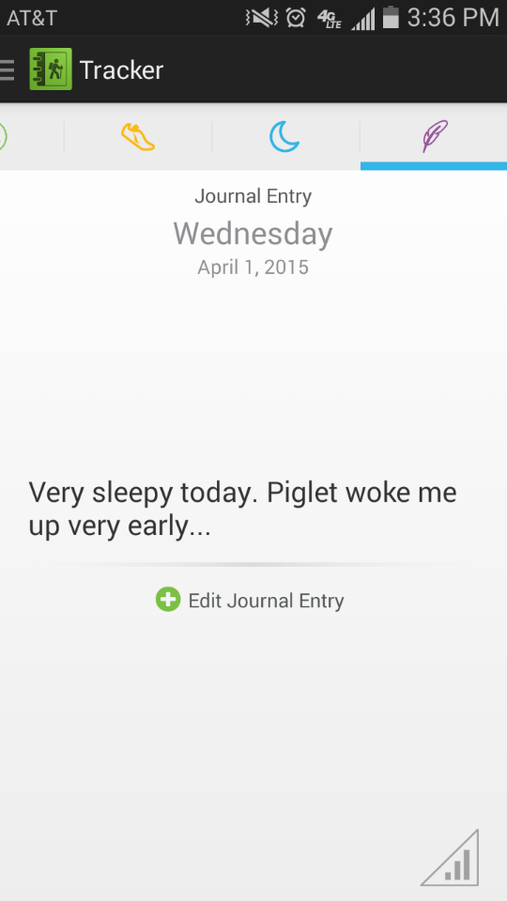
Mood-Trek…

Slide 32
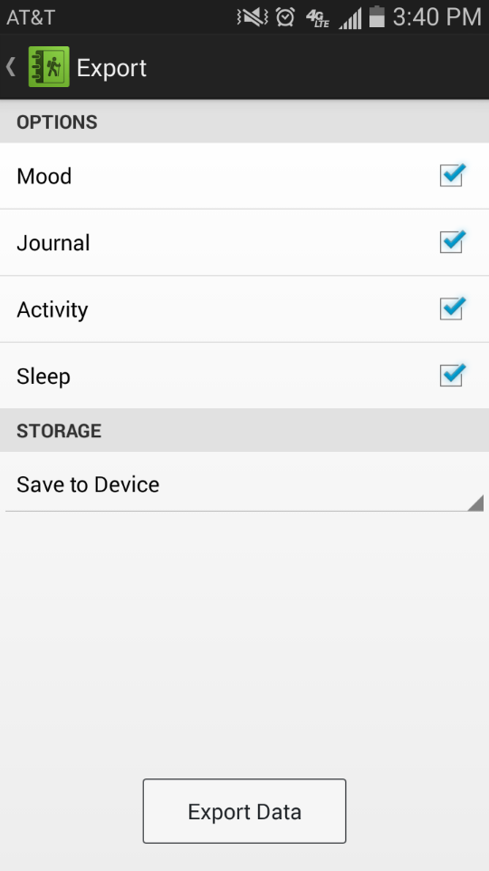
Mood-Trek

Slide 33
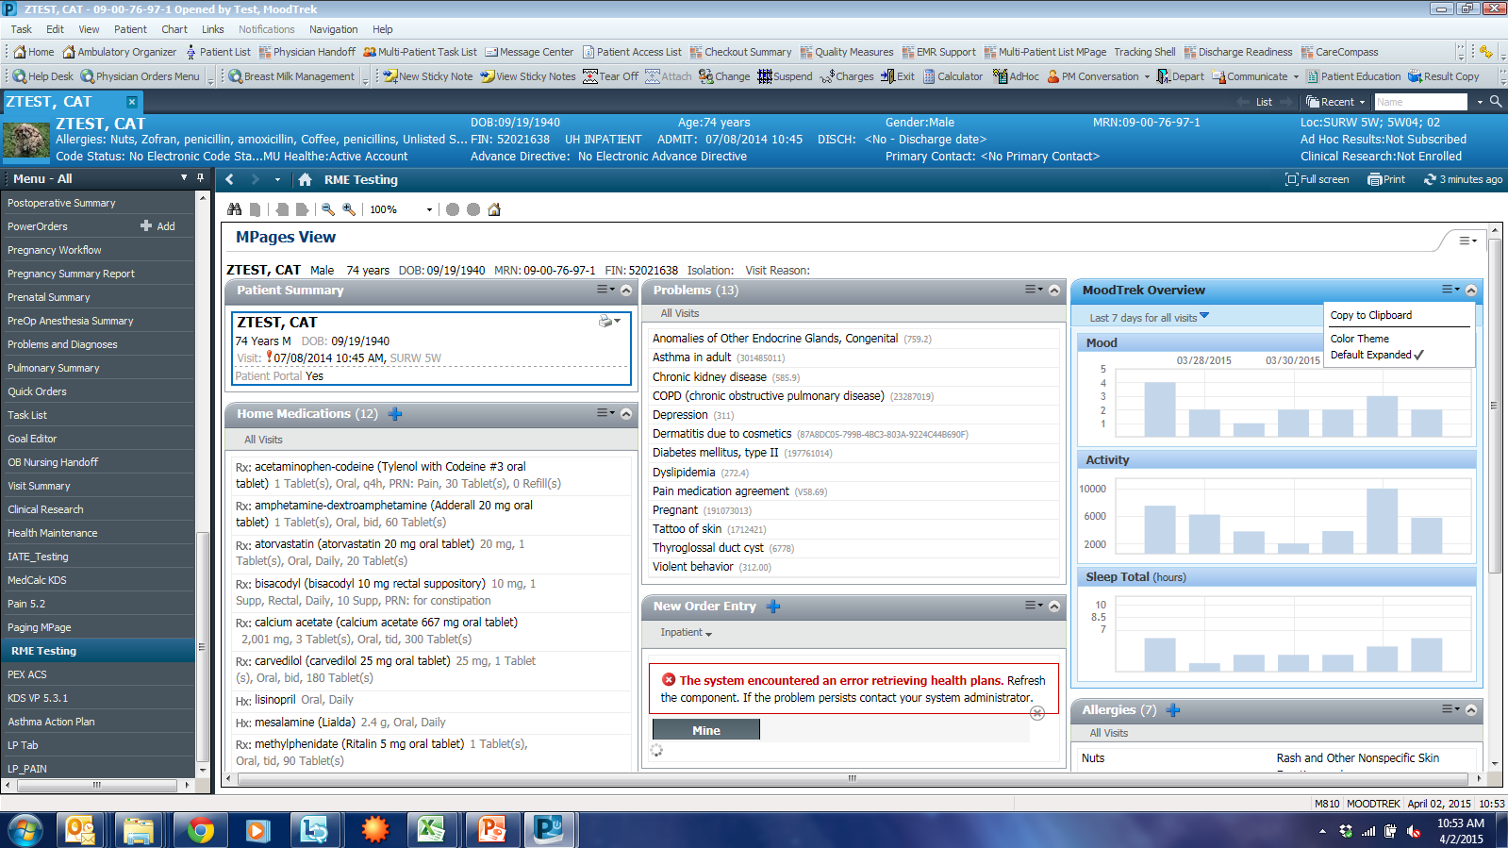
The Physician View

Slide 34
Performance Metrics
HeathCare Metrics
  Faster Turnaround time in Cure
  Reduction in Polypharmacy
  Minimize visits to Physicians
  Reduced visits to ER
Tech Metrics
  Standard testing, debugging, and sentiment analysis

Slide 35

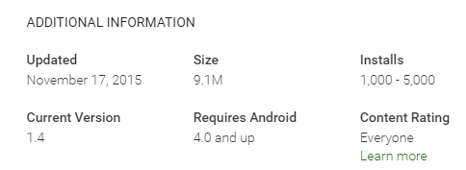
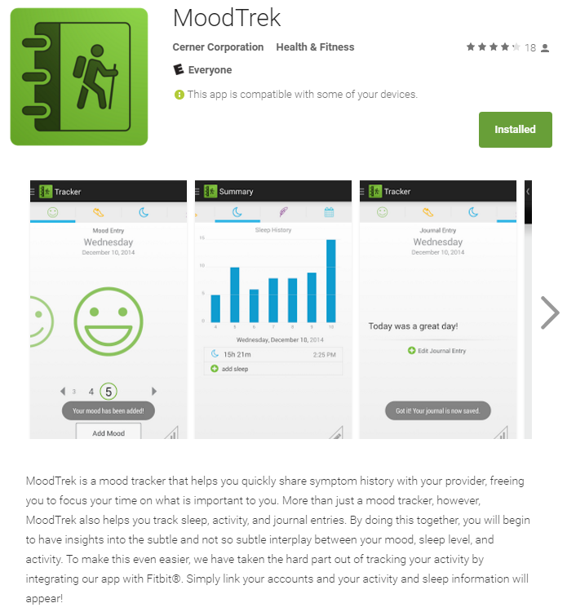
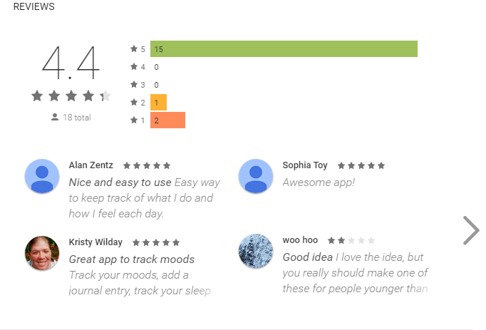
Where we are now

Slide 36
Wearable, BigData and HealthCare
Activity Recognition is an area of active research in the Tech and HealthCare domains
Industry and Academia are aggressive
Accelerometer, Gyroscope, Ambient Light, Altimeter, Heart Rate and more
Recent hardware advances also enable Cortisol monitoring, Blood Color
The field is exploding…

Slide 37
Our Work on Activity Classification
Problem Statement – Detecting complex human activities using multi-positional sensors in body, and ambient Bluetooth beacons
Sensors in waist, back, leg, and wrist positions are used
Mini Bluetooth beacons provide location context
Feature Extraction from Accelerometer, Gyroscope (from body), Temperature, Pressure and Humidity (from ambience) Sensors
Machine learning algorithms

Slide 38
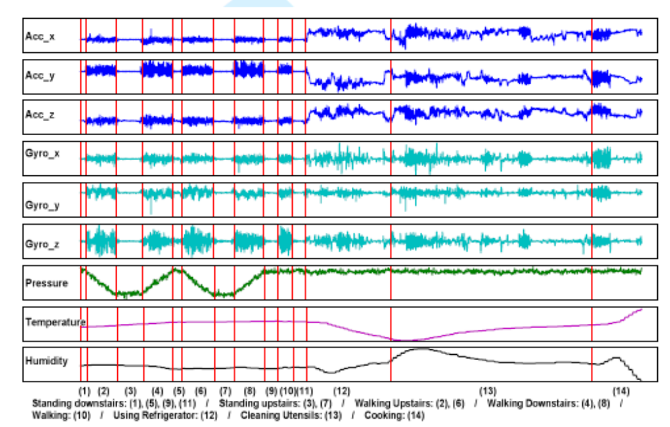
Rationale

Slide 39
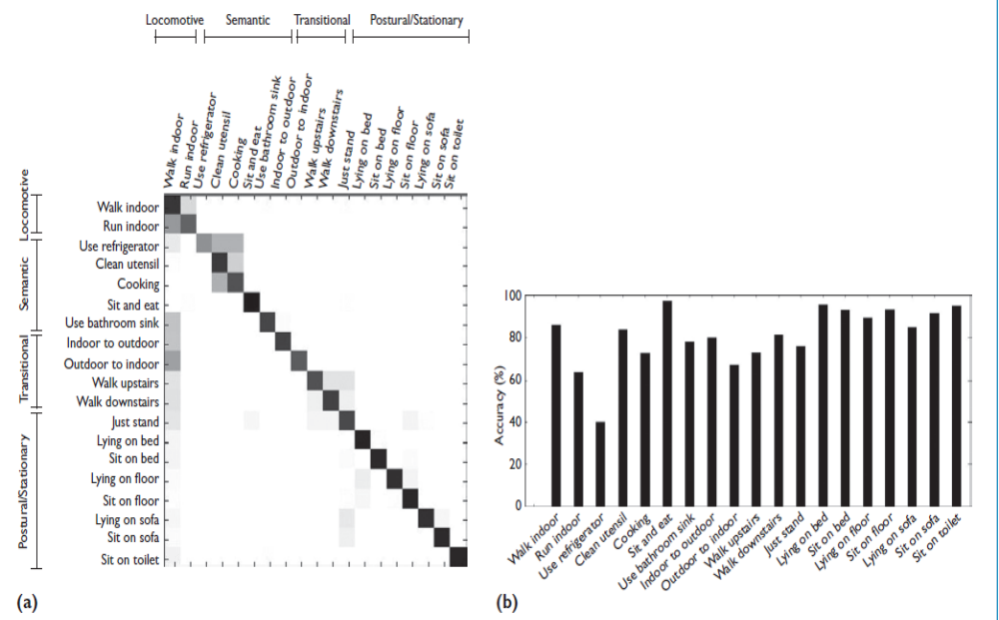
Results

Slide 40
HealthCare Relevance
Medicare Access and CHIP Reauthorization Act of 2015 (MACRA) - what this means in the context of Coronary Heart Disease
Activities Recognition is Vital – Called Ecological Momentary Assessments
Then comes JITAI – Just in Time Adaptive Interventions
Many companies are entering this space in different forms – Moving Analytics. Wellness mate

Slide 41
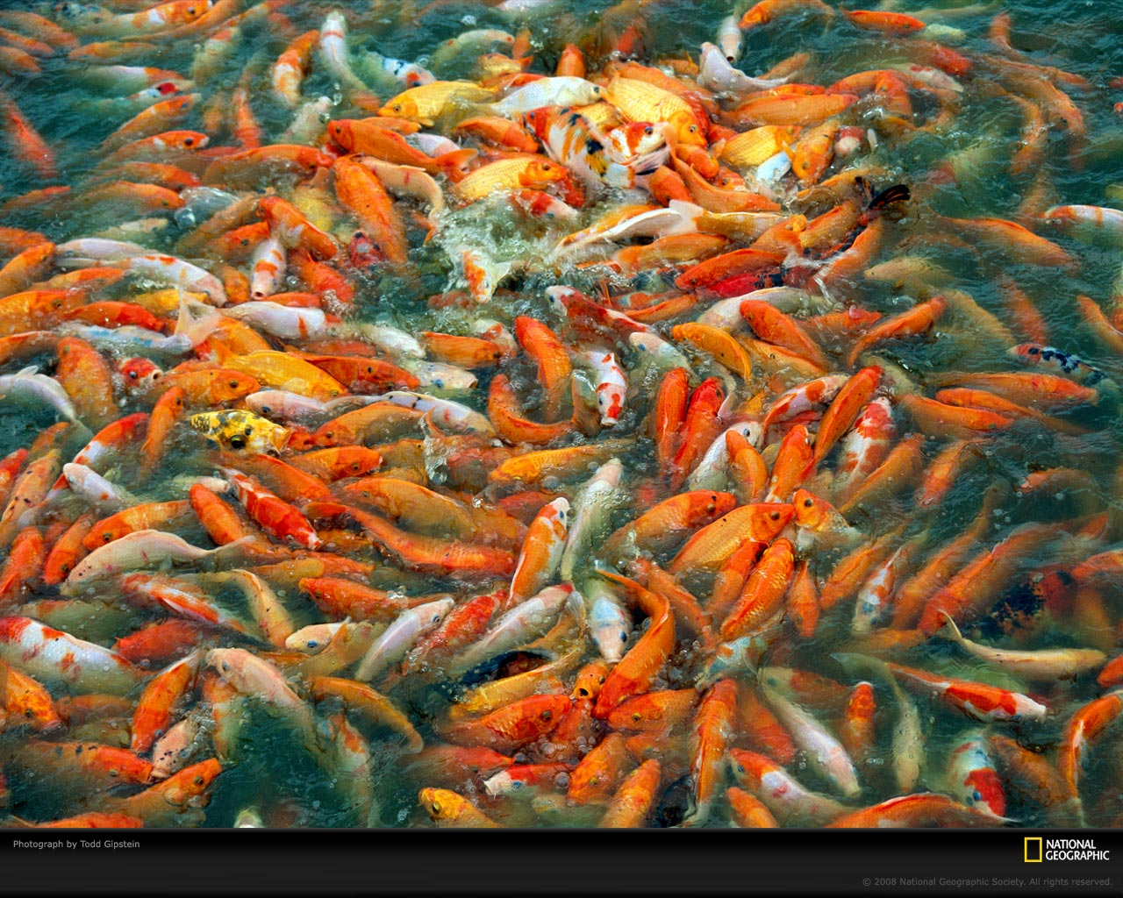
Wrapping it up
The field is congested, but there are clear opportunities for innovation

Slide 42
Acknowledgments
National Science Foundation CAREER, SaTC, REU and CRI programs
Army Research Office
National Security Agency
Dept. of Education
University of South Florida and University of Missouri System

Slide 43
Thank you

