Slide 1

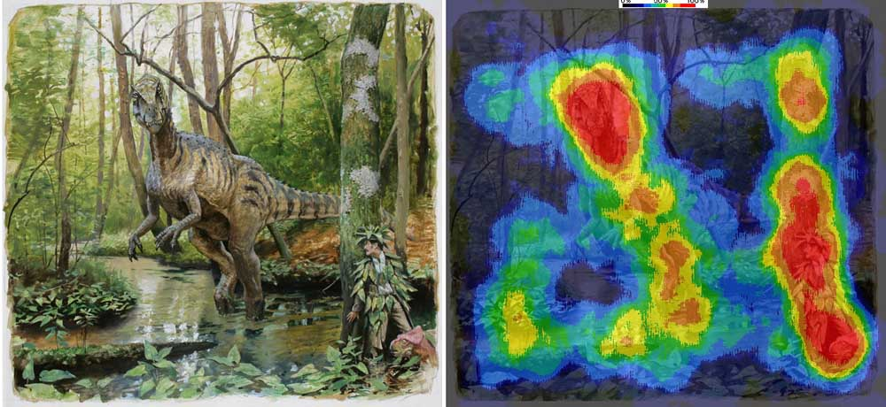
Effects of Visual Search on Memory Search
(From Measuring the Mind to Reading and Changing Its State)
Holly Westfall and Kenneth J. Malmberg
University of South Florida

Slide 2


Experimental Design
Search Condition
No Search Condition

Slide 3
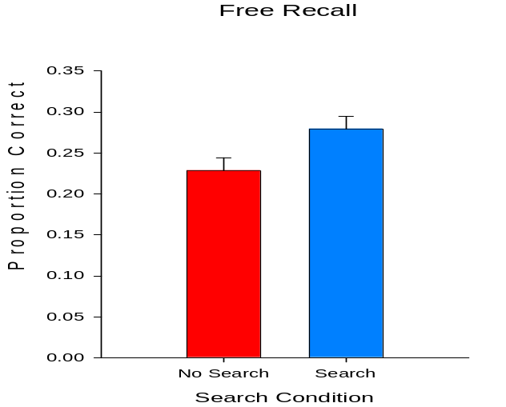
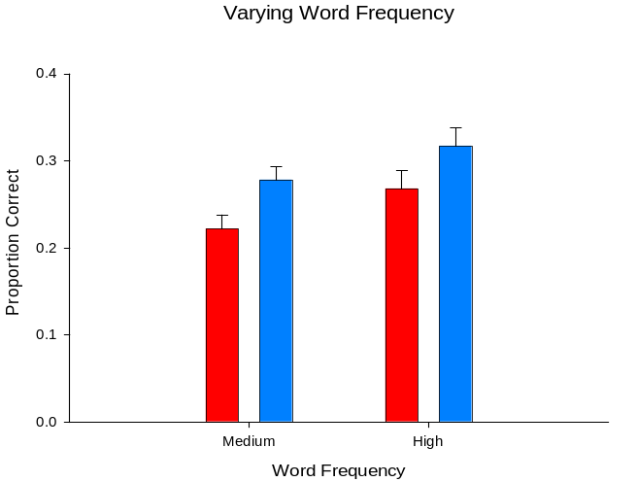
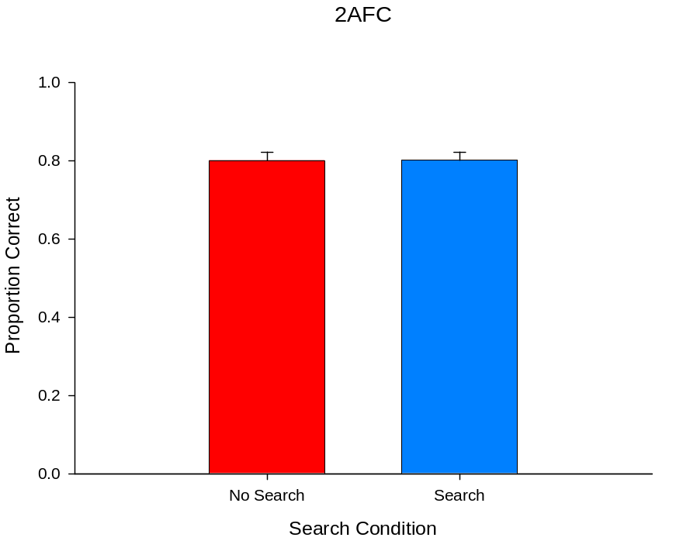
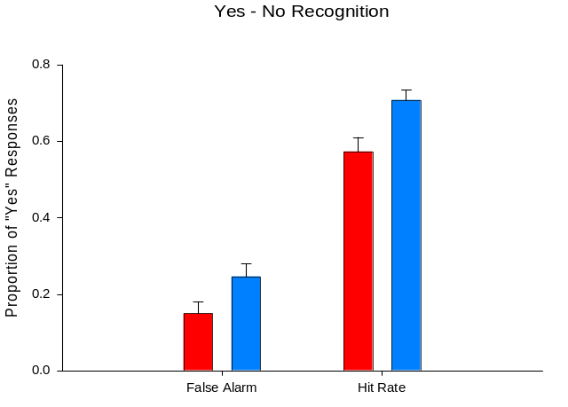
Results from 4 Experiments
(Westfall & Malmberg, 2013)

Slide 4
Types of Information Stored in Memory
Item: Information about the stimulus being attended to
Context: Information about where, when, and how a stimulus is encountered
Associative: The occurrence of stimuli and context
Different memory tasks emphasize the retrieval of different types information.

Slide 5
What is not Happening
The encoding of item information is not being enhanced by performing the visual search task.

Slide 6
What might be Happening
The binding of the item information
to the experimental context is being
strengthened by performing the visual
search task.
This may help the the subject reinstate
the context when initiating free recall
and provide a stronger match between
the context cue and the context stored
in memory for both targets and foils
during recognition testing.

Slide 7
Visual Search May Produce Greater Associative Encoding Too
It is possible that context is not only more strongly encoded while in an exploratory state, but it may be more strongly bound to the item information.
Hence, it is possible that exploratory states also encourage or promote the binding of items in memory leading to more organized memory traces.
Item
Item
Context

Slide 8
English-Swahili Vocabulary Learning
Rate of Learning
Study
Cold-Baiskeli
Test
?-Baiskeli

Slide 9
English-Swahili Vocabulary Learning
Rate of Learning Retention (2 Days Later)
Study
Cold-Baiskeli
Study
Cold-Baiskeli
Test
?-Baiskeli
Test
?-Baiskeli

Slide 10
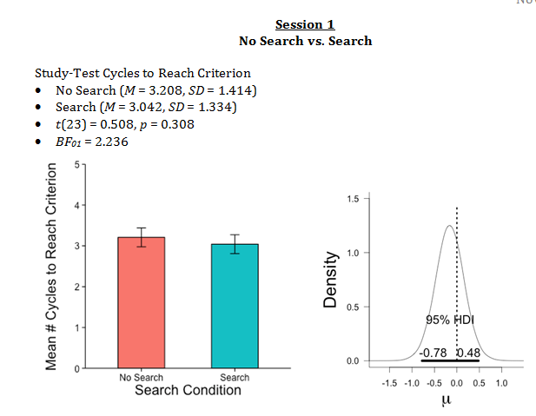
English-Swahili Vocabulary Learning

Slide 11
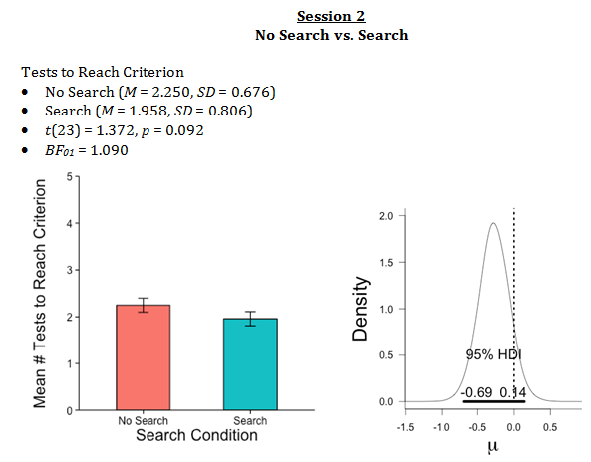
English-Swahili Vocabulary Learning

Slide 12
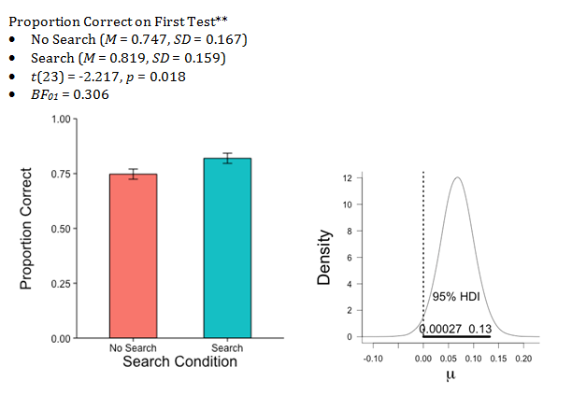
English-Swahili Vocabulary Learning

Slide 13
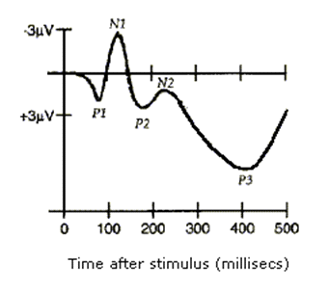
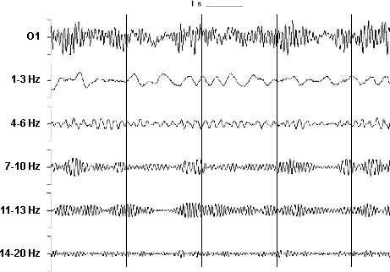
A CogNeuro Approach: Definitions
ERP
Oscillation
Notes:
ERP – electrophysiological response to single stimulus or event
Oscillation – synchronization of electrical activity in the brain which may be state dependent

Slide 14
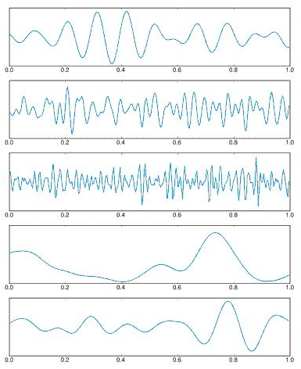
Oscillations
Alpha (8-12 Hz)
  Resting wakefulness
Beta (12-30 Hz)
  Active concentration
Gamma (25-100 Hz)
  Attention and feature binding
Delta (0.1 – 2 Hz)
  Deep sleep
Theta (2-8 Hz)
  Spatial navigation and memory

Slide 15
Theta and Search
Exploratory activities in rodents are associated with oscillations in the theta band of frequencies
(Vanderwolf, 1969)

Slide 16
Theta and Learning
Eye blink conditioning in rabbits
  Performance predicted by θ activity before training
  θ+ animals learned EB conditioning in half as many trials as θ-
  Older θ+ animals learned EB conditioning in just as many trials as young yolked controls
(Asaka et al., 2005; Berry & Thompson, 1978; Griffin et al., 2004; Seager et al., 2002)

Slide 17
Theta and Learning
Interference of theta
  Scopolamine (cholinergic antagonist)
  Procaine (local anesthetic)
  MS Lesioning
Enhancement of theta
  Water deprivation
  Electrical stimulation of MS
(Asaka et al., 2000; Asaka et al., 2002; Berry & Swain, 1989; Berry & Thompson, 1979)

Slide 18
Human Studies
Spatial navigation
  Virtual navigation induced cortical theta activity
    True for exploratory searching and goal-seeking behavior
Episodic memory
  Oscillations at gamma and theta frequencies during encoding predictive of words later recalled
(Caplan et al., 2003; Kahana et al., 1999; Sederberg et al., 2003
Notes:
Computer generated 3-D maze displayed on computer screen
Theta during virtual navigation (virtual movement)
***Possible to induce theta using only visual cues***

Slide 19
The Role of the Hippocampus
Important in the creation of new memories
May bind items and context together
(Davachi, 2006; Davachi, Mitchell, & Wagner, 2003)

Slide 20
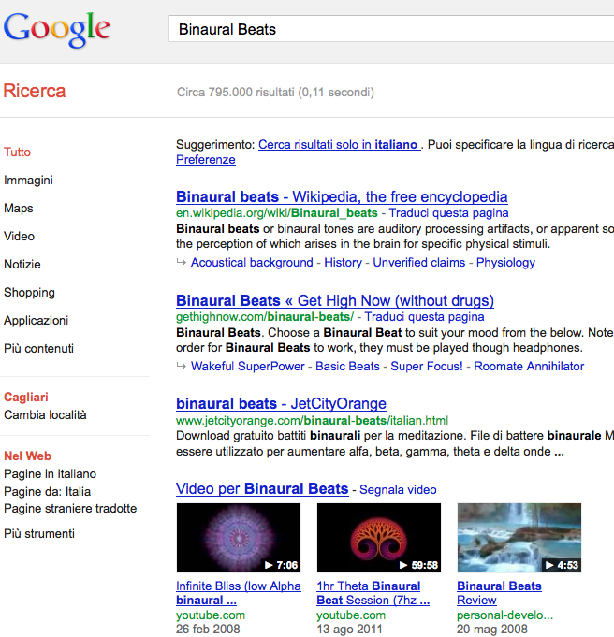
Binaural Beats
In pop culture, binaural beats are linked to concentration, lucid dreaming, relaxation, mood enhancement, meditation, etc.

Slide 21
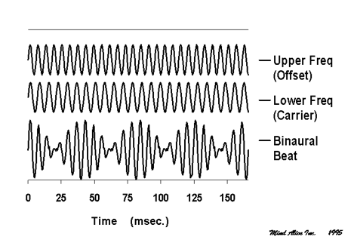
Binaural Beats

Slide 22
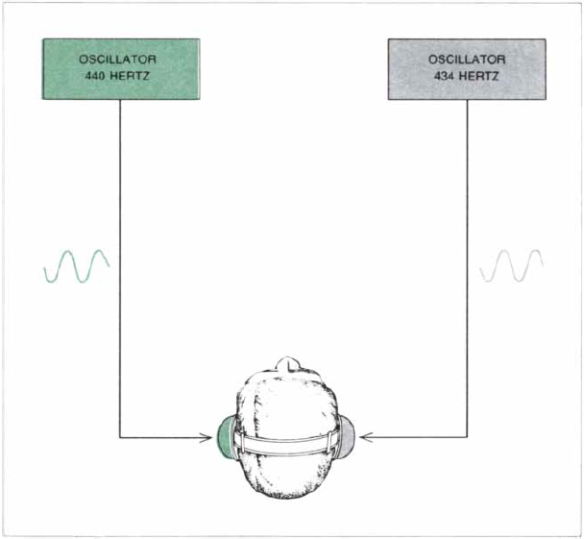
This produces a 5 Hz “beat”
300 Hz
310 Hz
(Oster, 1973)

Slide 23
Entrainment
Binaural beats can be used to entrain corresponding oscillatory frequencies
Entrainment linked to differences in mood and performance in a vigilance task
(Lane et al., 1988; Schwarz & Taylor, 2005)

Slide 24
Beats Experiment 2
Participants
  43 undergrads at USF
Materials
  Word Lists
    6 lists of 12 words
    Each word repeated 3 times per list
    Medium frequency nouns
  Auditory Stimuli
    Base frequency of 250 Hz
    Beat frequency of 2 Hz, 5 Hz, & 8 Hz

Slide 25
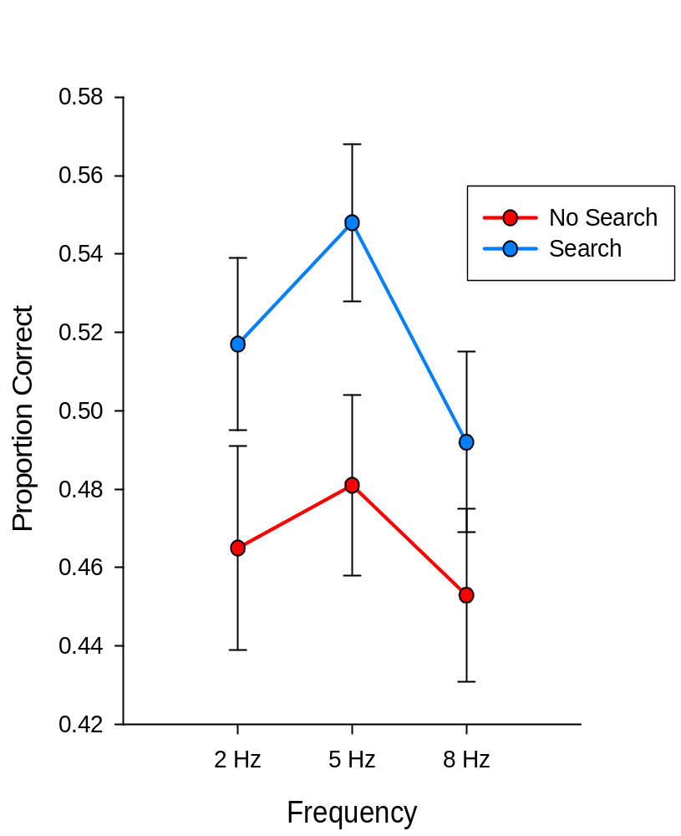
Beats Experiment 2: Results
Main effect of Search, F(1,42) = 15.96, p < .001
Significant quadratic trend for Frequency,
F(1,42) = 4.44, p < .05
Notes:
Partial eta squared for Search: .275
Partial eta squared for Frequency: .096

Slide 26
Status Quo
Visual search during study improves free recall, perhaps because due to enhancing the strength of the item-to-context association.
There is a strong relationship between theta and exploratory activities.
There is a strong relationship between theta and learning in animals.
Memory for the visual presentation of verbal stimuli embedded in binaural beats is best when the frequency of the beats is centered in the theta range of frequencies.
Notes:
Partial eta squared for Search: .275
Partial eta squared for Frequency: .096

Slide 27
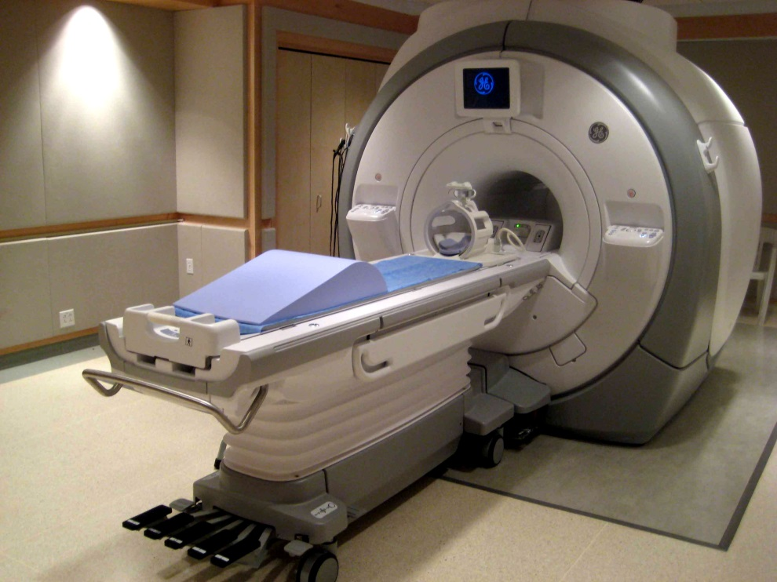
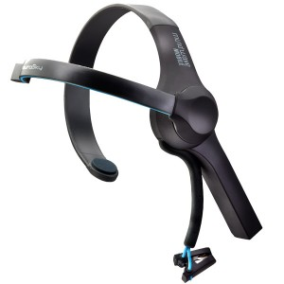
Future Work
fMRI
EEG Sensors
Notes:
ERP – electrophysiological response to single stimulus or event
Oscillation – synchronization of electrical activity in the brain which may be state dependent

Slide 28
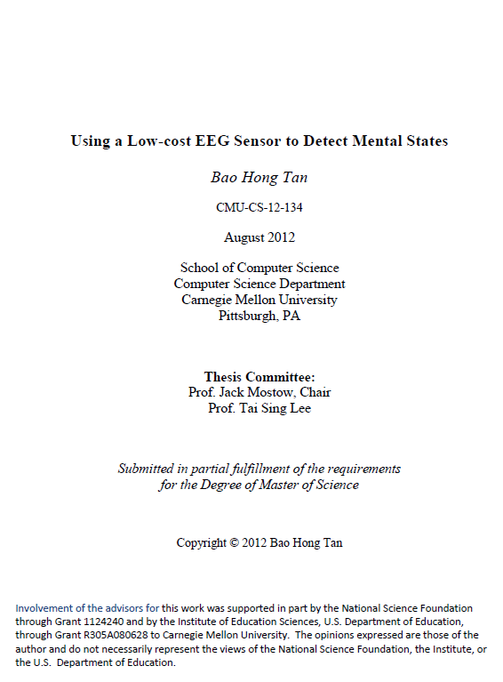

Future Work is Being Done Now

Slide 29
Future Work
Using EEG technology to determine the relationship between sensory stimulation, exploratory activity, brain activity and human memory.
We are interested in developing technology for improving human learning and memory via passive sensory stimulation and volitional exploratory activity (patent pending).
We would like to monitor brain oscillations in real time, and coordinate media streams and the presentation of instructions to encourage efficient brain processing.
Notes:
Partial eta squared for Search: .275
Partial eta squared for Frequency: .096

Slide 30
Future Work
*** We need to develop principled algorithms for detecting power changes of different oscillatory frequencies in static data and real-time streaming data. ***
We need to assess the proper placement of electrodes for optimizing power change detection.
We need to assess individual differences in oscillatory power and responses to feedback in order standardize and normalize analytics.
Notes:
Partial eta squared for Search: .275
Partial eta squared for Frequency: .096

