Slide 1
Bootstrapping Alcohol/Substance Use Research and Biobehavioral Science
  Mark Goldman, Ph.D.
  Distinguished University Professor, University of South Florida

Slide 2
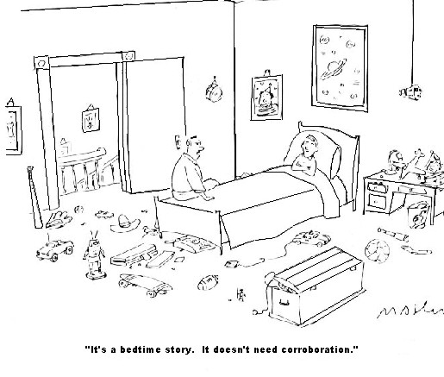

Slide 3
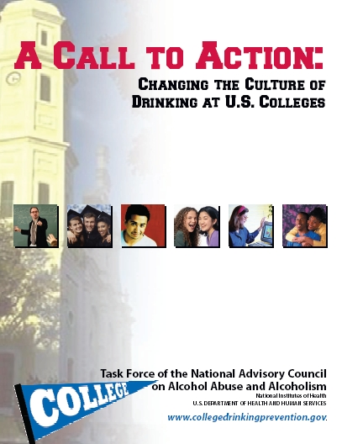
Task Force Report
Originally published April 9, 2002
Notes:
An extraordinary amount of effort and commitment by everyone to bring the Report and its related materials to the American People. (CLICK) The Report was published on April 9. In addition to the Task Force Report (CLICK), a number of materials were produced which have been made widely available to targeted populations. Included in the kit accompanying the Task Force Report are (CLICK) two panel reports; brochures aimed at (CLICK) parents, (CLICK) college presidents, and(CLICK) peer educators/resident advisors; (CLICK) a planning and evaluation guide; (CLICK) journal articles; and (CLICK) the April 9th press release. (CLICK) A College-drinking Web site, which has won numerous awards and other recognitions for its innovations, usability, and information was also launched on April 9.
The finishing touches were being made on the Task Force report when I arrived at NIAAA as Acting Director in January of last year. Although it was only one of many activities that I had to quickly get up to speed on, I was indeed encouraged that such an knowledgeable group had been assembled to tackle the college-drinking problem, and I was genuinely impressed by the enthusiasm and dedication evident in the work that had been underway both within the Institute and by those scientists, educators, and other collaborators involved.(CLICK)

Slide 4
“What the NIAAA task force called a culture of drinking leads many students to harm themselves or others and clearly is antithetical to academic success…sadly and tragically, the serious problem of alcohol abuse and misuse on college campuses persists with students often coming to our campuses with histories of excessive drinking.”
(Susan Resneck Pierce, former President U of Puget Sound).”

Slide 5
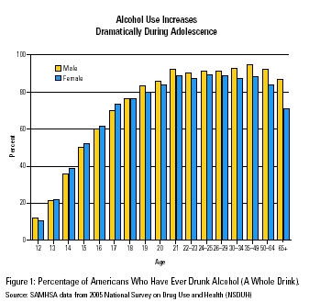

Slide 6
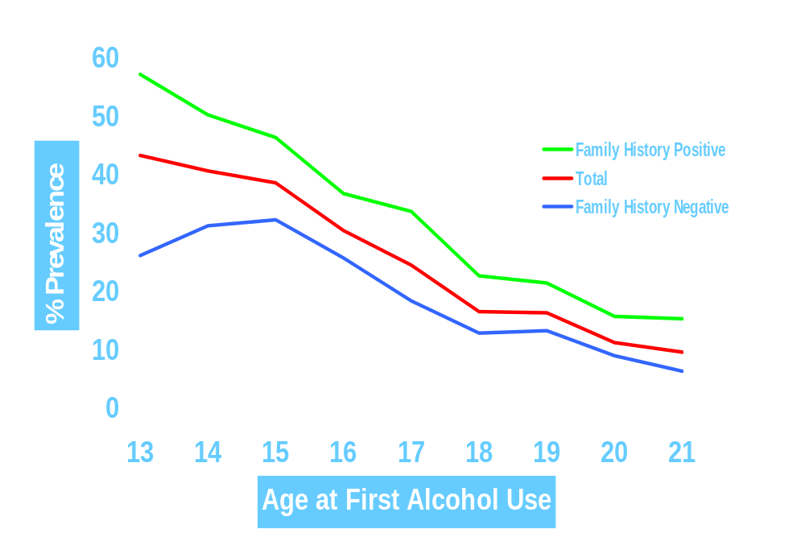
Prevalence of Lifetime Alcohol Dependence by Age of First Alcohol Use and Family History of Alcoholism
% Prevalence
Age at First Alcohol Use
Source: Grant and Dawson. J Subst Abuse. 1998. 10(2):163-73.

Slide 7
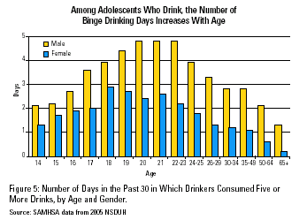

Slide 8
Emerging Paradigms in Biobehavioral Science:
Functional (Systems) Focus:
[Behavioral “Suites” ]

Slide 9
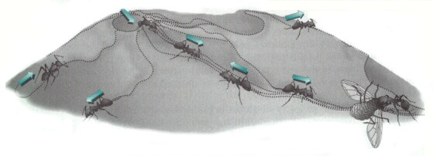
Gerhart, J., & Kirschner, M. (1997, p. 149). Cells, embryos, and evolution: Toward a cellular and developmental understanding of phenotypic variation and evolutionary adaptability. Oxford, London: Blackwell Science.

Slide 10
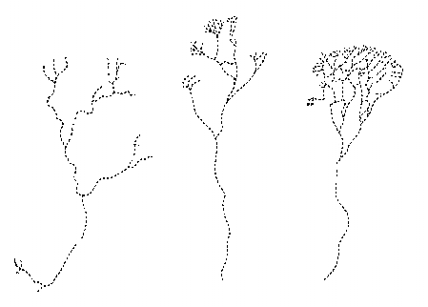
Gerhart, J., & Kirschner, M. (1997, p. 151). Cells, embryos, and evolution: Toward a cellular and developmental understanding of phenotypic variation and evolutionary adaptability. Oxford, London: Blackwell Science.

Slide 11
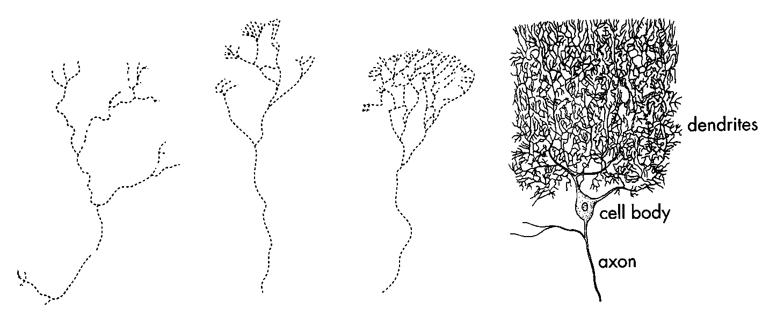
Gerhart, J., & Kirschner, M. (1997, p. 151). Cells, embryos, and evolution: Toward a cellular and developmental understanding of phenotypic variation and evolutionary adaptability. Oxford, London: Blackwell Science.

Slide 12
Gerhart, J., & Kirschner, M. (1997, p. 149). Cells, embryos, and evolution: Toward a cellular and developmental understanding of phenotypic variation and evolutionary adaptability. Oxford, London: Blackwell Science.

Slide 13
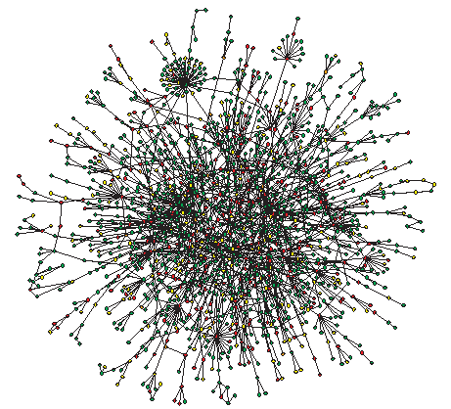
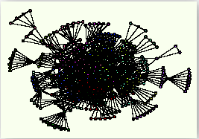
Complex dynamical systems
Yeast protein interactions
(Barabasi & Oltvai, 2004)
Collaborations among human genome
investigators (Barabasi, 2005)

Slide 14
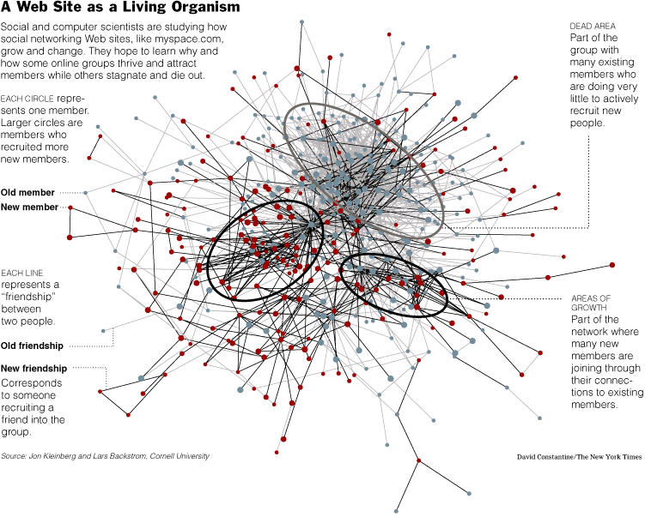

Slide 15
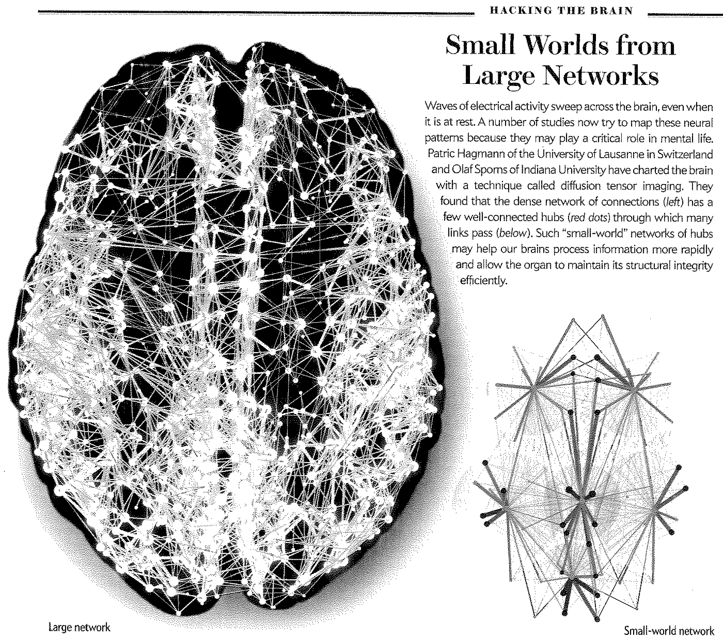
Zimmer, C. (2011). 100 Trillion Connections. Scientific American, 304(1).62

Slide 16
Social Behavior
Decision-making
Genetics/Epi
Emotion/motivation
Development

Slide 17
Genetics/
Epigenetics

Slide 18
Gene-environment interplay; correlation, evocation
Epigenetics:
“…how multiple genetic factors and multiple environmental factors become integrated over time through dynamic…processes to produce behaviorally relevant endophenotypes and phenotypes.”
Gottesman & Hanson (2005). Annu. Rev. Psychol., 56, 263-86.
Also: Zhang & Meany (2010). Annu. Rev. Psychol., 61, 439-466.

Slide 19
Noble, D. (2013). Physiology is rocking the foundations of evolutionary biology. Experimental Physiology, 98, 1235-1243.
“The modern synthesis (Neo-Darwinism) is a mid-twentieth century view of evolution, based on random mutations accumulating to produce gradual change through random selection.
…genetic change is far from random and often not gradual …reintroduces physiological function and interactions with the environment as…influencing…inherited change.
The twenty-first century can look forward to a new synthesis that will reintegrate physiology with evolutionary biology.”

Slide 20
Social Behavior

Slide 21
Social brain:
…relative size of the neocortex…correlates with many indices of social complexity, including
social group size, number of females in the group, grooming clique size, the frequency of coalitions, …etc.
Pair-bonding!!
Dunbar, R.I.M. & Shultz (2007). Evolution in the social brain. Science, 317, 1344-1347.

Slide 22
“Social psychology studies have demonstrated that imitation and mimicry are pervasive, automatic, and facilitate empathy.”
“Neuroscience investigations have demonstrated physiological mechanisms of mirroring at single cell and neural-system levels that support the cognitive and social psychology constructs.”
“Neural mirroring solves the “problem of other minds” (how we can access and understand the minds of others)…facilitating social behavior.”
Iacoboni, M. (2009). Imitation, empathy, and mirror neurons.
Annu. Rev. Psychol., 60, 653-670.

Slide 23
Oxytocin, Vasopressin, and the Neurogenetics of Sociality
“…a potential role for these peptides in personality, trust, altruism, social bonding, and our ability to infer the emotional state of others.”
Donaldson & Young (2008). Science, 322, 900-904.

Slide 24
“Humans, being highly social creatures, rely heavily on the ability to perceive what others are doing and to infer from gestures and expressions what others may be intending to do…Human action readily communicates intentions and feelings.”
Blake & Shifrar (2007). Annu. Rev. Psychol., 58, 47-73.

Slide 25
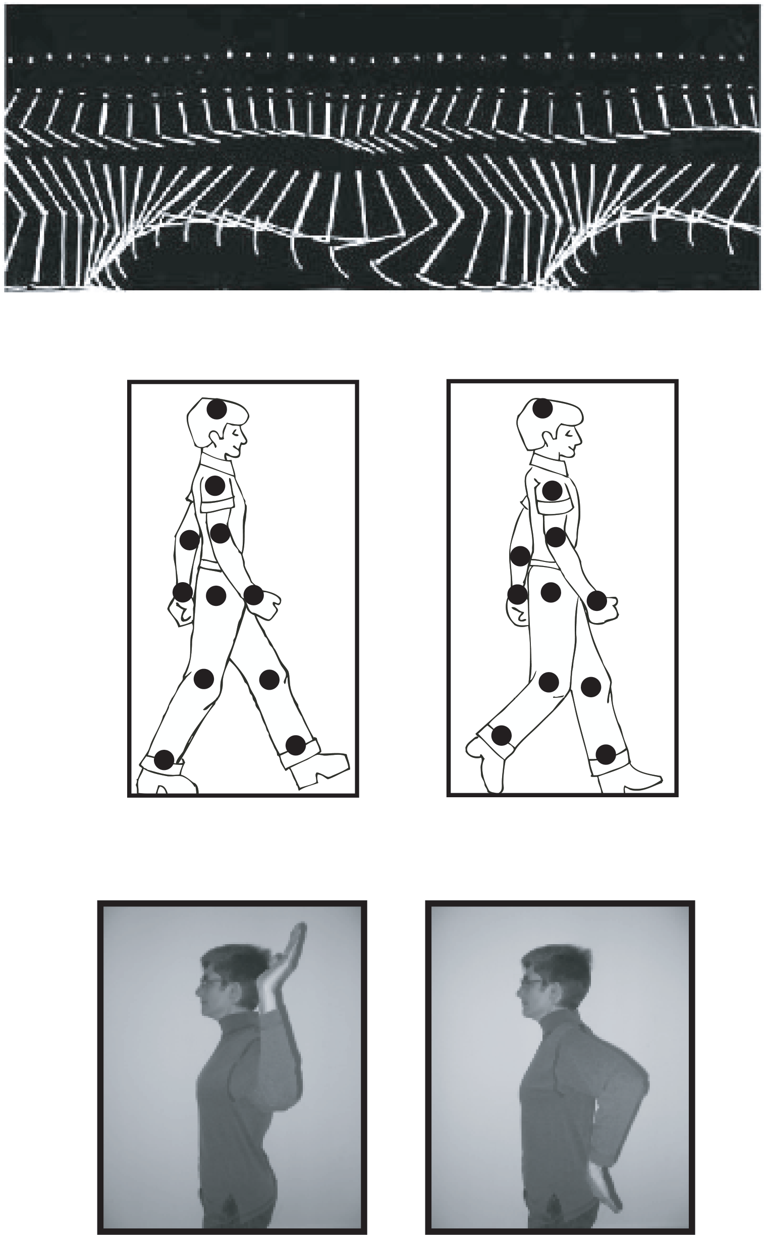

Slide 26
Decision-Making

Slide 27
The Princess Bride/Iocane
[Sicilian Vizzini and Dread Pirate Roberts]
Man in Black: All right. Where is the poison? The battle of wits has begun. It ends when you decide and we both drink, and find out who is right... and who is dead.
Vizzini: But it's so simple. All I have to do is divine from what I know of you: are you the sort of man who would put the poison into his own goblet or his enemy's? Now, a clever man would put the poison into his own goblet, because he would know that only a great fool would reach for what he was given. I am not a great fool, so I can clearly not choose the wine in front of you. But you must have known I was not a great fool, you would have counted on it, so I can clearly not choose the wine in front of me.
Man in Black: You've made your decision then?
Vizzini: Not remotely. Because iocane comes from Australia, as everyone knows, and Australia is entirely peopled with criminals, and criminals are used to having people not trust them, as you are not trusted by me, so I can clearly not choose the wine in front of you.………………

Slide 28
The Princess Bride/Iocane
[Sicilian Vizzini and Dread Pirate Roberts]
“…many of our most important decisions are made in the context of social interactions.”
Rilling and Sanfey (2011). Ann. Rev. Psychol., 62, 23-48.

Slide 29
Heuristic decision making:
“…research indicates that (a) individuals and organizations often rely on simple heuristics in an adaptive way, and (b) ignoring part of the information can lead to more accurate judgments than weighting and adding all information…for low predictability and small samples.”
Gigerenzer & Gaissmaier (2011).
Annu. Rev. Psychol., 62, 451-82.

Slide 30
Motivation/
Emotion

Slide 31
2 kinds of incentives:
1) biological needs (e.g., hunger, thirst, “craving”)
2) seeking advantage over others (evolutionary fitness)

Slide 32
Regulated by:
self/other (social) signals; i.e., emotions (temperament, mood, affect, personality)
…that are difficult to ignore

Slide 33
Signaling for incentives/
motivation is:
Dynamic
Internally competitive
Plays out over time; e.g., as motivational “pathways,” not isolated “events”

Slide 34
…And within a social system

Slide 35
Development

Slide 36
Everything above tailored for developmental epochs
e.g., adolescence/emerging adulthood

Slide 37
Adolescent rats:
…become more disposed to alcohol consumption after they have interacted socially with peers that have been intragastrically administered alcohol (Fernandez-Vidal & Molina, 2004; Hunt et al., 2001).
…effects vary by familiarity and sex (Maldonado et al., 2008); males and females interacting with familiar same sex peers increased drinking, but males interacting with unfamiliar males decreased consumption whereas females increased consumption with unfamiliar females.

Slide 38
Back to alcohol motivation:
Typically addressed as
drug/brain interplay.
Obviously, more than that…

Slide 39
Expectancy:
Anticipation of a systematic relationship between events or objects in some upcoming situation…
Based on prior experience (memory)

Slide 40
The brain is an “anticipatory machine…”
Dennett, D.C. (1991). Consciousness Explained.
New York, Little, Brown.

Slide 41
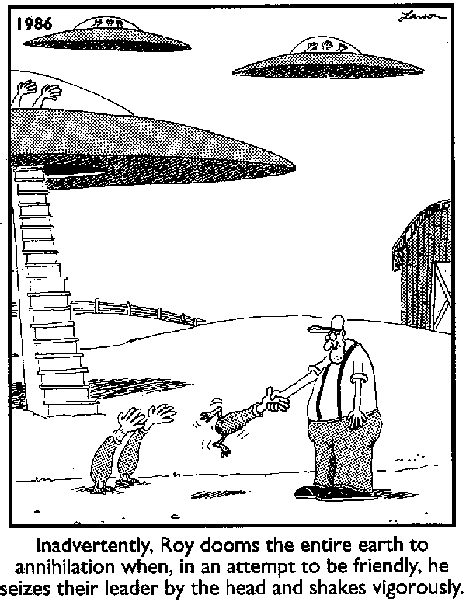

Slide 42
Expectancies in humans measured psychometrically:
Correlate with drinking - Up to 50% variance with error attenuated
e.g., Goldman, Greenbaum, & Darkes, 1997; Leigh & Stacy, 1993

Slide 43
Can be found in children before drinking begins (cross-sectional & Longitudinal)
e.g., Christiansen, Goldman & Inn, 1982;
Miller, Smith & Goldman, 1990;
Zucker, Kincaid, Fitzgerald & Bingham, 1996;
Newcomb, Chou, Bentler & Huba, 1988

Slide 44
Predict drinking prospectively (Social!!!)
e.g., Smith, Goldman, Greenbaum & Christiansen, 1995; Sher, Wood, Wood & Raskin, 1996

Slide 45


Slide 46
(memory) … “traces can be viewed as vectors or lists, as nodes in a network, or as points in multidimensional space.”
Estes, W. K. (1991, p. 12). Cognitive architecture from the standpoint of an experimental psychologist. Annual Review of Psychology, 42, 1-28.

Slide 47
HORNY
FUNNY
SEXY
TALKATIVE
CONFIDENT
DANGEROUS
SICK
WOOZY
SLEEPY

Slide 48
HORNY
FUNNY
SEXY
TALKATIVE
CONFIDENT
DANGEROUS
SICK
WOOZY
SLEEPY

Slide 49
HORNY
FUNNY
DRINK
SEXY
TALKATIVE
CONFIDENT
DANGEROUS
SICK
WOOZY
SLEEPY

Slide 50
HORNY
FUNNY
DRINK
SEXY
TALKATIVE
SEX
CONFIDENT
DANGEROUS
SICK
WOOZY
SLEEPY

Slide 51
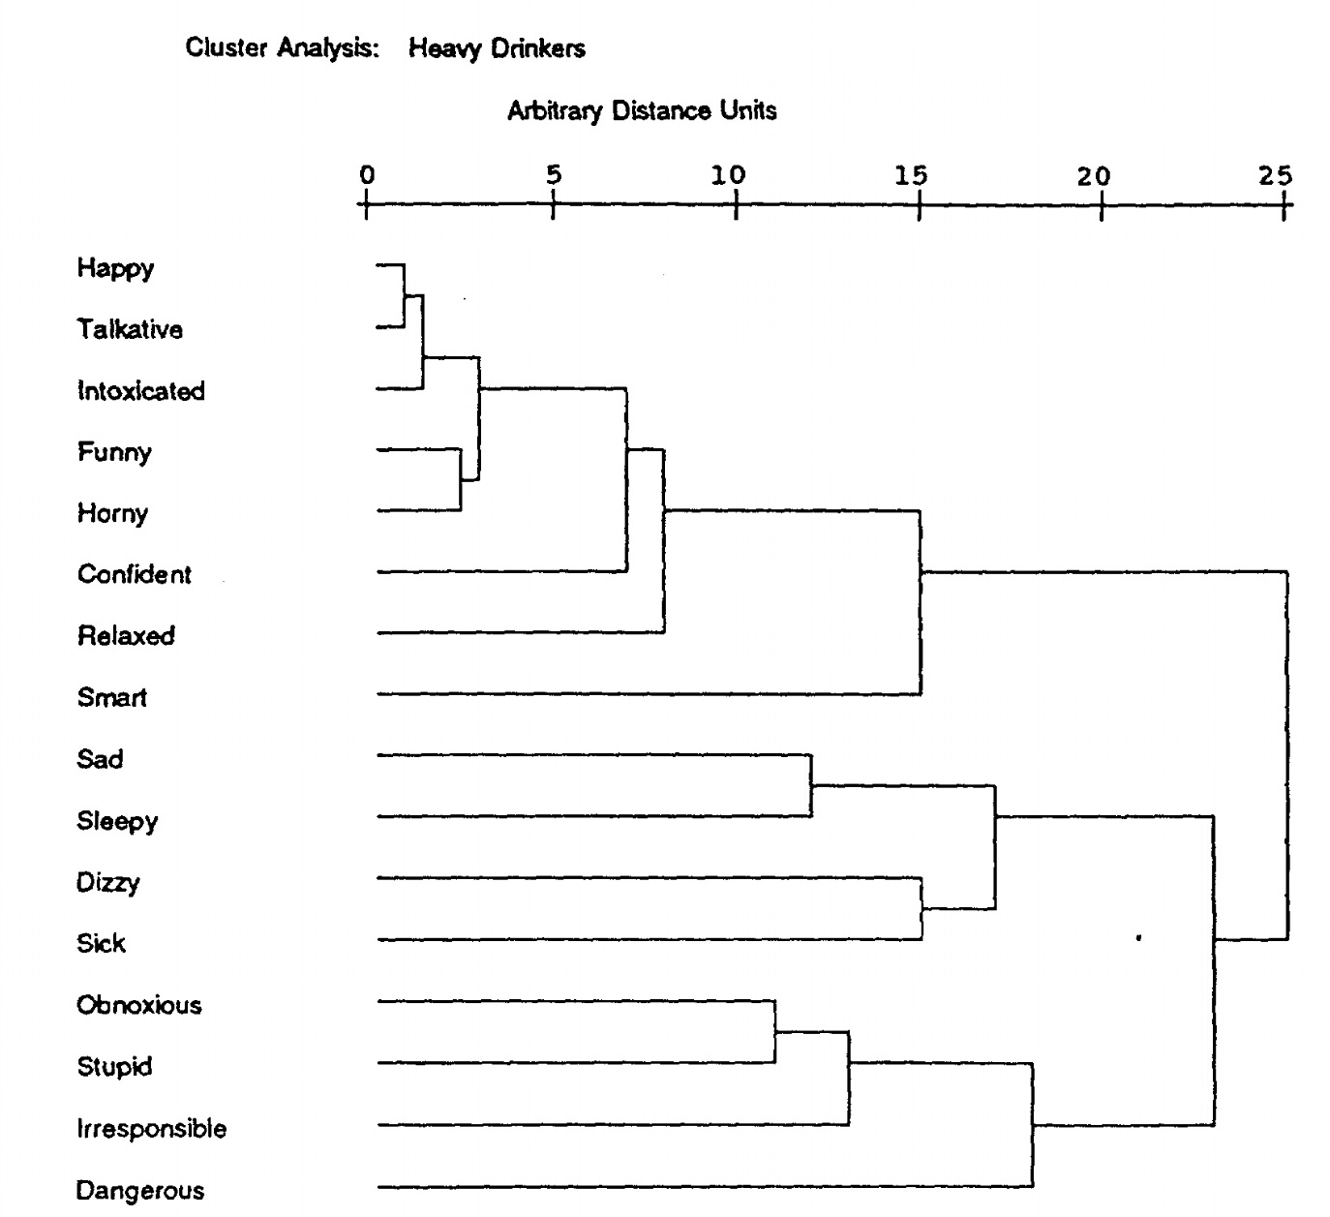
Rather, B.C. & Goldman, M.S. (1994). Drinking-related differences in the memory organization of alcohol expectancies. Experimental and Clinical Psychopharmacology, 2, 167-183

Slide 52
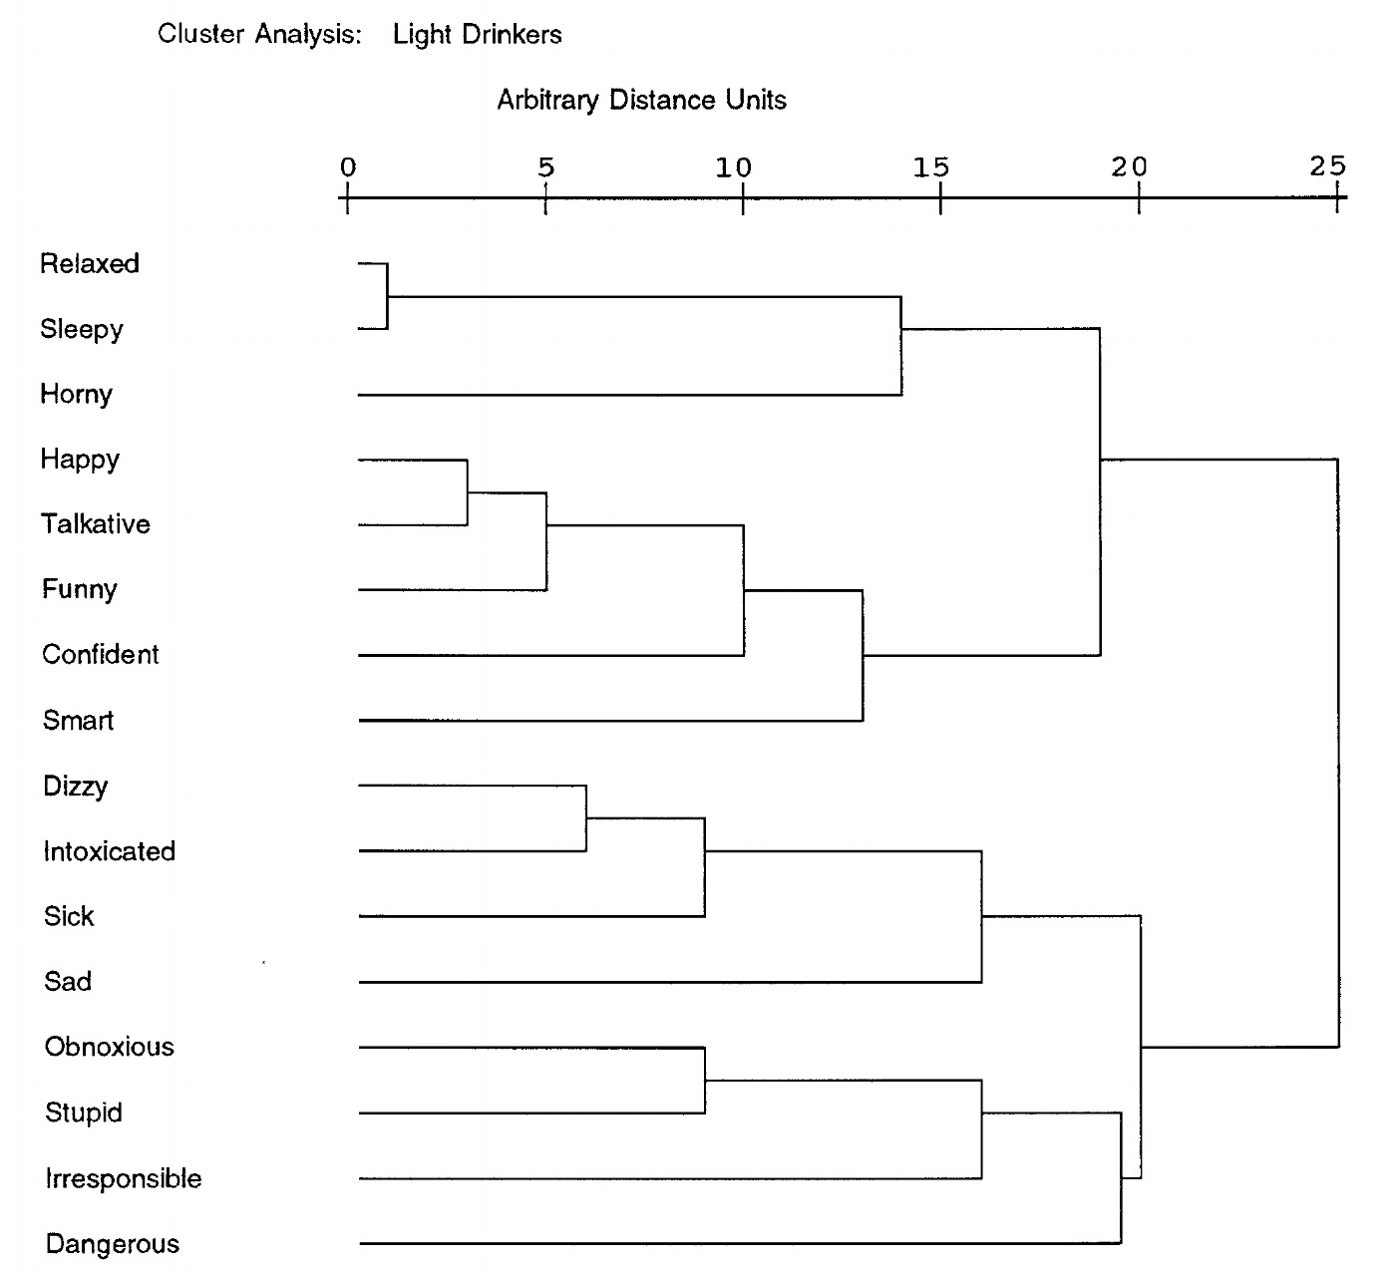
Rather, B.C. & Goldman, M.S. (1994). Drinking-related differences in the memory organization of alcohol expectancies. Experimental and Clinical Psychopharmacology, 2, 167-183

Slide 53
Rather, B.C. & Goldman, M.S. (1994). Drinking-related differences in the memory organization of alcohol expectancies. Experimental and Clinical Psychopharmacology, 2, 167-183

Slide 54
Rather, B.C. & Goldman, M.S. (1994). Drinking-related differences in the memory organization of alcohol expectancies. Experimental and Clinical Psychopharmacology, 2, 167-183

Slide 55
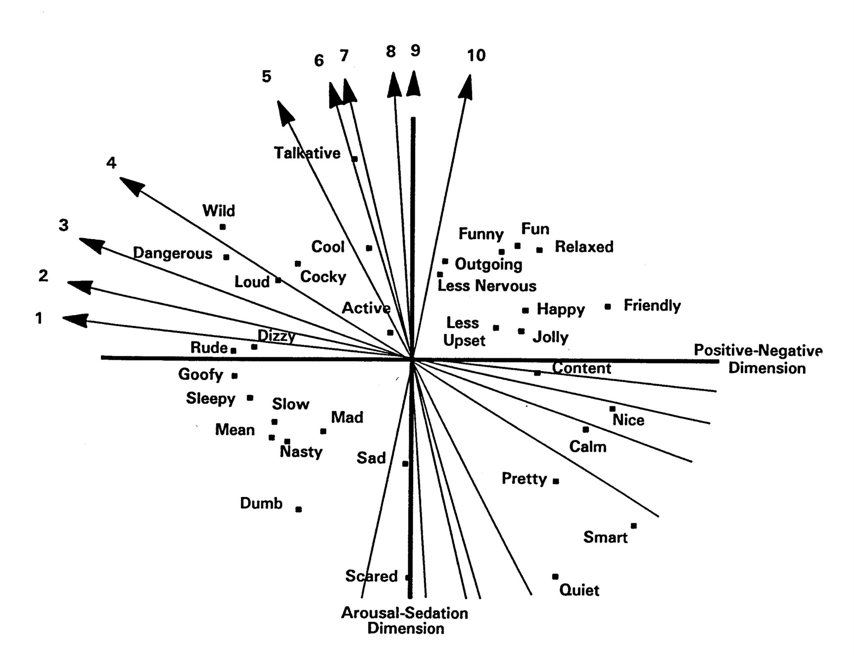
Dunn, M.E.& Goldman, M.S. (1998). Age and drinking-related differences in the memory organization of alcohol expectancies in 3rd-, 6th-, 9th-, and 12th-grade children. Journal of Consulting and Clinical Psychology, 66, 579-585.

Slide 56
Molly Below dissertation:
College students over 21 participated in “marketing” study, including taste test of placebo beer (ad libitum drinking session):
S[olo] condition; completed questionnaires alone.
Mere Presence (MP) condition; completed questionnaires with others present.
Social Facilitation (SF) condition; interacted as part of “marketing” discussions.
MP and SF participants reported greater desire to drink during the taste test than those in the S condition; those in both group conditions also poured and drank more.

Slide 57
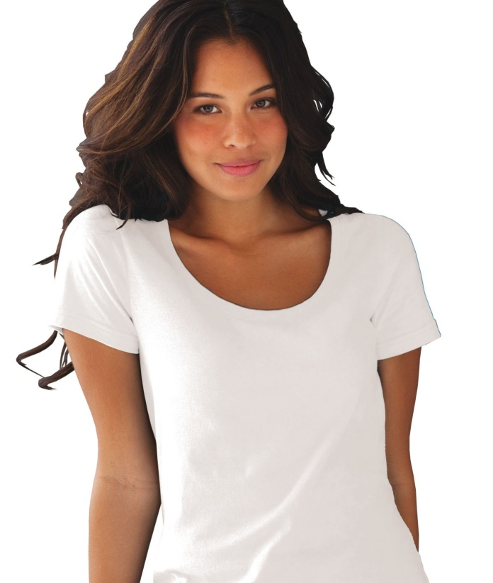
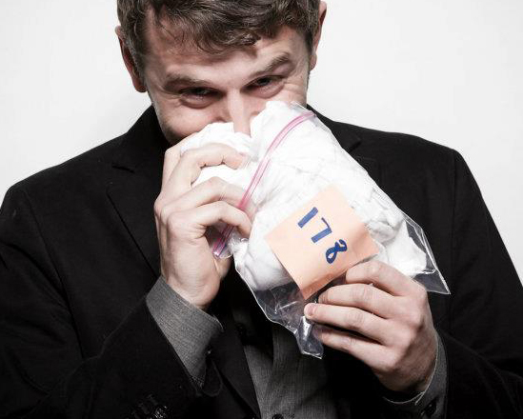
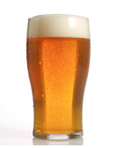
Tan, R. & Goldman, M.S. (2015). Experimental and Clinical
Psychopharmacology, 23, 139-146.
Ovulating?
Yes No
Judging
“detergent”
Judging
Beer

Slide 58
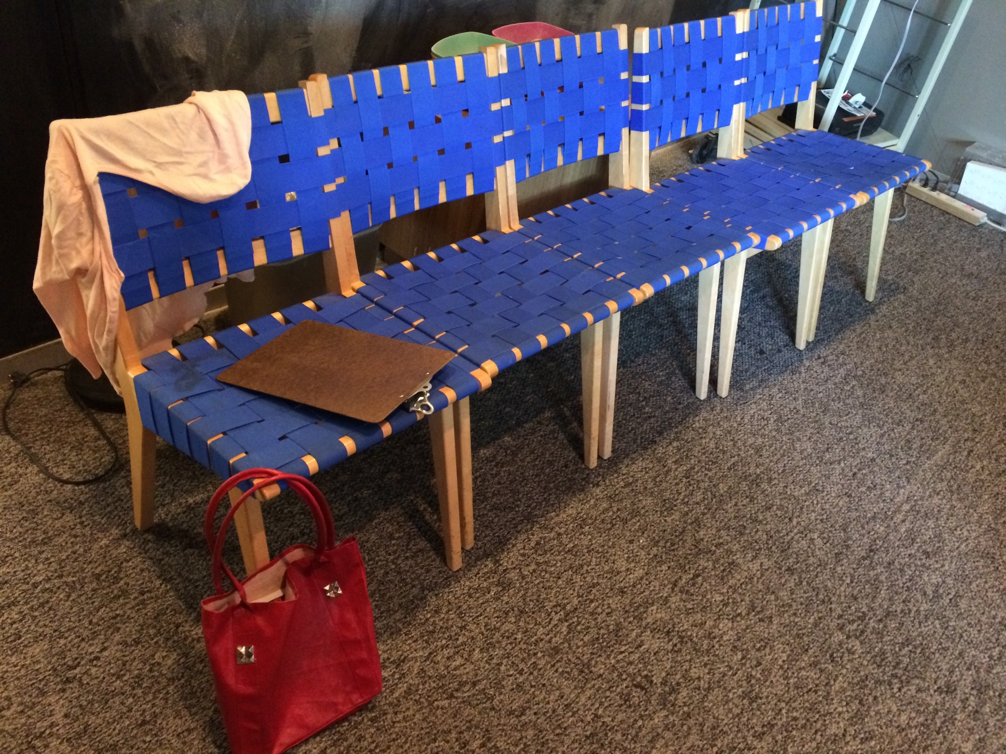

Slide 59
Figure 1. Means and 95% confidence intervals of amount of “beer” consumed by group.

Slide 60
Figure 2. Means and 95% confidence intervals of chair number by group.

Slide 61
Appreciation is expressed to the National Institute on Alcohol Abuse and Alcoholism for their support for portions of this work:
Grants R37 AA08333, R01s: AA6123, AA11925, AA16091

Slide 62
COLLEAGUES and STUDENTS:
Sandra Brown Bruce Christiansen Gregory Smith
Frances K. Del Boca Jack Darkes Paul Greenbaum Richard Reich Kevin Stein Amie L. Haas
Melinda Henderson Howard Steinberg Jane A. Noll
Bruce Rather Felecia Sheffield Brian Levine
Patricia Vincent-Roehling Laurie Roehrich W. Michael Hunt
Andrew Weintraub Michael Dunn Andrea Weinberger
Buffy Wooten Dennis Kramer Greg Aarons
Rita Monteiro Genevieve Chenier Nicole Bekman
Inna Fishman Ashlee Carter Karen Brandon
Molly Below Ty Brumback John Ray
Megan McMurray Robin Tan Patrick Logan
Lauren Adams Quinn Yowell Bryan Benitez

Slide 63
Thank You

Slide 64
The Temporal “Pulse” of Drinking: Tracking 5 Years of Binge Drinking in Emerging Adults
645 (50% female), 18-23 years, 2003-2009
Two-part statistical modeling
Reich, R.R., Cummings, J.R., Greenbaum, P.E., Moltisanti, A.J., & Goldman, M.S. (2015). Journal of Abnormal Psychology, 124, 635-647.

Slide 65
2004
Mean Age = 18.41, SD =.49
2005
Mean Age = 19.43, SD =.55
2006
Mean Age = 20.42, SD = .55
2007
Mean Age = 21.38, SD = .60
2008
Mean Age = 22.39, SD = .59

Slide 66
2004
Mean Age = 18.41, SD =.49
2005
Mean Age = 19.43, SD =.55
2006
Mean Age = 20.42, SD = .55
2007
Mean Age = 21.38, SD = .60
2008
Mean Age = 22.39, SD = .59

