Slide 1
A Normalized Poisson Model for Recognition Memory
Chad Dubé

Slide 2
Recognition Memory
Study: car, dog, apple, table
Test: car, ball, apple, office
Old/New decision
 | “Old” | “New”
Old | Hit Rate | Miss Rate
New | False Alarm Rate | Correct Rejections

Slide 3
Signal Detection Theory
(Green & Swets, 1966)
“New”
“Old”
New Items
Lures
Targets
Old Items
Memory Strength

Slide 4
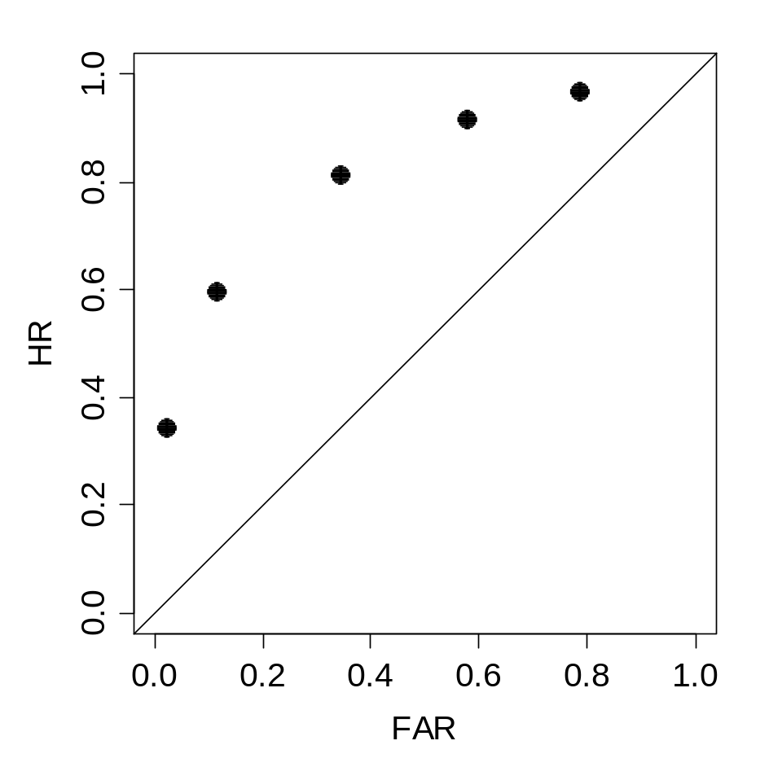
Ratings-Based Receiver Operating Characteristics (ROCs)
1+2+3
1+2
1 : Strong Memory

Slide 5
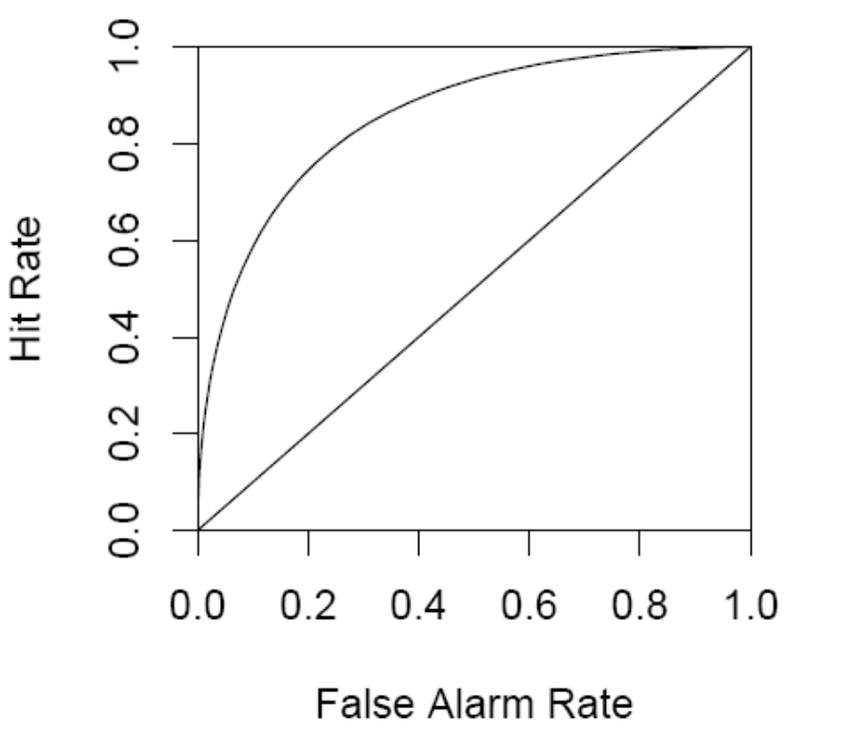
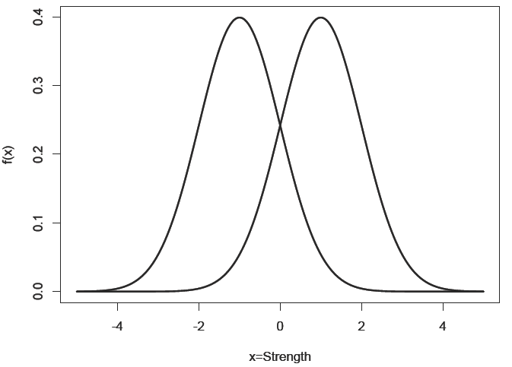
SDT and ROCs
1+2+3
6 5 4 3 2 1
1+2
1, Strong Memory

Slide 6
SDT and ROCs
6 5 4 3 2 1
1, Strong Memory

Slide 7
SDT and ROCs
6 5 4 3 2 1
1+2
1, Strong Memory

Slide 8
Some Strengths of SDT
A priori prediction for shape of ROCs
2AFC Theorem (Green & Swets, 1966)
Easy to implement
Minimal processing assumptions

Slide 9
Some Weaknesses
Biologically implausible
Requires edge corrections
Limited range of predictions

Slide 10
What should a detection model incorporate?
Output of contextual retrieval (Bower, 1972)
Criterion and/or distribution shifting (Treisman & Williams, 1984)
Principled explanation for nonunit zROC slopes (Wixted, 2007)
A more plausible x-axis
Psychophysical regularities

Slide 11
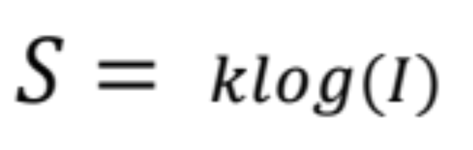
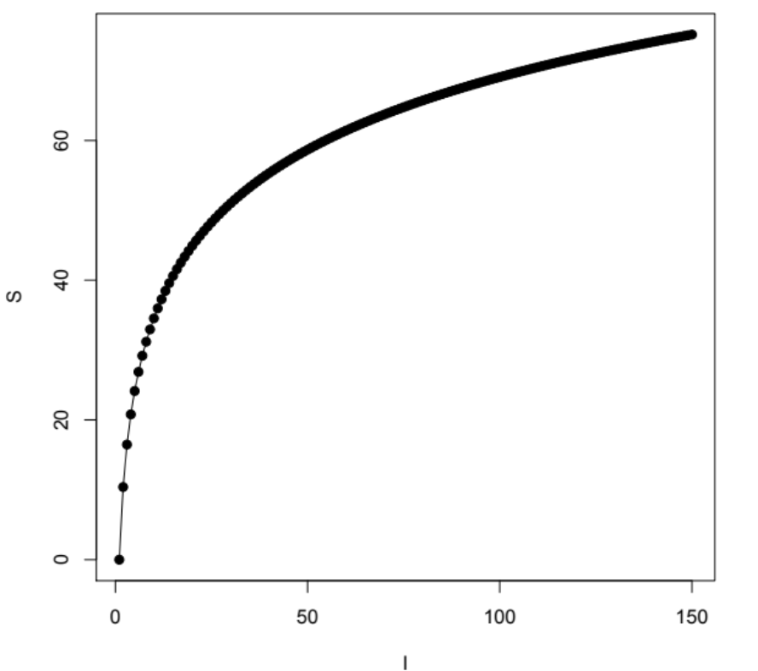
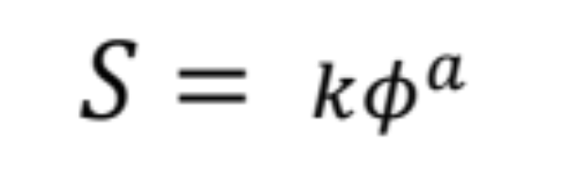
What should a detection model incorporate?
Fechner-Weber Saturation
What does the
brain do?

Slide 12
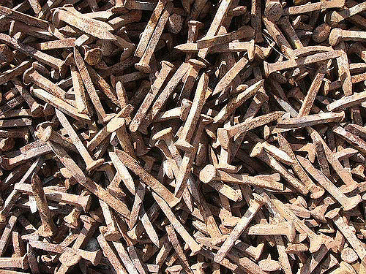
How Do Neurons Code Stimulus Magnitude?

Slide 13
How Do Neurons Code Stimulus Magnitude?
Spike rates increase with stimulus magnitude (Granit,1955; Kandel et al., 2000)
Spike rate approx. Poisson distributed (Ma, 2010; Gabbiani & Cox, 2010)
Mean (which is ≈ Var) spike rate shows nonlinear saturation!

Slide 14
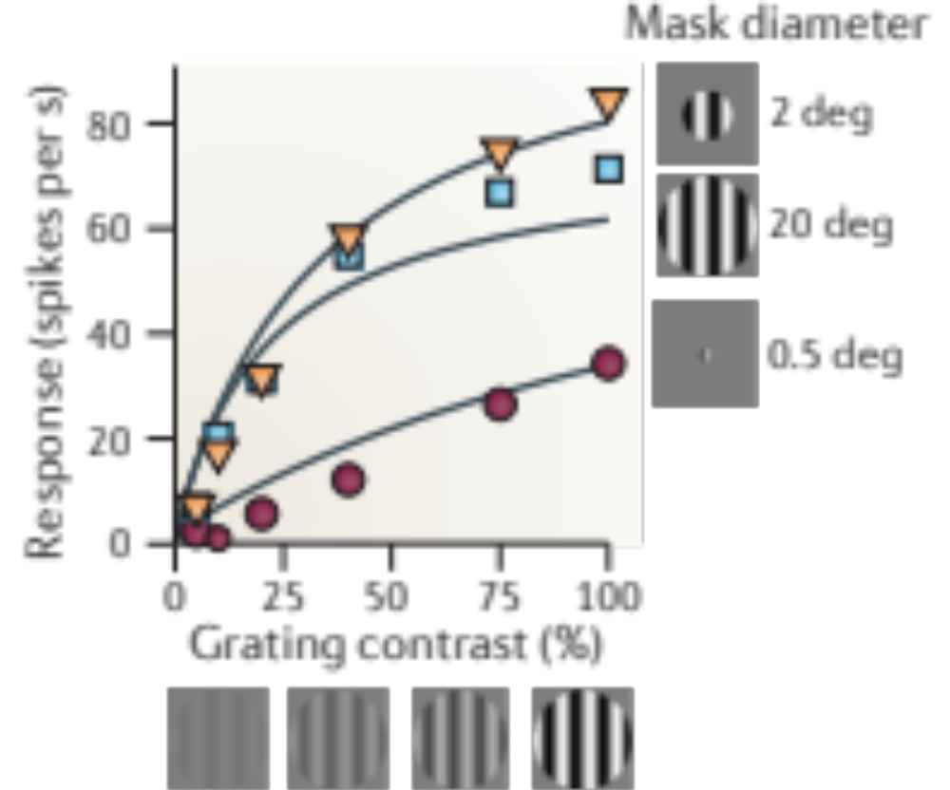
How Do Neurons Code Stimulus Magnitude?
Cf. Carandini and Heeger (2012)

Slide 15
Divisive Normalization
https://www.youtube.com/watch?v=_N23jFSrouo&app=desktop

Slide 16
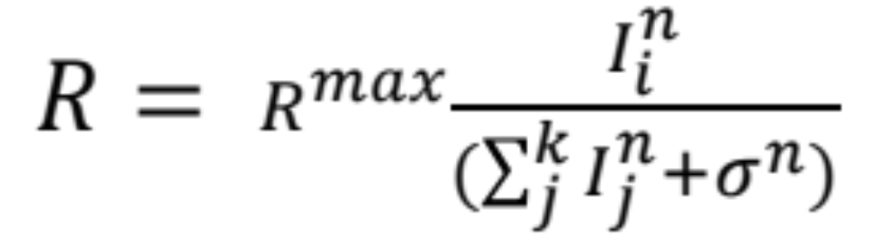
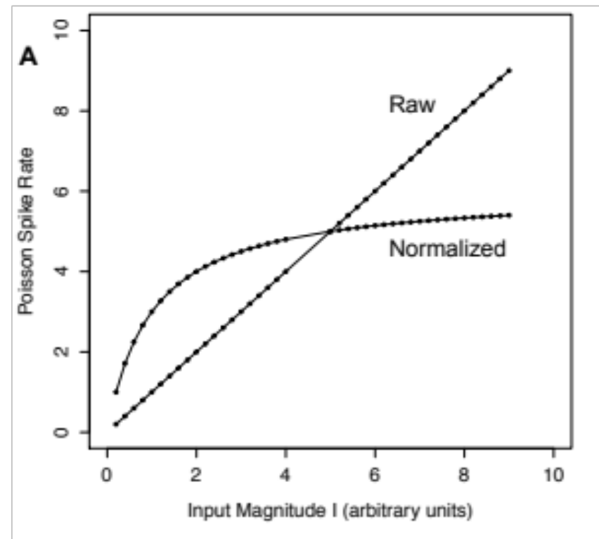
Divisive Normalization
Canonical?
(Spikes/s)

Slide 17
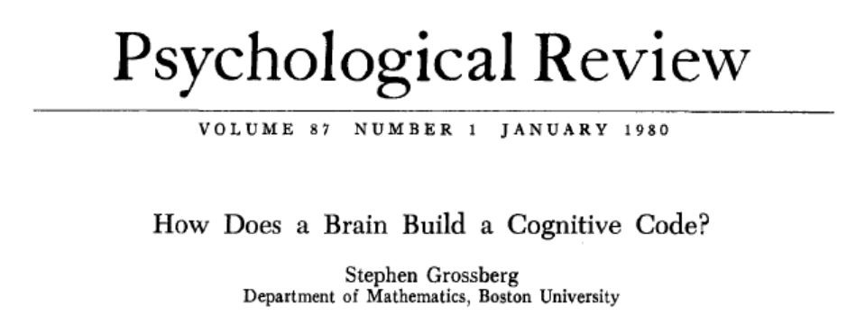
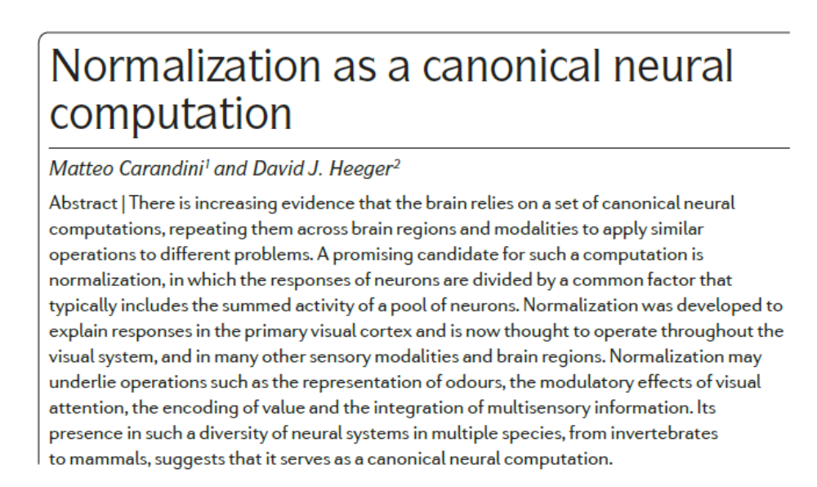
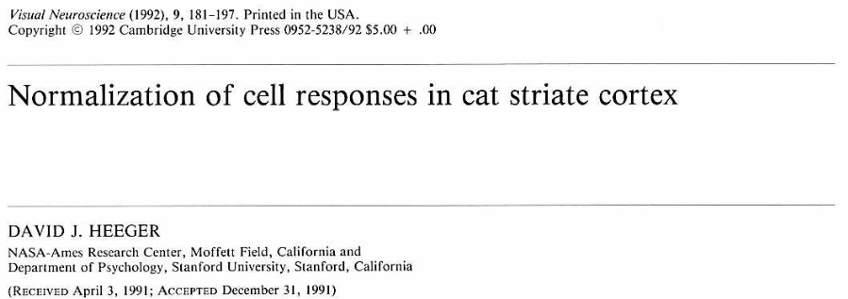
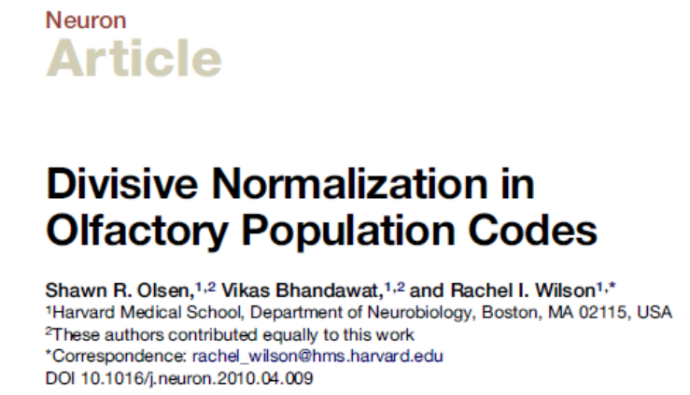
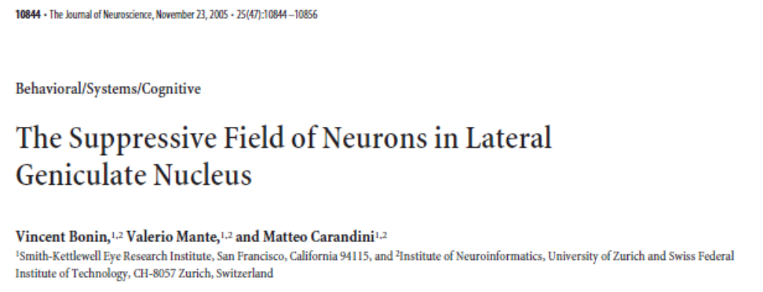
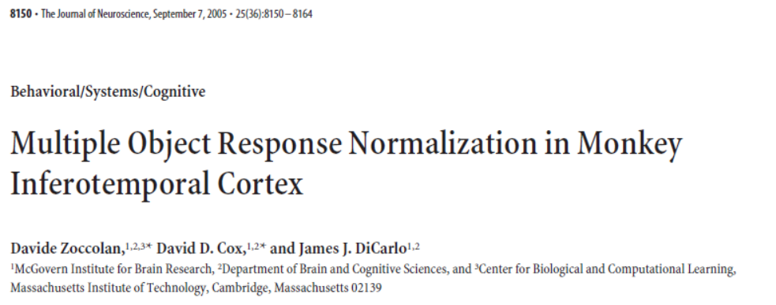
Divisive Normalization

Slide 18
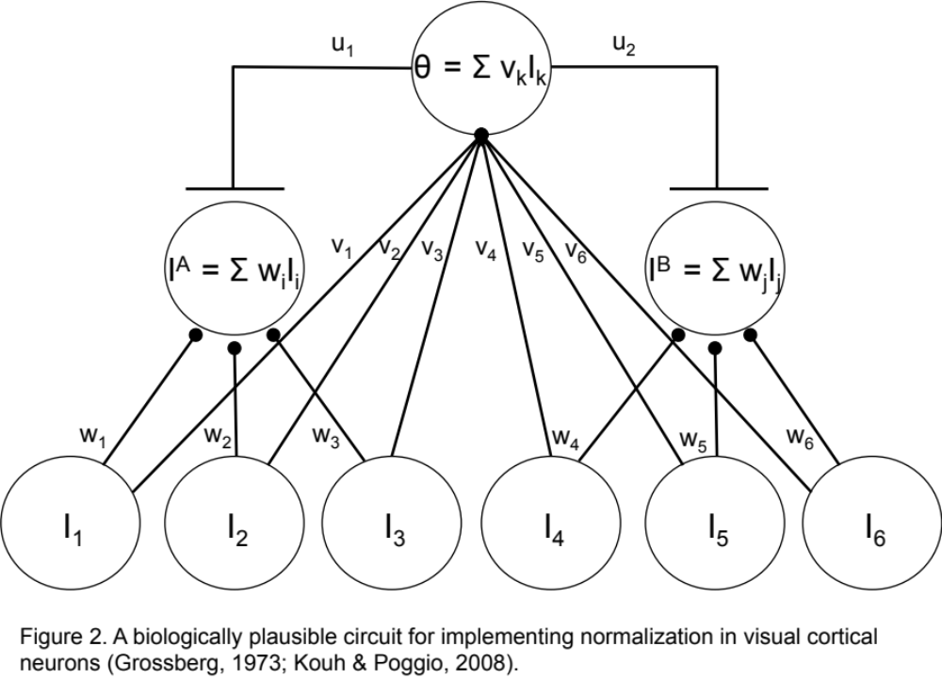
Divisive Normalization

Slide 19
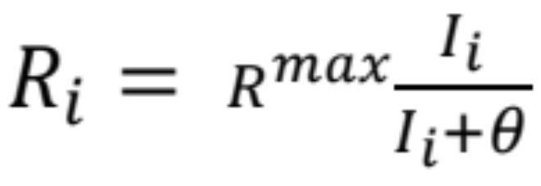
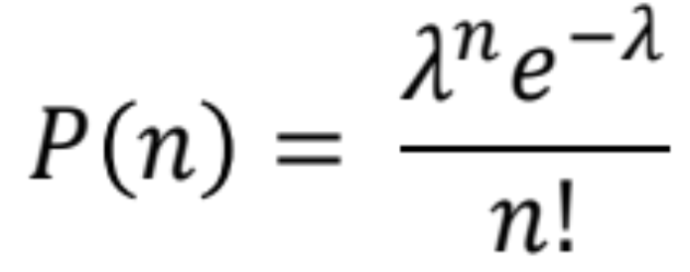
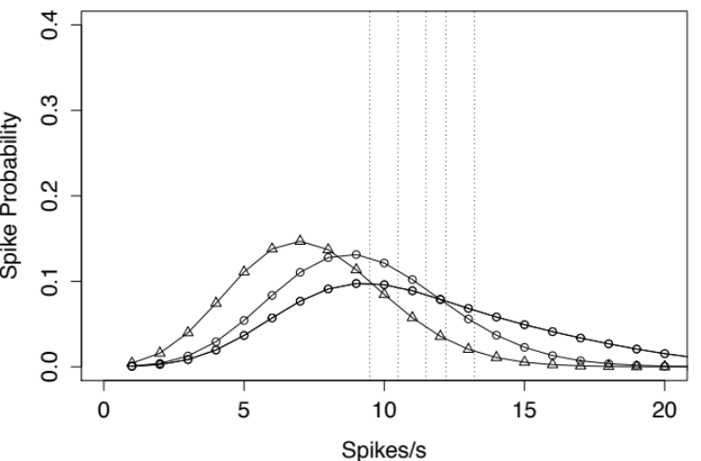
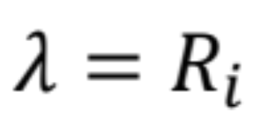
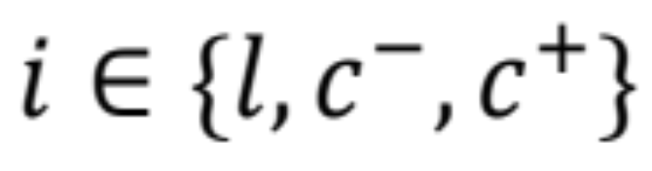
Normalized Poisson Model (NPM)
Mixing: k
Criteria: n*
Oscillation: o

Slide 20
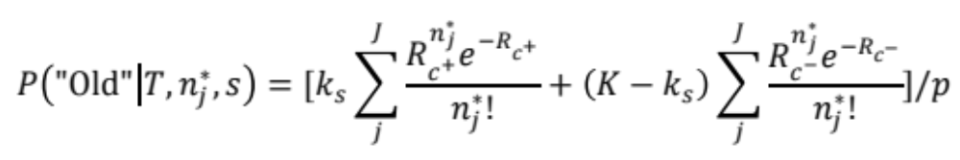
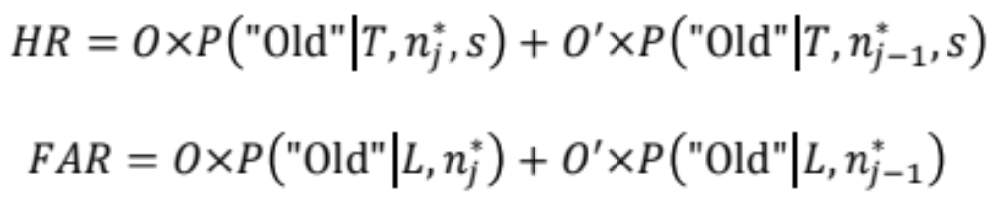
Normalized Poisson Model (NPM)

Slide 21
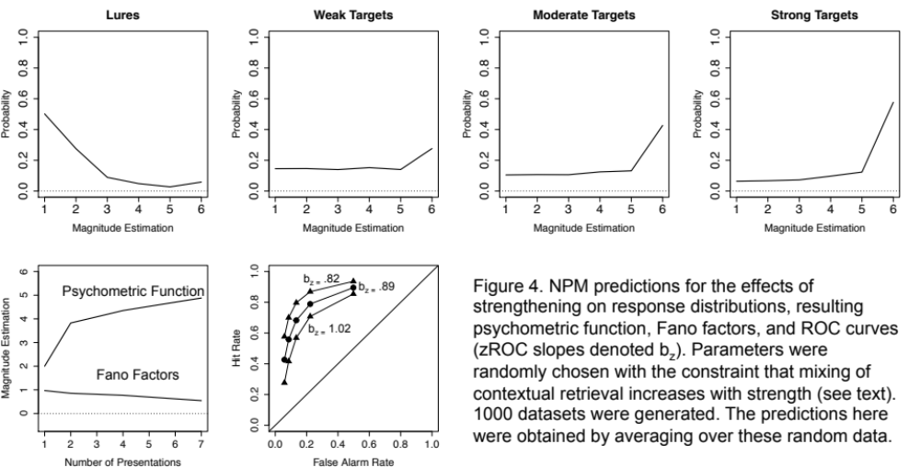
NPM Simulated Data

Slide 22
Experiment 1: Magnitude Estimation of Memory Strength
22 Participants
Study: 72 words, 24 1x, 24 3x, 24 6x (240 trials total)
Test: 72 Targets, 72 Lures
DV: Direct Strength Rating from 1 (no memory) to 6 (strong memory)
Predictions: Weber-Fechner saturation, Fano Factors near 1
Model comparison

Slide 23
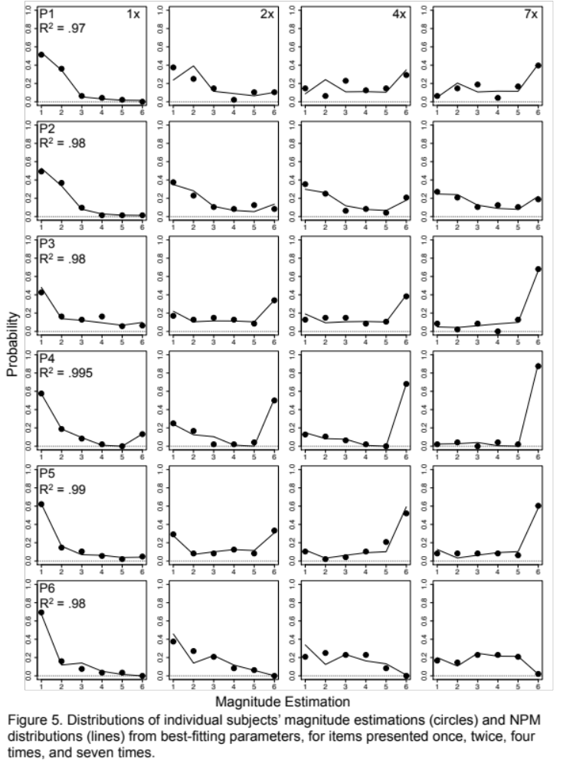

Slide 24
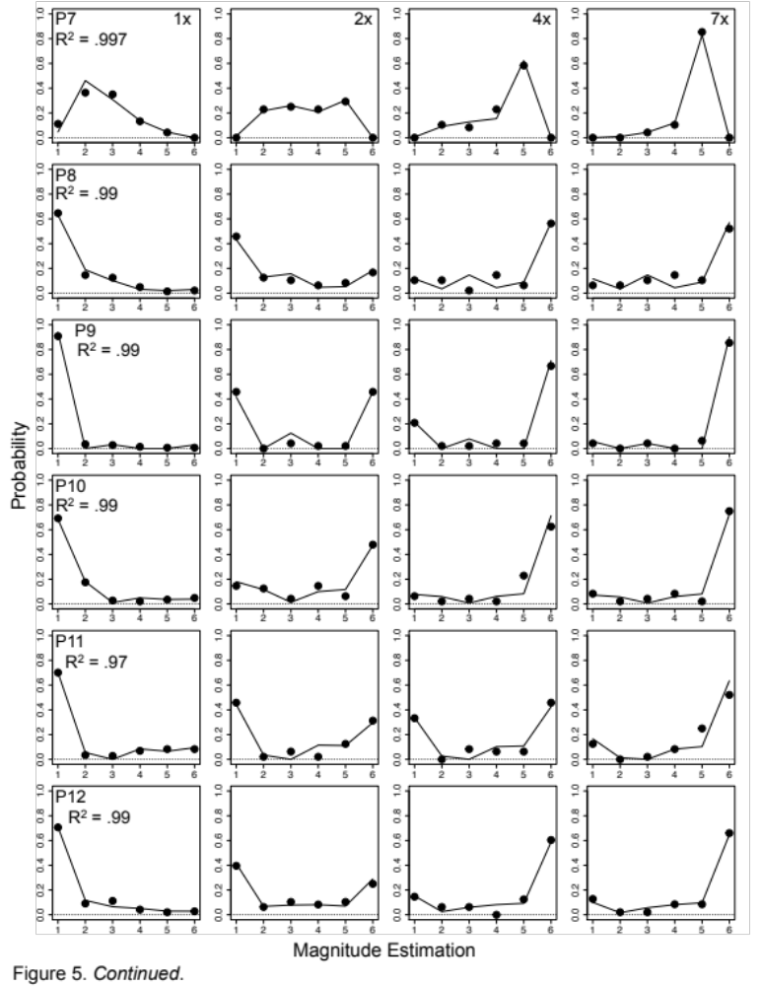

Slide 25
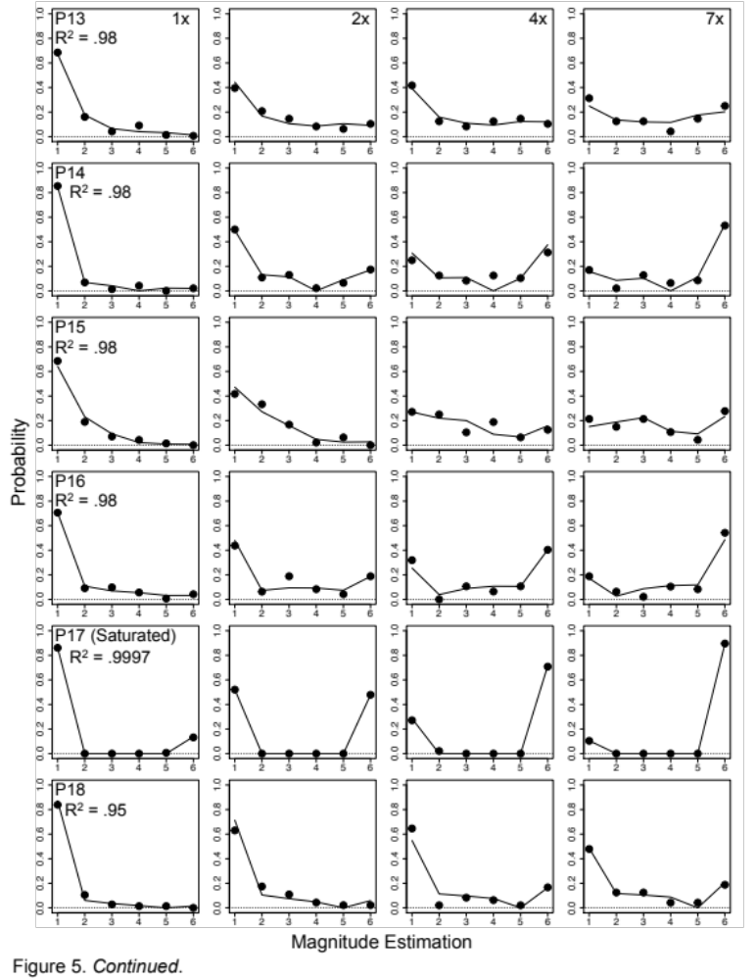

Slide 26
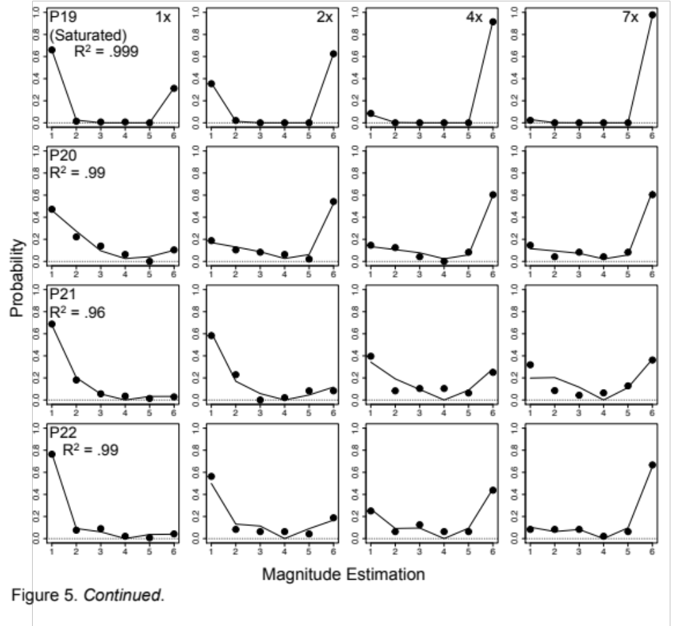

Slide 27
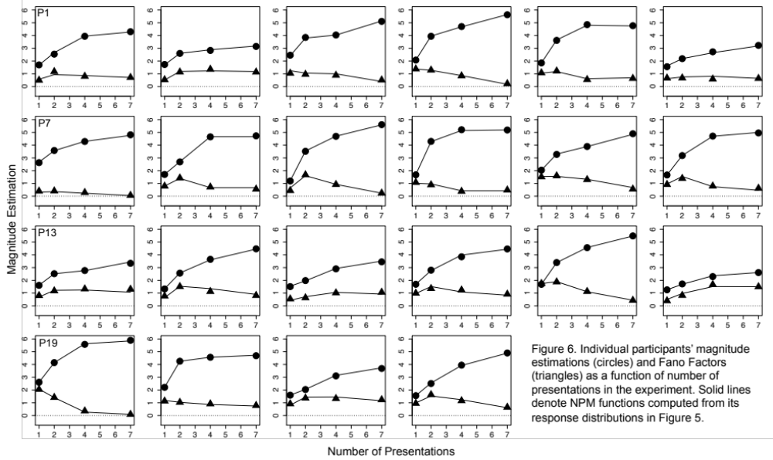

Slide 28
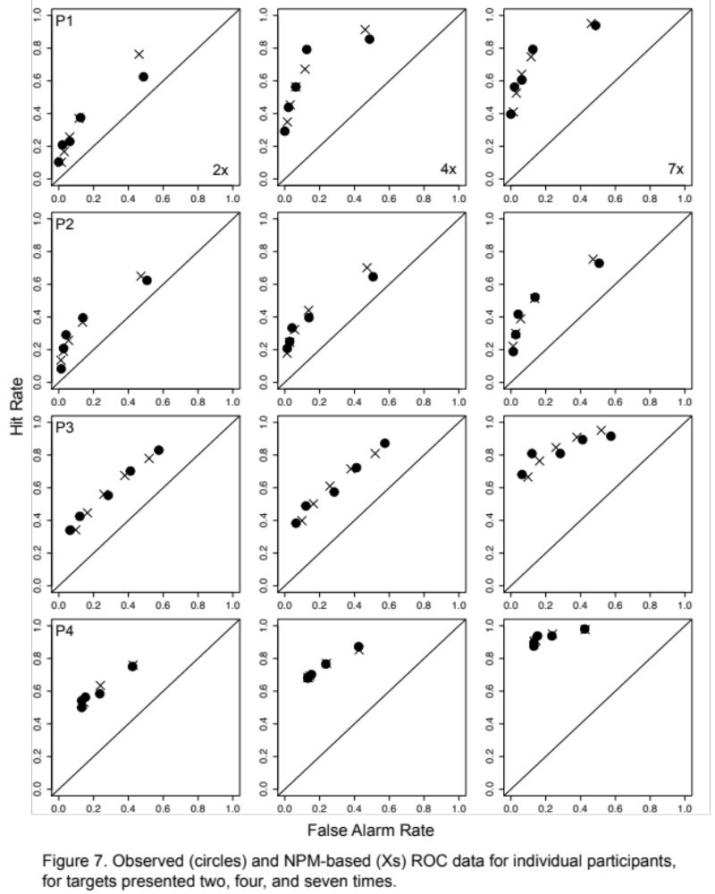

Slide 29
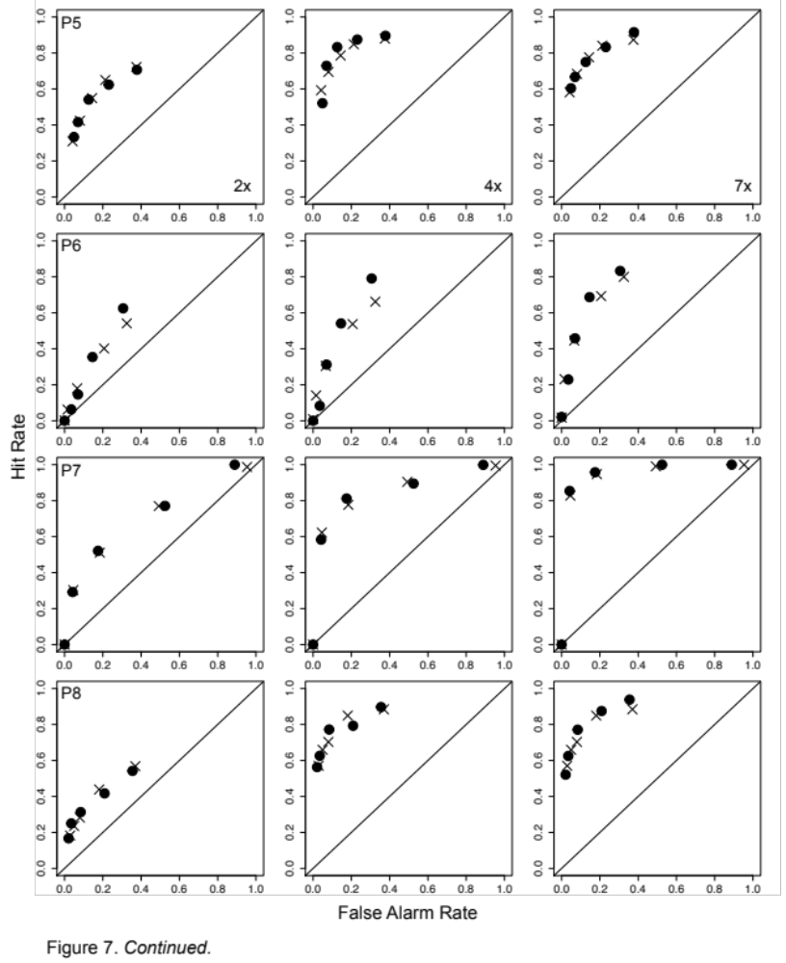

Slide 30
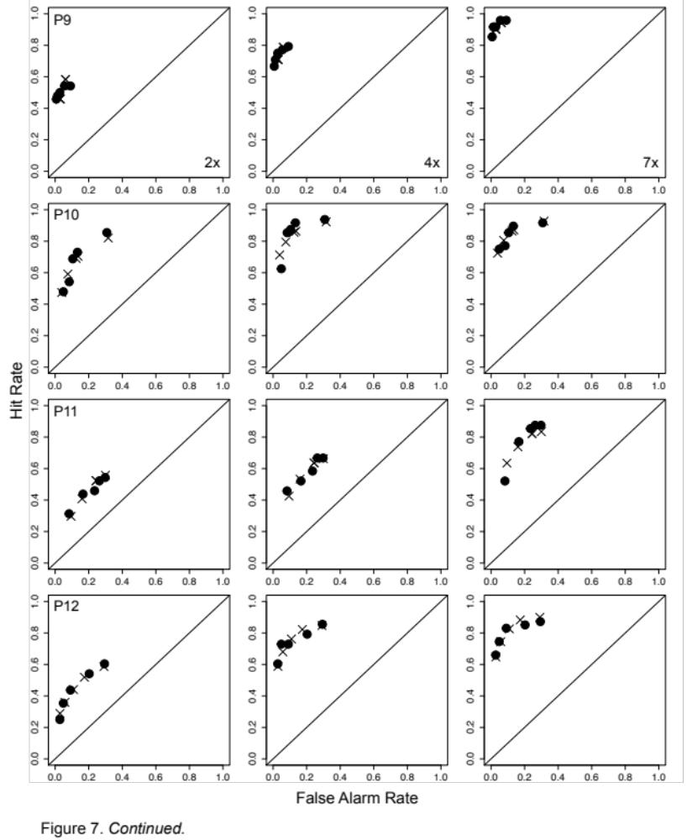

Slide 31
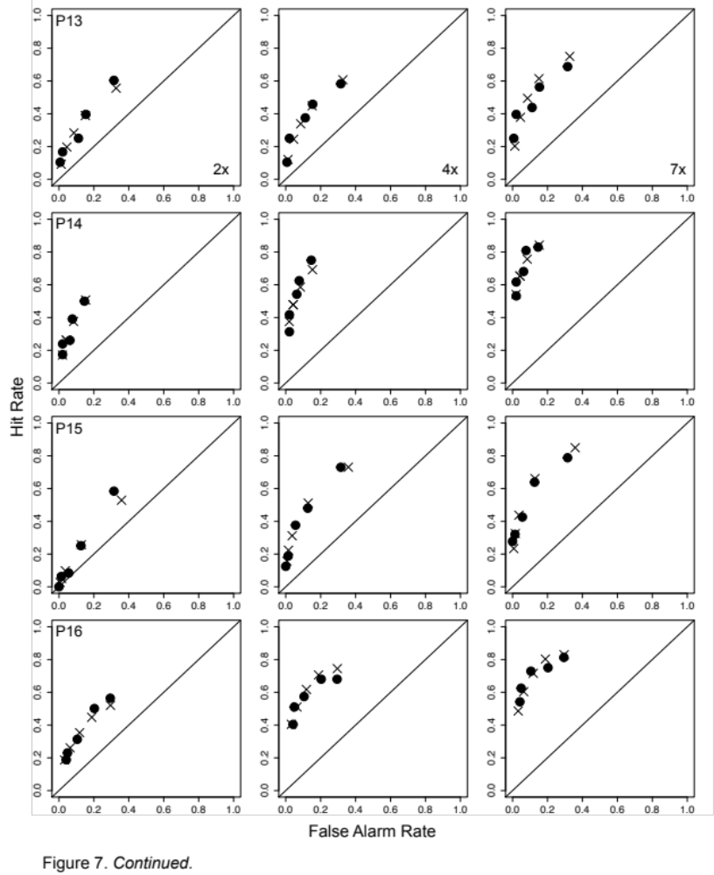

Slide 32
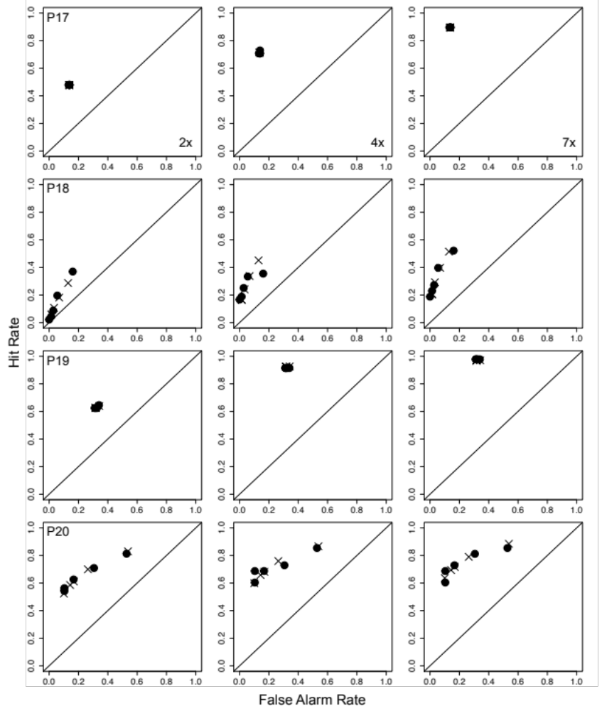

Slide 33
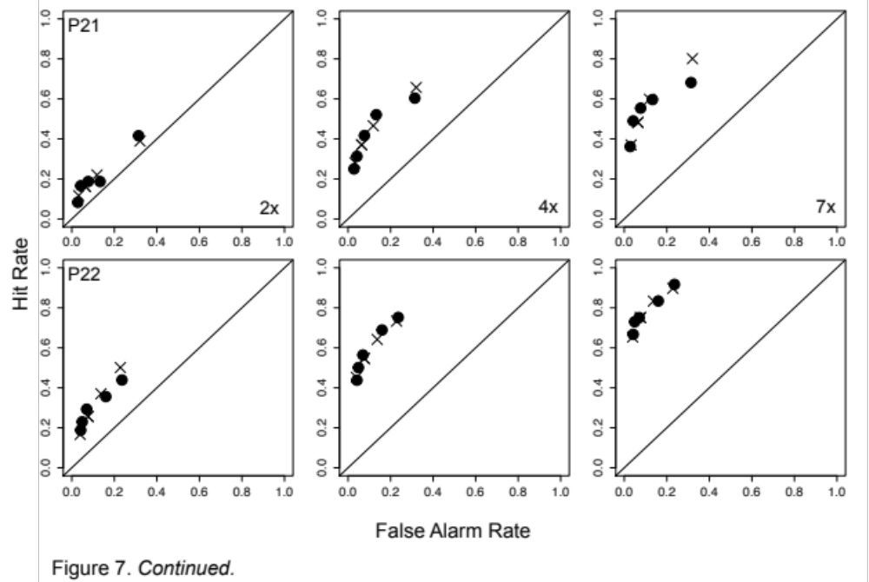

Slide 34
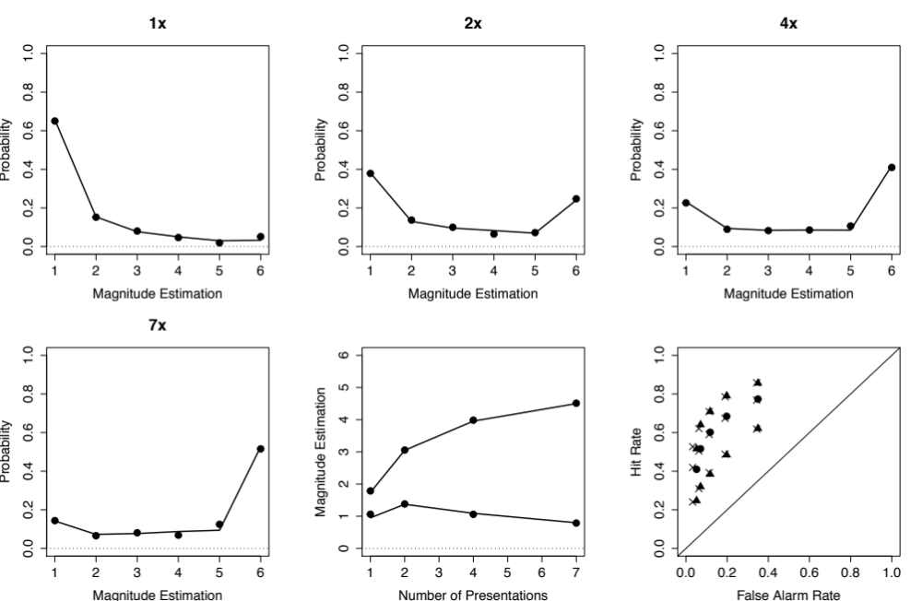

Slide 37
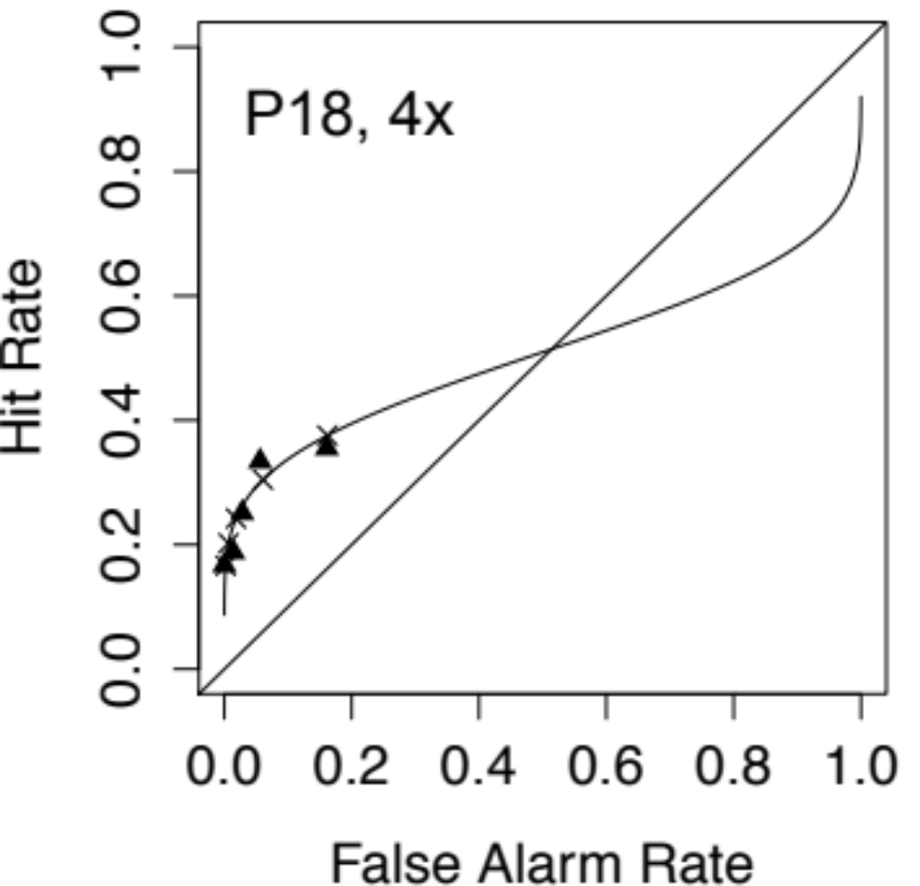

Slide 38
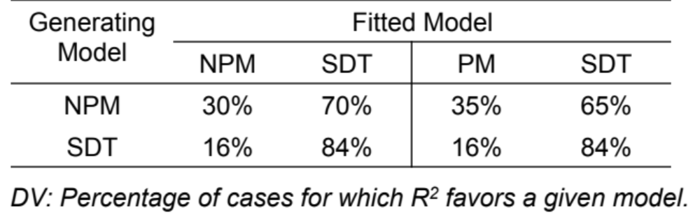
Model Recovery Simulations
100 simulated datasets from each model, random parameters, .05 noise
“A model with more parameters will always provide a better fit, all other things being equal (Linhart & Zucchini, 1986),” Myung and Pitt (2002).

Slide 39
Counfound?
Implicitly doing JOFs?
zROC slope from JOFs reliably > 1 (Hintzman, 2004), but confidence rating slopes typically < 1 (Ratcliff, McKoon, & Tindall, 1994)
Data: Slope = .78

Slide 40
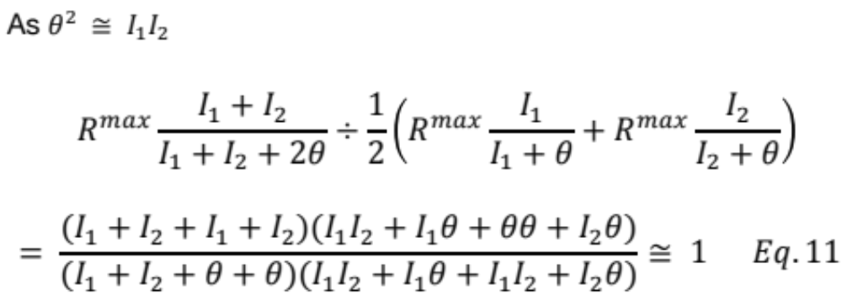
Divisive Normalization

Slide 41
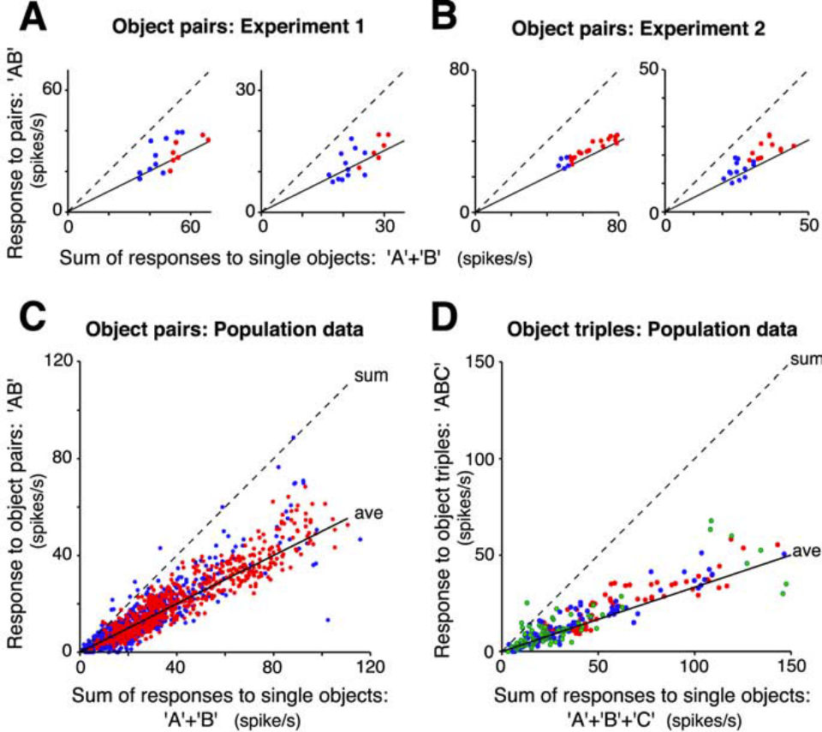
Divisive Normalization
Zoccolan, Cox, and DiCarlo (2005; JON)

Slide 42
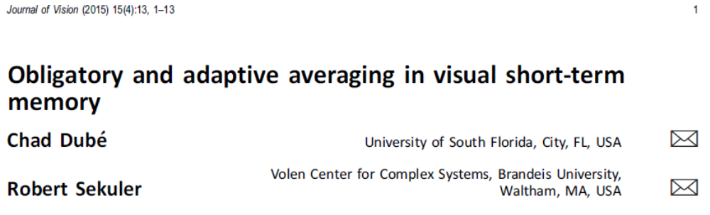
Summary Statistical Representation
Like normalization?
Demonstrated for visual perception and memory tasks involving:
Spatial arrays
Sequentially-presented stimuli
Motion, multiple-object tracking, change detection, RSVP, Sternberg scanning, etc.
Both vision and audition
Low decay rate
Adaptive
Obligatory

Slide 43
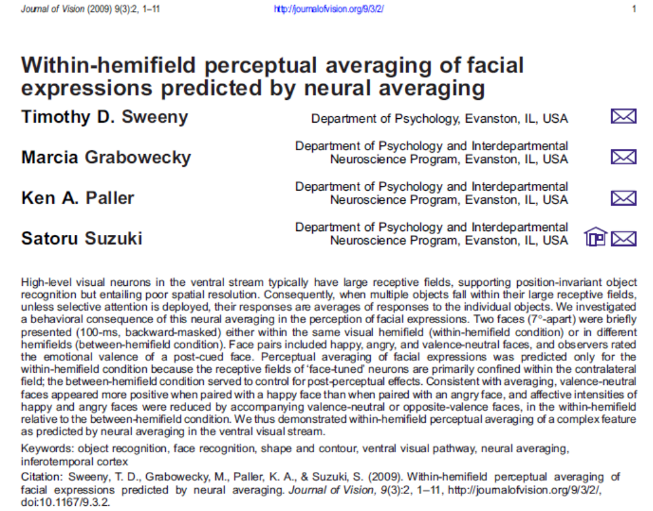
Summary Statistical Representation

Slide 44
Experiment 2: Summary Statistical Representation of Memory Strength
29 Participants
Study: 72 words, 24 1x, 24 3x, 24 6x (240 trials total)
Test: 72 Targets, 72 Lures
Presented in pairs, with all combinations of repetitions
DV: Direct Strength Rating of Average Strength from 1 (no memory) to 6 (strong memory)
Predictions: DV = .5*(Summed Rating) + bias
Notes:
Test words were paired so that words from each repetition group (including lures) were paired with words from every other repetition group, including self-pairings, and every permutation of repetition group was represented at least three times. Collapsing over order (left or right side of the screen), this produces a total of 10 pairings. A summed repetition value of 6, however, can be obtained in 2 ways: [3,3] and [0, 6], hence we collapsed over these two categories in the analysis.

Slide 45
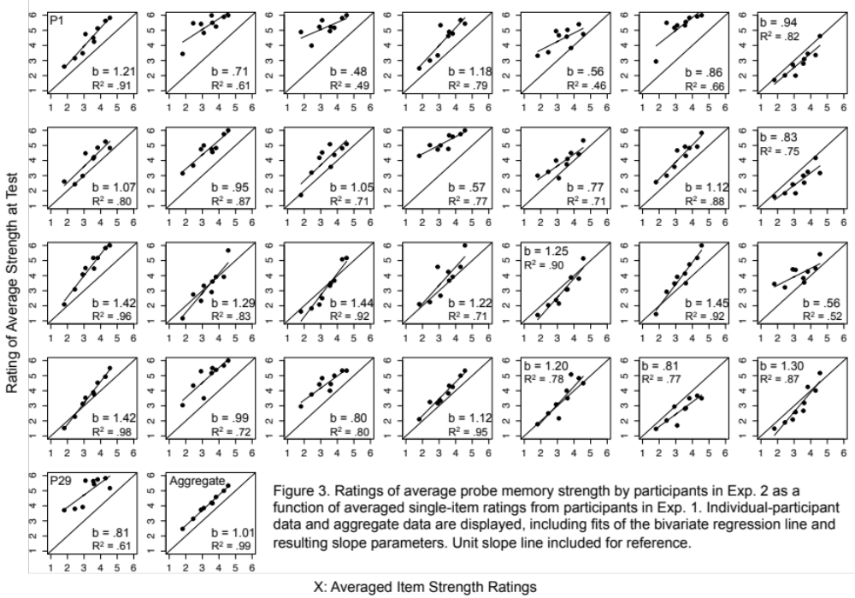

Slide 46
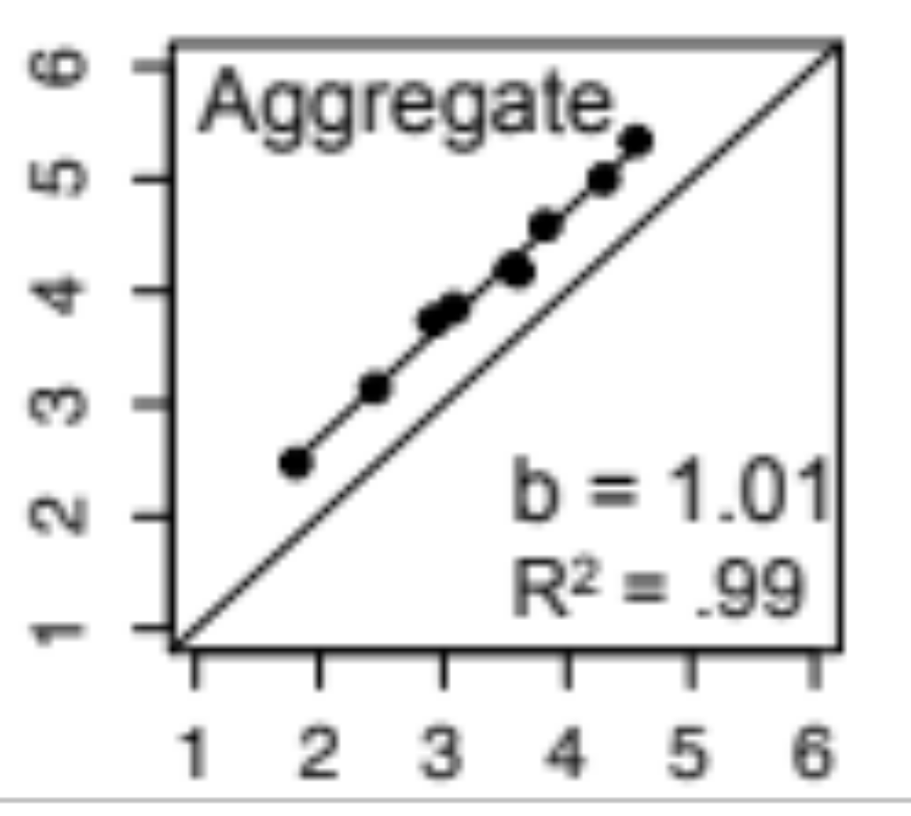
Rating of Average Strength at Test
Averaged Item Strength Rating

Slide 47
Counfounds?
Summed the item strengths?
Summation: Var(E2) > Var(E1)
Averaging: Var(E2) ≈ Var(E1)/2
Data: Var(E2)/Var(E1) = .83
Subsampled one item?
Subsampling: SD increase with difference in number of repetitions within pairs
Data: [1, 1]: 1.62
[1, 3]: 1.76
[1, 4]: 1.68
[1, 7]: 1.67
Notes:
Test words were paired so that words from each repetition group (including lures) were paired with words from every other repetition group, including self-pairings, and every permutation of repetition group was represented at least three times. Collapsing over order (left or right side of the screen), this produces a total of 10 pairings. A summed repetition value of 6, however, can be obtained in 2 ways: [3,3] and [0, 6], hence we collapsed over these two categories in the analysis.

Slide 48
Summary
NPM is an advance over SDT:
Principled, a priori account of Fano Factors, Weber-Fechner saturation, ROC asymmetry, and mirror effects.
Greater plausibility
No edge corrections!
Summary statistical representation extends to long-term memory strength
Results suggest neurons that support recognition memory share the properties of visual cortical cells

Slide 49

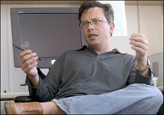


Acknowledgments

Slide 50
Thanks!

